Slide 1


The Importance of Public-Private Partnerships to Combat Cyber Crime
TLP:CLEAR
CISA | Cybersecurity and Infrastructure Security Agency
JCDC | Joint Cyber Defense Collaborative
Dr. Patricia Soler, JCDC International Section Chief
Notes:
Presentation for OAS – Re: Ransomware OAS - Organization of American States: Democracy for peace, security, and development
Duration: 1 hour and a half (including Q&A session)
Audience: Broad audience from law enforcement, prosecution/judicial, technical (cybersecurity) and diplomatic background.
Other info: Presentation for day 1 to kick-off; goal is to be interactive and high level

Slide 2
Critical Infrastructure Protection and Legislation
TLP:CLEAR

Slide 3
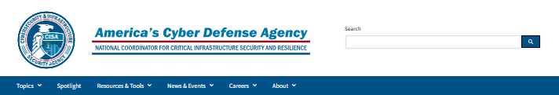



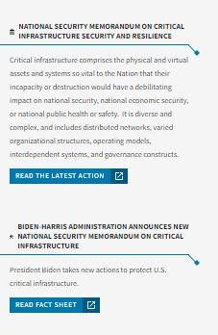
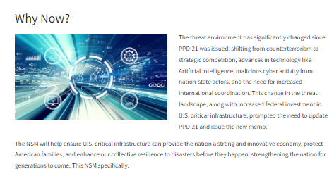
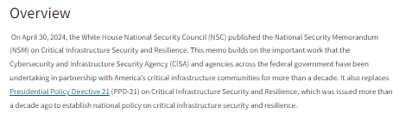
National Security Memorandum on
Critical Infrastructure Security and Resilience (NSM-22)
TLP:CLEAR
National Security Memorandum on Critical Infrastructure Security and Resilience | CISA

Slide 4
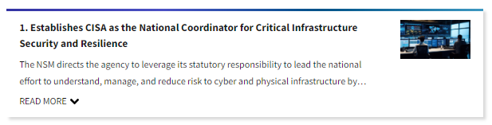
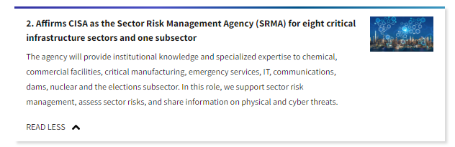
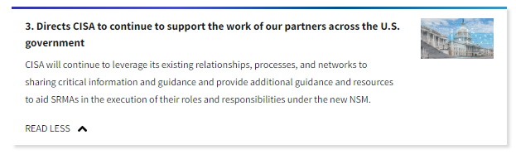
National Security Memorandum on
Critical Infrastructure Security and Resilience
TLP:CLEAR
National Security Memorandum on Critical Infrastructure Security and Resilience | CISA

Slide 5
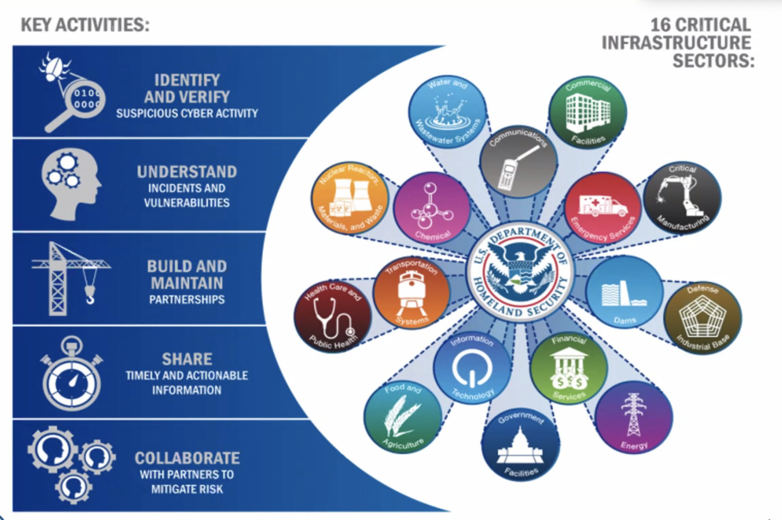
U.S. Critical Infrastructure and Sectors
TLP:CLEAR
As the nation’s risk advisor, CISA is uniquely positioned to assess and identify malicious cyber activity by nation-states or criminals, and push knowledge and awareness about reducing the risk of a ransomware attack to the broader cybersecurity ecosystem.
CISA is working with our partners – both at home and abroad – to provide actionable information so organizations both large and small can protect their networks, operations, data, and employees from ransomware attacks.
Together with our industry and interagency partners, including law enforcement, we are working together to make it more difficult and more expensive for hackers and cybercriminals to operate.

Slide 6
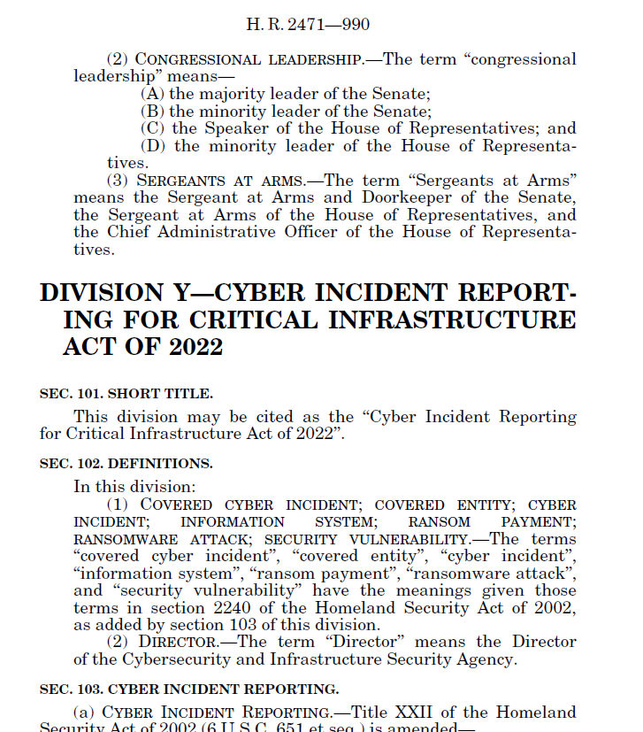
CIRCIA Overview
TLP:CLEAR
In March 2022, Congress enacted the Cyber Incident Reporting for Critical Infrastructure Act of 2022 (CIRCIA).
Requires the Cybersecurity and Infrastructure Security Agency (CISA) to coordinate with Federal partners and others on various cyber-incident reporting and ransomware-related activities.
Requires CISA to establish a new regulatory program requiring “covered entities” to report certain cyber incidents and ransom payments.
Will allow CISA to better understand the threats we are facing, to spot adversary campaigns earlier, and to take more coordinated action with our public and private sector partners in response.
CIRCIA is currently in rule-making.

Slide 7
CISA Workforce
TLP:CLEAR
From March 22, 2023:
CISA hired 516 people in fiscal 2022, and it’s on track to hire 600 people in 2023.
The Department of Homeland Security’s budget overview shows CISA now has about 3,300 full-time equivalent staff. CISA’s cybersecurity division alone is at about 1,155 staff, while its other divisions, like infrastructure security, also have positions responsible for cybersecurity work.

Slide 8
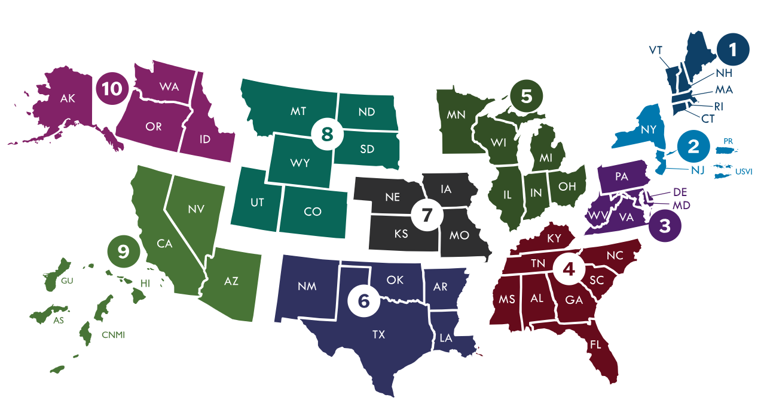
CISA Regional Offices
TLP:CLEAR

Slide 9
JCDC’s Role
TLP:CLEAR
Mission
To unite the global cyber community in the collective defense of cyberspace.
Vision
Fuse JCDC members' insight, expertise, and capabilities to enable synchronized cyber defense planning and collective response to promote national resilience and reduce risk to U.S. critical infrastructure.
Value
To create a proactive capability for government and private sector to work together closely before an incident occurs to strengthen the connective tissue and ensure a common understanding of processes.
Notes:
JCDC leads development of the Nation’s cyber defense plans by working across the public and private sectors to unify deliberate and crisis actioning planning, while coordinating the integrated execution of these plans.

Slide 10







JCDC’s Interagency Partners
TLP:CLEAR
It is complicated but we must work together
to combat ransomware.
DHS
DoD
DoJ
ODNI
NSA
FBI
Notes:
JCDC is not a law enforcement agency, the role of CISA is the technical aspect.
How CISA deals with ransomware in our agency vs. How other parts of USG deal with prosecution and criminal elements
We urge organizations to report observed activity, including ransomware indicators of compromise and tactics, techniques, and procedures, to CISA or our federal law enforcement partners. You can find information on reporting at stopransomware.gov.

Slide 11
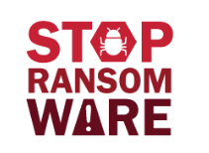
Ransomware 101
TLP:CLEAR
What is ransomware?
  Malware that is designed to encrypt files on a device, rendering any files and the systems that rely on them unusable.
Why is it a problem?
  Malicious actors then demand ransom in exchange for decryption. Ransomware actors often target and threaten to sell or leak exfiltrated data or authentication information if the ransom is not paid.
Why do we have to work together to combat it?
  In recent years, ransomware incidents have become increasingly prevalent among the Nation’s state, local, tribal, and territorial (SLTT) government entities and critical infrastructure organizations.
Ransomware is a growing threat
to the nation’s security and the economy.
Stop Ransomware | CISA
Notes:
RANSOMWARE
Ransomware is a form of malware designed to encrypt files on a device, rendering any files and the systems that rely on them unusable. Malicious actors then demand ransom in exchange for decryption. In recent years, ransomware incidents have become increasingly prevalent among the Nation’s SLTT government entities and critical infrastructure organizations.
Ransomware incidents can severely impact business processes and leave organizations without the data they need to operate and deliver mission-critical services.
Malicious actors have adjusted their ransomware tactics over time to include pressuring victims for payment by threatening to release stolen data if they refuse to pay and publicly naming victims as secondary forms of extortion.
The monetary value of ransom demands has also increased, with some demands exceeding US $1 million.
• Ransomware incidents have become more destructive and impactful in nature and scope. Malicious actors engage in lateral movement to target critical data and propagate ransomware across entire networks.
These actors also increasingly use tactics, such as deleting or encrypting system backups, that make restoration and recovery more difficult or infeasible for impacted organizations.
The economic and reputational impacts of ransomware incidents, throughout the initial disruption and, at times, extended recovery, have also proven challenging for organizations large and small.
According to “The Cost of Malicious Cyber Activity to US Economy,” (February 2018), White House Council of Economic Advisers (CEA), estimates that the cost to the US economy was between $57 billion and $109 billion in 2016 alone.

Slide 12
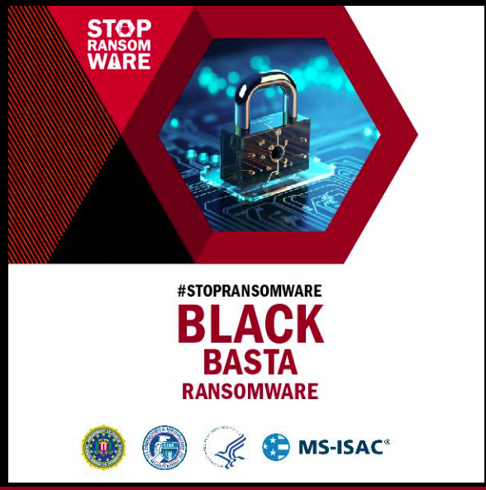
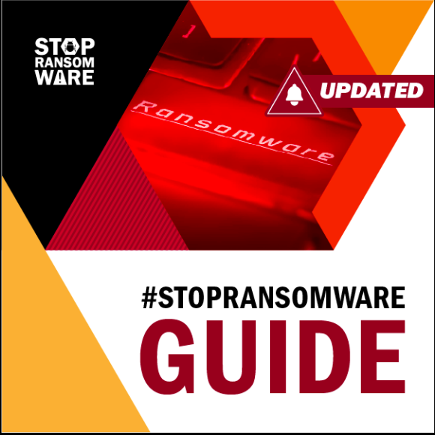
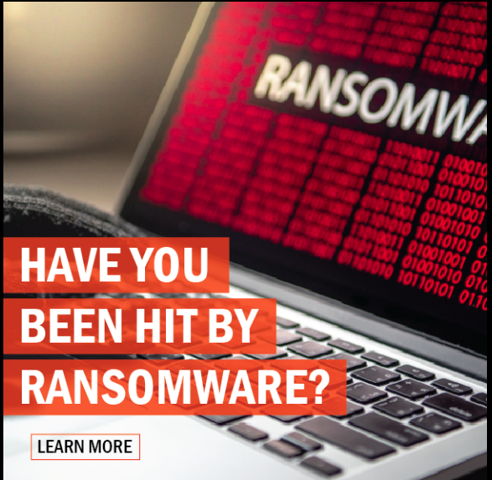
#STOPRANSOMWARE
TLP:CLEAR
Visit StopRansomware.gov today!
Notes:
StopRansomware.gov launched on July 15, 2021 and is a collaborative initiative by the federal government to make it easier for stakeholders across the private and public sectors to find free, authoritative information, resources, and tools that can help prevent and mitigate ransomware attacks in the United States.
TOPLINE MESSAGING
StopRansomare.gov is a one-stop resource where public and private sector entities can find U.S. government tools, information, and resources that can help site visitors reduce their risk of ransomware attacks and improve resilience.
This new website is a coordinated initiative across the federal government, pooling publicly available federal resources into one location to help organizations better find the information they want on ransomware.
• Any organization can be impacted by ransomware, regardless of size. There have been many notable ransomware cases in 2021. StopRansomware.gov was developed to reduce the impact that ransomware has on our nation’s educational and healthcare institutions, critical infrastructure and small business owners, among others.
• Organizations of all sizes should review the resources on StopRansomware.gov to reduce their risk of ransomware. In addition to government institutions at all levels and critical infrastructure, large and small business and even non-profit organizations are also vulnerable to malicious cyber actors.

Slide 13
JCDC’s Operation
TLP:CLEAR
Cybersecurity and Infrastructure Security Agency (CISA) is the operational lead for federal cybersecurity and the national coordinator for critical infrastructure security and resilience. We are designed for collaboration and partnership, in which JCDC sits within.
Joint Cyber Defense Collaborative (JCDC)
JCDC is a platform to unify members to gather, analyze, and share actionable cyber risk information to enable synchronized, holistic cybersecurity planning, cyber defense, and response.
Who Comprises JCDC?
Background
Function
JCDC brings together a full spectrum of cyber defense partners—including U.S. federal as well as state, local, tribal, and territorial (SLTT) governments; private industry; and international governments and organizations.
No one entity can secure cyberspace alone. CISA established JCDC to help gap and bring together diverse partners for collective defense. A public and private sector partnership of cyber defenders from organizations worldwide
JCDC is part of US-CERT operational cyber defense on behalf of USG, in which USG coordinates internally to share real time operational defense with other CERTs.

Slide 14





JCDC’s Core Functions
TLP:CLEAR
JCDC leads collaborative, public-private sector cyber defense planning, cybersecurity information fusion, and the purposeful dissemination of cyber defense guidance to reduce risk to National Critical Functions.
Bring together the technical expertise of key partners to lead collaborative information sharing, analysis, and solutioning to benefit the broader cyber ecosystem.
Build and execute cyber defense plans to reduce cyber risk in partnership with the Alliance, the interagency, and other entities.
Synchronize the operational cyber defenses of the community and integrate CISA’s own efforts during a significant cyber incident.
Leverage the capabilities and insight of key partners to provide guidance and coordinate collective action to reduce cyber risk.
Maintain a strategic operations capability to mature enabling organizational and business infrastructure.
To unite the global cyber community in the collective defense of cyberspace.

Slide 15
Actionable Intelligence
TLP:CLEAR
Definition of Indicators: | Observables: | Contextual information:
composite of observables and contextual information | network addresses, domain names, file metadata, protocol components (headers, flags, etc.), registry keys, etc. | source, sensitivity, confidence, impact, relationships, etc.
 | More Actionable | Less Actionable
URLs | Complete URL with port, protocol, FQDN, file path, and query parameters. | http://www.example.com/creeper
Domain Names | FQDNs including description of associated activity. | “Block List” with no details. Example: www.example.com, evil.example.com, etc.
IP addresses | IP address used for encrypted command and control, with port and protocol information. | IP address described merely as “bad.” Example: 203.0.113.10
Files & Malware | Filename svchost.exe with an MD5, SHA-1 and SSDEEP. | Common filenames such as svchost.exe with no further details.
Network | Distinctive patterns of traffic. | Example: Scanning activity from IP; Web scanning from Acme Webscanner
Attacker techniques and campaign behavior | Specific attacker techniques demonstrated citing MITRE ATT&CK framework | Example: Attacker utilized command-line interface without specifying (T1059 ATT&CK ID) and/or what specifically they were doing within command line interface
Further technical analysis | “Abnormal” registry behavior and activity (e.g., key pair value generation by ransomware), code overlap from other known/historical malware samples, file extension modification, campaign artifacts (e.g., recycle bin or other file removal/app modification) | Lack of specificity as to the unauthorized/”abnormal” behavior observed.
Cryptocurrency wallet addresses and/or attacker (ransom) note sites | Attacker or third-party controlled wallet addresses or communications site(s) | Example: Cryptocurrency wallet or comms service use noted vaguely, but with no specific wallet address or comms platform noted
Victimology (if known) | If known, specific or type (i.e., sector and geography) of victims known to be targeted based on sharer’s interactions and/or campaign attributes | Example: Vague scope of campaign noted (i.e., “guestimated” target pool and locations) without observable data
Control impacts or evasion | Specific cyber defense controls targeted, subverted, or evaded by attacker (including technique, if observed) | Example: Threat actor bypassed email security or EDR controls without citing specific control solution subverted and/or method utilized
Other |  | Summary statistics e.g. SYN scans per day.
Notes:
Talking Points
These are just some examples of the preferred formatting of information that we would like to see from our partners.
We would also love to hear from you on what your preferred intake of data is. We want to provide you with information that is actually useful for you.
Questions to ask:
What type of data does your organization primarily handle?
What makes your information/data unique compared to other organizations?
How do you think you will be able to contribute to the JCDC?

Slide 16
TLP:CLEAR
For more information visit:
  CISA.gov/JCDC
JCDC International’s contact information:
  cyberliaison_intl@cisa.dhs.gov
Please feel free to send technical information via PGP encrypted message using our key located here: CISA Public Key (Contact Us | CISA). You can send this to international@mail.cisa.dhs.gov.
Notes:
JCDC International’s Contact Information
cyberliaison_intl@cisa.dhs.gov: Used for general communications
International@us-cert.gov: Used for sensitive communications or PGP content that contains any threat intel/IOCs
CISA’s PGP Public Key: https://www.cisa.gov/sites/default/files/publications/CISA-Public-Sep2022.asc
Joint Cyber Defense Collaborative (JCDC) Public Website: https://www.cisa.gov/jcdc
Details our mission, vision, as well as our 21 private sector Alliance partners
Malware Submission Website: https://www.malware.us-cert.gov
Note: Please notify our team after submitting for expedited processing

