Slide 1
Audiência Pública
Comissão de Ciência, Tecnologia, Inovação, Comunicação e Informática
Senado Federal
Brasília, 26 de outubro de 2021
Ricardo César Cavalcanti
Diretor-Presidente do Hospital do Coração de Alagoas

Slide 2
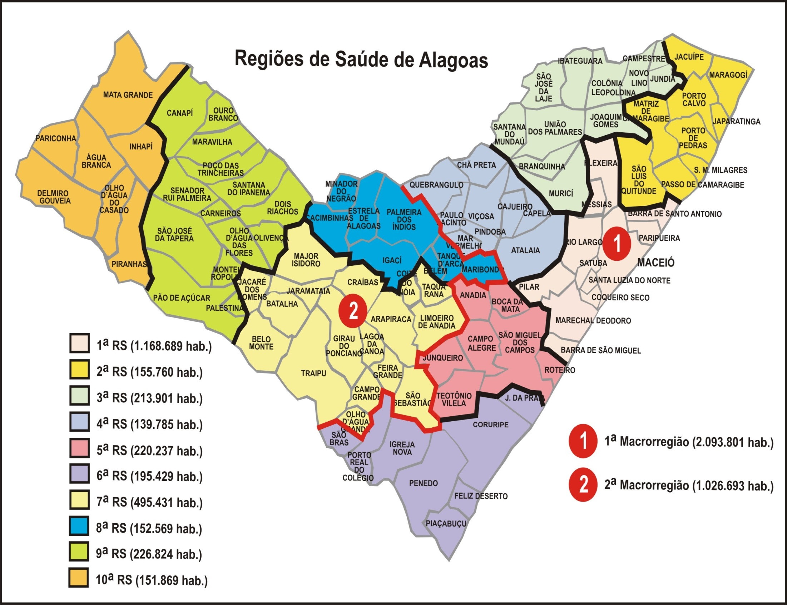

Notes:
For the treatment of Acute MI in public healthcare setting, however, all patients are sent to the capital city and to the only public hospital where there is a cardiac intensive care unit

Slide 3
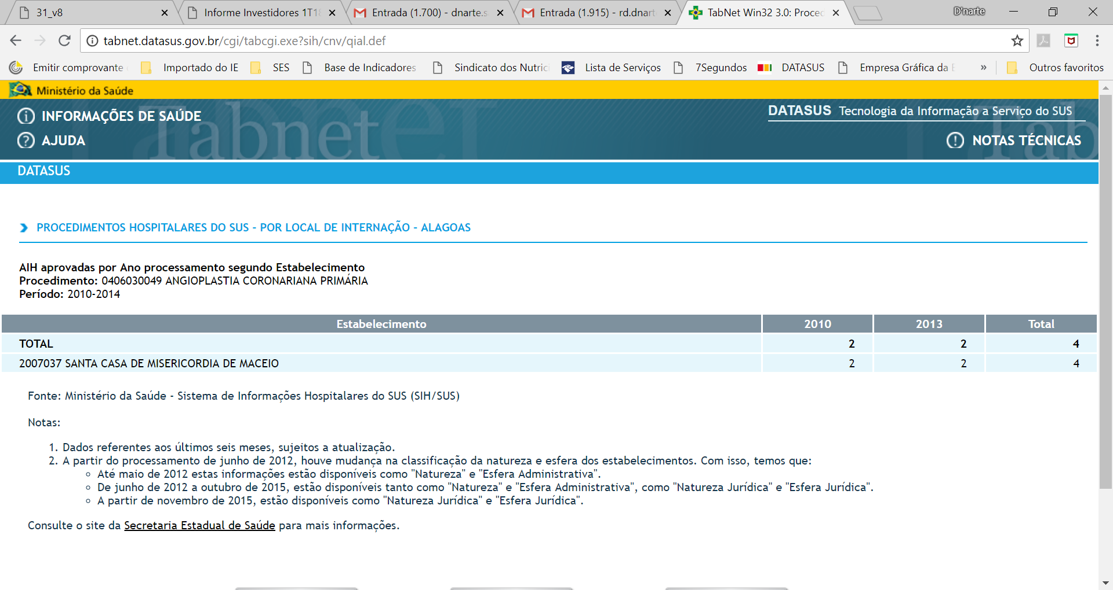
Primary Angioplasties perfomed
between 2010-2014: 4
Notes:
Actually, as you can see here, according to official statistics from the DATASUS system, only four primary angioplasties had been performed between 2010 and 2014.
Look at this! four , not in a month or in a year ... in 4 years ... This was the stark reality back then.

Slide 4

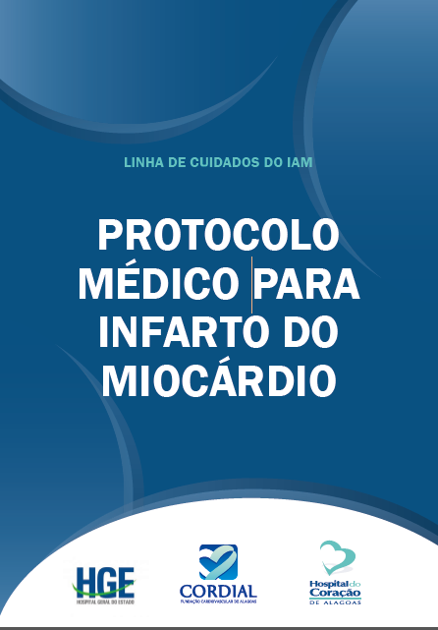
Notes:
Also, we deployed in all SPOKES an acute MI treatment protocol based on LATIN, thus unifying the medical procedures

Slide 5
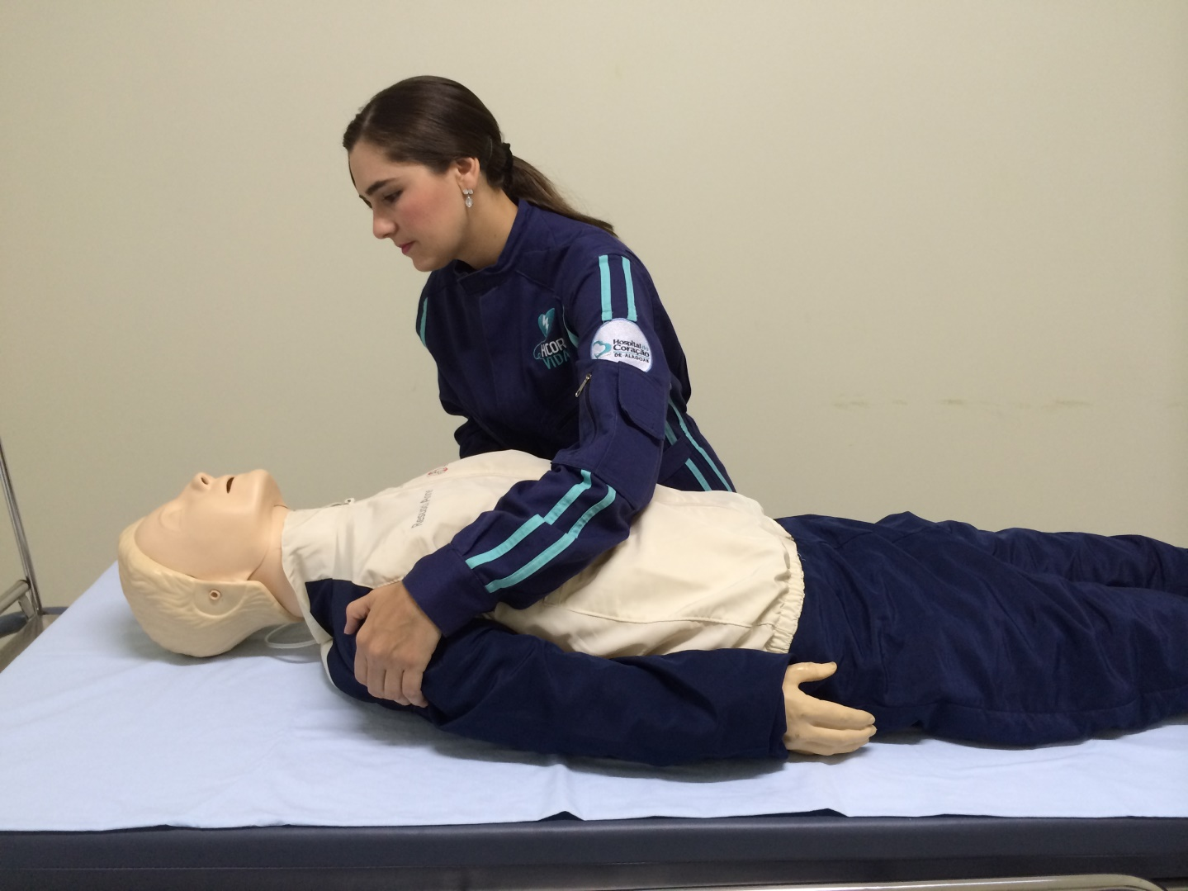
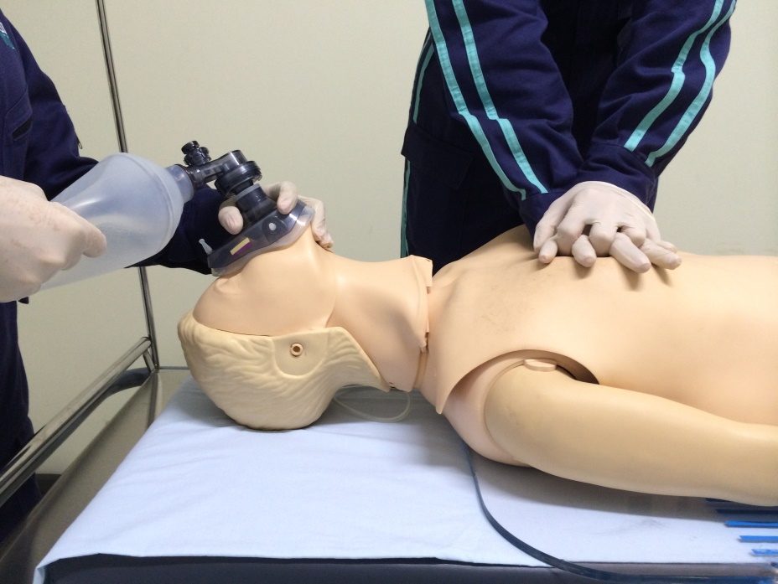
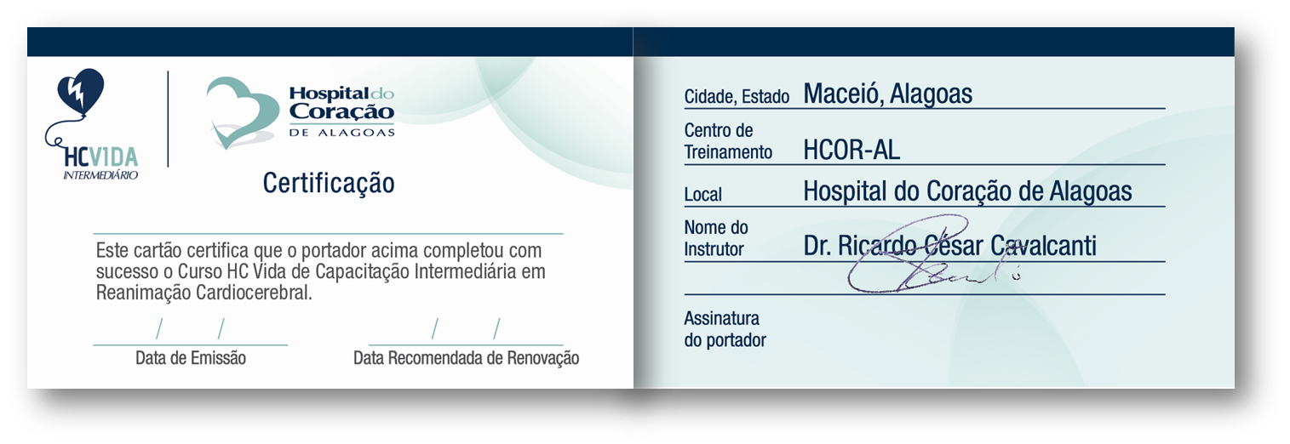
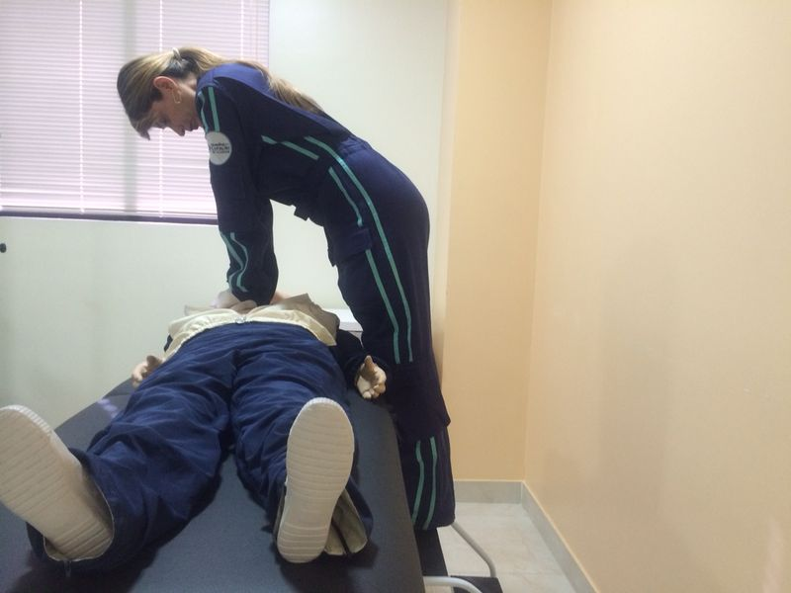
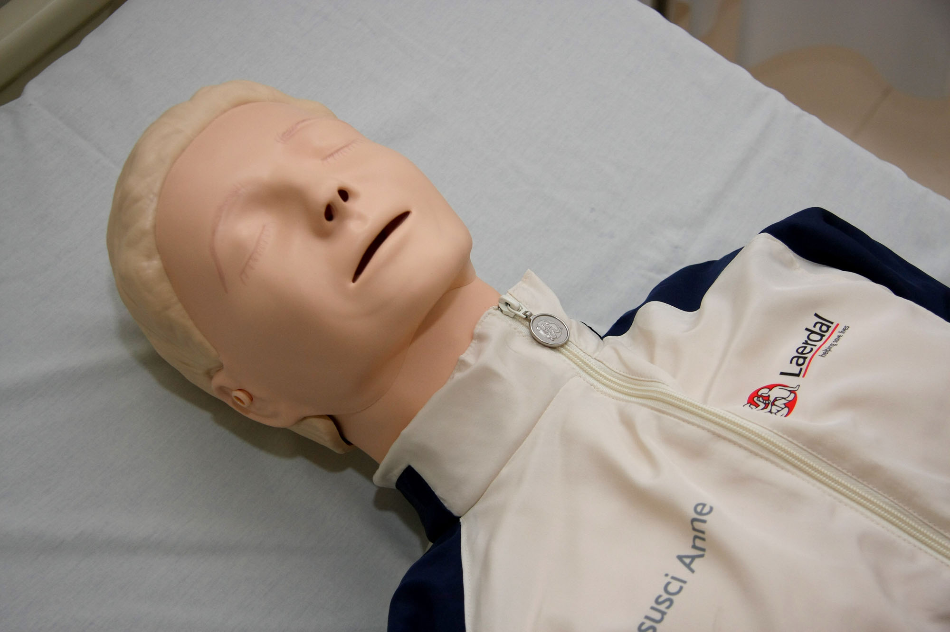
CPR training
Notes:
We also began CPR training at the spokes and refresher courses in diagnostics and treatment of acute coronary syndrome to improve the level of first response provided.

Slide 6

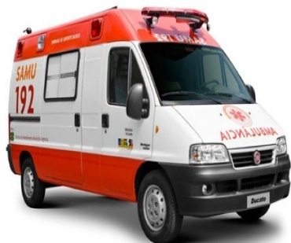

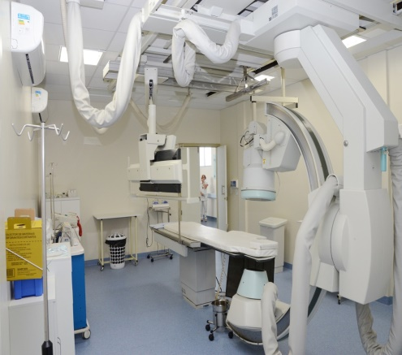

TELEMEDICINA
(LATIN)
Notes:
At the same time, we, above all, implantamos o LATIN program and the implemeting LATIN, indeed...

Slide 7
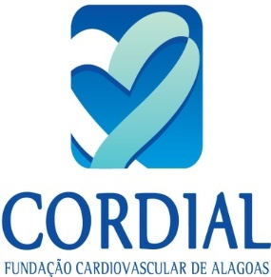

Vid
TELEMEDICINA
(LATIN)
VIDA
24/7 Interventional
Cardiology Team
Notes:
reconfigured the whole system, thus connecting the centers and resulting in an impressive improvement in the quality of healthcare services delivered, both in enhanced diagnosis and treatment speed, KEY to patient survival.

Slide 8
LATIN Program Alagoas
STEMI Mortality : 5,2%
2014
Before LATIN
Notes:
But, Despite all the obstacles and shortcomings and the usual prolonged delay in patient arrival, we were able to attain a very low mortality rate of five point two percent compare whith overall mortality of 19% in 2014

Slide 9
Primary Angioplasties: 446
Catheterizations NSTEMI: 950
Angioplasties NSTEMI: 407
IAM Alagoas: 2 year experience
( July 2016 to July 2018 )
Total number in the first 24 months :
853 angioplasties in ACS
Notes:
Finally, in addition to the four hundred forty-six Primary angioplasties, this Program make possible that we did more four hundred seven PCIs in non-STEMI patients.
So, In these two years of the program, a total of eight hundred fifty trhee PCIs was made in patients with ACS

Slide 10
Distribuição Geográfica dos Médicos no Brasil
460 mil médicos
60% estão em 39 cidades
40% em 5.531 cidades
5.570 cidades
2.000 cidades não possuem médicos todos os dias
70% das cidades tem menos de 50 mil habitantes
Fonte: Demografia Médica do Brasil -2018

Slide 11
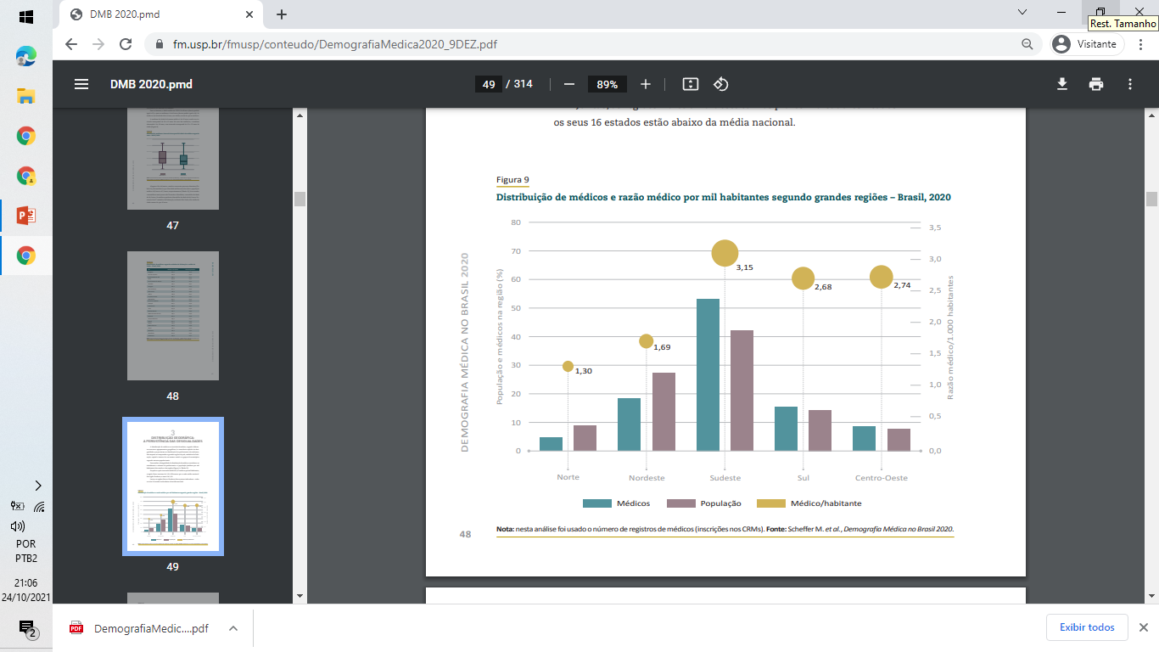

Slide 12
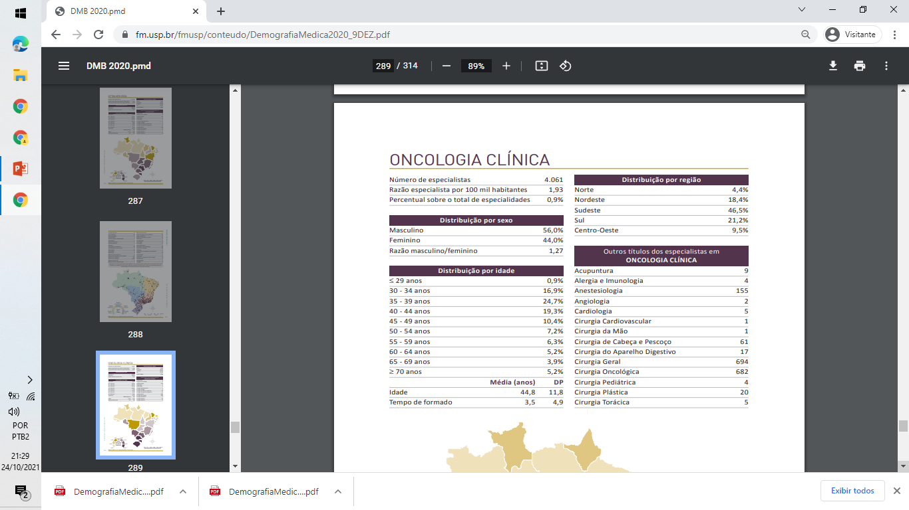
/

Slide 13


