Slide 1
Controle Integrado de Mosquitos
Novas Estratégias
Margareth Capurro
Universidade de São Paulo
mcapurro@icb.usp.br
mlcapurro@gmail.com

Slide 2
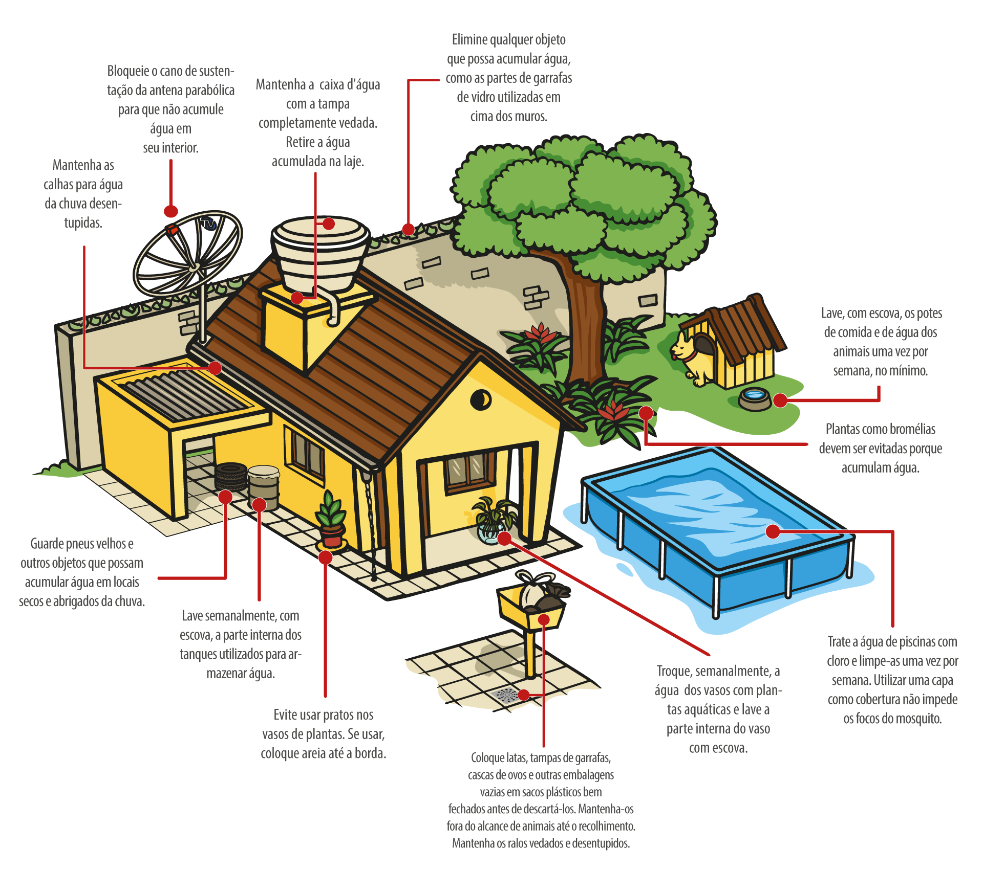
Recomendação

Slide 3
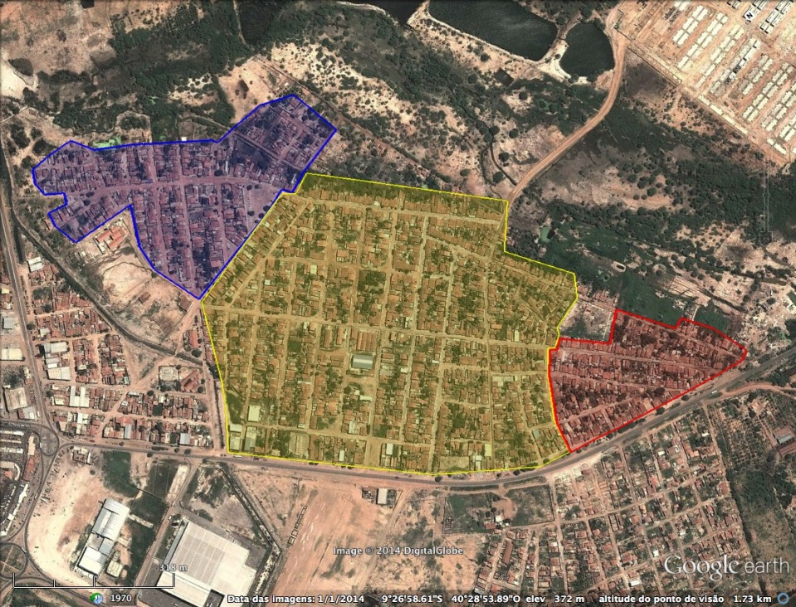
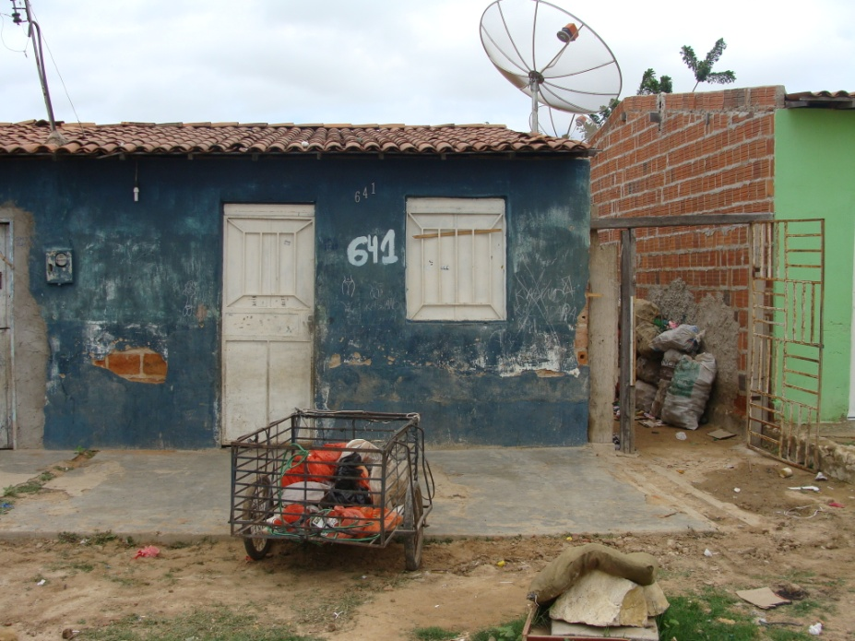
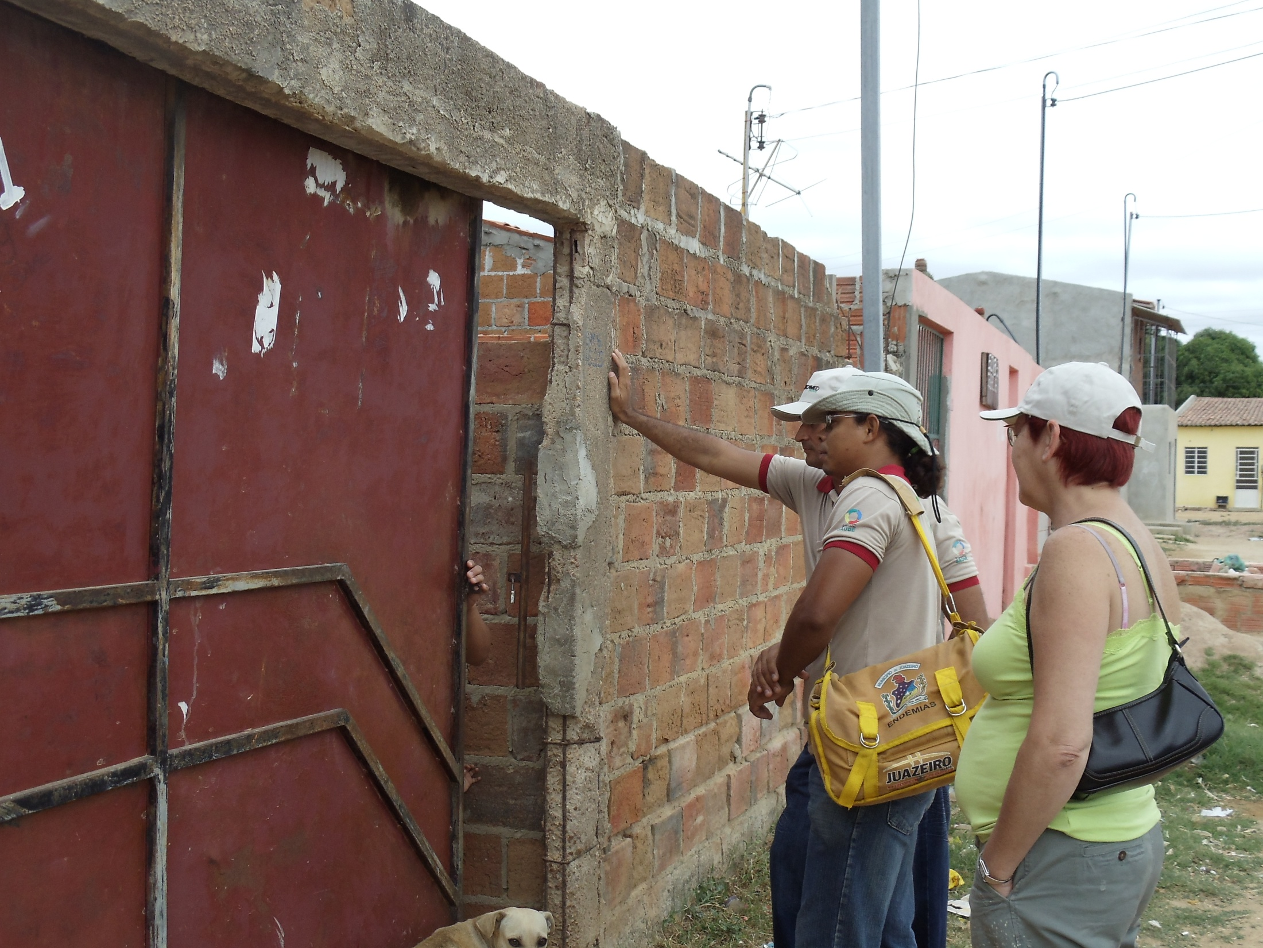
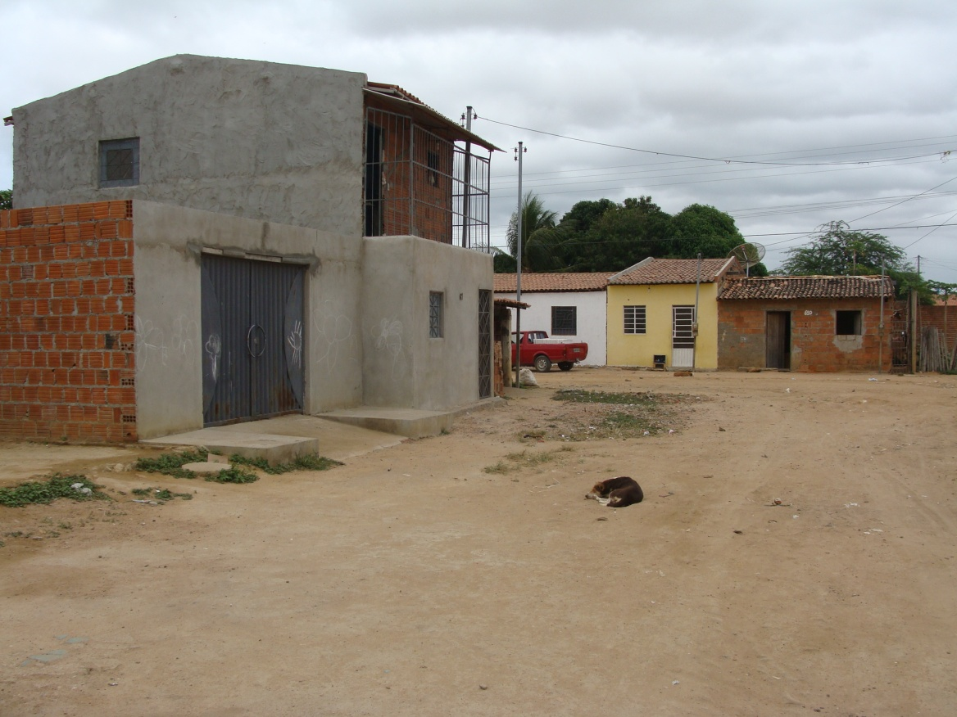
Itaberaba – Juazeiro, Bahia

Slide 4
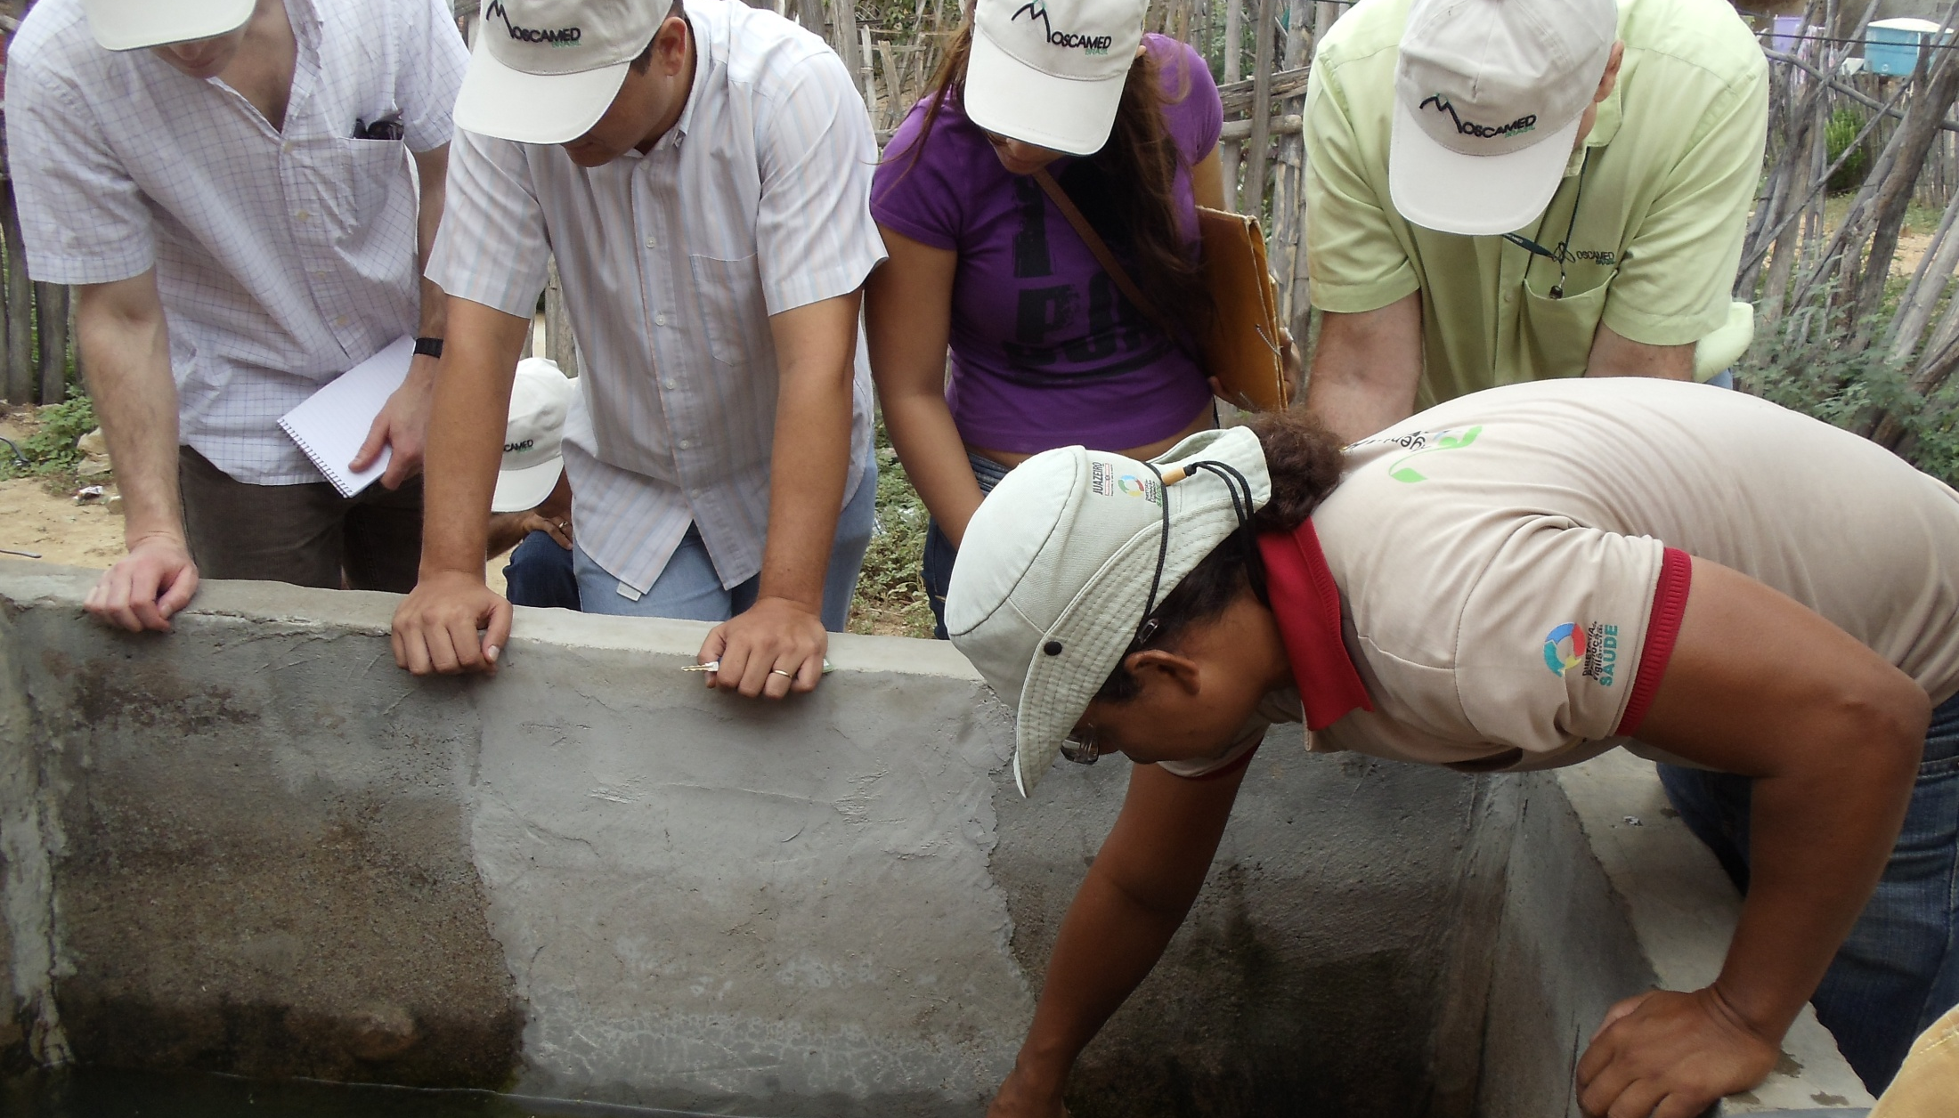
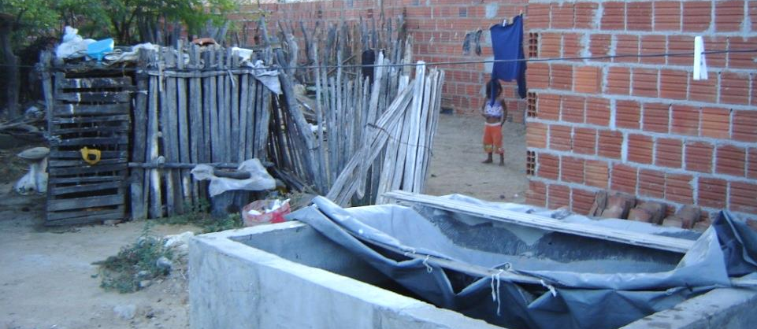
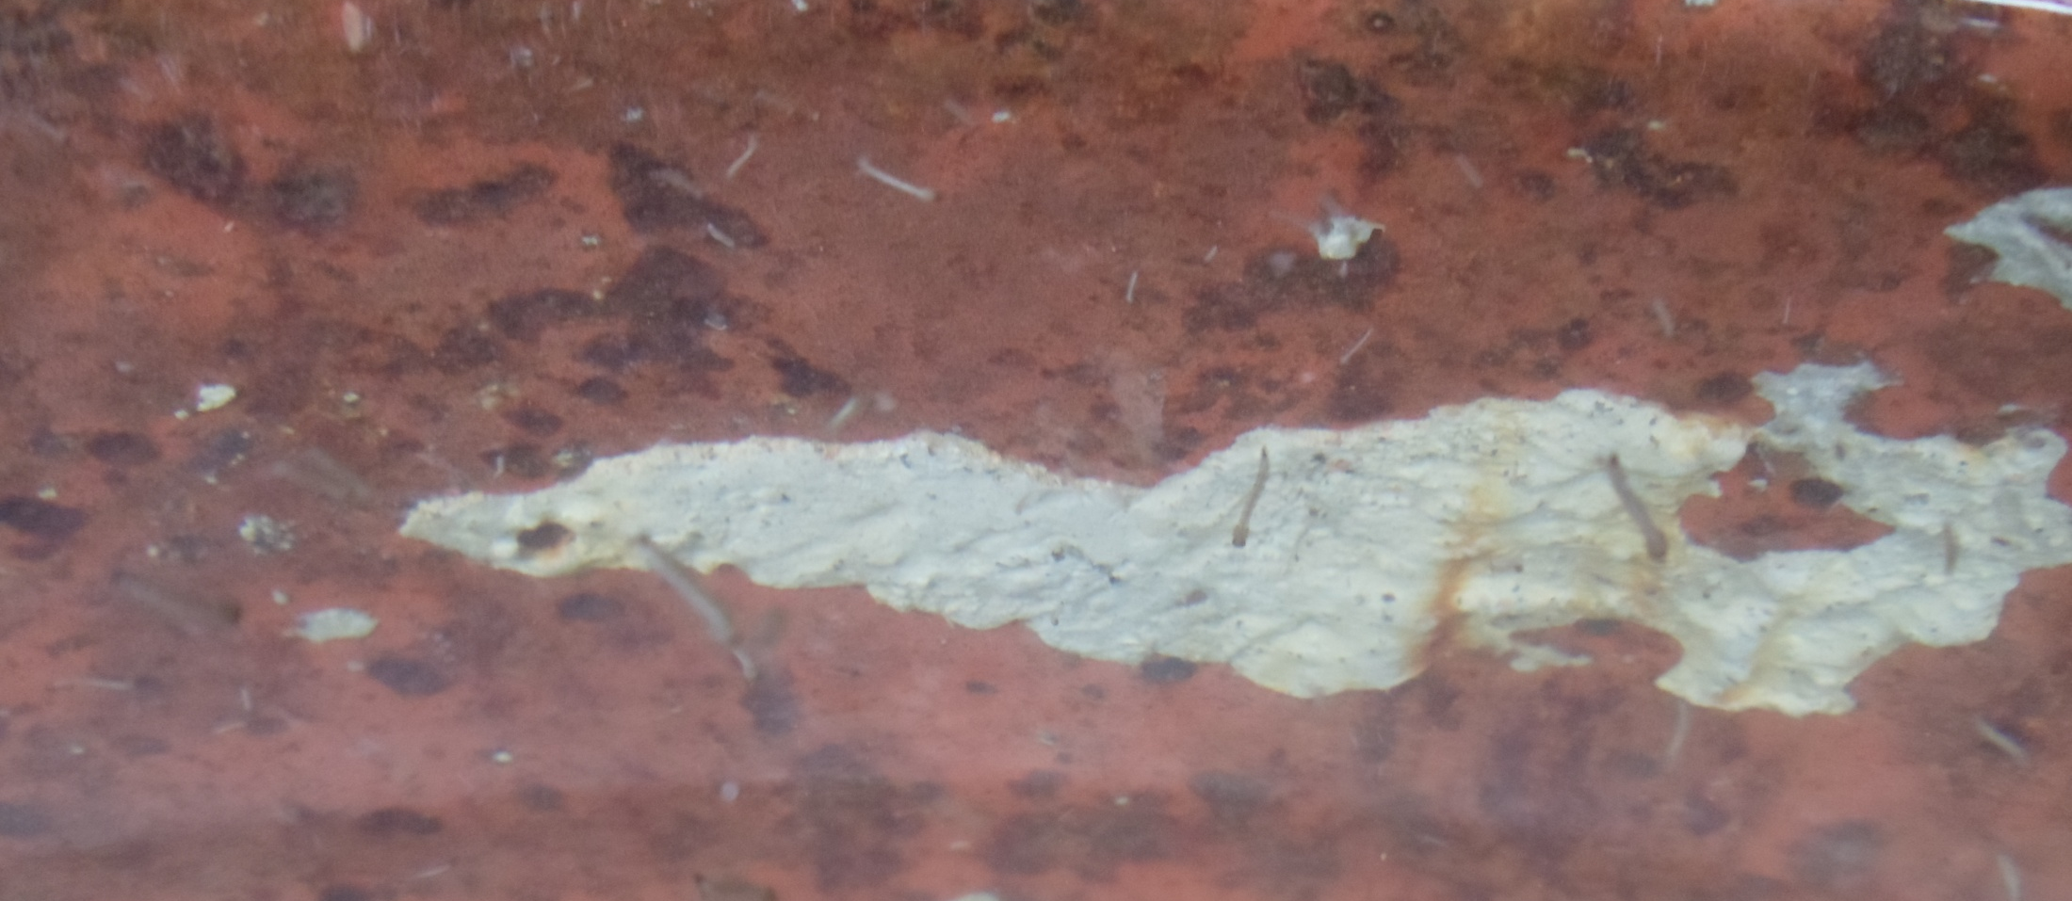
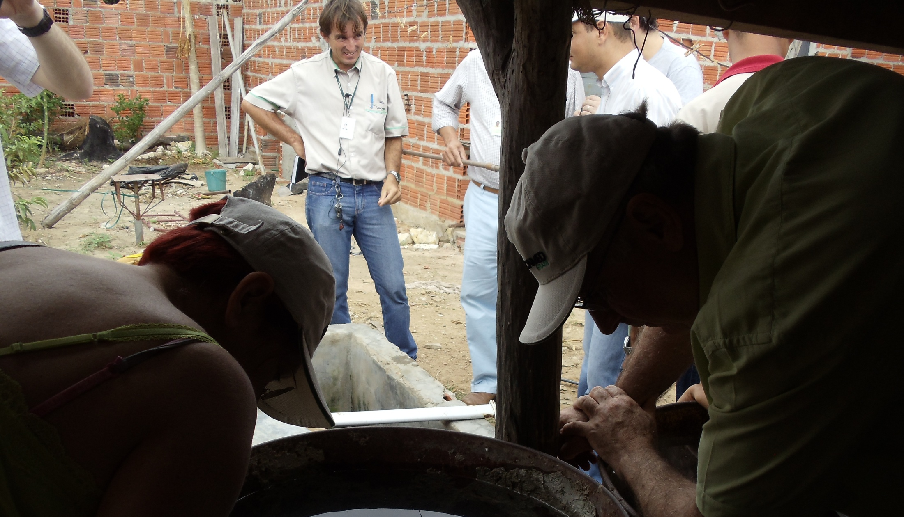

Slide 5
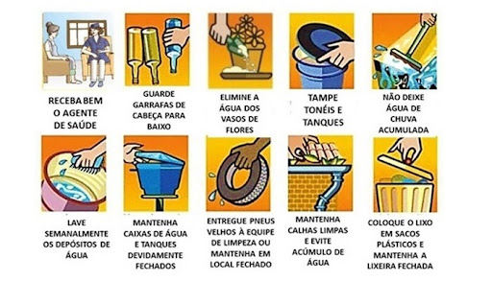

Slide 6
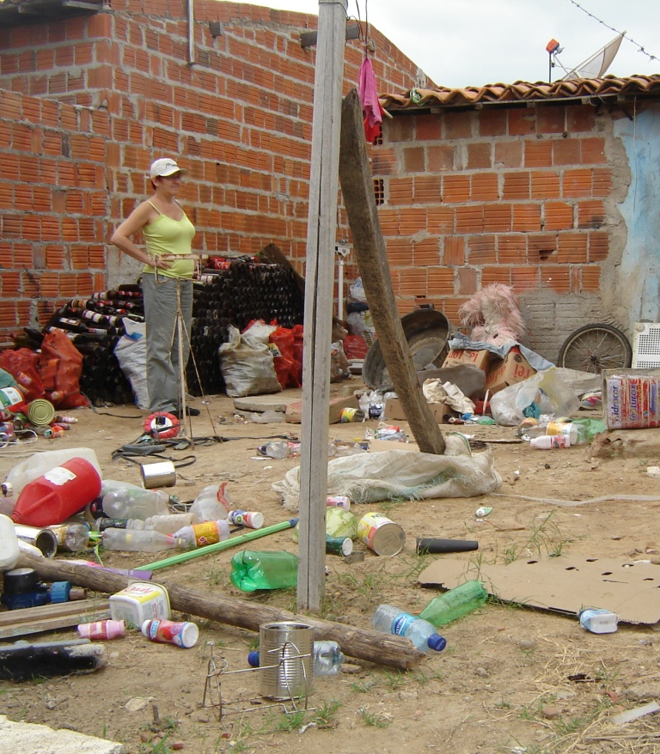
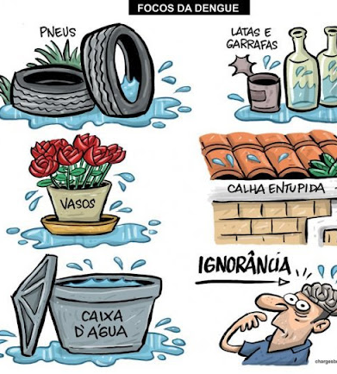
Educação?

Slide 7
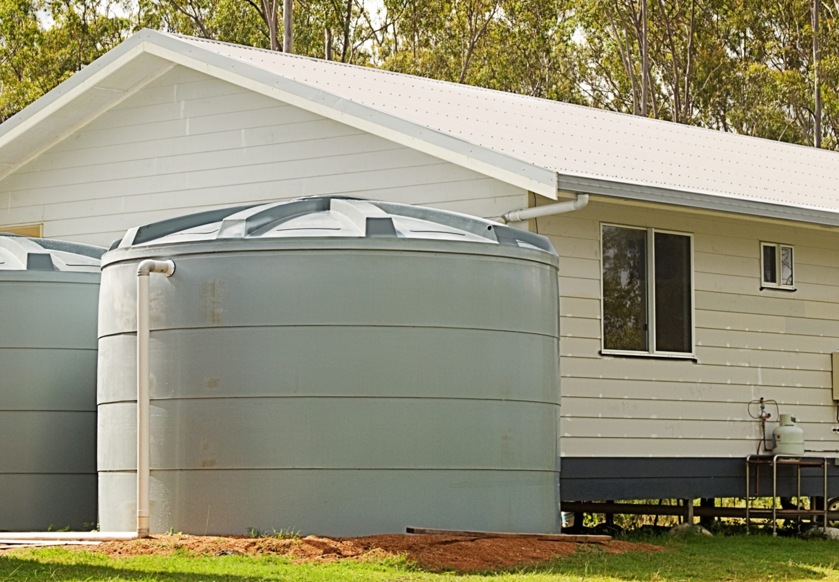
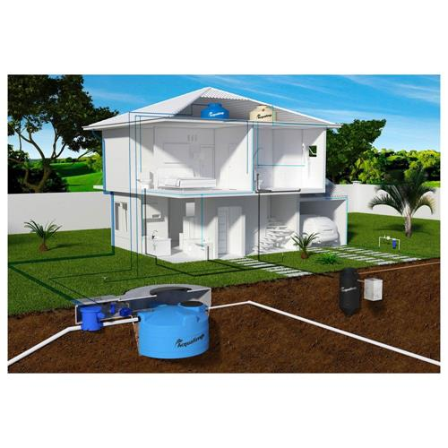
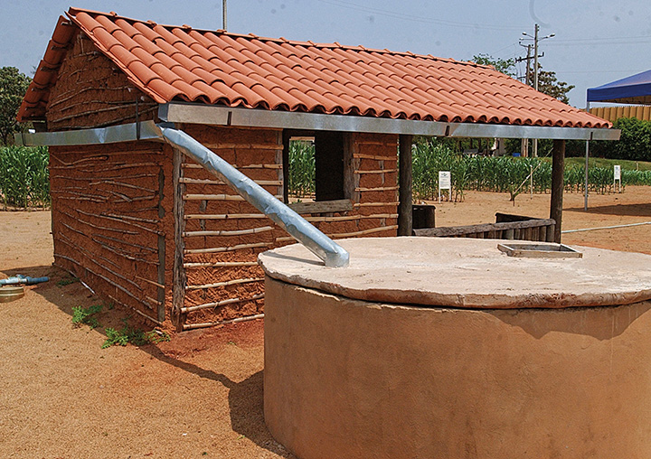
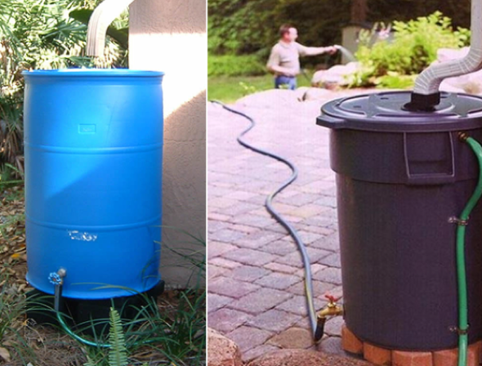
Cisternas

Slide 8
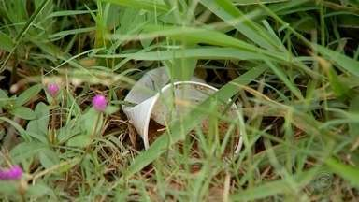
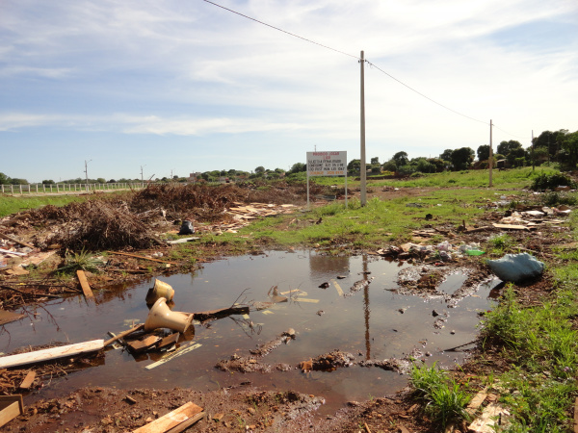
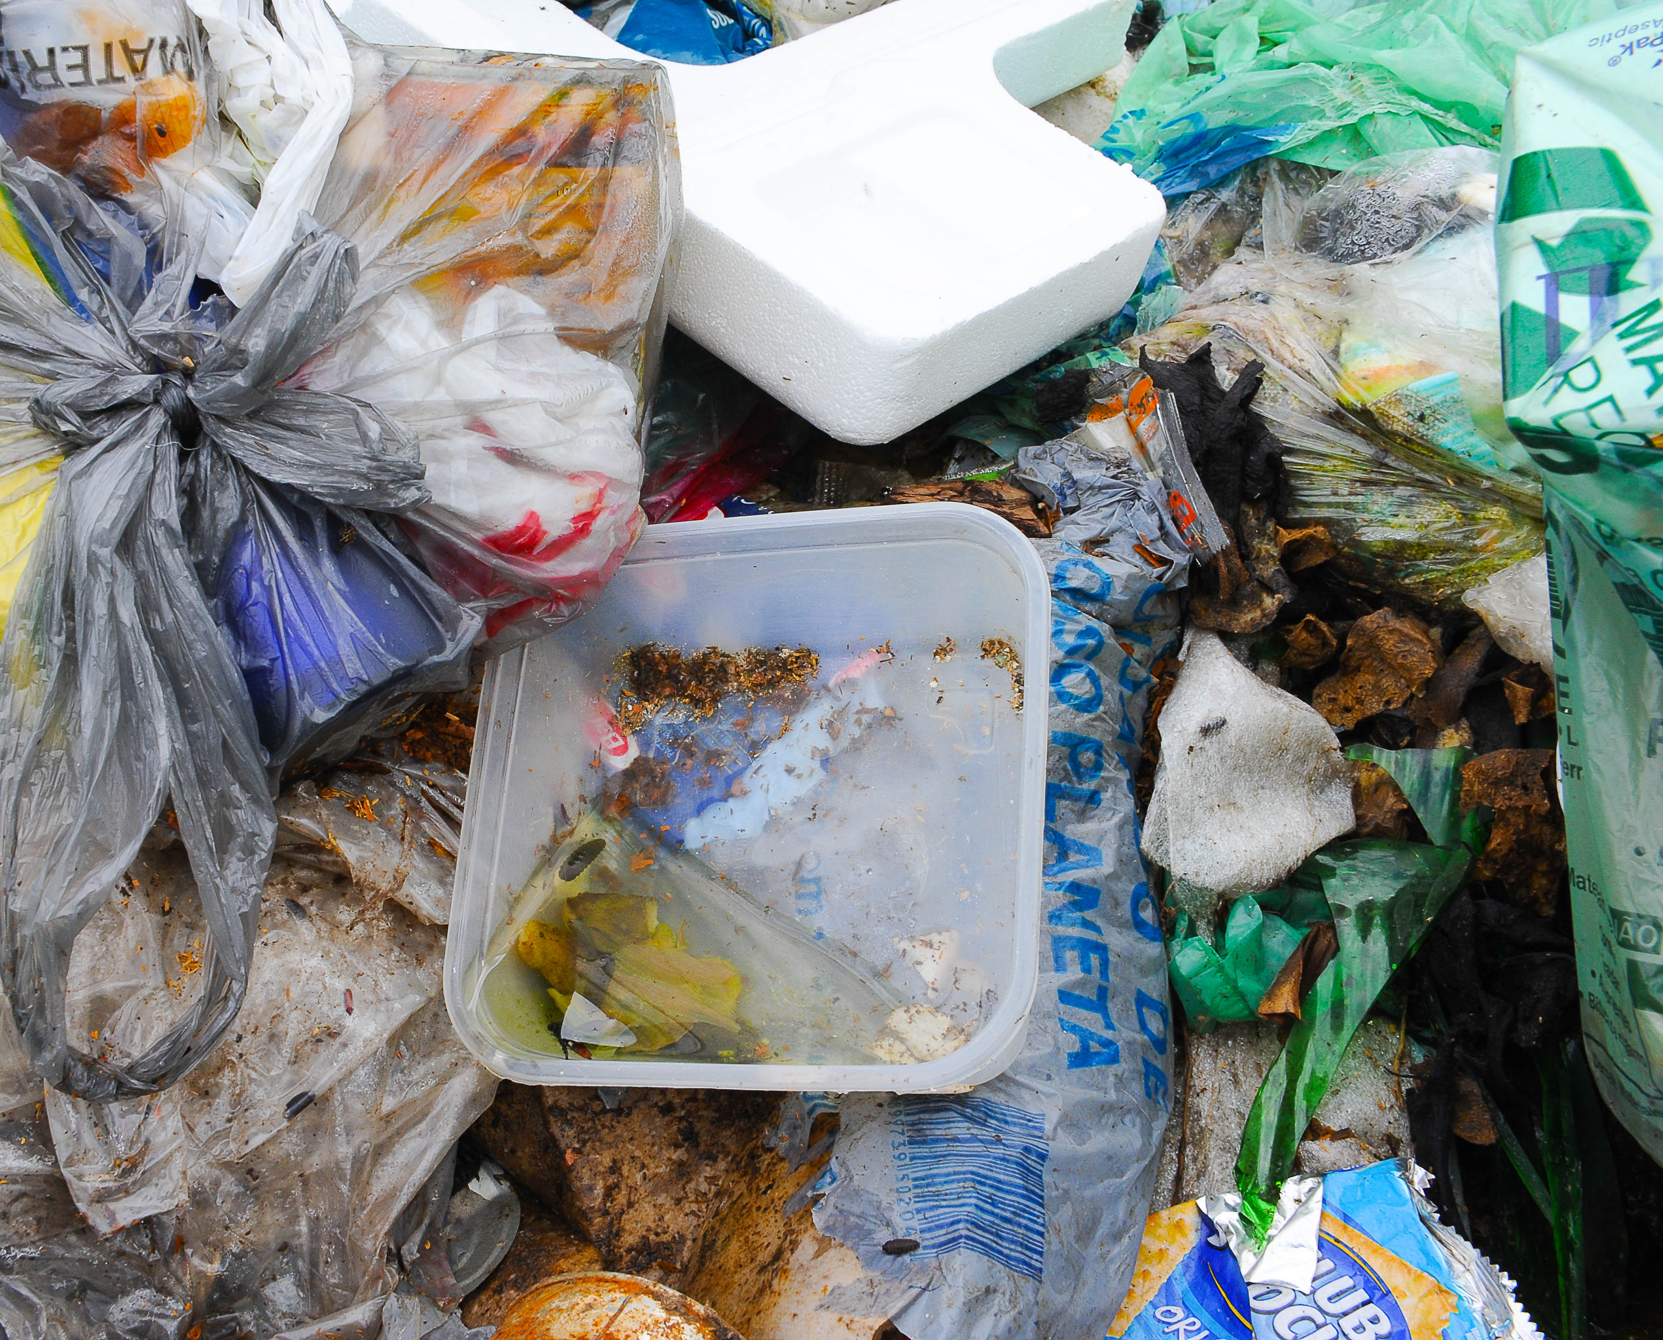
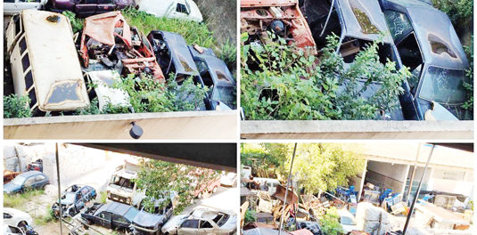

Slide 9
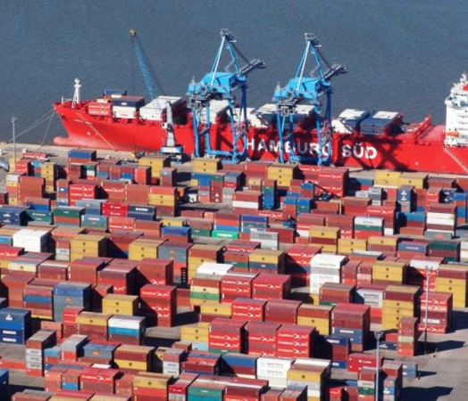



Slide 10
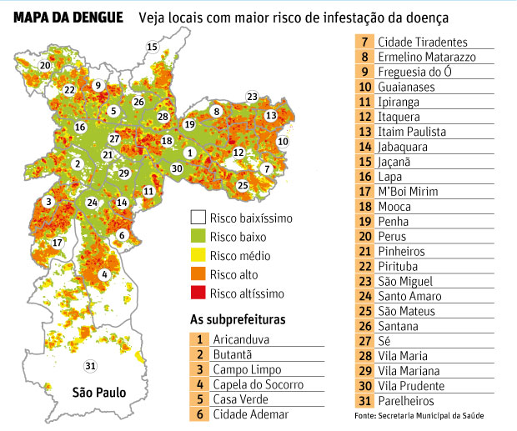
Hot Spot
São Paulo City - 12,33 million (2020) - 1.521 km²

Slide 11
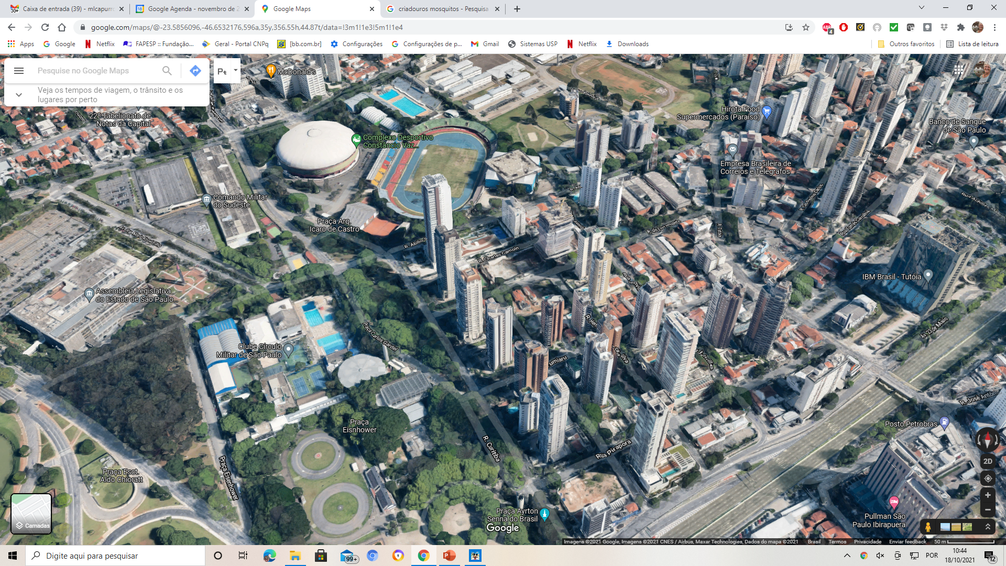
Hot Spot

Slide 12
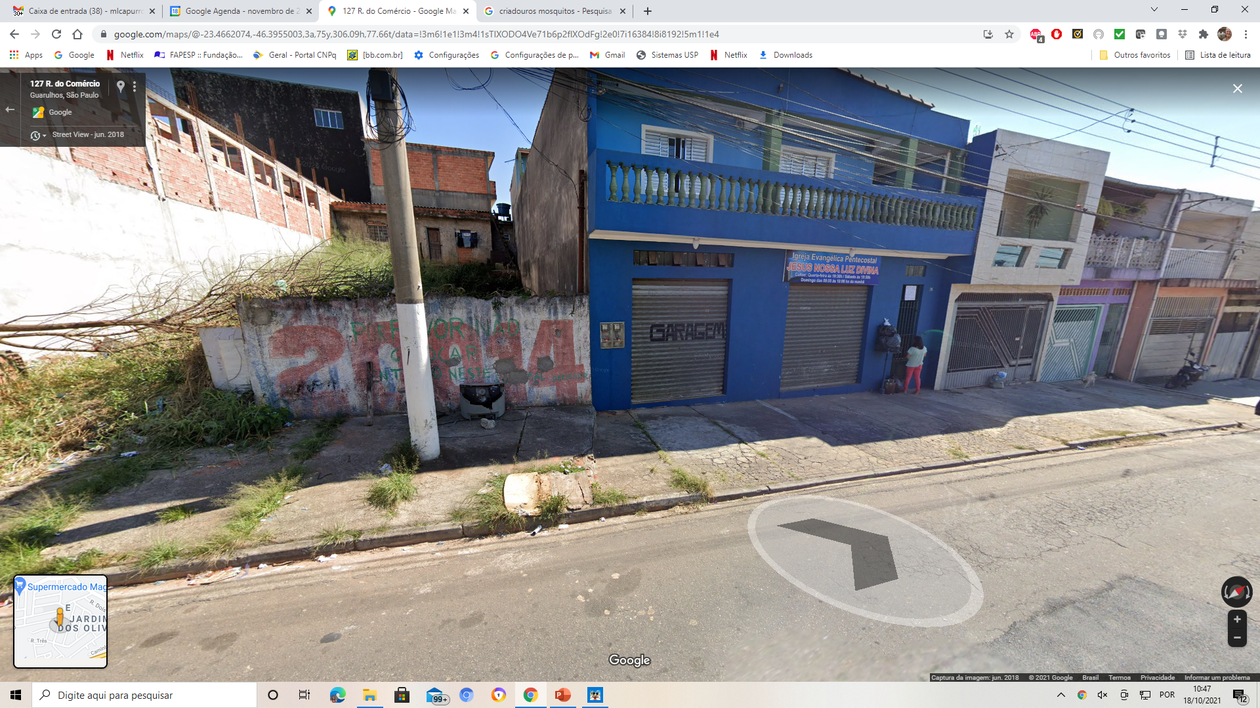
Hot Spot

Slide 13
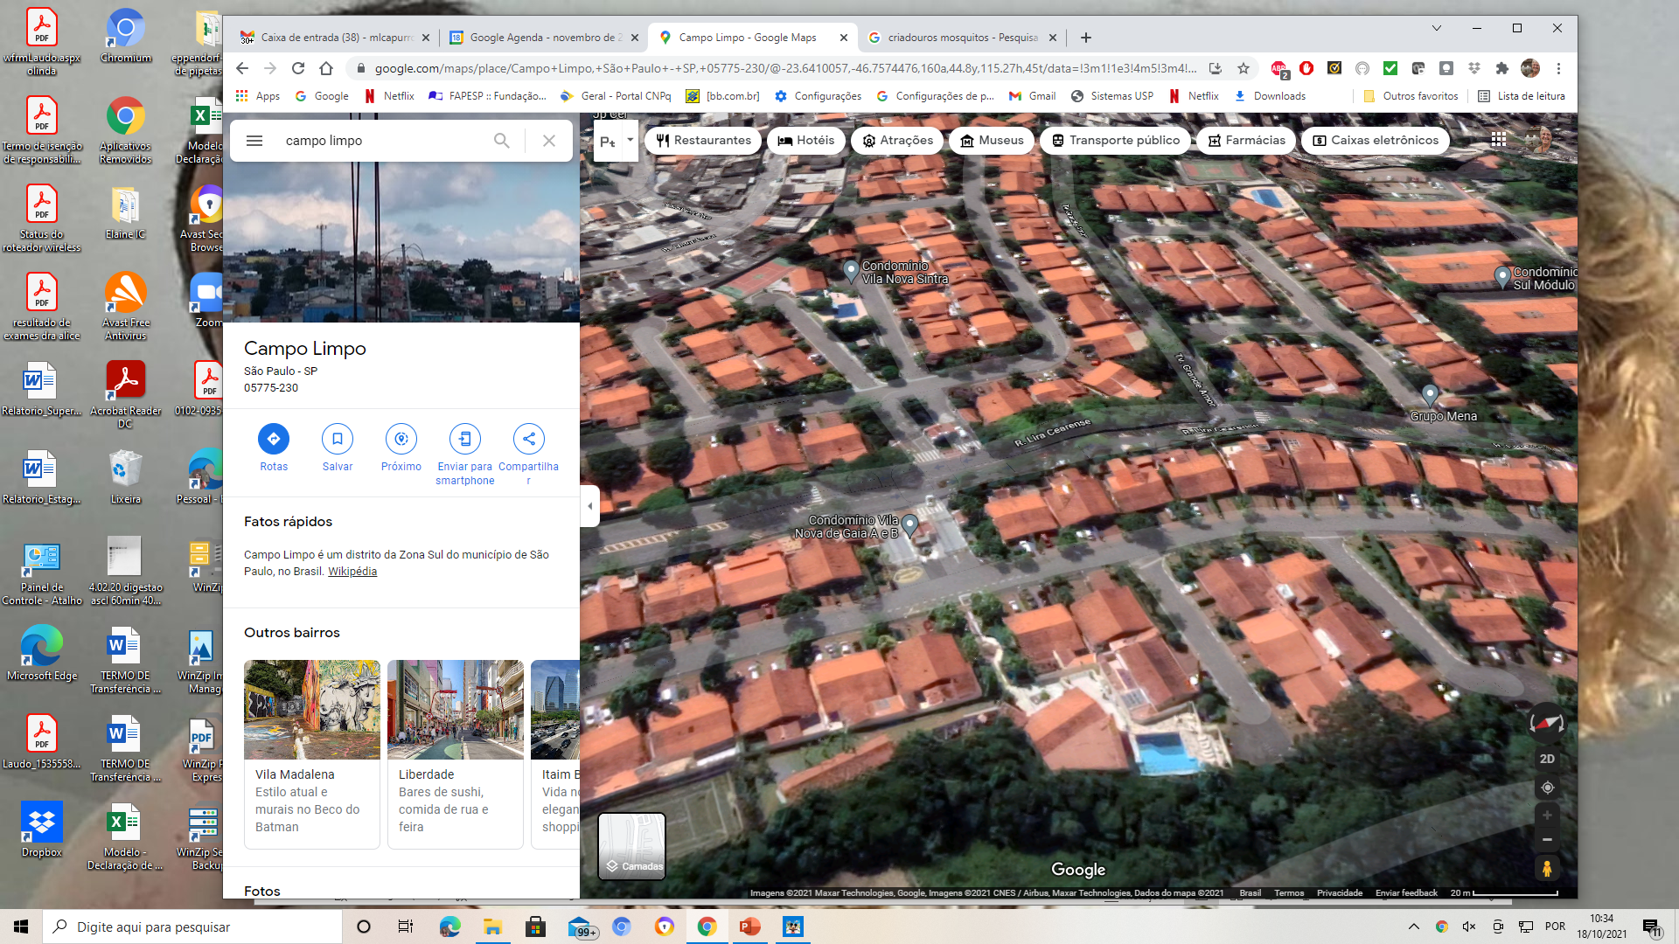
?
?
Hot Spot
?
?

Slide 14
?
?

Slide 15
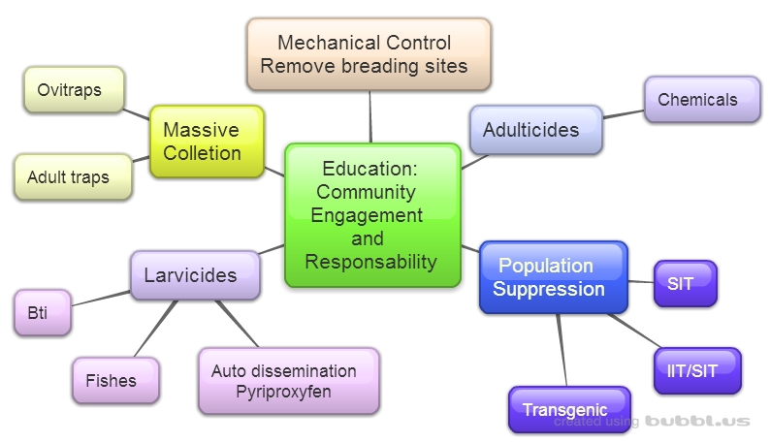
Integrated Population Control of Aedes aegypti

Slide 16
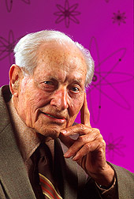
Sterile Insect Technique ou Técnica do Inseto Estéril
(SIT/TIE)
Radiation Sterilization
EDWARD F. KNIPLING
The idea came up: 1937
The success of the technique was achieved in: 1955 - Curaça Island- Screwworm fly

Slide 17
SIT/TIE
Wild
Sterile
Males
Female
Wild
X
Sterile

Slide 18
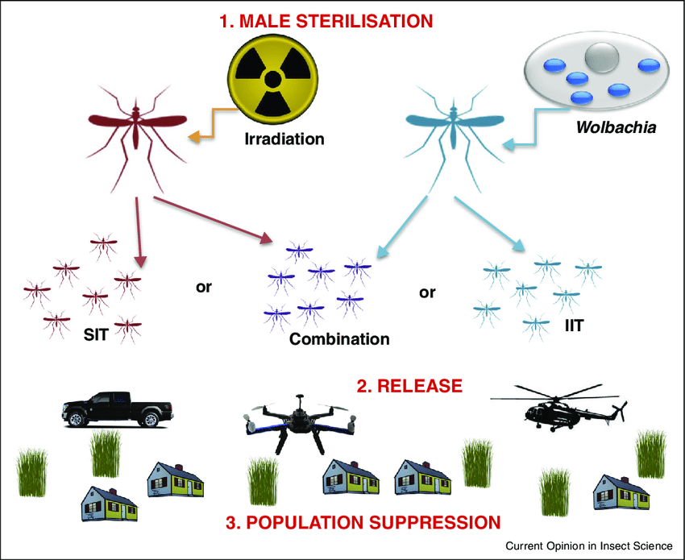
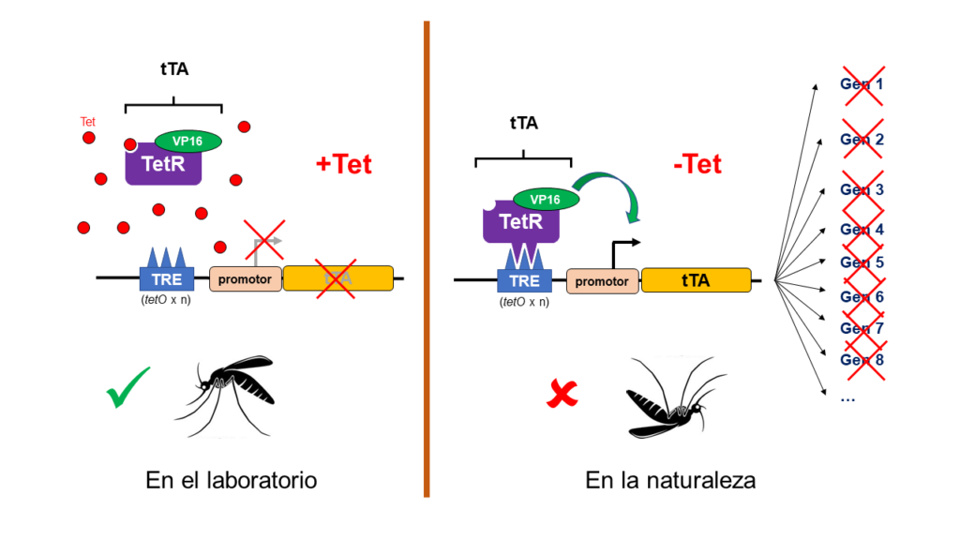
Transgenic Aedes aegypti

Slide 19
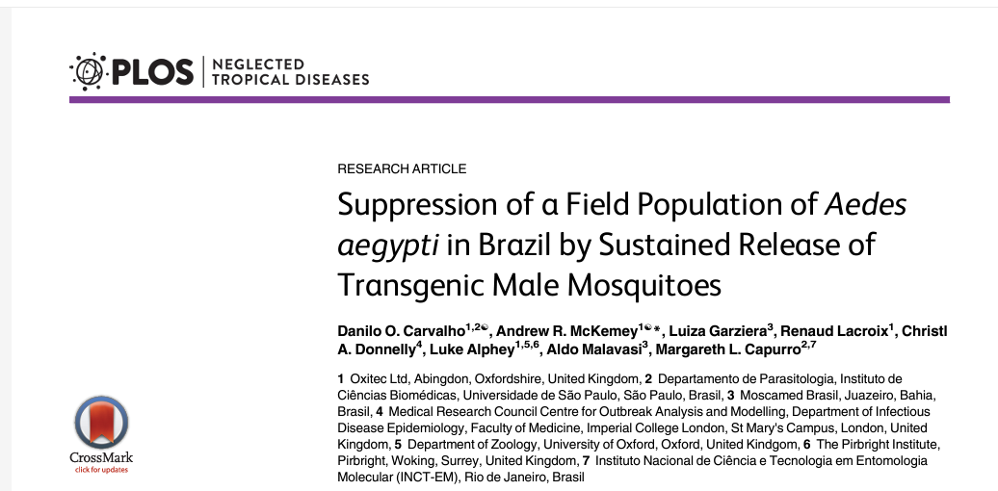
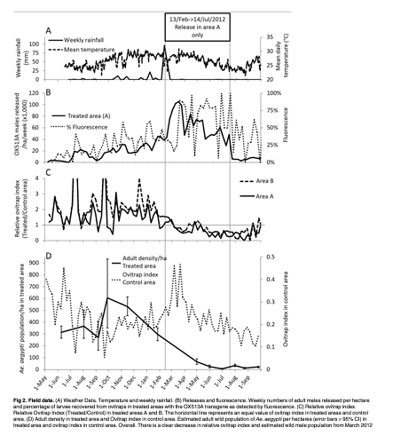
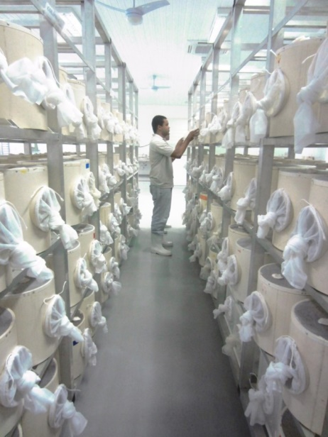
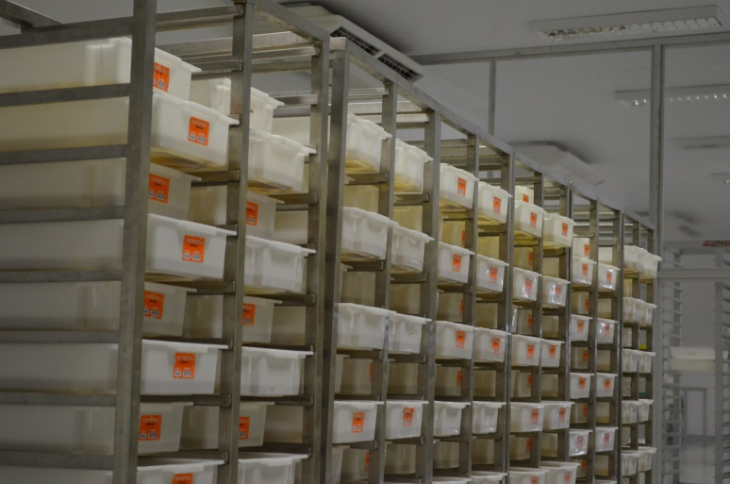
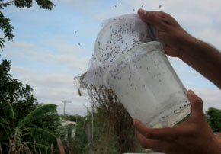

Slide 20
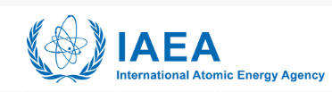
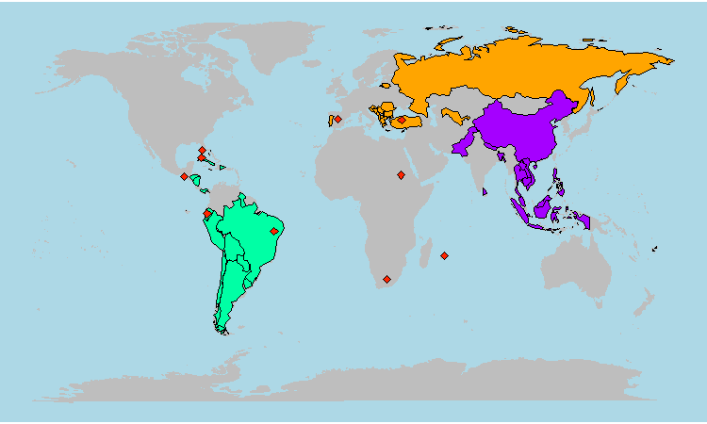
Países com projetos em SIT (TIE)
Regional projects
Latin America and Caribbean (20 countries)
Europe (16 countries)
Southeast Asia (15 countries)
National
Brazil | South Africa
Ecuador | Sudan
Mauritius | Spain
Mexico | Turkey
Reunion (France) | USA

Slide 21
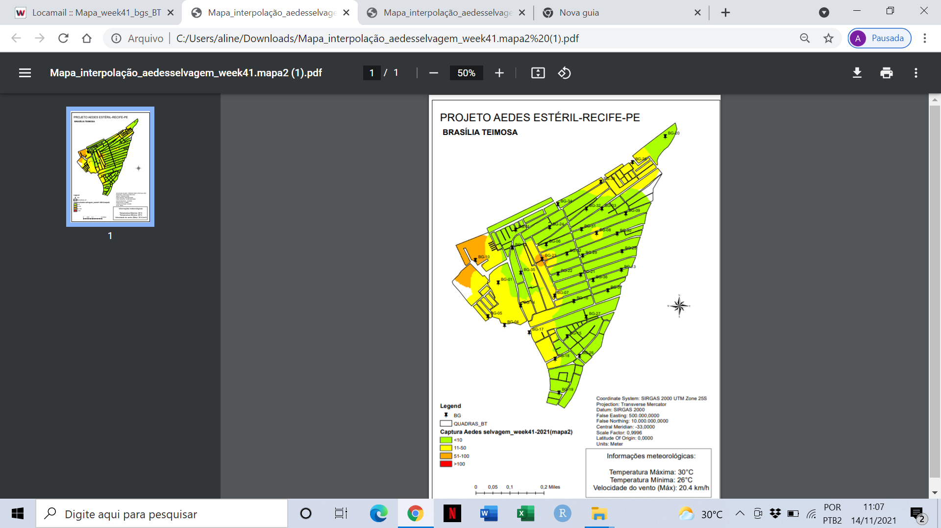
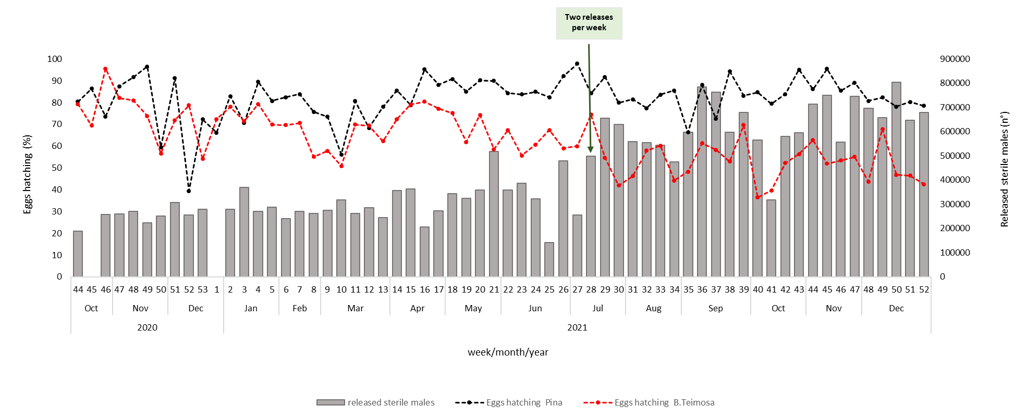
SIT (TIE)– Pilot Trial in Brazil
Week 10
Week 41
Pilot site: 60 ha
Ovitraps: 54 (weekly)
Adult traps: 68 (twice a week)
Sterilization: gamma
Releases: October 2021
Egg hatch: reduction ~ 50%

Slide 22
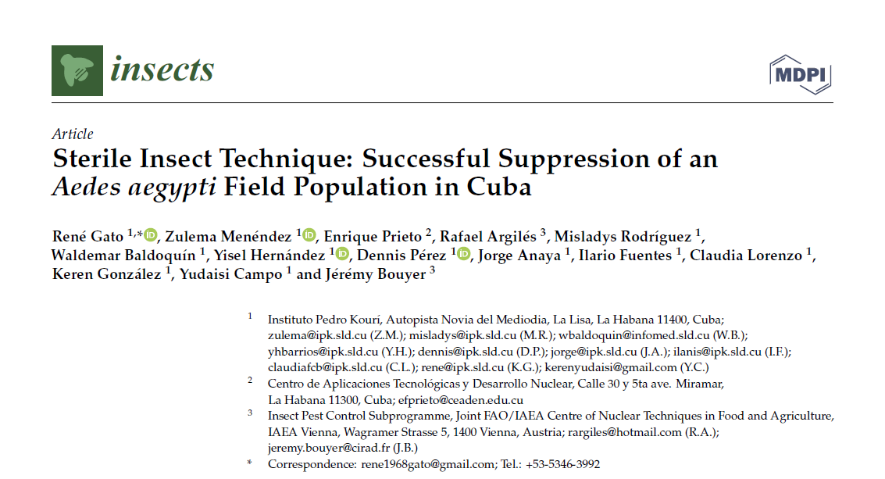
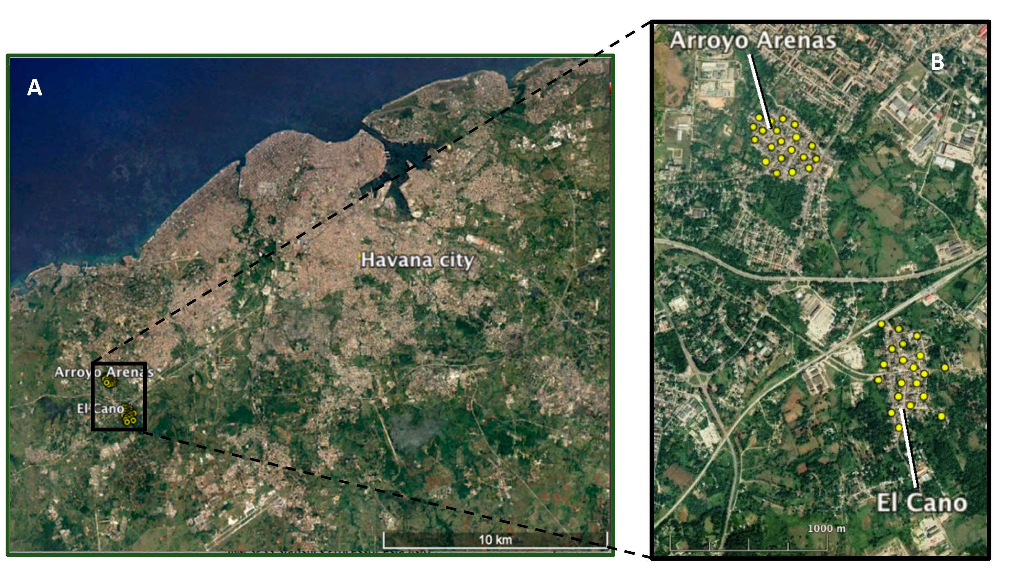
SIT (TIE) – Pilot Trial in Cuba
Pilot site: 50 ha
Ovitraps: 20 (weekly)
Adult traps: not evaluated
Sterilization: gamma
Releases: April 2020
Egg hatch: population suppressed

Slide 23
SIT (TIE) – Pilot Trial in USA (Captiva Island)
Pilot site: 240 ha
Ovitraps: 78 (weekly)
Adult traps: 58 (twice a week)
Sterilization: X ray
Releases: June 2020
Egg hatch: population fully suppressed

Slide 24
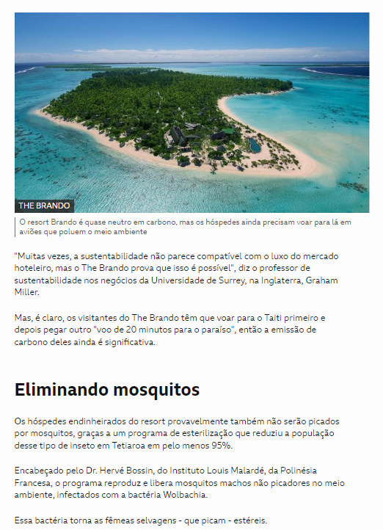
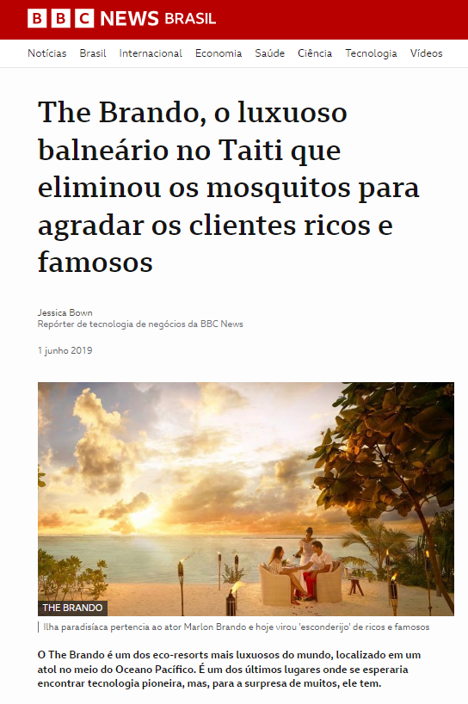
IIT/SIT

Slide 25
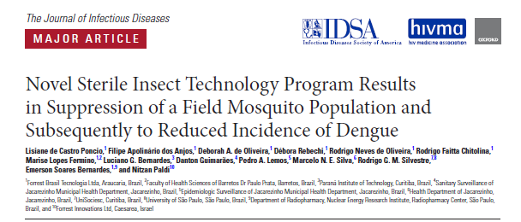
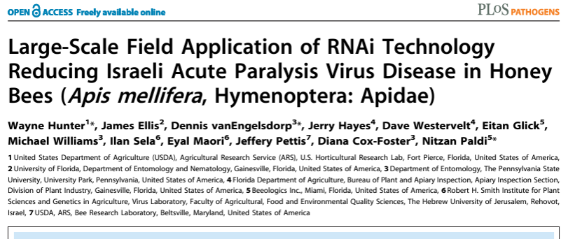
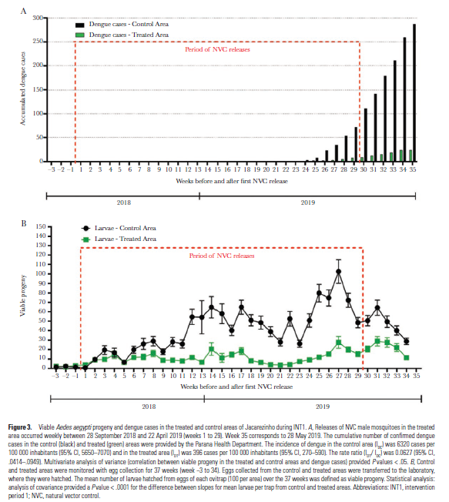
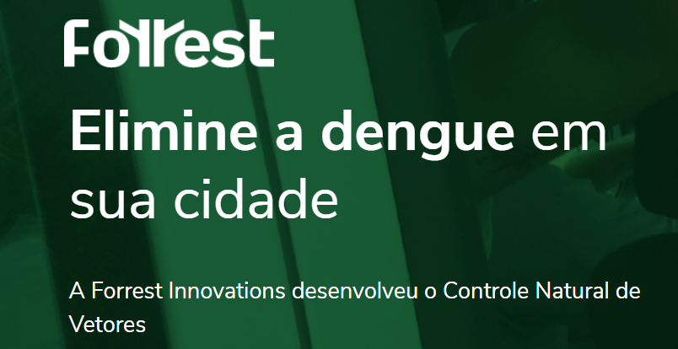

Slide 26
Inovação

Slide 27

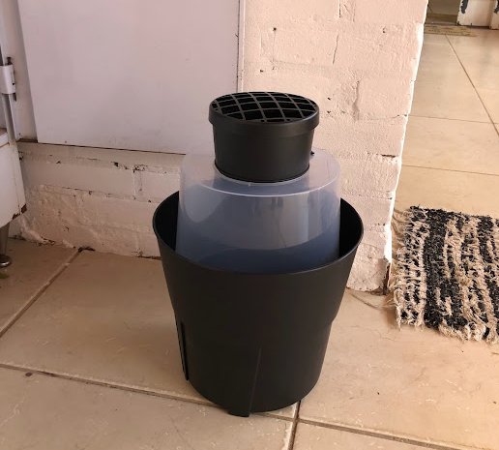
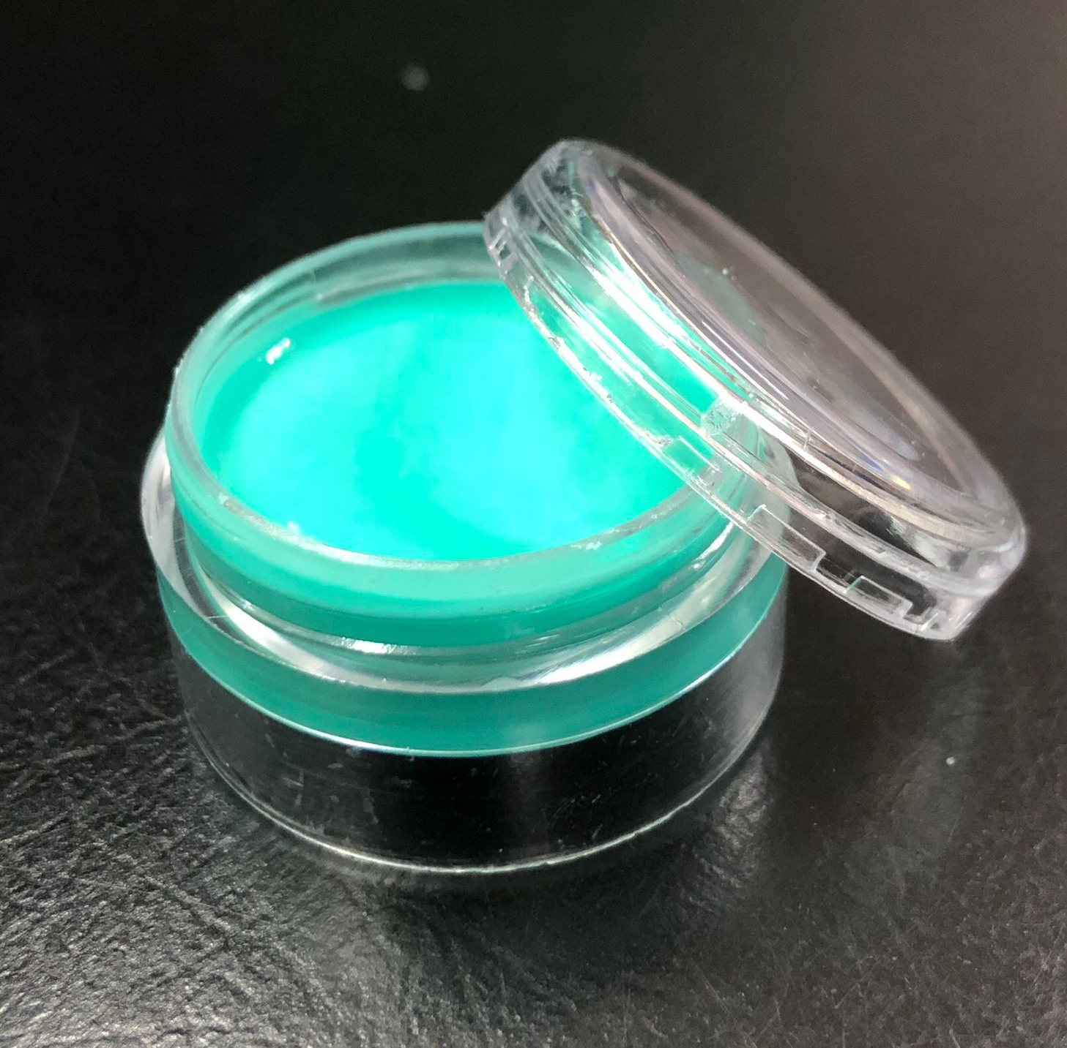

Armadilha
BioGAT e Bio Aedes
Duração de 30 dias em campo
Polímero de alta resistência e volatilidade lenta
Composição de princípio ativo e estabilizantes
Utilizado juntamente com a Bio GAT
Desenvolvimento próprio e patenteado
Atrativo
Bio Aedes
Agência de inovação da Inglaterra

Slide 28
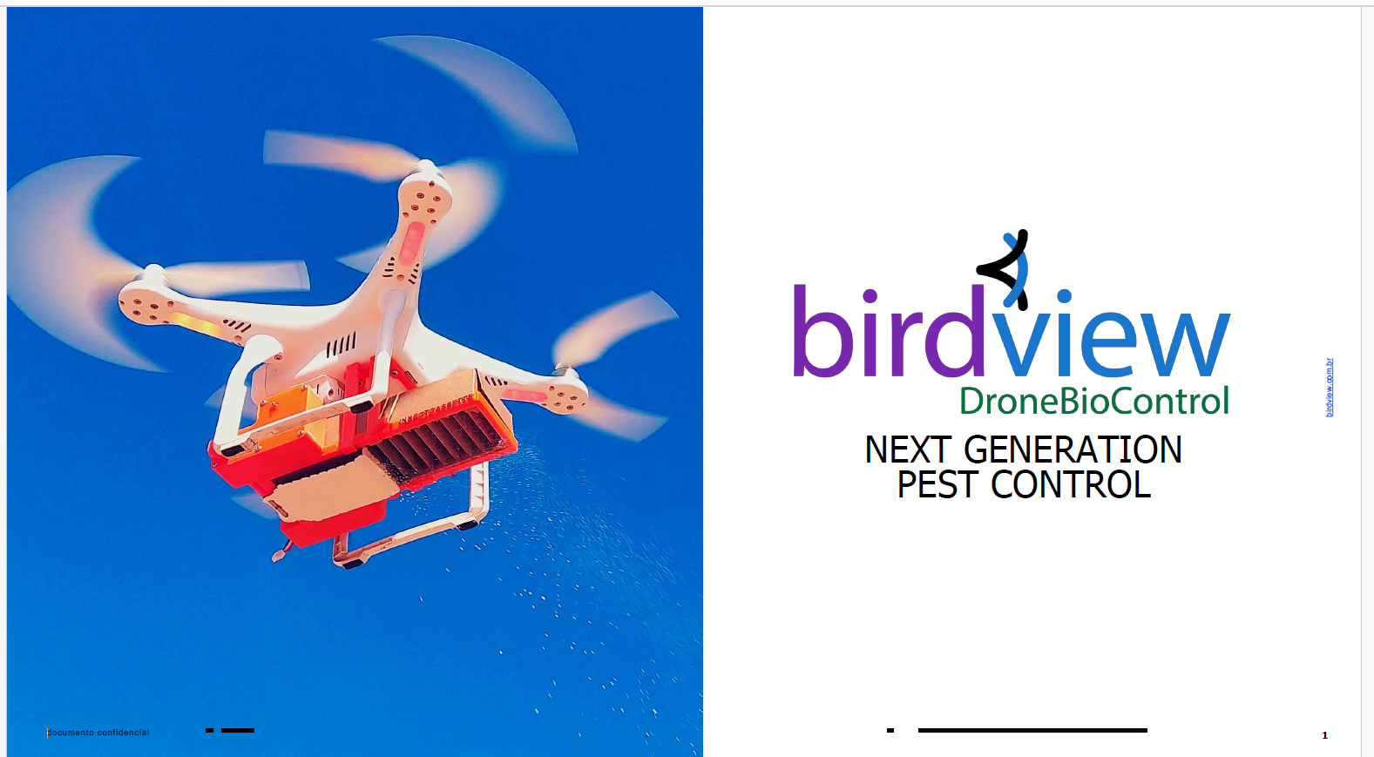

Slide 29
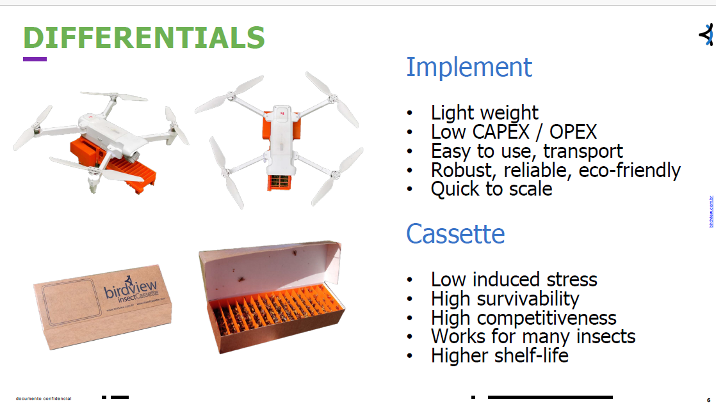


Slide 30
Obrigada!

