Slide 1
Natural Capital: concepts & trends
Jonathan Hughes
CEO, Scottish Wildlife Trust
Founder, World Forum on Natural Capital

Slide 2
“Natural Capital is the stock of natural ecosystems on Earth including air, water, land, soil, biodiversity and geological resources.
This stock underpins our economy and society by producing value for people, both directly and indirectly.”
Draft Natural Capital Charter, 2015

Slide 3
Government policy ideas
Why Natural Capital?
What mechanisms are available?

Slide 4
Why Natural Capital?

Slide 5
“By 2050 agricultural production will grow by about 60%, with increasing wealth projected to boost annual demand for meat products by 76%”
FAO, 2012

Slide 6
“will require a short term increase in the global food crop area of about
1 million km² ”
OECD, 2012

Slide 7
“palm oil plantations alone set to increase from around 6 million hectares to 20 million in 2030, mostly at the expense of forest [and peatland]”
UNEP, 2009

Slide 8
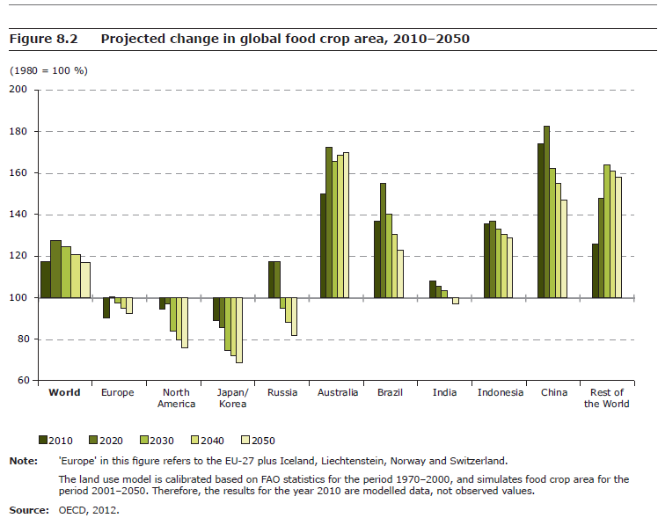

Slide 9
“Over half the world’s river basins, containing 2.7 billion people, face water scarcity at least one month per year”
Hoekstra et al, 2012

Slide 10
“Business as usual not an option”
World Forum on Natural Capital, 2015

Slide 11
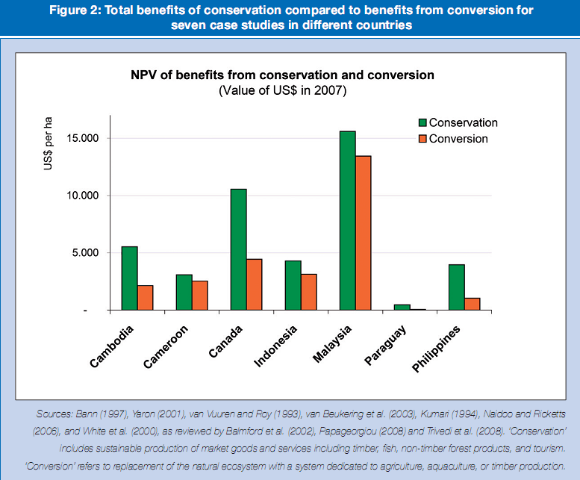
Monocultures don’t pay
TEEB, 2010

Slide 12
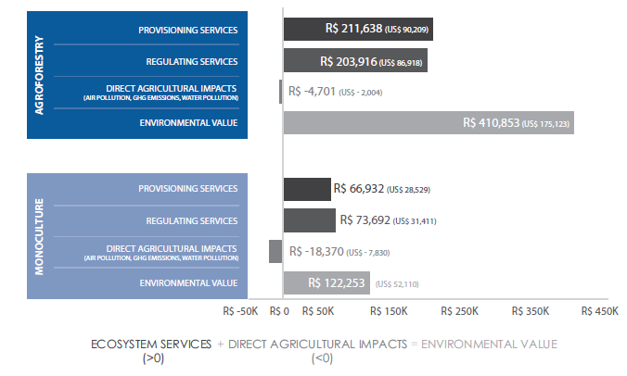
Natura, Brazil palm oil case study
TEEB for Business, Brazil, 2014

Slide 13
Moral pleading
Socio-economic imperative

Slide 14
What mechanisms are available?

Slide 15
3. Emerging mechanisms
State led natural capital valuations & mapping
Radical subsidy reform - pay for goods not bads
Biodiversity and other offsets
Corporate natural capital accounting (Natural Capital Protocol)
Credit risk ratings & Natural Capital risk exposure
Investor policy shifts – the cost of capital

Slide 16
Government policy ideas

Slide 17



Economic Strategy
Government’s Purpose
Characteristics of Prosperity Path
Foundations of Prosperity
Economic Policy Priorities
Refresh Themes
Flourishing Scotland
Sustainability
Competitiveness
Equality
Natural Capital
Economic Capital
Social Capital
Low Carbon &
Circular Economy
Productive Resources & Capital
Innovation &
Global Outlook
Well Qualified & Highly Skilled Workforce
Access to Fairly Paid Jobs
Community Empowerment & Regional Development
Innovation
Investment
Internationalisation
Inclusion

Slide 18

Public policy priorities?
Five best options to leverage business
Investments in natural capital
Offsets and no net loss
Subsidy reform
Tax and fiscal incentives
National green accounting
Protected/ managed areas
Feasibility
Green public procurement
Payments for ecosystem services
Standards and certification
Efficiency and effectiveness
World Business Council for Sustainable Development /OECD 2012

Slide 19
Ecosystem Health Indicators

Slide 20
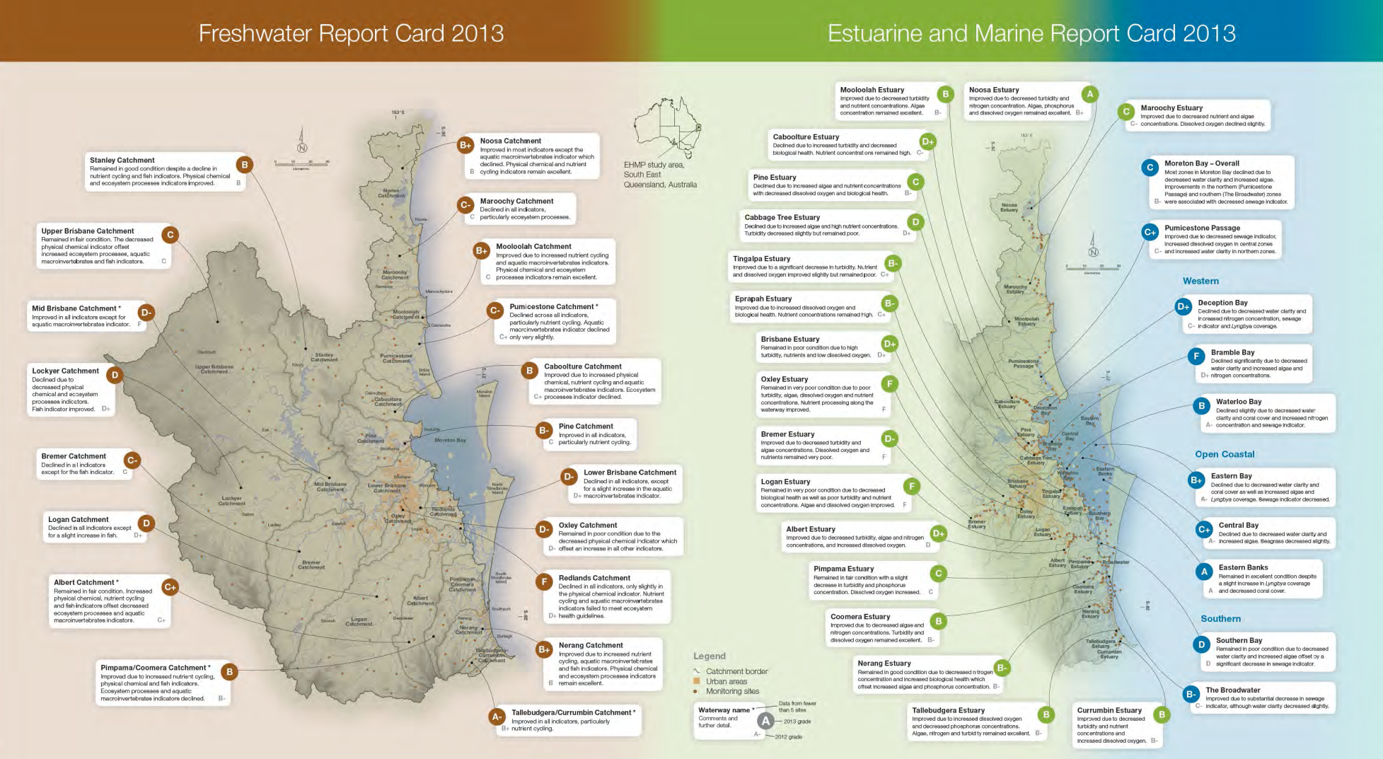
Importance of spatial scales
Source: Healthy Waterways 2013, Queensland, Australia

Slide 21
Priorities for Government Action
Valuation
Value and map Natural Capital at both local catchment and national level
Use sound science to develop Ecosystem Health Indicators and targets at catchment and national level
Collaboration
Create forums where public & private sector, NGOs and communities work together to identify biggest risks and investment needs
Recovery
Relentlessly focus investment on key systemic threats to Natural Capital stock depletion - catchment by catchment
Public finance institutions work with ratings agencies and others to create finance products which internalise Natural Capital externalities
Better regulation and implementation to protect Natural Capital from private, short-term plunder

Slide 22




Thank you
See you all in November 2015 in Edinburgh at the 2nd World Forum on Natural Capital!

