Slide 1
Implementing International Agreements on Biodiversity Protection: Challenges and Opportunities
Marina von Weissenberg, Ministerial Adviser, Finland – IUCN Councillor, Vice President
19 March 2015, Brasilia

Slide 2
Content of this Presentation
1) Introduction
2) Policy context: Aichi Biodiversity targets 2020
3) Governance: Needs and Challenges
4) Tools and methods
5) Capacity and support for implementation
6) SDG/Post -15 and Biodiversity
7) Way Forward

Slide 3
Remit of this presentation
The six global biodiversity-related conventions:
Convention on Biological Diversity (CBD)
Convention on International Trade in Endangered Species of Wild Fauna and Flora (CITES)
Convention on Migratory Species (CMS)
International Treaty on Plant Genetic Resources for Food and Agriculture (ITPGRFA)
Ramsar Convention on Wetlands
World Heritage Convention (WHC)
World Summit on Sustainable Development (1992),
Johannesburg Plan of Action (2002),
Rio+20 (2012)
Notes:
1992 World Summit on Sustainable Development,
Johannesburg Plan of Action (2002),
Rio+20 (2012)

Slide 4

Policy context: Aichi Biodiversity Targets
Convention on Biological Diversity adopted 2010:
Aichi Targets and the Strategic Plan 2011-2020;
State of Biodiversity: Actions needed on all levels -> Global Biodiversity Outlook-4 (2014)
Aim:
Halt the biodiversity loss by 2020;
The favourable status of biodiversity and ecosystem services will be ensured by 2050.
Notes:
Loss of biodiversity is still overshadowed by other environmental problems, despite the fact that more weight and visibility have been given to biodiversity issues in recent years. Traditional nature conservation issues related to individual species and conservation areas arise more easily as topics of debate. The connections between biodiversity loss to issues such as the degradation of ecosystem services due to climate change have attracted less attention.
I would like to conclude that the concept of ecosystem services, its content and the link to the Green economy and natural capital discussion and the way forward, including the aim of strengthening the integration of environmental concerns into economic decisions in an important task, not least because in 2012 (Rio +20 Earth Summit) this issue among others will be on the international agenda.
The linkages between biodiversity and ecosystem services needs clear messages and assets, because the changes in the natural environment are proceeding alarmingly rapidly.
In order to enhance general awareness and that of communications work, the loss of biodiversity should be more closely linked to other key environmental issues, such as climate change, the services obtained by people from nature, food safety, human well-being/Health and protection of water resources.

Slide 5
Capacity and support for implementation
Where do we stand?
Loss of biodiversity is costing more than USD 750 billion annually in lost ecosystem services;
Lack of sector integration is a challenge in reaching our targets 2020;
Biodiversity loss, climate change and land degradation: closely linked and interdependent;
GEF (Global Environment Facility) e.g. IUCN and biodiversity related conventions (MEAs);
Role of Private sector and Business;
Reporting framework & Indicators.

Slide 6
Opportunities
Biodiversity crisis – failure to achieve the 2010 biodiversity target -> GBO-4, 2014
Strategic Plan for Biodiversity 2011-2020
Institutional framework for sustainable development of Rio+20
Many MEA governing body decisions/resolutions call for increased cooperation and synergies
Intergovernmental Science - Policy Platform on Biodiversity and Ecosystem Services (IPBES)
Lack of capacity means that we need to share and cooperate.
Marina von Weissenberg

Slide 7
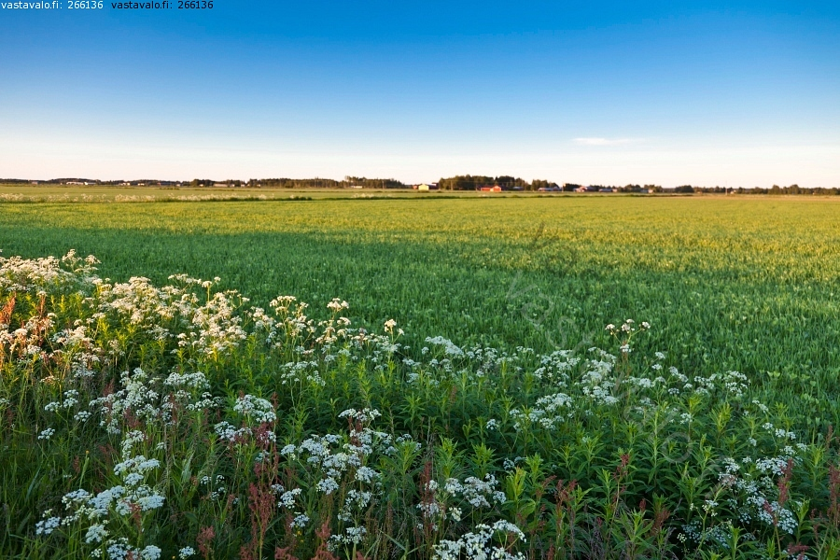
Governanace system: Needs and challenges
Protection of Biodiversity requires sector integration:
Legislation, EIA, land use planning, clear obligations, cooperation, compliance, reporting and indicators.
Challenges: ”lack of political will”, tools,
resources, incentives, harmful subsidies,
environment versus economics,
fragmentation , social problems/human
rights, understanding of biodiversity goods and
services.

Slide 8
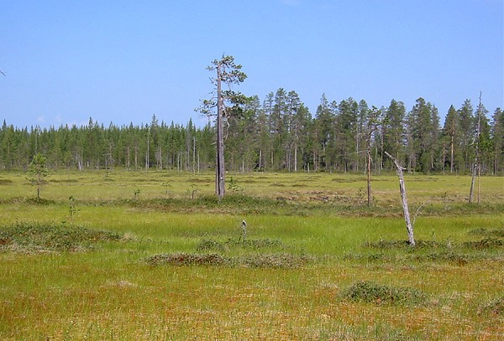
Tools and methods
In terms of valuing biodiversity and ecosystem services, we still need to promote the wider use of tools and approaches for biodiversity for instance linked to health and human wellbeing:
Integrating natural values into policies and decision-making (e.g. GNP);
Improve the understanding of Natural capital; Issues and values related to biodiversity must become fundamental elements in decision-making;
Communication and sharing of knowledge and information.
Notes:
Biodiversity and ecosystems are fundamental building blocks for achieving resilient and productive food, water and energy systems. Healthy and productive ecosystems are essential for supporting water infrastructure and to ensure greater food security for instance. Not to forget the role nature conservation areas has for safeguarding biodiversity and providing humans with the services we need for our daily life.
The concepts of ecosystem services and natural capital can help us recognize the many benefits that nature provides.

Slide 9

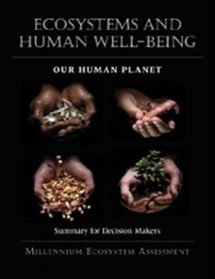
Biodiversity and
ecosystem services
declining at
unprecedented
rate:
IPCC Assessment Reports
UNEP Global Environment Outlook
CBD Global Biodiversity Outlook (GBO)
Need for an
Intergovernmental
Science-policy
platform (IPBES) for
Biodiversity and
Ecosystem services.
Notes:
The Millennium Ecosystem Assessment, publicly launched in March 2005, highlighted the consequences of ecosystem change for human well-being and the scientific basis for action needed to enhance the conservation and sustainable use of those systems and their contribution to human well-being.
Current rates of species extinction are unparalleled. Driven mainly by human activities, species are currently being lost 100 to 1,000 times faster than the natural rate: according to the FAO, 60% of the world's ecosystems are degraded or used unsustainably; 75% of fish stocks are over-exploited or significantly depleted and 75% of the genetic diversity of agricultural crops has been lost worldwide since 1990. An estimated 13 million hectares of tropical forests are cleared each year and 20% of the world’s tropical coral reefs have already disappeared, while 95% will be at risk of destruction or extreme damage by 2050 if climate change continues unabated.
FAO, 2010.
'Reefs at Risk Revisited', World Resources Institute, 2011.

Slide 10

IPBES Assessments: 2014-2017
Pollination and pollinators associated with food production (2014-2015)
Scenario analysis and modelling of biodiversity and ecosystem services (2014-2015)
Conceptualisation of values of biodiversity and nature’s benefits to people (2014-2017)
Land degradation and restoration (2014-2016)
Invasive alien species (2014-2017)
Sustainable use and conservation of biodiversity (2014-2017)
Marina von Weissenberg

Slide 11

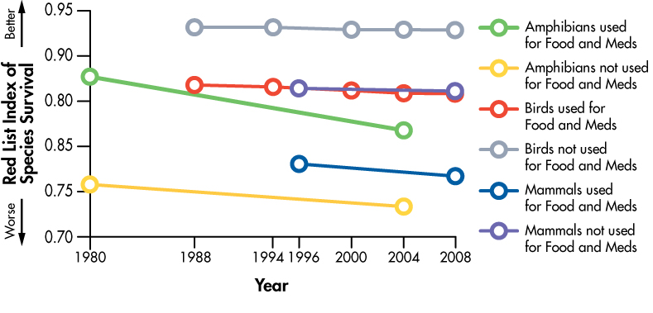



Aichi Target 14: Essential Ecosystem Services
Indicator: Biodiversity for food and medicine
http://www.bipindicators.net/foodandmedicine
Notes:
Target 14: By 2020, ecosystems that provide essential services, including services related to water, and contribute to health, livelihoods and well-being, are restored and safeguarded, taking into account the needs of women, indigenous and local communities, and the poor and vulnerable.
Background: Many terrestrial animal and plant species are used by humans for food and medicine. These species make significant contributions to diet and healthcare, particularly in developing countries. An estimated 50,000–70,000 plant species are used in traditional and modern medicine. Many of the wild species used for food and medicine are threatened with extinction, some due to over-exploitation, or different pressures such as habitat loss, disease or a combination of factors. Regardless of the causes, the diminishing availability of these resources affects supply and demand and thus threatens those depending on wildlife resources for income, health and well-being.
Policy questions that the indicator addresses: Biodiversity makes a significant contribution to human diets and healthcare, particular in developing countries, whether directly or through provision of income. Where species that people rely on are threatened, whether through over use, habitat loss or pollution, this also threatens those that rely on them.
Indicator to main Aichi Biodiversity Target: Biodiversity harvested for food and medicine contribute to health, livelihoods and well-being. Unsustainable use and other threats to species used for food and medicine must be prevented and ecosystems maintained to ensure these vital ecosystem services continue to contribute to human health, livelihoods and well-being, particularly for the poor and vulnerable who may have no alternatives for their primary health care.
Status: The Biodiversity for Food and Medicine Indicator has been developed by TRAFFIC in collaboration with the IUCN-SSC Medicinal Plant Specialist Group and with assistance from the IUCN Species Programme and BirdLife International.
Two indicators were developed to investigate the use of wildlife for food and medicine and the impacts on ecosystem integrity and ecosystem goods and services.
RED LIST INDEX (RLI)
This indicator provides a measure of change over time in the conservation status of animals used for food and medicine and a baseline for the conservation status of medicinal plants. Plants harvested for food have not been included; apart from medicinal use, collection of data on harvest for other purposes is not as advanced as for terrestrial animals. A Red List Index (RLI) for birds, mammals and amphibians used for food and medicine has been produced. This uses data from repeated assessments of the status of each species for the IUCN Red List, and illustrates overall trends in the extinction risk over time.
ACCESSIBILITY INDEX
To complement the global approach based on the IUCN Red List, primary data from selected countries were collected to investigate how the accessibility of species used for food and medicine is changing over time for poorer people. Price data has been collected for food and medicine ‘baskets’ from markets in eight countries, representing Latin America, Africa and Asia, regions chosen for their high biodiversity. ‘Baskets’ represent commonly used wild food (animals) and medicinal (plants and animals) products, with different species selected for each country. Price data were collected from vendors at the markets for a standard unit of the goods (for example, a kilogramme, or an individual). In addition to current price for each product, vendors were asked to recall the price in 2000. Current and historical prices for locally relevant marker products (such as staple food products, for example rice, maize, domestic meat, and generic/manufactured medicines, for example aspirin) were also obtained for each country, in order to compare prices and/or affordability of these with those of the wildlife products. Other sources of published data for the selected countries were obtained for income.
Last update: 2010
Next update: 2014 (depending on funding availability)
Indicator scale The RLI indicator provides a global picture of the changing status of bird, mammal, and amphibian species used for food or medicine. These data can be disaggregated to show regional patterns of use and trends in species extinction risks.
Level at which the indicator is currently used: Global and national

Slide 12
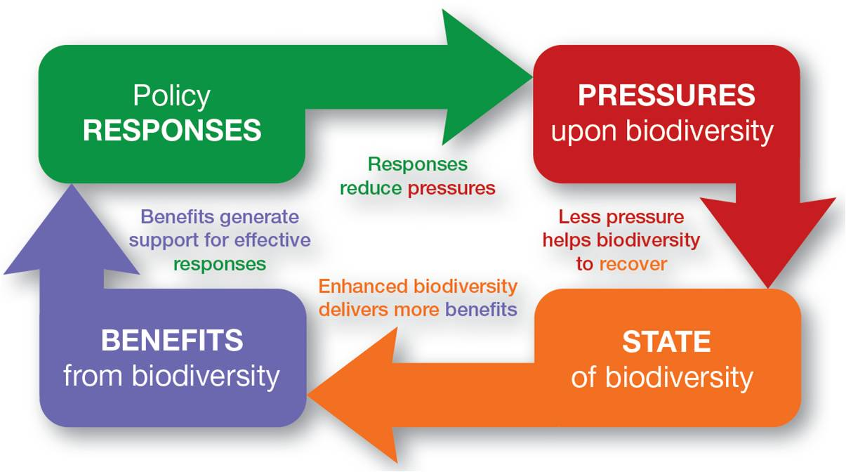
Joined-up thinking:
Four kinds of indicators are needed to make a joined-up set:
• Responses – policies or actions to prevent or reduce biodiversity loss.
• Pressures – the threats to biodiversity that responses aim to address.
• State – the condition of biodiversity and how it is changing.
• Benefits – amount and change in benefits and services that humans derive from biodiversity.

Slide 13
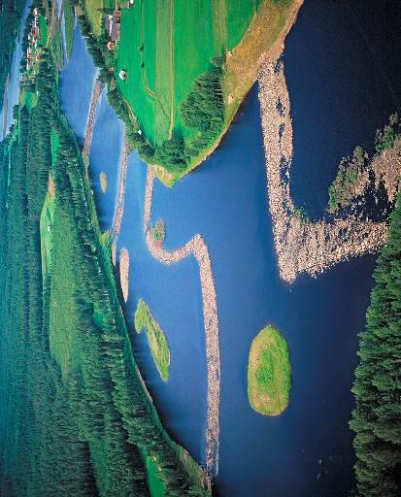
Way forward
The link between ecosystem services, Green Economy and natural capital environmental concerns into economic decisions and policy formulation (Rio +20).
The underlying causes for biodiversity loss needs deliveries.
Synergies between Biodiversity related MEAs. Possibilities: cost savings, local actions, enhance quality of life and secure livelihoods.
Notes:
Way forward
I would like to conclude that the concept of ecosystem services, its content and the link to the Green economy and natural capital discussion and the way forward, including the aim of strengthening the integration of environmental concerns into economic decisions in an important task, not least because in 2012 (Rio +20 Earth Summit) this issue among others will be on the international agenda.
The linkages between biodiversity and ecosystem services needs clear messages and assets, because the changes in the natural environment are proceeding alarmingly rapidly. The underlying causes needs attention and clear deliveries.
According to The Economics of Ecosystems and Biodiversity (TEEB) – study, half the welfare of the world's 1.1 billion poorest people comes directly from nature. Current unsustainable patterns of consumption and production put a heavy stress on ecosystems and on critical life-support systems and impact on the quality of life and social well-being.
Considering ecosystem services in policy making can save on future costs, boost local economics, enhance quality of life and secure livelihoods, all over the world.
Thank you for your attention!

Slide 14
Thank you!
For more information:
http://www.biodiversity.fi
http://www.environment.fi/
marina.vonweissenberg@
ymparisto.fi

