Slide 1

Challenges to Sustainable Development in Latin
America
BY: ALVARO SALAS

Slide 2
Social Mobility
Education
Infrastructure
Rule of Law

Slide 3
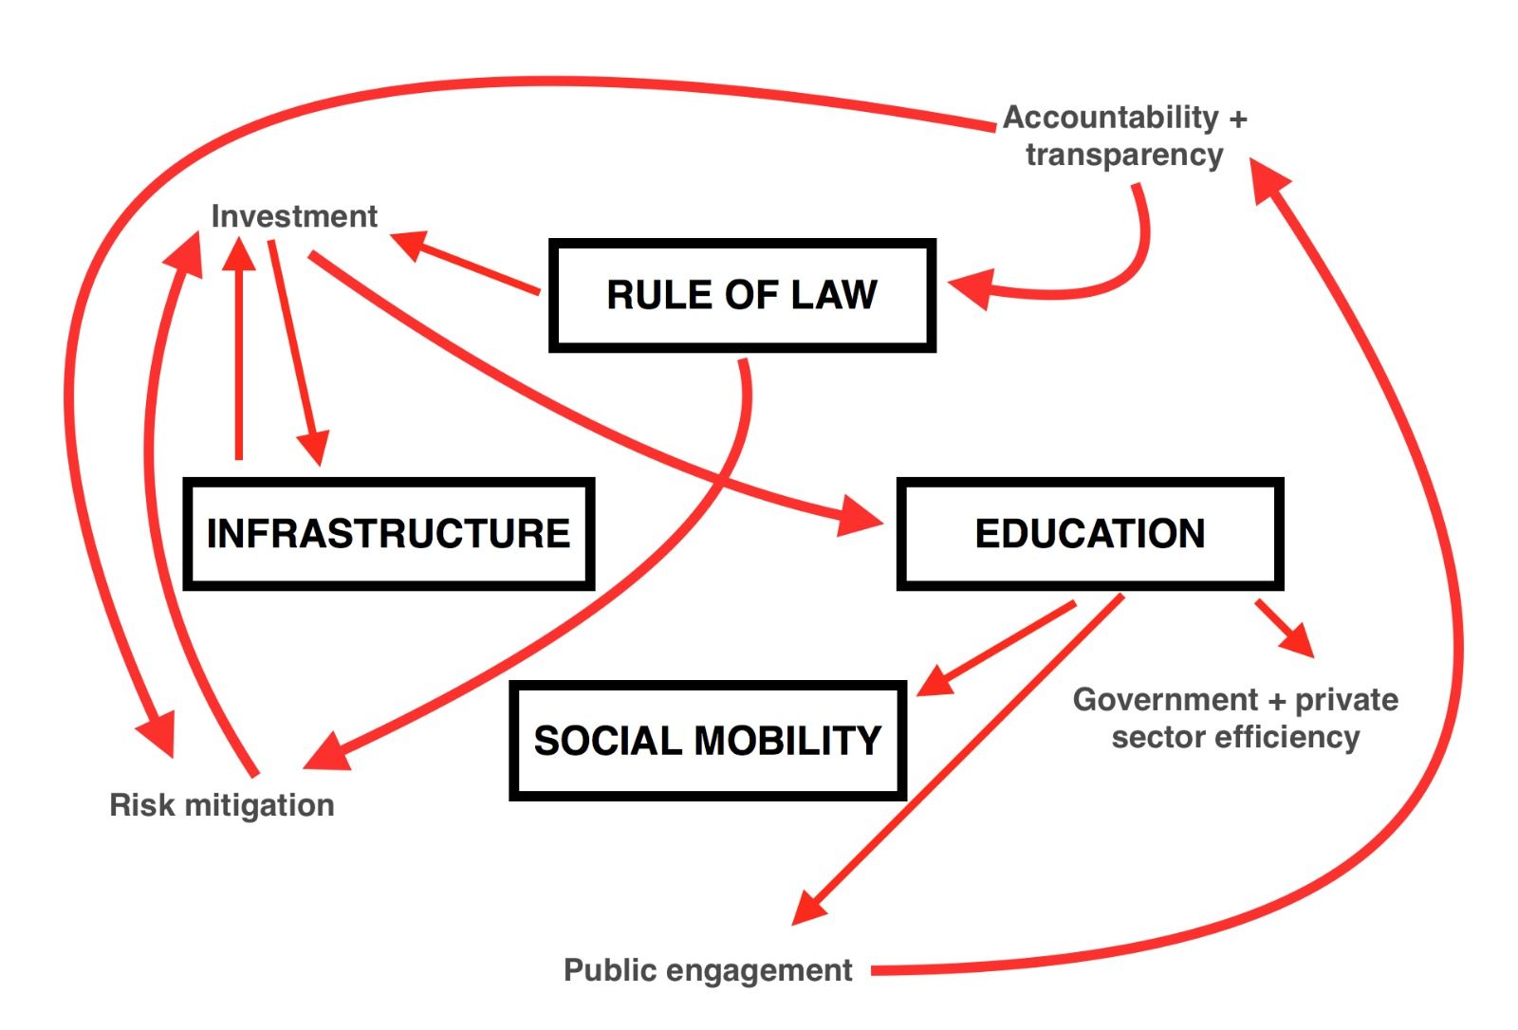

Slide 4
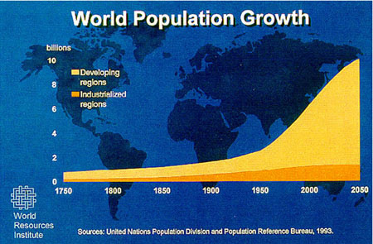

Slide 5
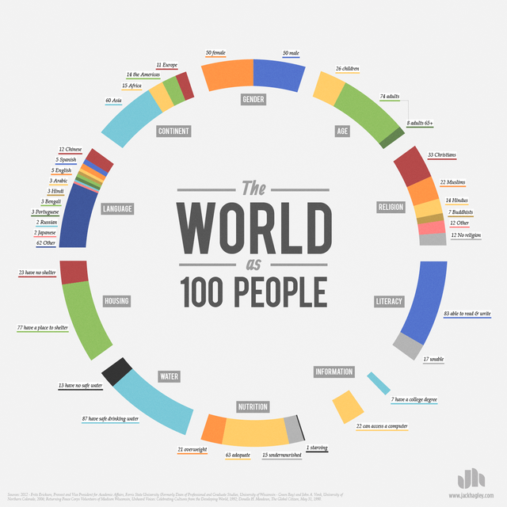

Slide 6
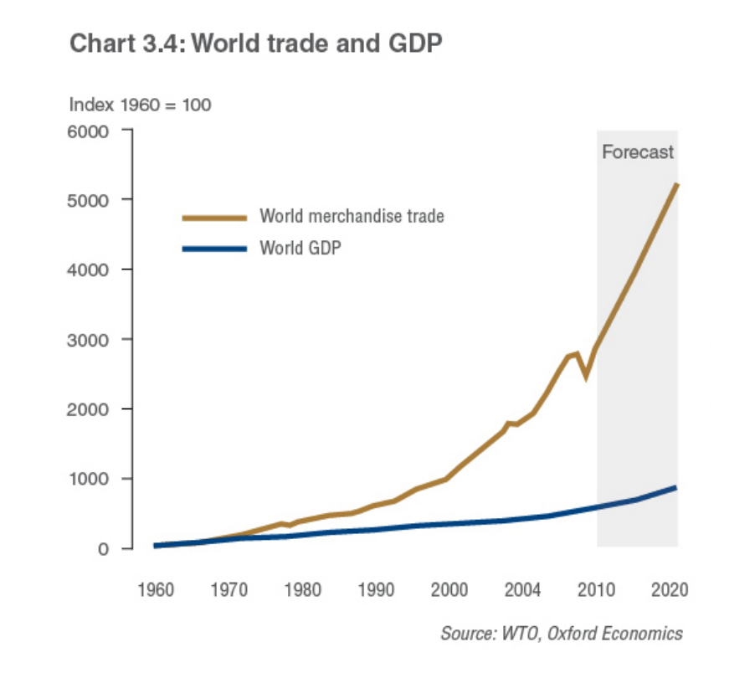

Slide 7
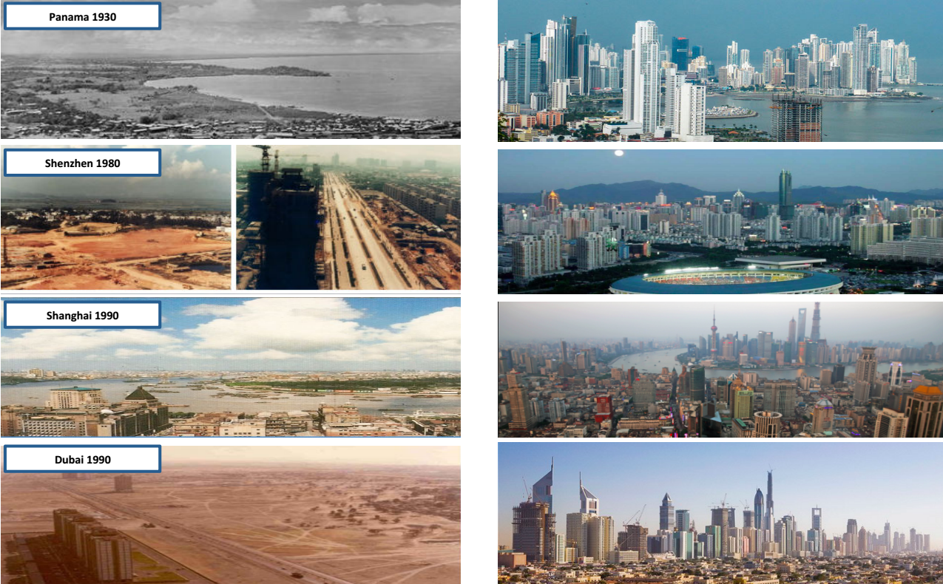
Web Urbanist, 2011

Slide 8


Slide 9
Social Mobility
Education
Infrastructure
Rule of Law
Notes:
Now, why are these 4 challenges global shifts in the economy and society

Slide 10
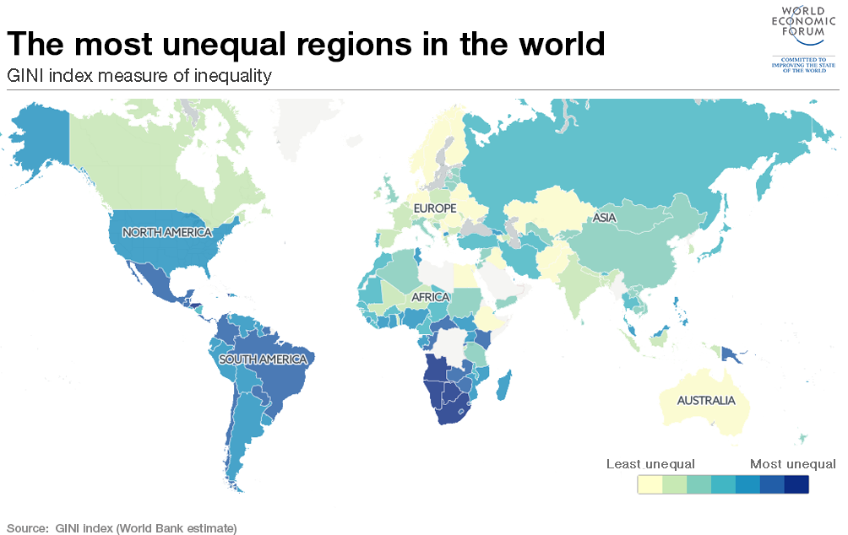
Notes:
Social mobility

Slide 11
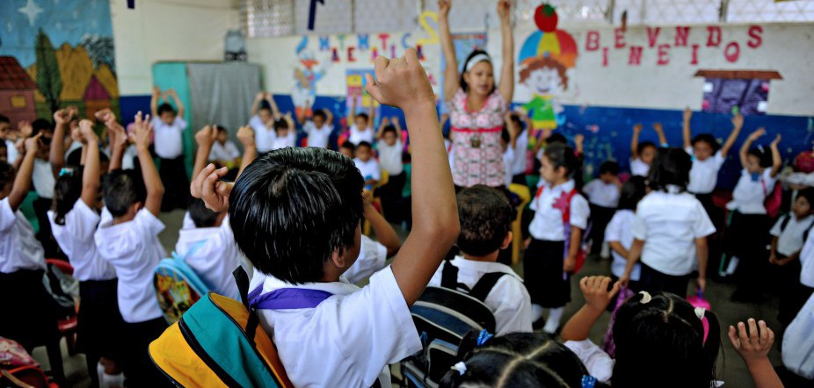
University of California; Berkeley, 2002.
Notes:
Education

Slide 12
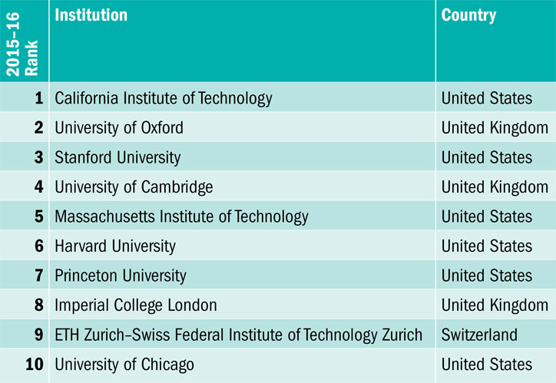
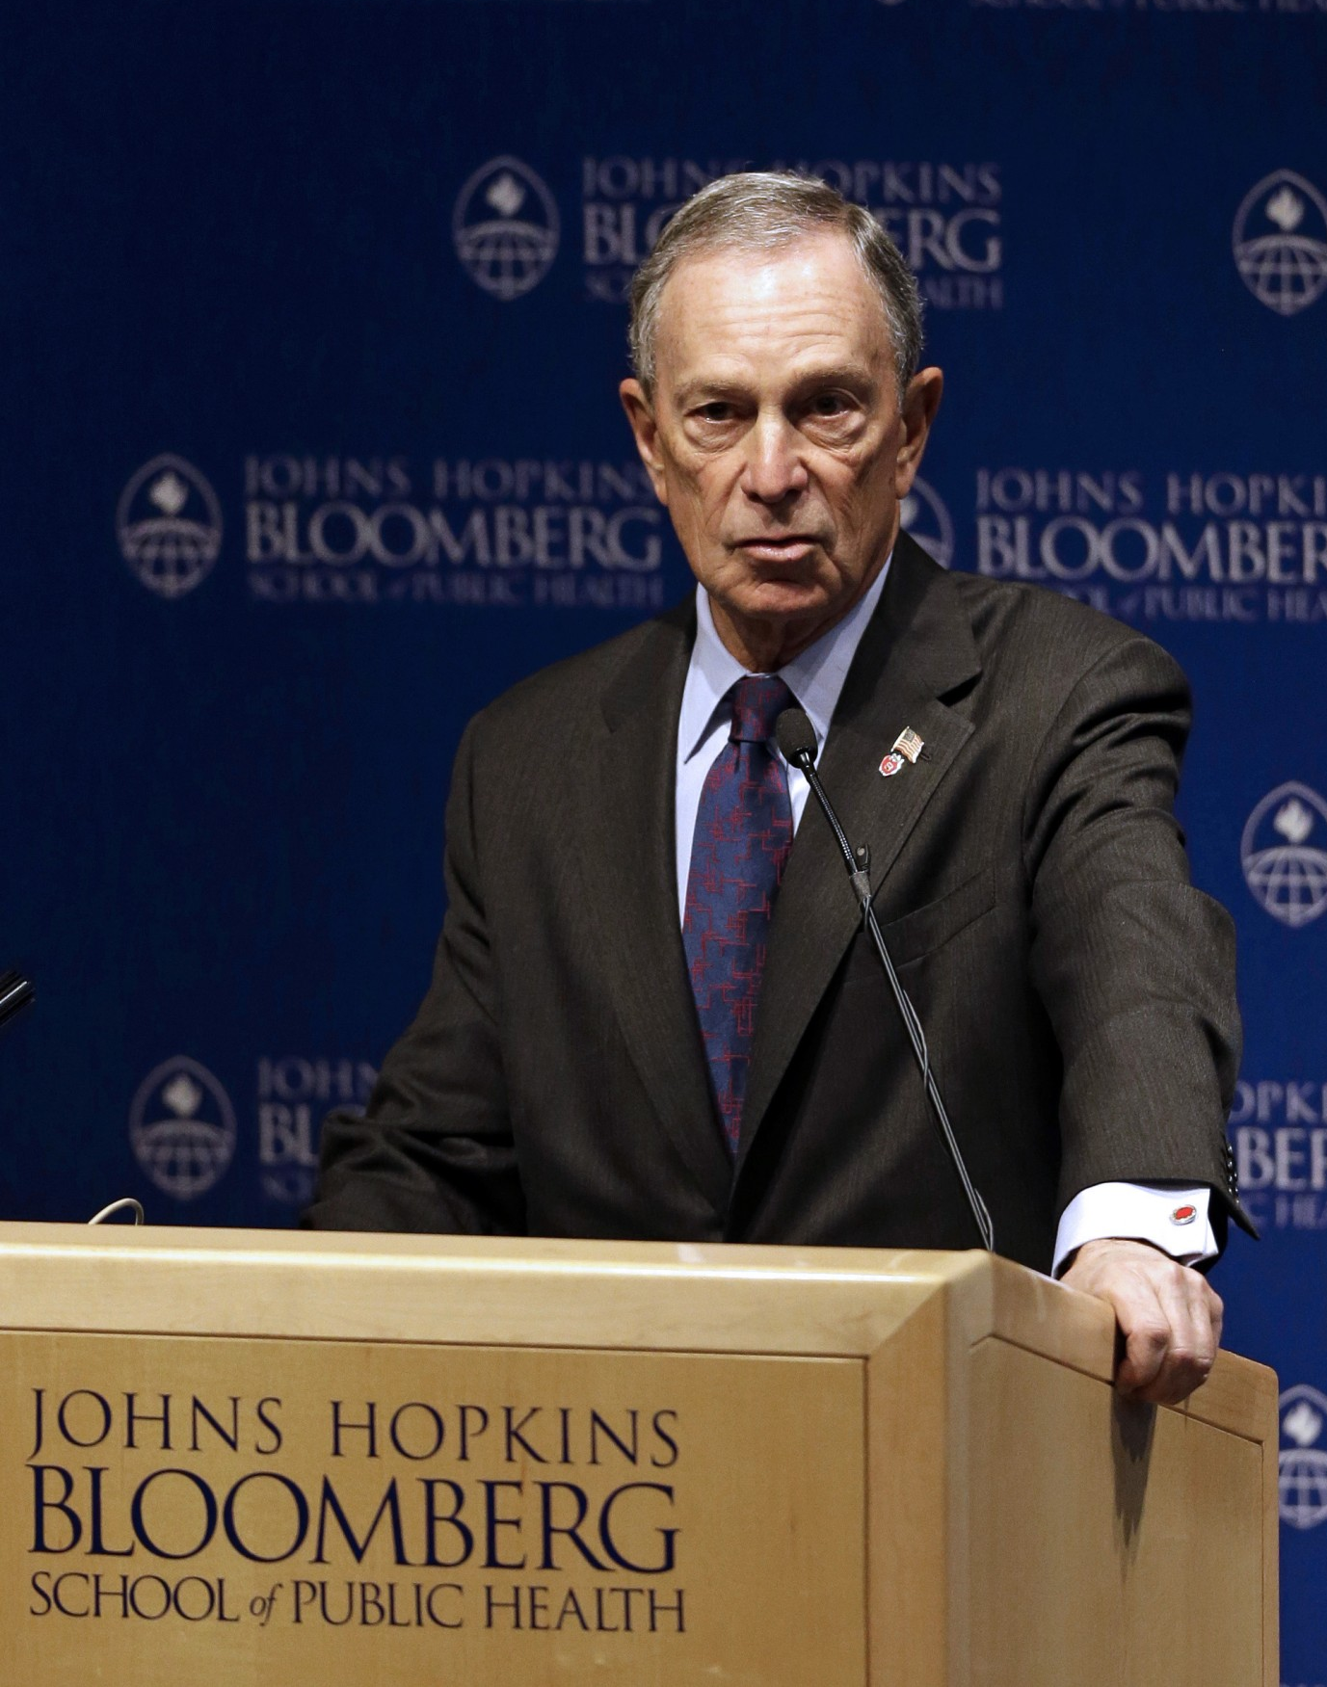
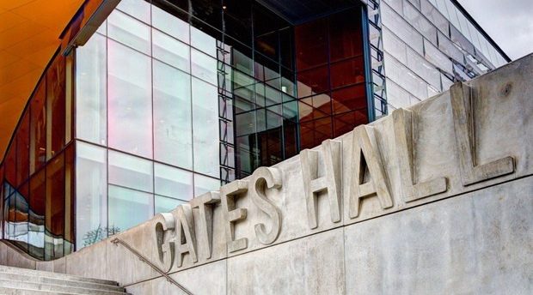
(Times Higher Education, Network World, Patrick Semansky/AP)

Slide 13
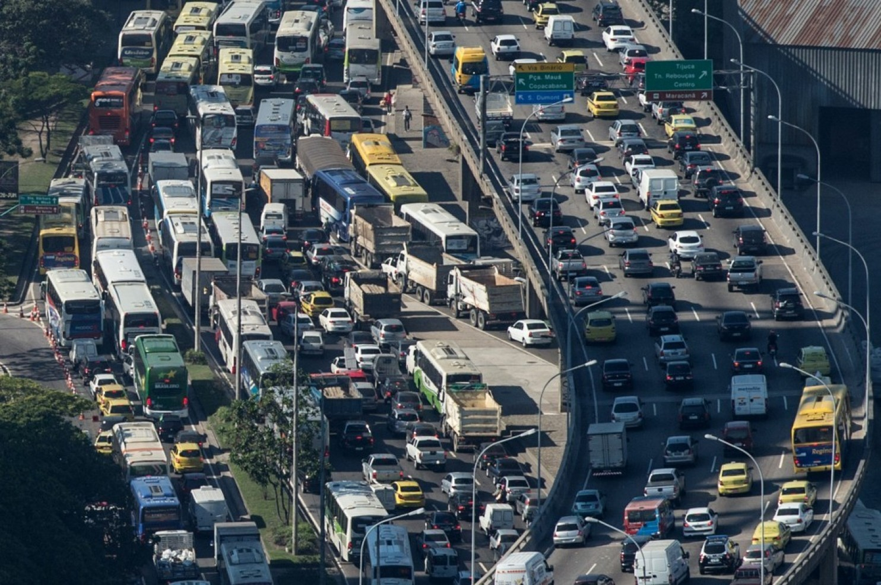
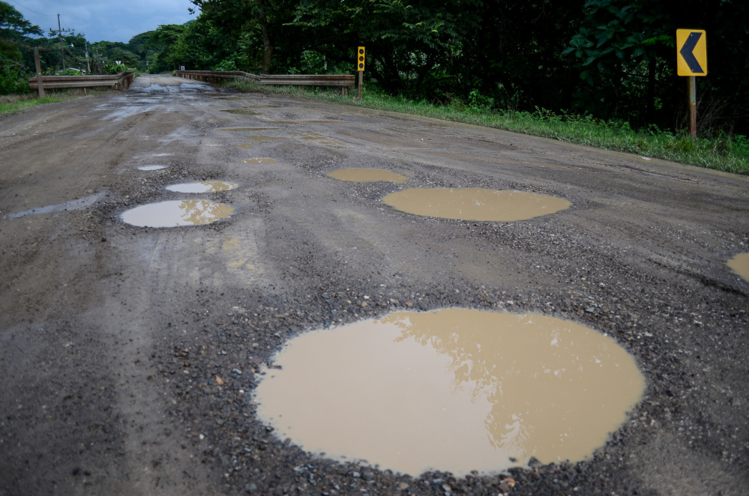
Rio de Janeiro, Brazil
Guanacaste, Costa Rica
(Yasuyoshi Chiba/AFP/Getty Images, The Tico Times)

Slide 14
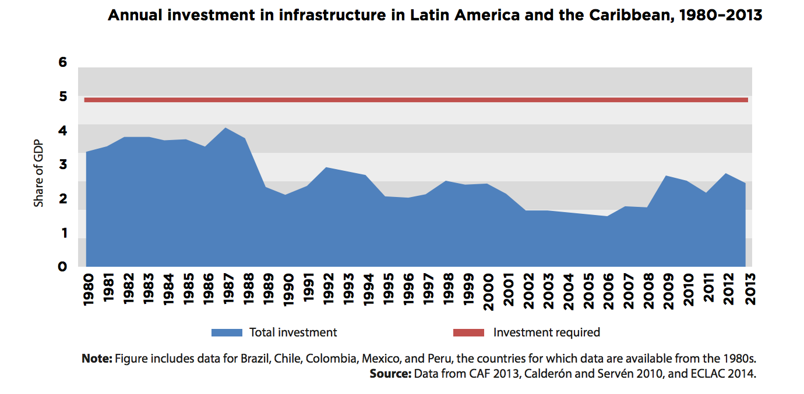

Slide 15
(Al Jazeera Americas)
Notes:
RULE OF LAW: asymmetry of information, corruption, zero transparency and accountability

Slide 16
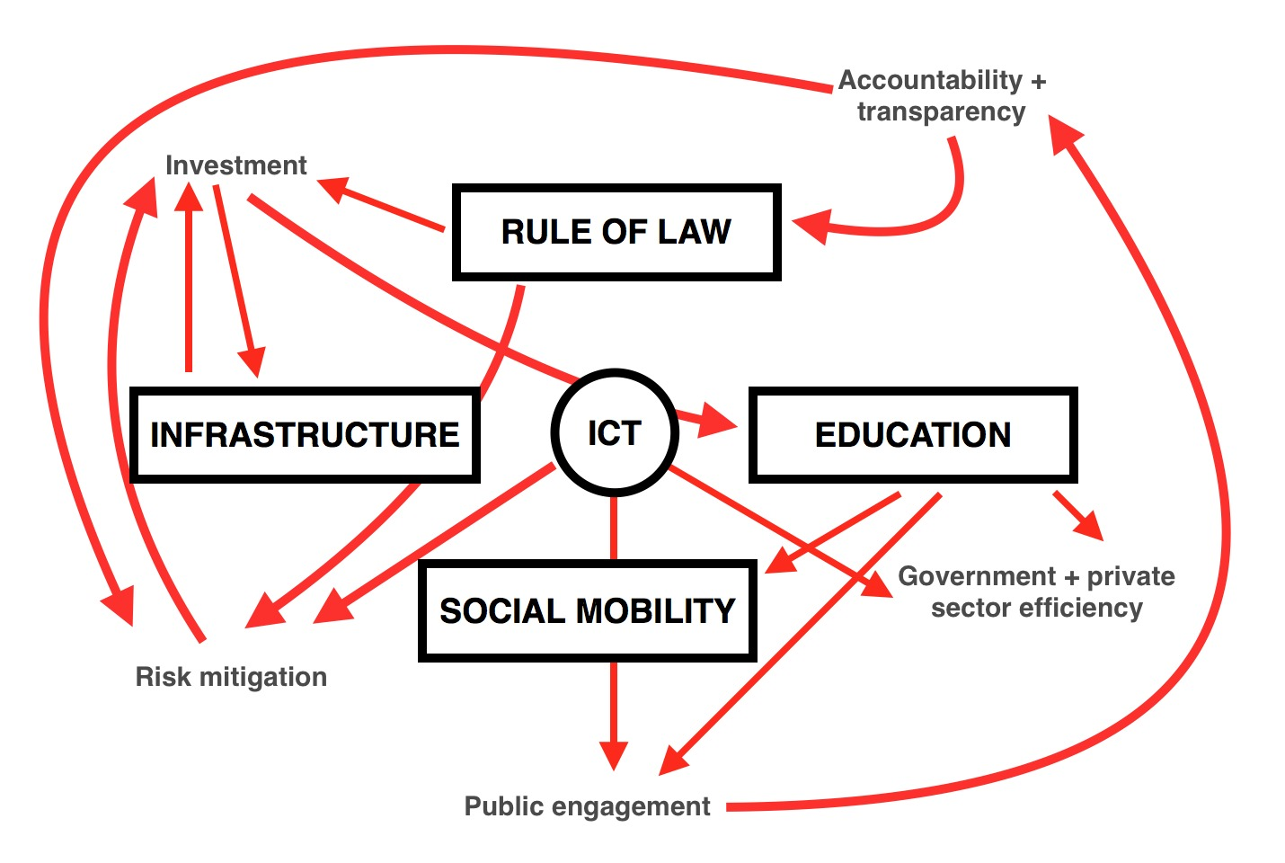

Slide 17

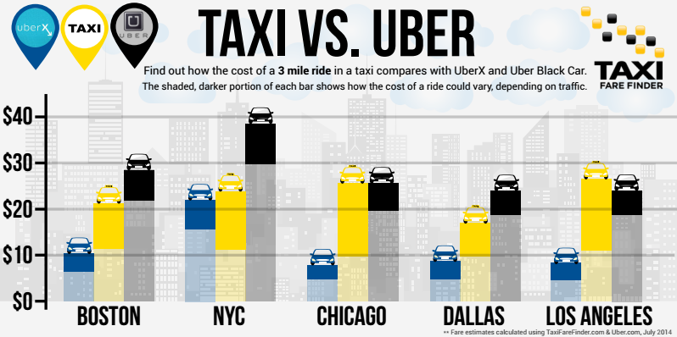
(Point me to the Plane)
Notes:
New Forms of Competition in a Collaborative Economy

Slide 18
Chile: Ciudadano Inteligente Foundation
Mexico: Compranet e-procurement
Colombia: e-government platform

Slide 19

A Look into the Future
Notes:
CONCLUDING REMARKS:

