Slide 1

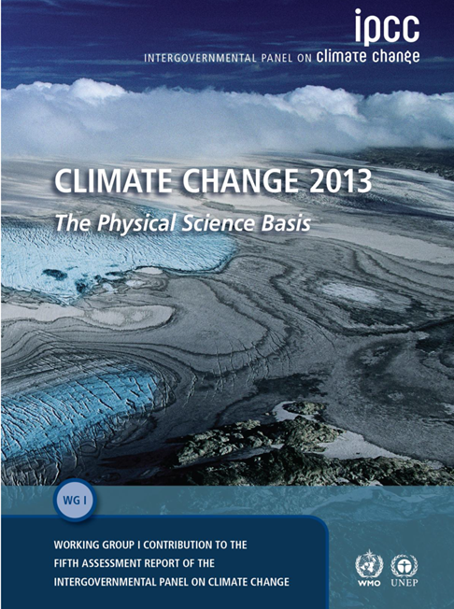
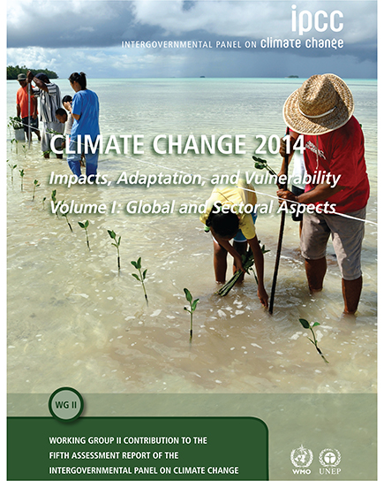
Audiência Pública
Discussão do Relatório do IPCC
Osvaldo Moraes – DEPPT/SEPED/MCTI
Thanks to C. Nobre
Thanks to J. Marengo

Slide 2

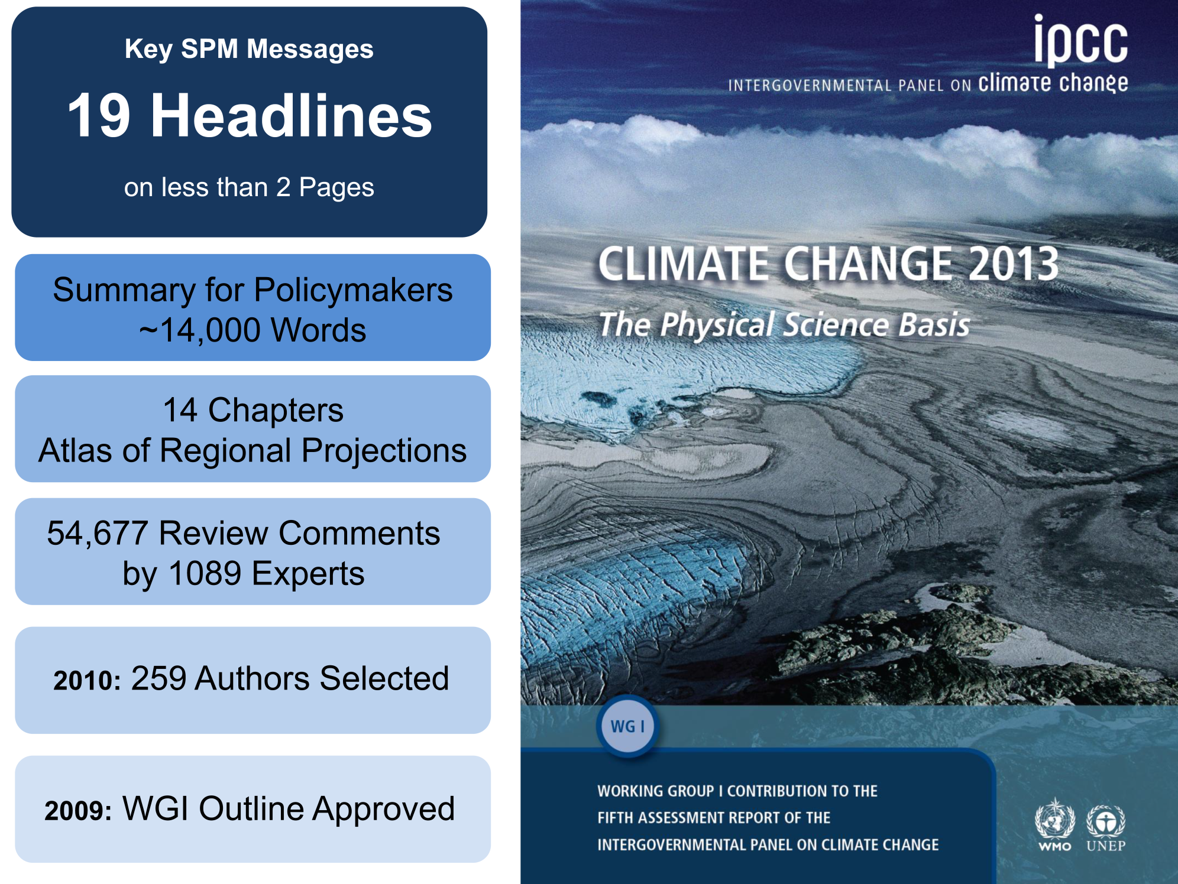
Ministry of Science, Technology and Innovation of Brazil
Secretariat of Policies and Programs of Research and Development - SEPED

Slide 3
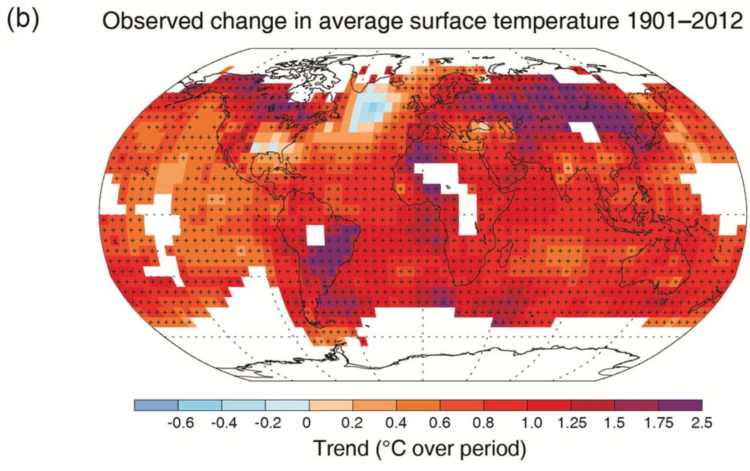

Ministry of Science, Technology and Innovation of Brazil
Secretariat of Policies and Programs of Research and Development - SEPED
B.1 Atmosphere
Warming in the climate system is unequivocal
(IPCC 2013, Fig. SPM.1b)
Figure SPM.1 (b) Map of the observed surface temperature change from 1901 to 2012 derived from temperature trends determined by linear regression from one dataset
Notes:
(b) Map of the observed surface temperature change from 1901 to 2012 derived from temperature trends determined by linear regression from one dataset (orange line in panel a). Trends have
been calculated where data availability permits a robust estimate (i.e., only for grid boxes with greater than 70% complete records and more than 20% data availability in the first and last 10% of the time period). Other areas are white. Grid boxes where the trend is significant at the 10% level are indicated by a + sign.

Slide 4
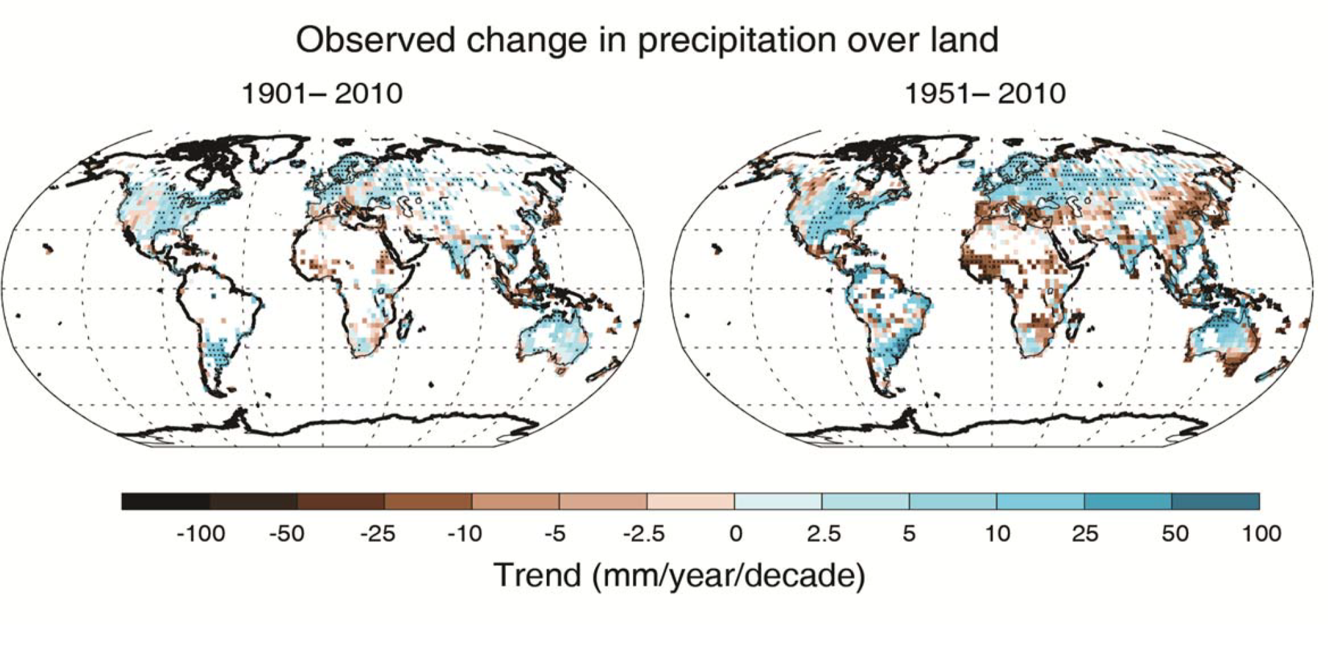
Ministry of Science, Technology and Innovation of Brazil
Secretariat of Policies and Programs of Research and Development - SEPED
B.1 Atmosphere
Figure SPM.2: Maps of observed precipitation change from 1901 to 2010 and from 1951 to 2010 (trends calculated using the same criteria as in Figure SPM.1b) from one data set
Notes:
Figure SPM.2: Maps of observed precipitation change from 1901 to 2010 and from 1951 to 2010 (trends calculated using the same criteria as in Figure SPM.1b) from one data set.

Slide 5
Ministry of Science, Technology and Innovation of Brazil
Secretariat of Policies and Programs of Research and Development - SEPED
D. Understanding the Climate System and its Recent Changes
D.1 Evaluation of Climate Models
D.2 Quantification of Climate System Responses

Slide 6
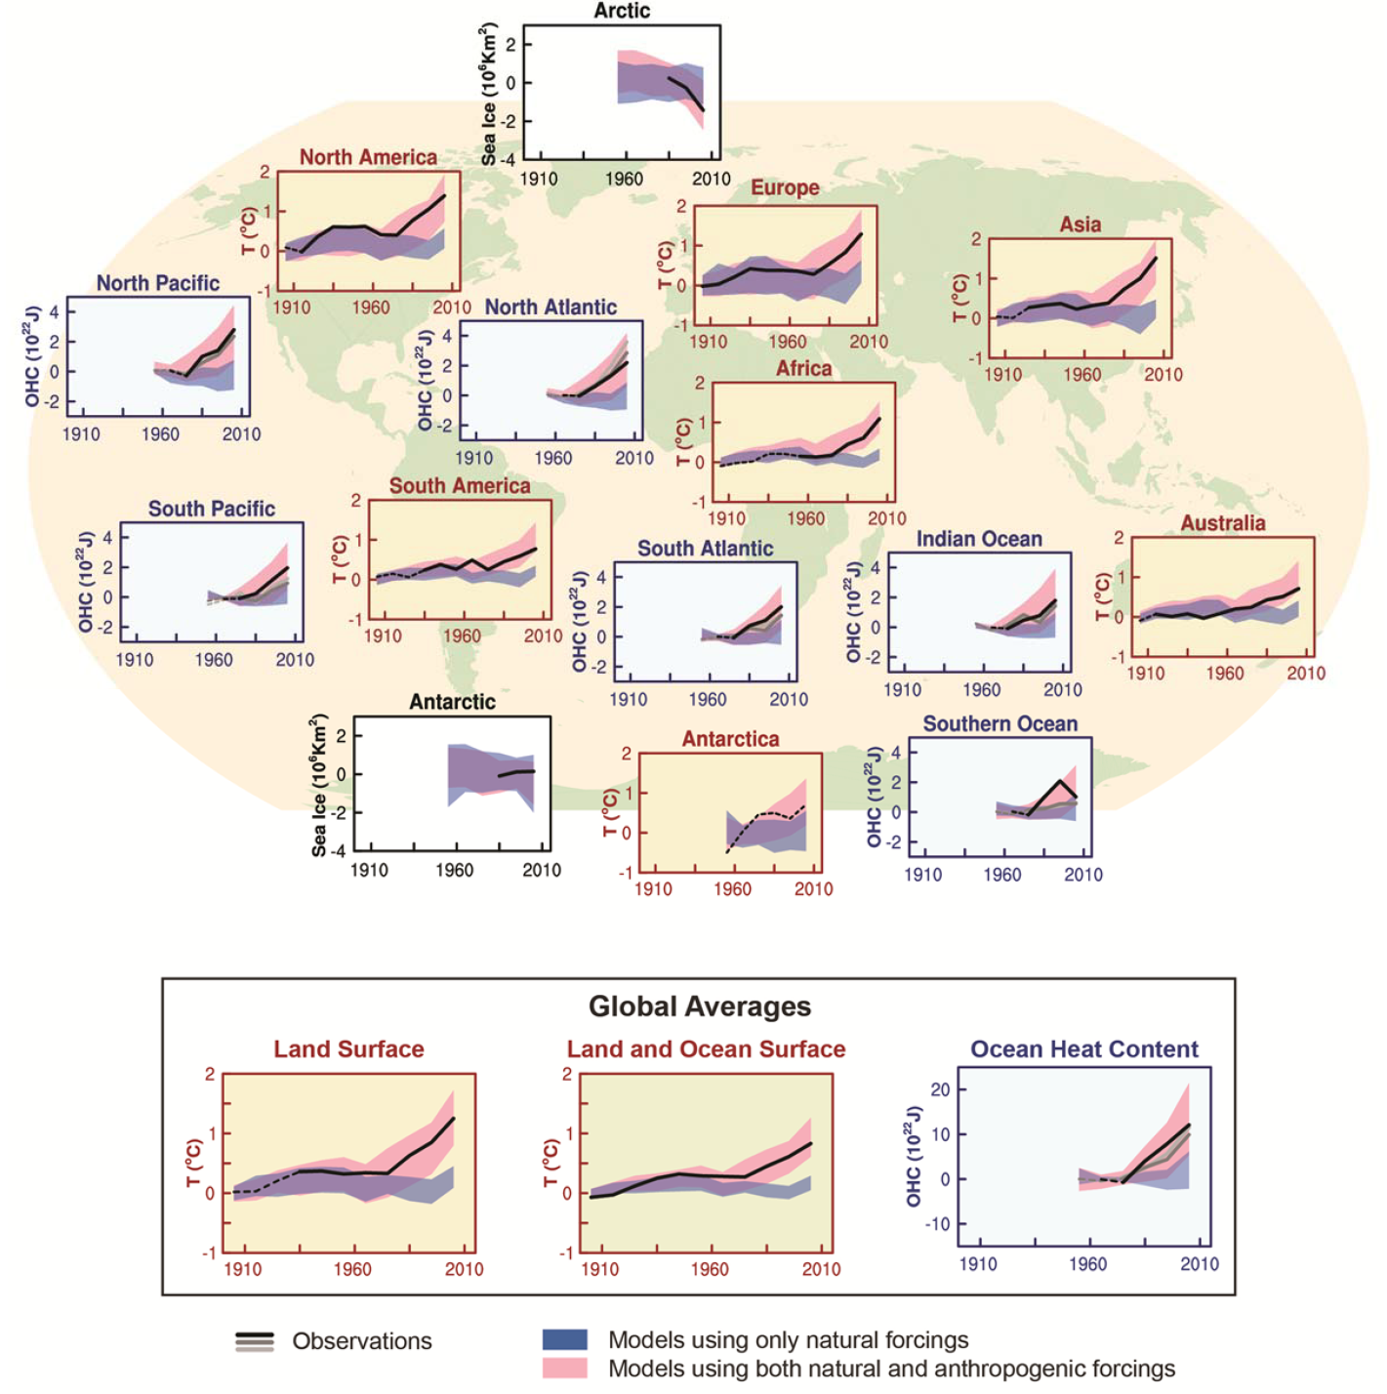
Ministry of Science, Technology and Innovation of Brazil
Secretariat of Policies and Programs of Research and Development - SEPED
D.3 Detection and Attribution of Climate Change
Figure SPM.6: Comparison of observed and simulated climate change based on three large-scale indicators in the atmosphere, the cryosphere and the ocean
Human influence on the climate system is clear
Notes:
Figure SPM.6: Comparison of observed and simulated climate change based on three large-scale indicators in the atmosphere, the cryosphere and the ocean: change in continental land surface air temperatures (yellow panels), Arctic and Antarctic September sea ice extent (white panels), and upper ocean heat content in the major ocean basins (blue panels). Global average changes are also given. Anomalies are given relative to 1880–1919 for surface temperatures, 1960–1980 for ocean heat content and 1979–1999 for sea ice. All time-series are decadal averages, plotted at the centre of the decade. For temperature panels, observations are dashed lines if the spatial coverage of areas being examined is below 50%. For ocean heat content and sea ice panels the solid line is where the coverage of data is good and higher in quality, and the dashed line is where the data coverage is only adequate, and thus, uncertainty is larger. Model results shown are Coupled Model Intercomparison Project Phase 5 (CMIP5) multi-model ensemble ranges, with shaded bands indicating the 5 to 95% confidence intervals.

Slide 7
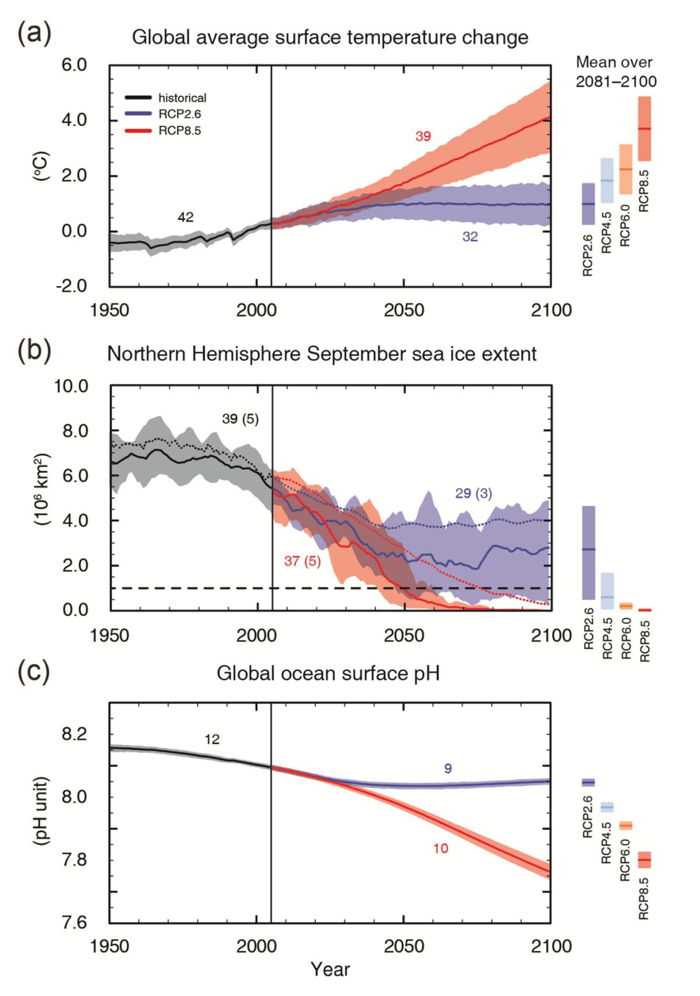
Ministry of Science, Technology and Innovation of Brazil
Secretariat of Policies and Programs of Research and Development - SEPED
CMIP5 - Coupled Model Intercomparison Project Phase 5
E. Future Global and Regional Climate Change
Figure SPM.7: CMIP5 multi-model simulated time series from 1950 to 2100 for :
change in global annual mean surface temperature relative to 1986–2005 (see Table SPM.2 for other reference periods),
Northern Hemisphere September sea ice extent (5 year running mean) and
global mean ocean surface pH. Time series of projections and a measure of uncertainty (shading) are shown for scenarios RCP2.6 (blue) and RCP8.5 (red). Black (grey shading) is the modelled historical evolution using historical reconstructed forcings.
The four RCPs, RCP2.6, RCP4.5, RCP6, and RCP8.5, are named after a possible range of radiative forcing values in the year 2100 relative to pre-industrial values (+2.6, +4.5, +6.0, and +8.5 W/m², respectively).
In simple terms, radiative forcing is "...the rate of energy change per unit area of the globe as measured at the top of the atmosphere."
Notes:
Figure SPM.7: CMIP5 multi-model simulated time series from 1950 to 2100 for
change in global annual mean surface temperature relative to 1986–2005 (see Table SPM.2 for other reference periods),
Northern Hemisphere September sea ice extent (5 year running mean) and
global mean ocean surface pH. Time series of projections and a measure of uncertainty (shading) are shown for scenarios RCP2.6 (blue) and RCP8.5 (red). Black (grey shading) is the modelled historical evolution using historical reconstructed forcings.
The mean and associated uncertainties averaged over 2081−2100 are given for all RCP scenarios as colored vertical bars. The numbers of CMIP5 models used to calculate the multi-model mean is indicated. For sea ice extent (b), the projected mean and uncertainty (minimum-maximum range) of the subset of models that most closely reproduce the climatological mean state and 1979‒2012 trend of the Arctic sea ice is given (number of models given in brackets). For completeness, the CMIP5 multi-model mean is also indicated with dotted lines. The dashed line represents nearly ice-free conditions (i.e., when sea ice extent is less than 106 km2 for at least five consecutive years).

Slide 8
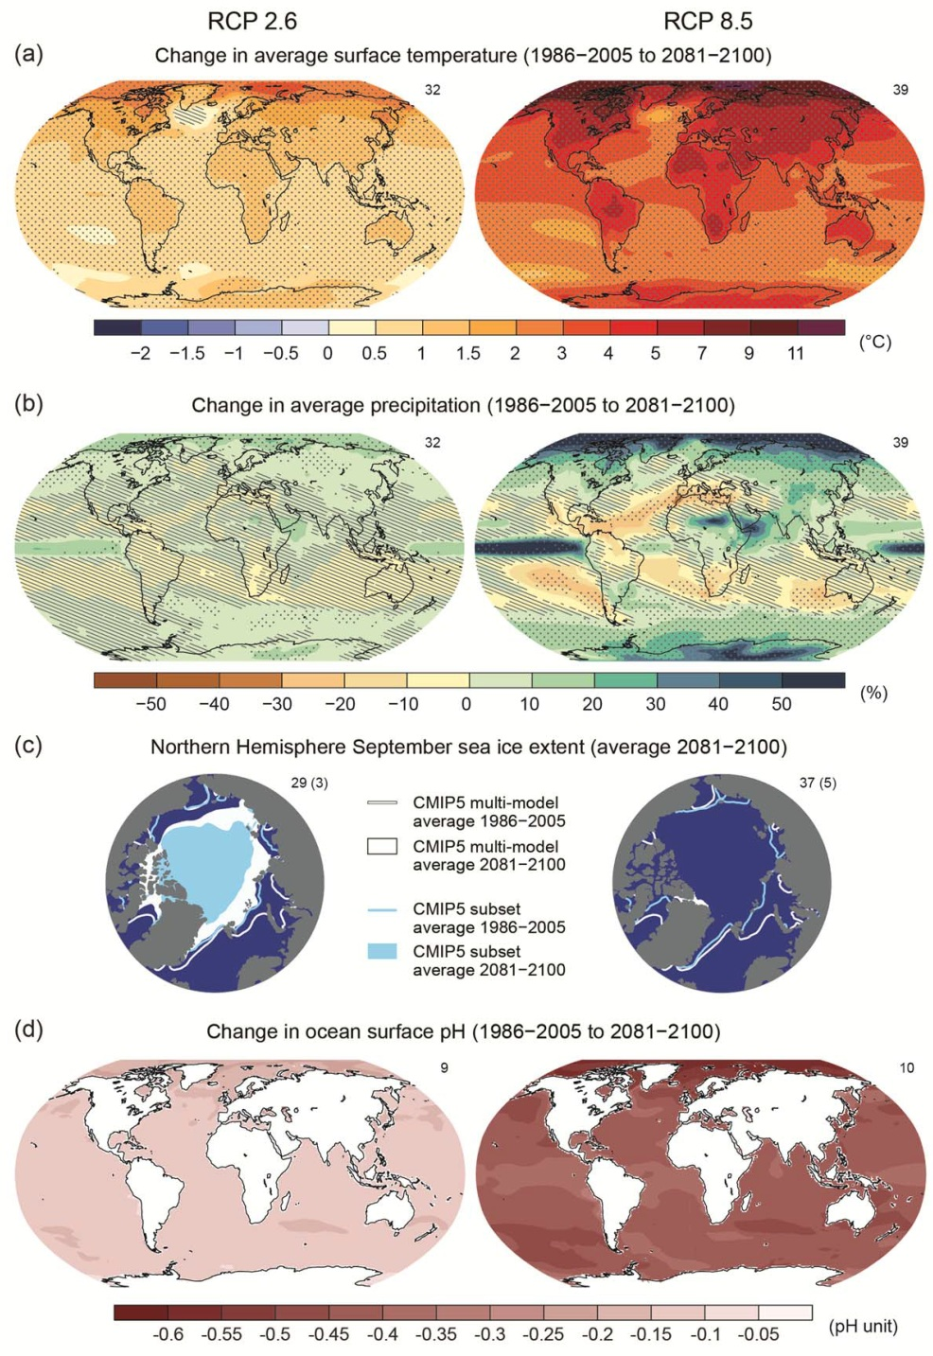
Ministry of Science, Technology and Innovation of Brazil
Secretariat of Policies and Programs of Research and Development - SEPED
E. Future Global and Regional Climate Change
Figure SPM.8: Maps of CMIP5 multi-model mean results for the scenarios RCP2.6 and RCP8.5 in 2081–2100 of
(a) annual mean surface temperature change,
(b) average percent change in annual mean precipitation,
(c) Northern Hemisphere September sea ice extent and
(d) change in ocean surface pH.
Notes:
Figure SPM.8: Maps of CMIP5 multi-model mean results for the scenarios RCP2.6 and RCP8.5 in 2081–2100 of
(a) annual mean surface temperature change,
(b) average percent change in annual mean precipitation,
(c) Northern Hemisphere September sea ice extent and
(d) change in ocean surface pH.
Changes in panels (a), (b) and (d) are shown relative to 1986–2005. The number of CMIP5 models used to calculate the multi-model mean is indicated in the upper right corner of each panel. For panels (a) and (b), hatching indicates regions where the multi-model mean is small compared to internal variability (i.e., less than one standard deviation of internal variability in 20-year means). Stippling indicates regions where the multi-model mean is large compared to internal variability (i.e., greater than two standard deviations of internal variability in 20-year means) and where 90% of models agree on the sign of change (see Box 12.1).
In panel (c), the lines are the modelled means for 1986−2005; the filled areas are for the end of the century.
The CMIP5 multi-model mean is given in white colour, the projected mean sea ice extent of a subset of models (number of models given in brackets) that most closely reproduce the climatological mean state and
1979‒2012 trend of the Arctic sea ice extent is given in light blue colour.

Slide 9
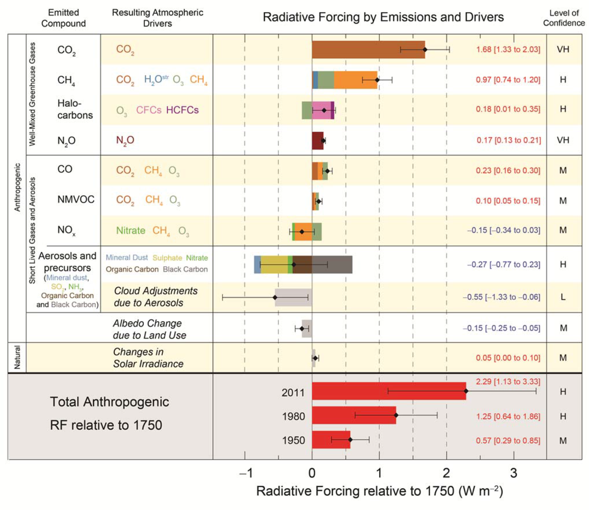
Ministry of Science, Technology and Innovation of Brazil
Secretariat of Policies and Programs of Research and Development - SEPED
C. Drivers of Climate Change
Figure SPM.5: Radiative forcing estimates in 2011 relative to 1750 and aggregated uncertainties for the main drivers of climate change.
Notes:
Figure SPM.5: Radiative forcing estimates in 2011 relative to 1750 and aggregated uncertainties for the main drivers of climate change. Values are global average radiative forcing (RF15) partitioned according to the emitted compounds or processes that result in a combination of drivers. The best estimates of the net radiative forcing are shown as black diamonds with corresponding uncertainty intervals; the numerical values are provided on the right of the figure, together with the confidence level in the net forcing (VH – very high, H – high, M – medium, L – low, VL – very low). Albedo forcing due to black carbon on snow and ice is included in the black carbon aerosol bar. Small forcings due to contrails (0.05 W m–2, including contrail induced cirrus), and HFCs, PFCs and SF6 (total 0.03 W m–2) are not shown. Concentration-based RFs for gases can be obtained by summing the like-coloured bars. Volcanic forcing is not included as its episodic nature makes is difficult to compare to other forcing mechanisms. Total anthropogenic radiative forcing is provided for three
different years relative to 1750.

Slide 10
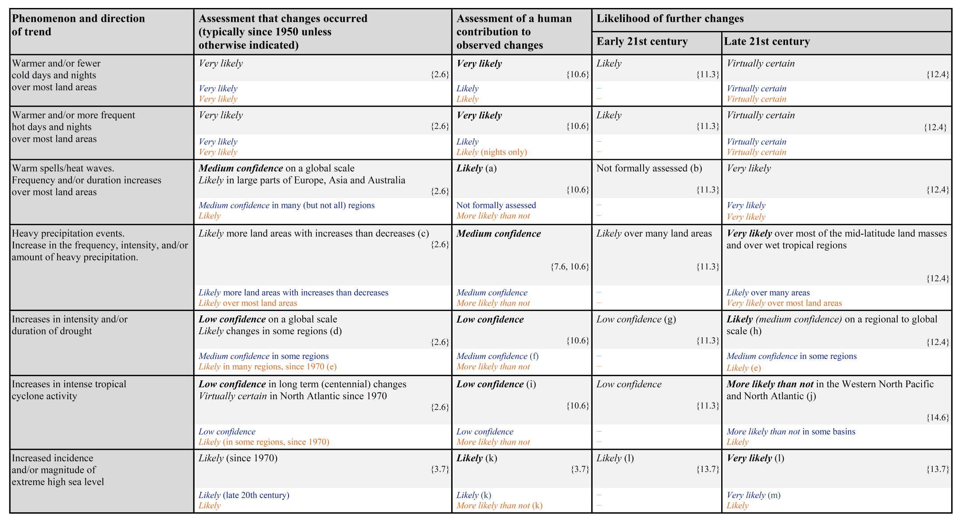
Ministry of Science, Technology and Innovation of Brazil
Secretariat of Policies and Programs of Research and Development - SEPED
Table SPM.1: Extreme weather and climate events: Global-scale assessment of recent observed changes, human contribution to the changes, and projected further changes for the early (2016–2035) and late (2081–2100) 21st century
Notes:
Table SPM.1: Extreme weather and climate events: Global-scale assessment of recent observed changes, human contribution to the changes, and projected further changes for the early (2016–2035) and late (2081–
2100) 21st century. Bold indicates where the AR5 (black) provides a revised* global-scale assessment from the SREX (blue) or AR4 (red). Projections for early 21st century were not provided in previous assessment
reports. Projections in the AR5 are relative to the reference period of 1986–2005, and use the new Representative Concentration Pathway (RCP) scenarios (see Box SPM.1) unless otherwise specified. See the Glossary for definitions of extreme weather and climate events.

Slide 11
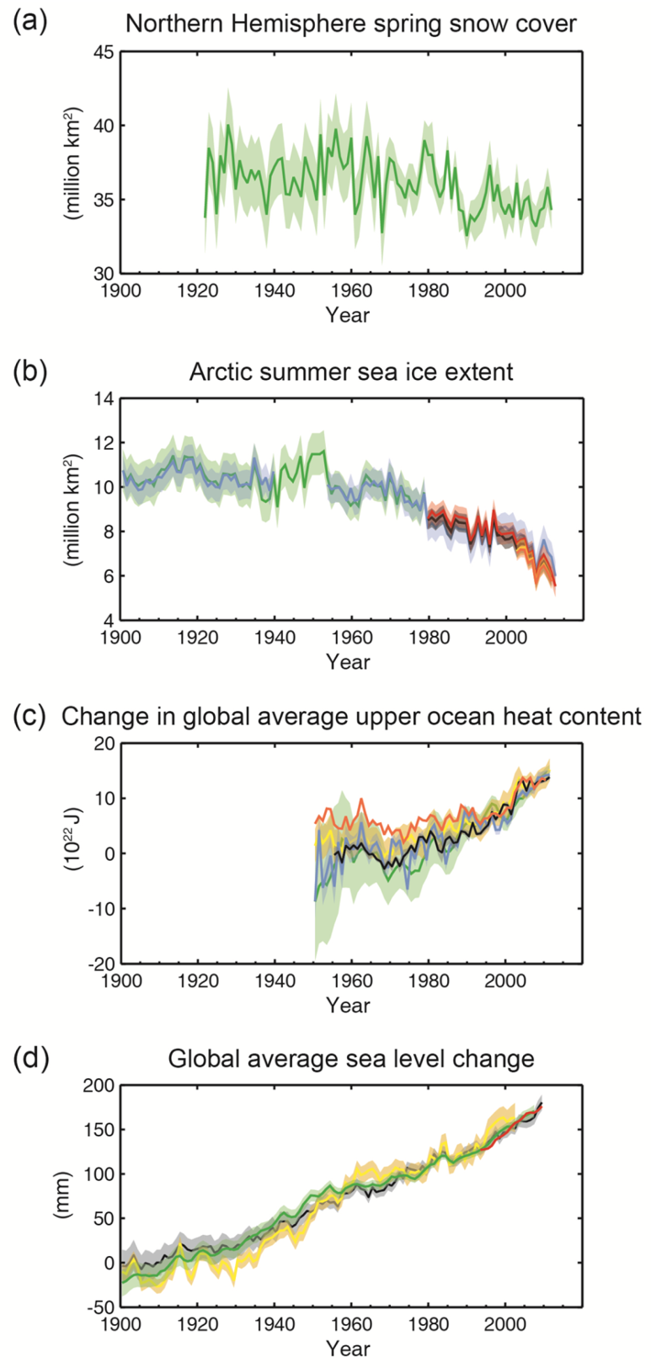
Ministry of Science, Technology and Innovation of Brazil
Secretariat of Policies and Programs of Research and Development - SEPED
B.3 Cryosphere
Figure SPM.3: Multiple observed indicators of a changing global climate:
Extent of Northern Hemisphere March-April (spring) average snow cover,
Extent of Arctic July-August-September (summer) average sea ice,
(c) change in global mean upper ocean (0–700 m) heat content aligned to 2006−2010, and relative to the mean of all datasets for 1971,
(d) global mean sea level relative to the 1900–1905 mean of the longest running dataset, and with all datasets aligned to have the same value in 1993, the first year of satellite altimetry data.
Notes:
Figure SPM.3: Multiple observed indicators of a changing global climate: (a) Extent of Northern Hemisphere March-April (spring) average snow cover, (b) Extent of Arctic July-August-September (summer) average sea
ice, (c) change in global mean upper ocean (0–700 m) heat content aligned to 2006−2010, and relative to the mean of all datasets for 1971, (d) global mean sea level relative to the 1900–1905 mean of the longest
running dataset, and with all datasets aligned to have the same value in 1993, the first year of satellite altimetry data. All time-series (coloured lines indicating different data sets) show annual values, and where assessed, uncertainties are indicated by coloured shading.

Slide 12
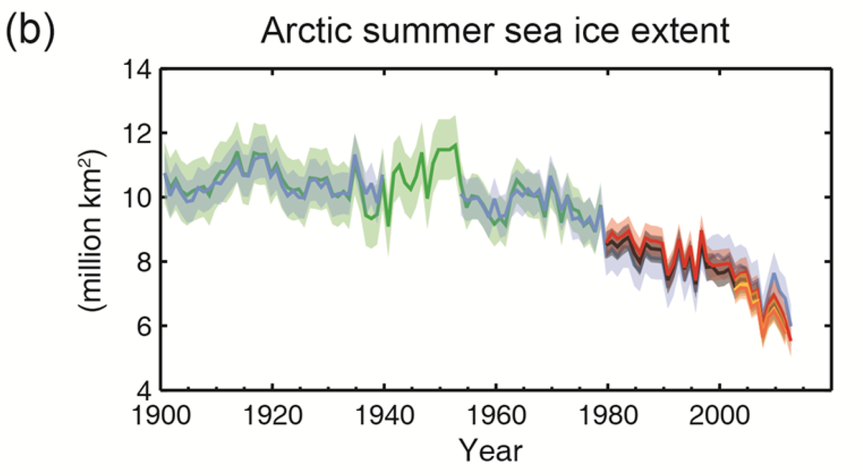
Ministry of Science, Technology and Innovation of Brazil
Secretariat of Policies and Programs of Research and Development - SEPED
B.3 Cryosphere
Figure SPM.3
Notes:
Figure SPM.3: Multiple observed indicators of a changing global climate: (a) Extent of Northern Hemisphere March-April (spring) average snow cover, (b) Extent of Arctic July-August-September (summer) average sea
ice, (c) change in global mean upper ocean (0–700 m) heat content aligned to 2006−2010, and relative to the mean of all datasets for 1971, (d) global mean sea level relative to the 1900–1905 mean of the longest
running dataset, and with all datasets aligned to have the same value in 1993, the first year of satellite altimetry data. All time-series (coloured lines indicating different data sets) show annual values, and where assessed, uncertainties are indicated by coloured shading.

Slide 13
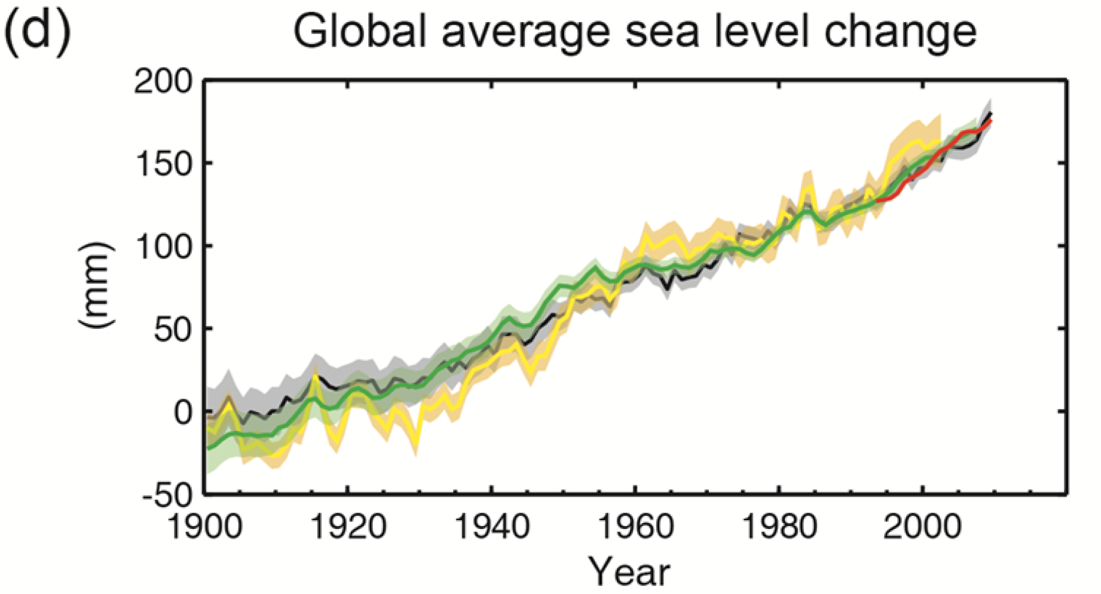
Ministry of Science, Technology and Innovation of Brazil
Secretariat of Policies and Programs of Research and Development - SEPED
B.3 Cryosphere
Figure SPM.3
Notes:
Figure SPM.3: Multiple observed indicators of a changing global climate: (a) Extent of Northern Hemisphere March-April (spring) average snow cover, (b) Extent of Arctic July-August-September (summer) average sea
ice, (c) change in global mean upper ocean (0–700 m) heat content aligned to 2006−2010, and relative to the mean of all datasets for 1971, (d) global mean sea level relative to the 1900–1905 mean of the longest
running dataset, and with all datasets aligned to have the same value in 1993, the first year of satellite altimetry data. All time-series (coloured lines indicating different data sets) show annual values, and where assessed, uncertainties are indicated by coloured shading.

Slide 14
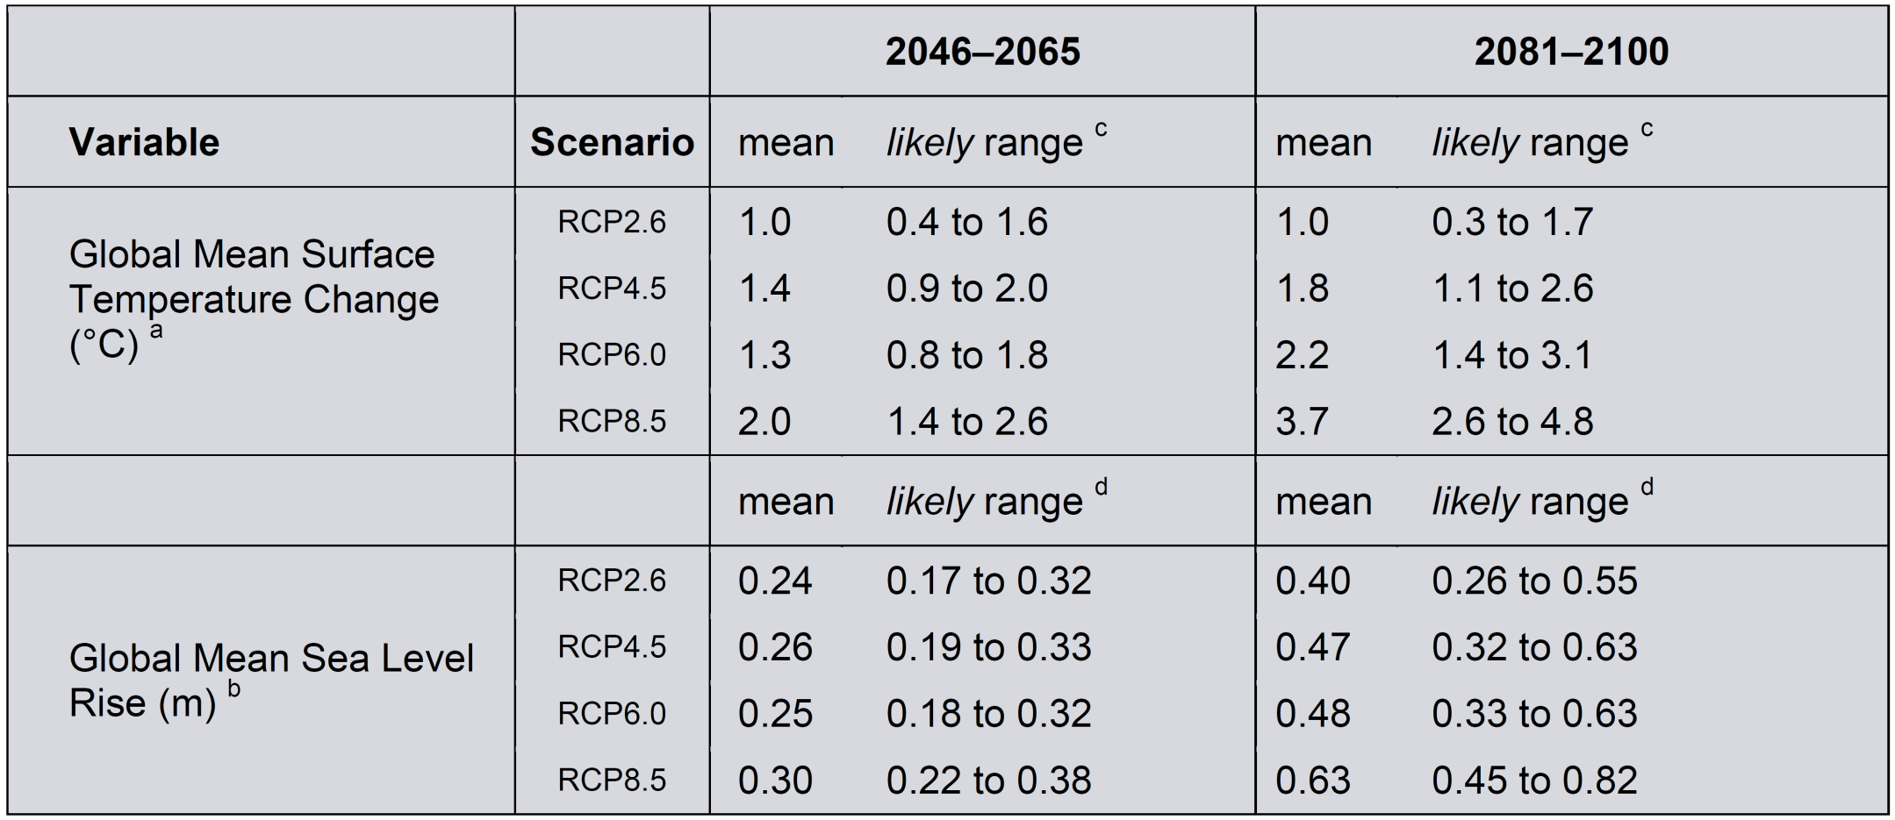
Ministry of Science, Technology and Innovation of Brazil
Secretariat of Policies and Programs of Research and Development - SEPED
E. Future Global and Regional Climate Change
Table SPM.2: Projected change in global mean surface air temperature and global mean sea level rise for the mid- and late 21st century relative to the reference period of 1986–2005.
Notes:
Table SPM.2: Projected change in global mean surface air temperature and global mean sea level rise for the mid- and late 21st century relative to the reference period of 1986–2005.

Slide 15
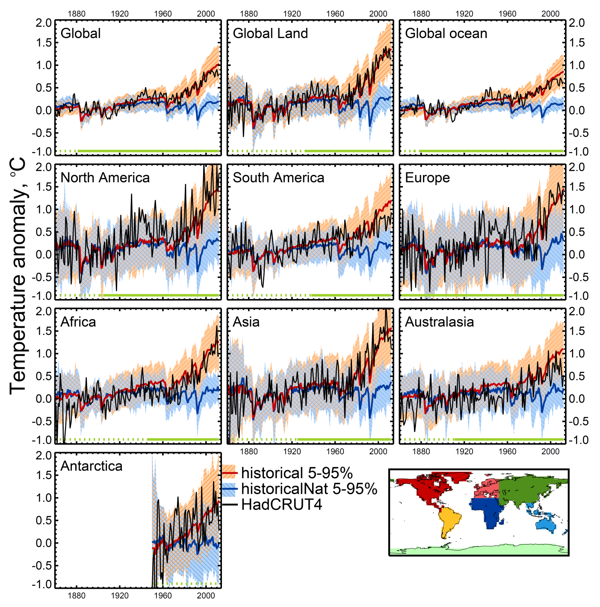
Ministry of Science, Technology and Innovation of Brazil
Secretariat of Policies and Programs of Research and Development - SEPED
Figure 10.7: Global, land, ocean and continental annual mean temperatures for CMIP3 and CMIP5 historical (red) and historical Nat (blue) simulations (multi-model means shown as thick lines, and 5–95% ranges shown as thin light lines) and for HadCRUT4 (black).
Notes:
Figure 10.7: Global, land, ocean and continental annual mean temperatures for CMIP3 and CMIP5 historical (red) and historical Nat (blue) simulations (multi-model means shown as thick lines, and 5–95% ranges shown as thin light lines) and for HadCRUT4 (black). Mean temperatures are shown for Antarctica and six continental regions formed by combining the sub-continental scale regions defined by Seneviratne et al. (2012). Temperatures are shown with respect to 1880–1919 for all regions apart from Antarctica where temperatures are shown with respect to 1950–2010. Adapted from Jones et al. (2013 ).

Slide 16
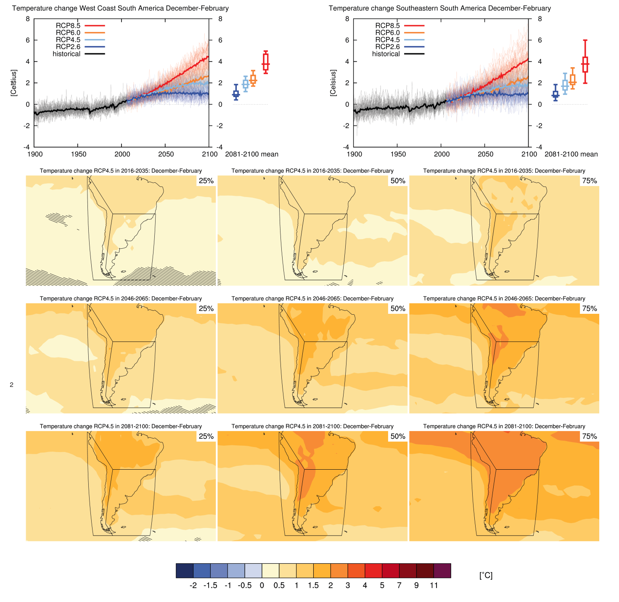
Ministry of Science, Technology and Innovation of Brazil
Secretariat of Policies and Programs of Research and Development - SEPED
Climate Change in South America
Figure AI.32: Top 3 left: time series of temperature change relative to 1986–2005 averaged over land grid points in the West Coast of South America
in December–February.
Notes:
Figure AI.32: Top 3 left: time series of temperature change relative to 1986–2005 averaged over land grid points in theWest Coast of South America (79.7_W,1.2_S; 66.4_W,20_S; 72.1_W,50_S; 67.3_W56.7_S; 82.0_W 56.7_S; 82.2_W,0.5_N) in December–February. Top right: same for land grid points in Southeastern South America (39.4_W,20_S; 39.4_W,56.6_S; 67.3_W,56.7_S; 72.1_W,50_S; 66_W,20_S). Thin lines denote one en7 semble member per model, thick lines the CMIP5 multi-model mean. On the right-hand side the 5th, 25th, 50th (median), 75th and 95th percentiles of the distribution of 20-yr mean changes are given for 2081–2100 in the four RCP scenarios.
Below: maps of temperature changes in 2016–2035, 2046–2065 and 2081–2100 with respect to 1986–2005 in the RCP4.5 scenario. For each point, the 25th, 50th and 75th percentile of the distribution of the CMIP5 ensemble are shown, this includes both natural variability and inter-model spread. Hatching denotes areas where the 20-yr mean differences of the percentiles are less than the standard deviation of model-estimated present-day natural variability of 20-yr mean differences.

Slide 17
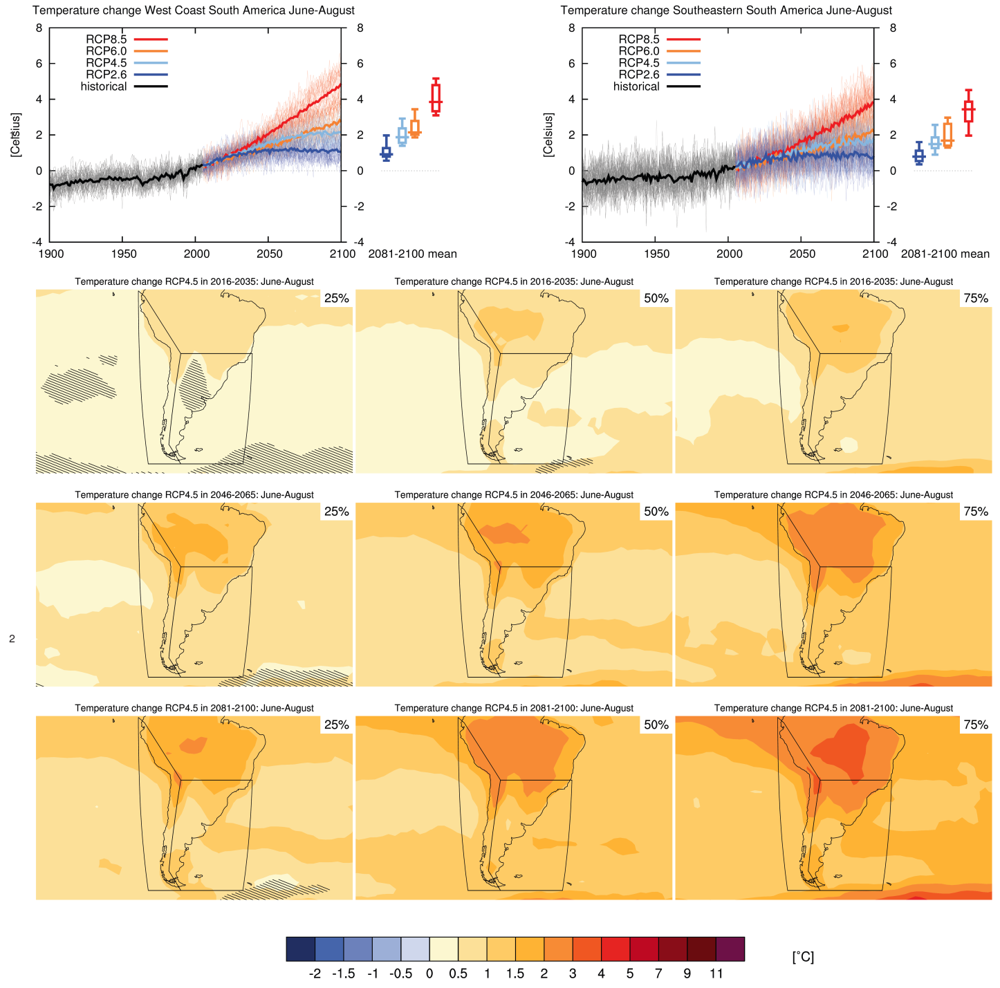
Ministry of Science, Technology and Innovation of Brazil
Secretariat of Policies and Programs of Research and Development - SEPED
Climate Change in South America
Figure AI.33: Top 3 left: time series of temperature change relative to 1986–2005 averaged over land grid 4 points in theWest Coast of South America in June–August.
Notes:
Figure AI.33: Top 3 left: time series of temperature change relative to 1986–2005 averaged over land grid 4 points in theWest Coast of South America (79.7W,1.2S; 66.4W,20S; 72.1W,50S; 67.3W56.7S; 82.0W 56.7S; 82.2W,0.5N) in June–August. Top right: same for land grid points in Southeastern South America (39.4W,20S; 39.4W,56.6S; 67.3W,56.7S; 72.1W,50S; 66W,20S). Thin lines denote one ensemble member per model, thick lines the CMIP5 multi-model mean. On the right-hand side the 5th, 25th, 50th (median), 75th and 95th percentiles of the distribution of 20-yr mean changes are given for 2081–2100 in the four RCP scenarios.
Below: maps of temperature changes in 2016–2035, 2046–2065 and 2081–2100 with respect to 1986–2005 in the RCP4.5 scenario. For each point, the 25th, 50th and 75th percentile of the distribution of the CMIP5 ensemble are shown, this includes both natural variability and inter-model spread. Hatching denotes areas where the 20-yr mean differences of the percentiles are less than the standard deviation of model-estimated present-day natural variability of 20-yr mean differences.

Slide 18
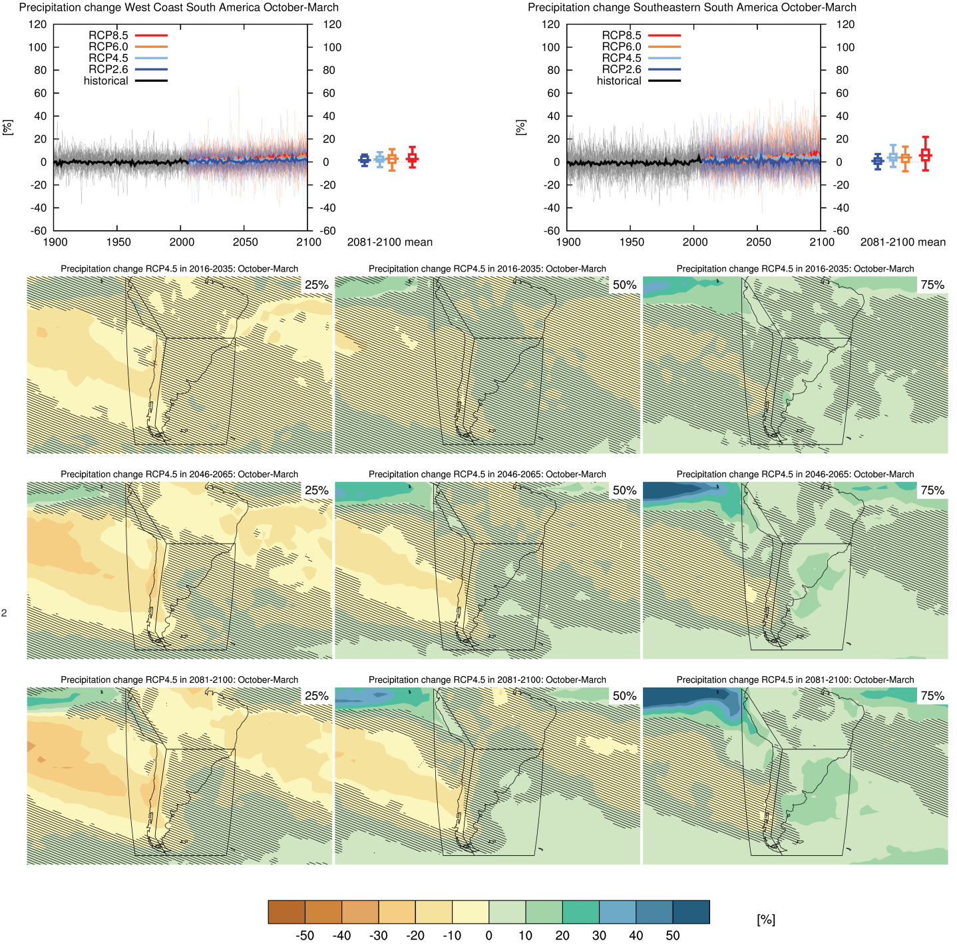
Ministry of Science, Technology and Innovation of Brazil
Secretariat of Policies and Programs of Research and Development - SEPED
Climate Change in South America
Figure AI.34: Top left: time 3 series of relative change relative to 1986–2005 in precipitation averaged over land grid points in the West Coast of South America in October–March.
Notes:
Figure AI.34: Top left: time 3 series of relative change relative to 1986–2005 in precipitation averaged over land grid points in the West Coast of South America (79.7W,1.2S; 66.4W,20S; 72.1W,50S; 67.3W56.7S; 82.0W 56.7S; 82.2W,0.5N) in October–March. Top right: same for land grid points in Southeastern South America (39.4W,20S; 39.4W,56.6S; 67.3W,56.7S; 72.1W,50S; 66W,20S). Thin lines denote one en7 semble member per model, thick lines the CMIP5 multi-model mean. On the right-hand side the 5th, 25th, 50th (median), 75th and 95th percentiles of the distribution of 20-yr mean changes are given for 2081–2100 in the four RCP scenarios.
Below: maps of precipitation changes in 2016–2035, 2046–2065 and 2081–2100 with respect to 1986–2005 in the RCP4.5 scenario. For each point, the 25th, 50th and 75th percentile of the distribution of the CMIP5 ensemble are shown, this includes both natural variability and inter-model spread. Hatching denotes areas where the 20-yr mean differences of the percentiles are less than the standard deviation of model-estimated present-day natural variability of 20-yr mean differences.

Slide 19
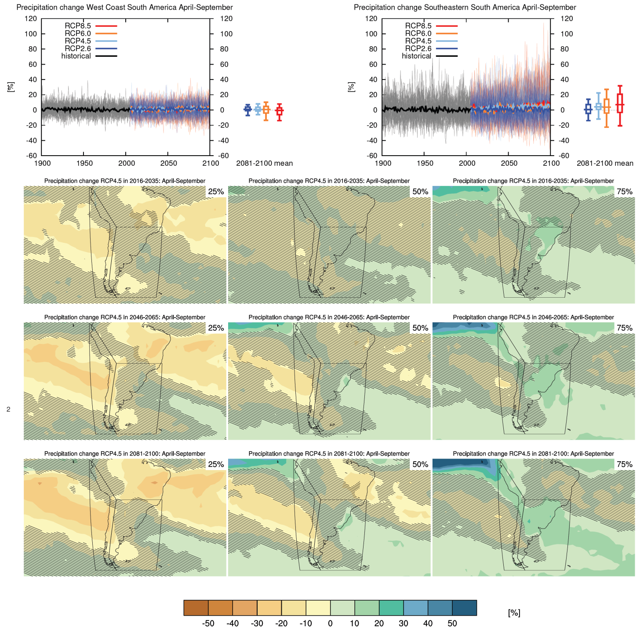
Ministry of Science, Technology and Innovation of Brazil
Secretariat of Policies and Programs of Research and Development - SEPED
Climate Change in South America
Figure AI.35: Top left: time 3 series of relative change relative to 1986–2005 in precipitation averaged over land grid points in the West Coast of South America in April–September.
Notes:
Figure AI.35: Top left: time 3 series of relative change relative to 1986–2005 in precipitation averaged over land grid points in the West Coast of South America (79.7W,1.2S; 66.4W,20S; 72.1W,50S; 67.3W56.7S; 82.0W 56.7S; 82.2W,0.5N) in April–September. Top right: same for land grid points in Southeastern South America (39.4W,20S; 39.4W,56.6S; 67.3W,56.7S; 72.1W,50S; 66W,20S). Thin lines denote one ensemble member per model, thick lines the CMIP5 multi-model mean. On the right-hand side the 5th, 25th, 50th (median), 75th and 95th percentiles of the distribution of 20-yr mean changes are given for 2081–2100 in the four RCP cenarios. Below: maps of precipitation changes in 2016–2035, 2046–2065 and 2081–2100 with respect to 1986–2005 in the RCP4.5 scenario. For each point, the 25th, 50th and 75th percentile of the distribution of the CMIP5 ensemble are shown, this includes both natural variability and inter-model spread. Hatching denotes areas where the 20-yr mean differences of the percentiles are less than the standard deviation of model-estimated resent-day natural variability of 20-yr mean differences.

Slide 20
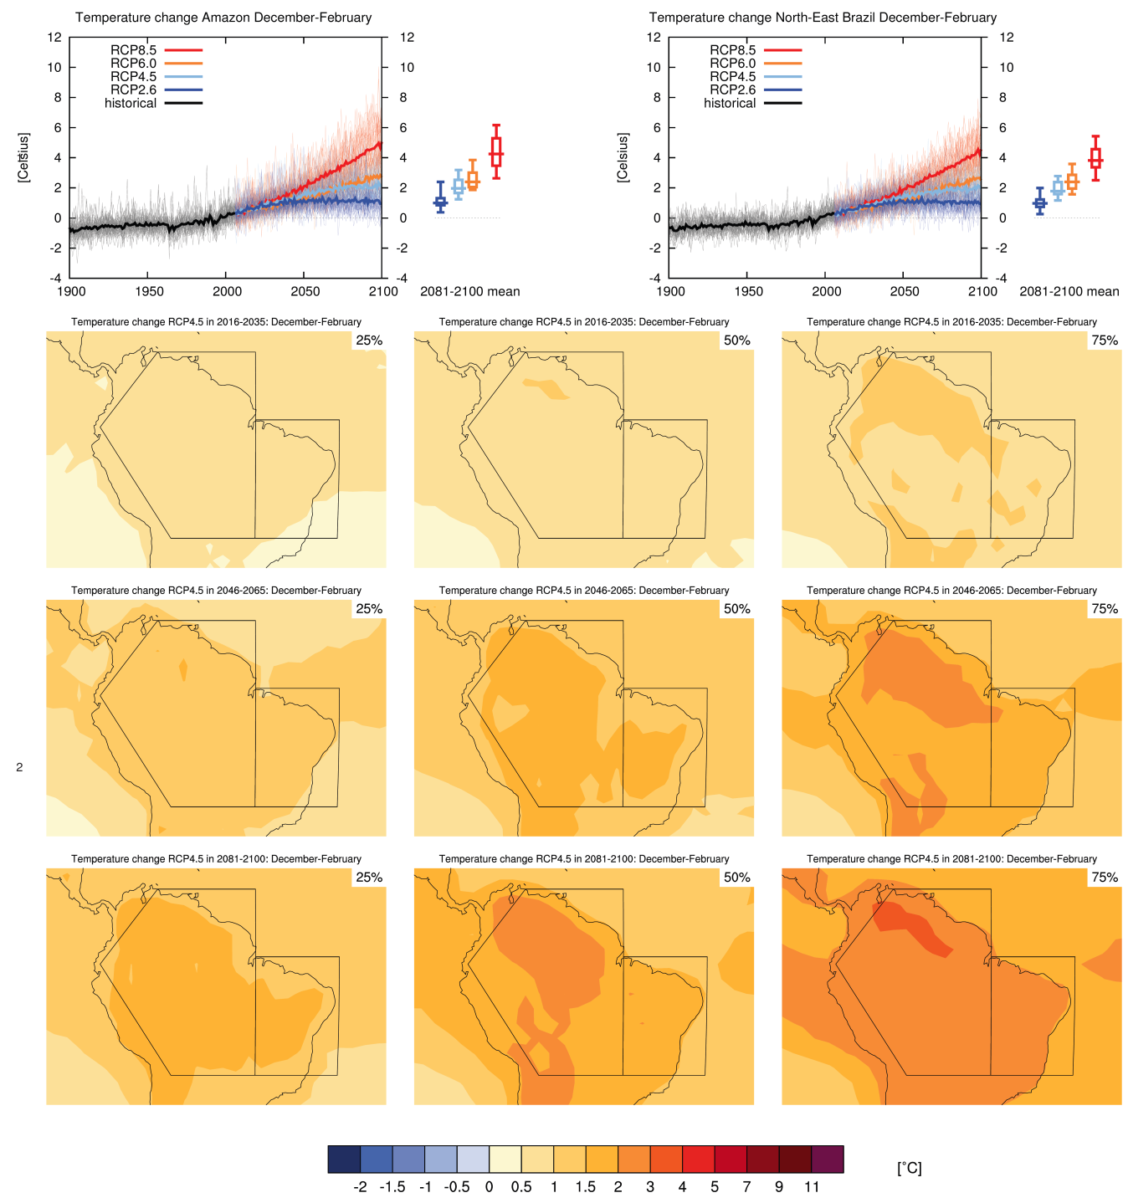
Ministry of Science, Technology and Innovation of Brazil
Secretariat of Policies and Programs of Research and Development - SEPED
Climate Change in South America
Figure AI.28: Top 3 left: time series of temperature change relative to 1986–2005 averaged over land grid points in the Amazon in December– February.
Notes:
Figure AI.28: Top 3 left: time series of temperature change relative to 1986–2005 averaged over land grid points in the Amazon (20S,66.4W; 1.24S,79.7W; 11.4S,68.8W; 11.44S,50W; 20S,50W) in December– February. Top right: same for land grid points in North-East Brazil (20S–EQ, 50–34W). Thin lines de note one ensemble member per model, thick lines the CMIP5 multi-model mean. On the right-hand side the 5th, 25th, 50th (median), 75th and 95th percentiles of the distribution of 20-yr mean changes are given for 2081–2100 in the four RCP scenarios.
Below: maps of temperature changes in 2016–2035, 2046–2065 and 2081–2100 with respect to 1986–2005 in the RCP4.5 scenario. For each point, the 25th, 50th and 75th percentile of the distribution of the CMIP5 ensemble are shown, this includes both natural variability and inter-model spread. Hatching denotes areas where the 20-yr mean differences of the percentiles are less than the standard deviation of model-estimated present-day natural variability of 20-yr mean differences.

Slide 21
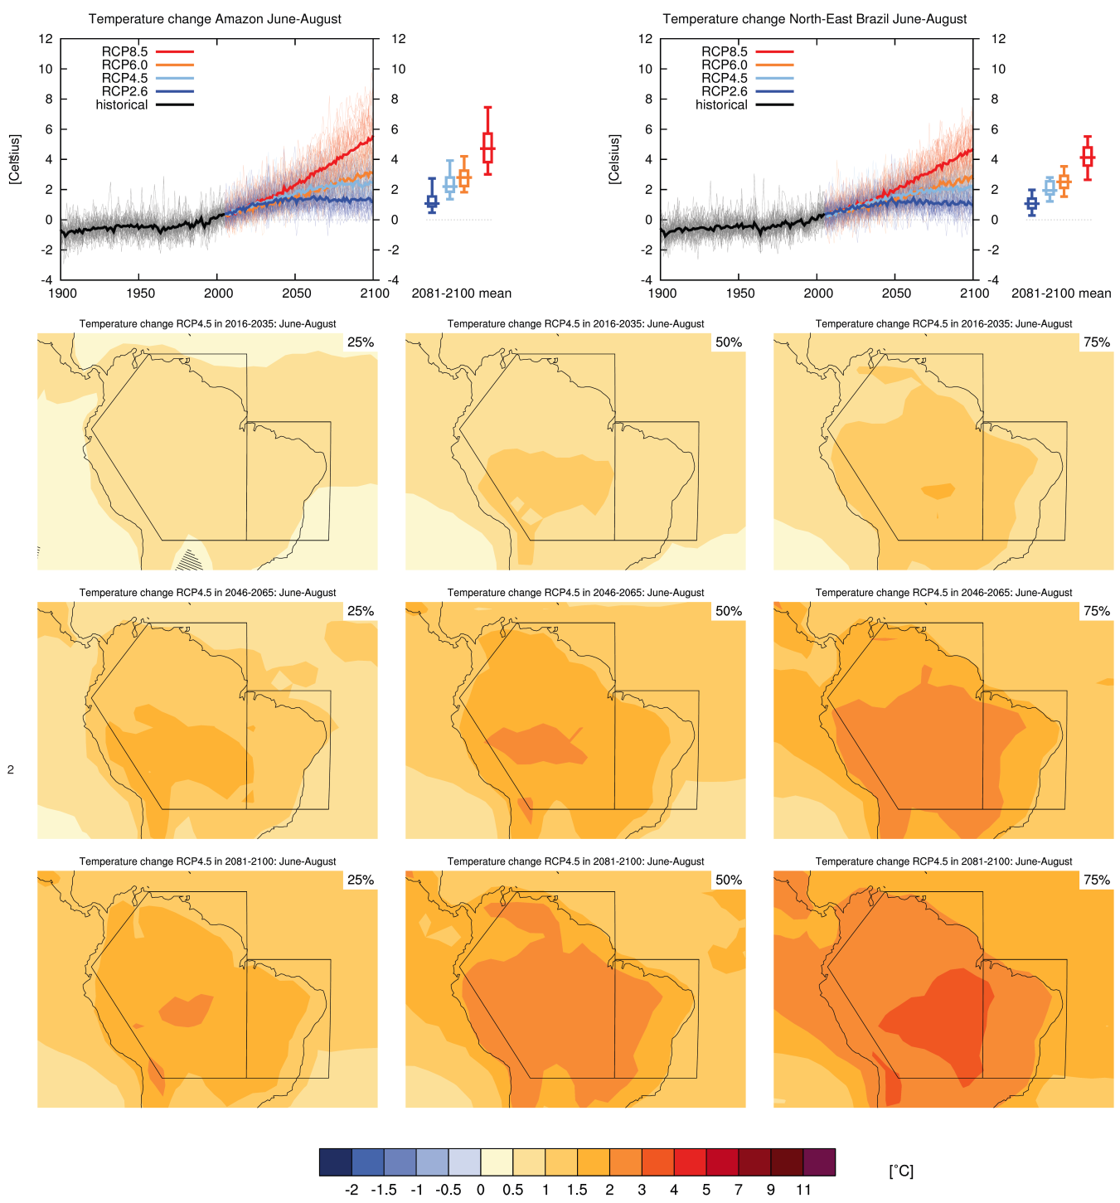
Ministry of Science, Technology and Innovation of Brazil
Secretariat of Policies and Programs of Research and Development - SEPED
Climate Change in South America
Figure AI.29: Top 3 left: time series of temperature change relative to 1986–2005 averaged over land grid points in the Amazon in June–August.
Notes:
Figure AI.29: Top 3 left: time series of temperature change relative to 1986–2005 averaged over land grid points in the Amazon (20S,66.4W; 1.24S,79.7W; 11.4S,68.8W; 11.44S,50W; 20S,50W) in June–August. Top right: same for land grid points in North-East Brazil (20S–EQ, 50–34W). Thin lines denote one ensemble member per model, thick lines the CMIP5 multi-model mean. On the right-hand side the 5th, 25th, 50th (median), 75th and 95th percentiles of the distribution of 20-yr mean changes are given for 2081– 2100 in the four RCP scenarios.
Below: maps of temperature changes in 2016–2035, 2046–2065 and 2081–2100 with respect to 1986–2005 in the RCP4.5 scenario. For each point, the 25th, 50th and 75th percentile of the distribution of the CMIP5 ensemble are shown, this includes both natural variability and inter-model spread. Hatching denotes areas where the 20-yr mean differences of the percentiles are less than the standard deviation of model-estimated present-day natural variability of 20-yr mean differences.

Slide 22
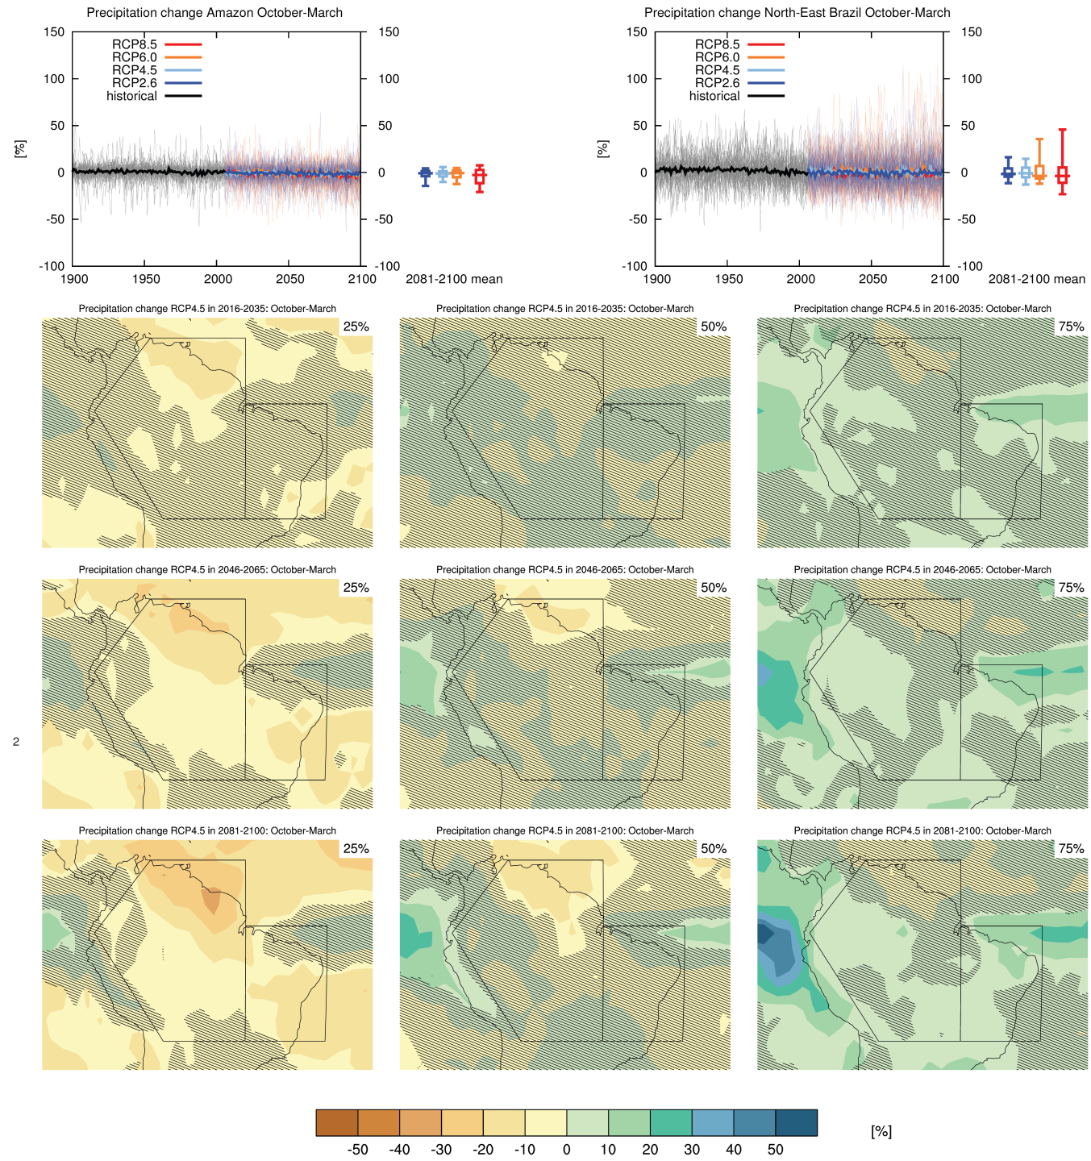
Ministry of Science, Technology and Innovation of Brazil
Secretariat of Policies and Programs of Research and Development - SEPED
Climate Change in South America
Figure AI.30: Top left: time 3 series of relative change relative to 1986–2005 in precipitation averaged over land grid points in the Amazon in October–March.
Notes:
Figure AI.30: Top left: time 3 series of relative change relative to 1986–2005 in precipitation averaged over land grid points in the Amazon (20S,66.4W; 1.24S,79.7W; 11.4S,68.8W; 11.44S,50W; 20S,50W) in October–March. Top right: same for land grid points in North-East Brazil (20S–EQ, 50–34W). Thin lines denote one ensemble member per model, thick lines the CMIP5 multi-model mean. On the right-hand side the 5th, 25th, 50th (median), 75th and 95th percentiles of the distribution of 20-yr mean changes are given for 2081–2100 in the four RCP scenarios.
Below: maps of precipitation changes in 2016–2035, 2046–2065 and 2081–2100 with respect to 1986–2005 in the RCP4.5 scenario. For each point, the 25th, 50th and 75th percentile of the distribution of the CMIP5 ensemble are shown, this includes both natural variability and inter-model spread. Hatching denotes areas where the 20-yr mean differences of the percentiles are less than the standard deviation of model-estimated present-day natural variability of 20-yr mean differences.

Slide 23
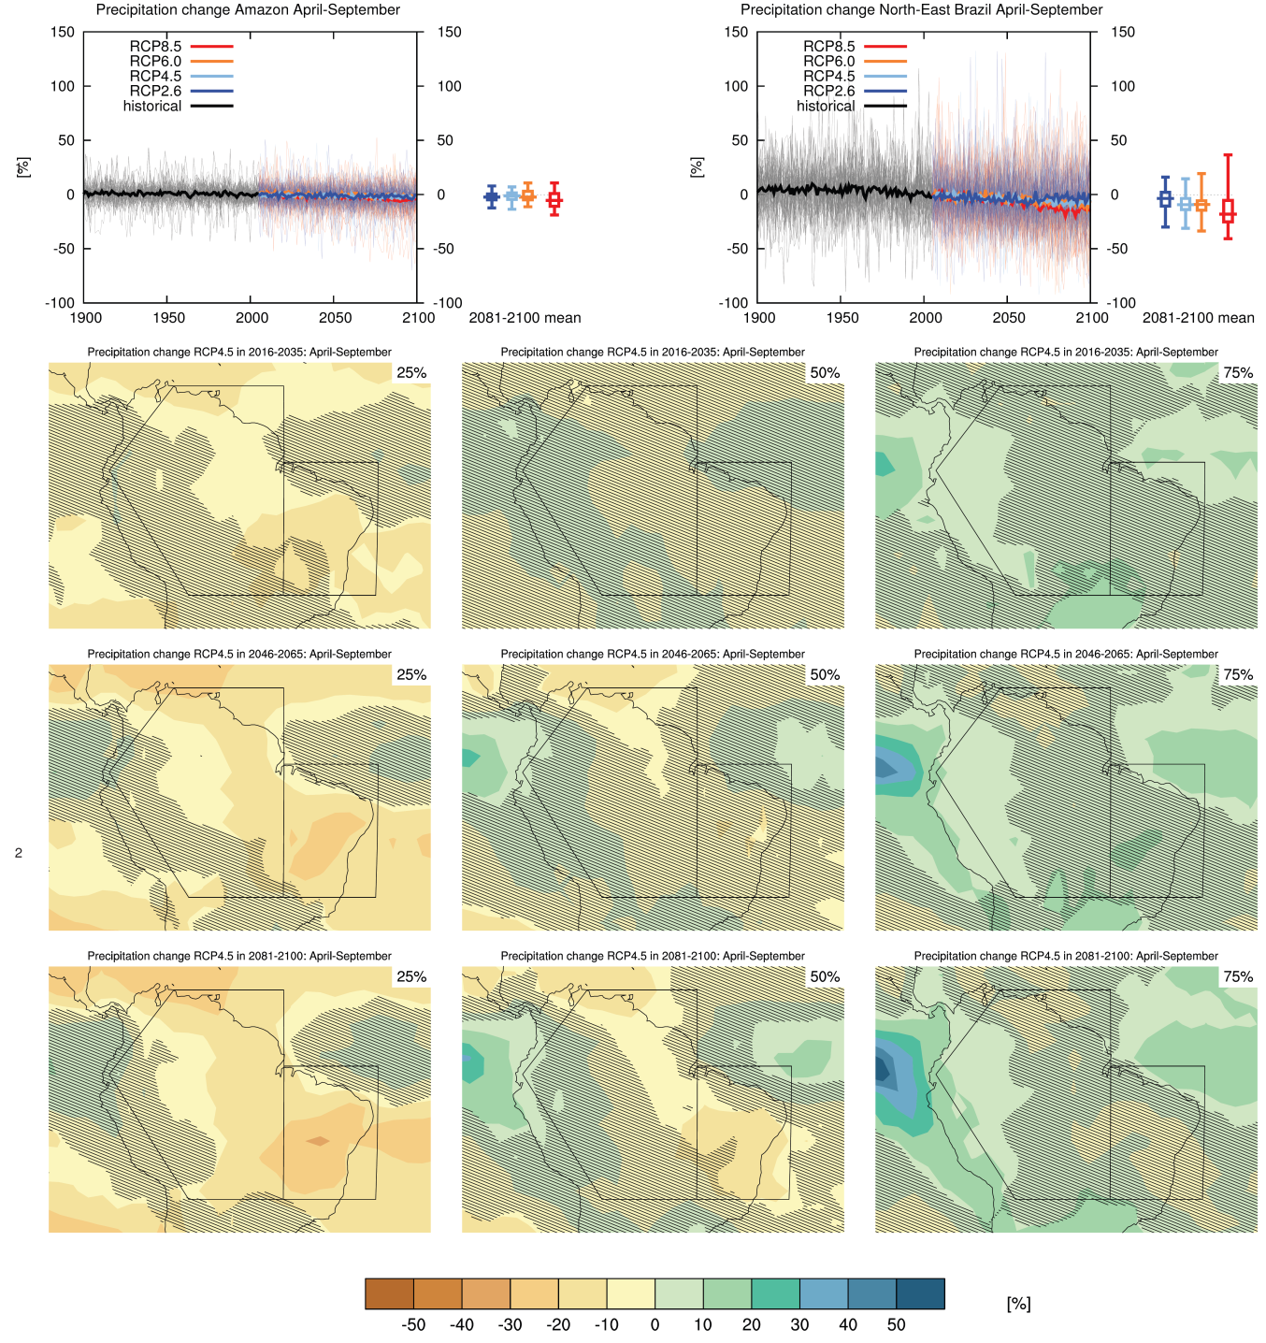
Ministry of Science, Technology and Innovation of Brazil
Secretariat of Policies and Programs of Research and Development - SEPED
Climate Change in South America
Figure AI.31: Top left: time 3 series of relative change relative to 1986–2005 in precipitation averaged over land grid points in the Amazon in April– September.
Notes:
Figure AI.31: Top left: time 3 series of relative change relative to 1986–2005 in precipitation averaged over land grid points in the Amazon (20S,66.4W; 1.24S,79.7W; 11.4S,68.8W; 11.44S,50W; 20S,50W) in April– September. Top right: same for land grid points in North-East Brazil (20S–EQ, 50–34W). Thin lines denote one ensemble member per model, thick lines the CMIP5 multi-model mean. On the right-hand side the 5th, 25th, 50th (median), 75th and 95th percentiles of the distribution of 20-yr mean changes are given for 2081–2100 in the four RCP scenarios.
Below: maps of precipitation changes in 2016–2035, 2046–2065 and 2081–2100 with respect to 1986–2005 in the RCP4.5 scenario. For each point, the 25th, 50th and 75th percentile of the distribution of the CMIP5 ensemble are shown, this includes both natural variability and inter-model spread. Hatching denotes areas where the 20-yr mean differences of the percentiles are less than the standard deviation of model-estimated present-day natural variability of 20-yr mean differences.

Slide 24
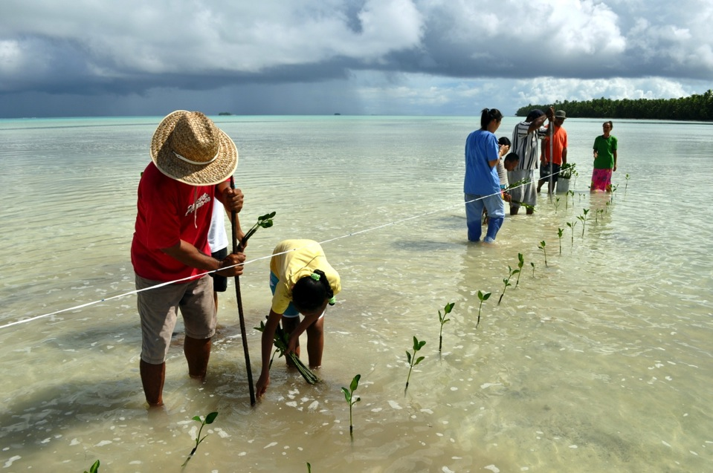
CLIMATE CHANGE 2014:
IMPACTS, ADAPTATION, AND VULNERABILITY

Slide 25
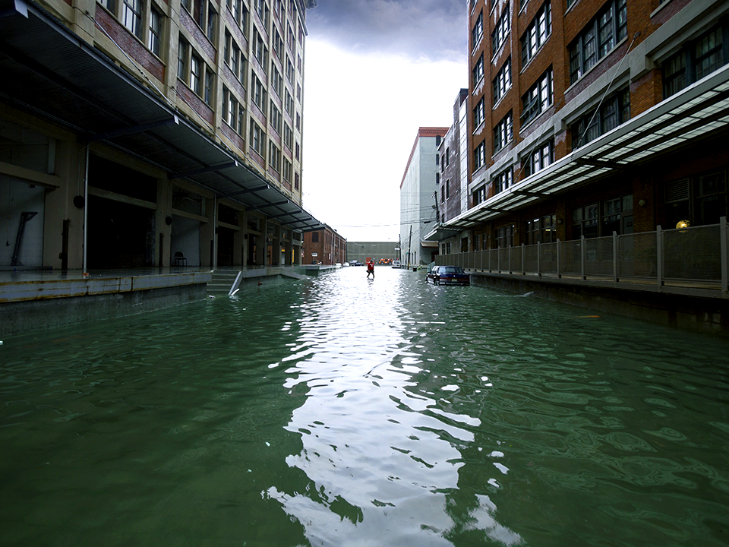
KEY MESSAGES
• Climate change is already causing harm.
• The more we warm the climate the more risks we will face including the possibility of irreversible damage.
• Effective and inclusive climate-change adaptation can help build a richer more resilient world n the near-term and beyond.

Slide 26
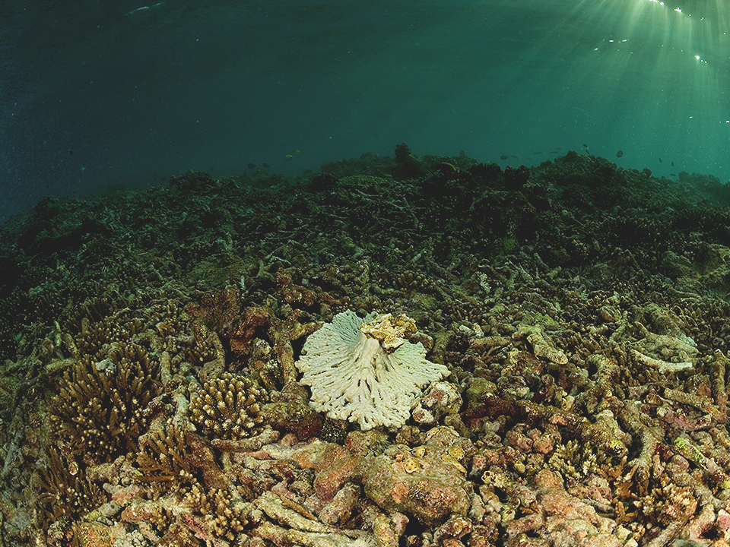
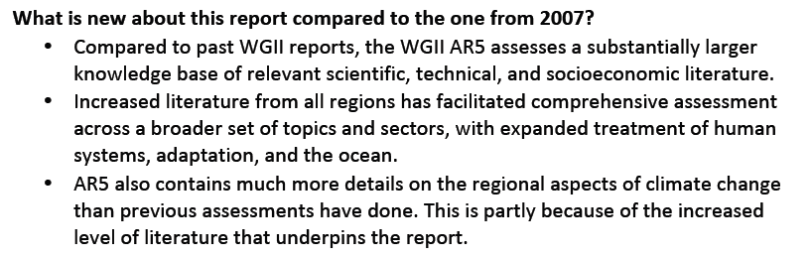


Slide 27
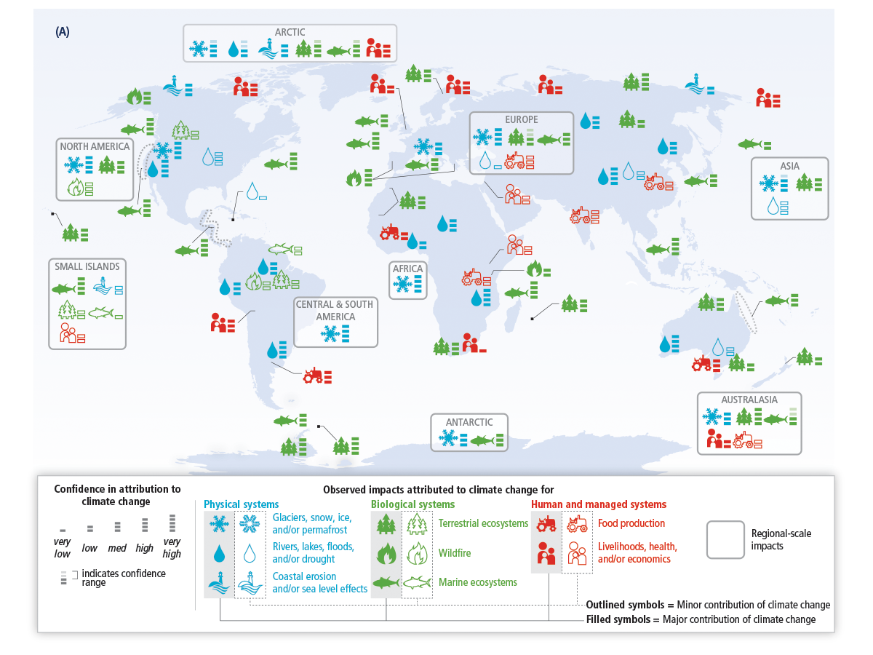
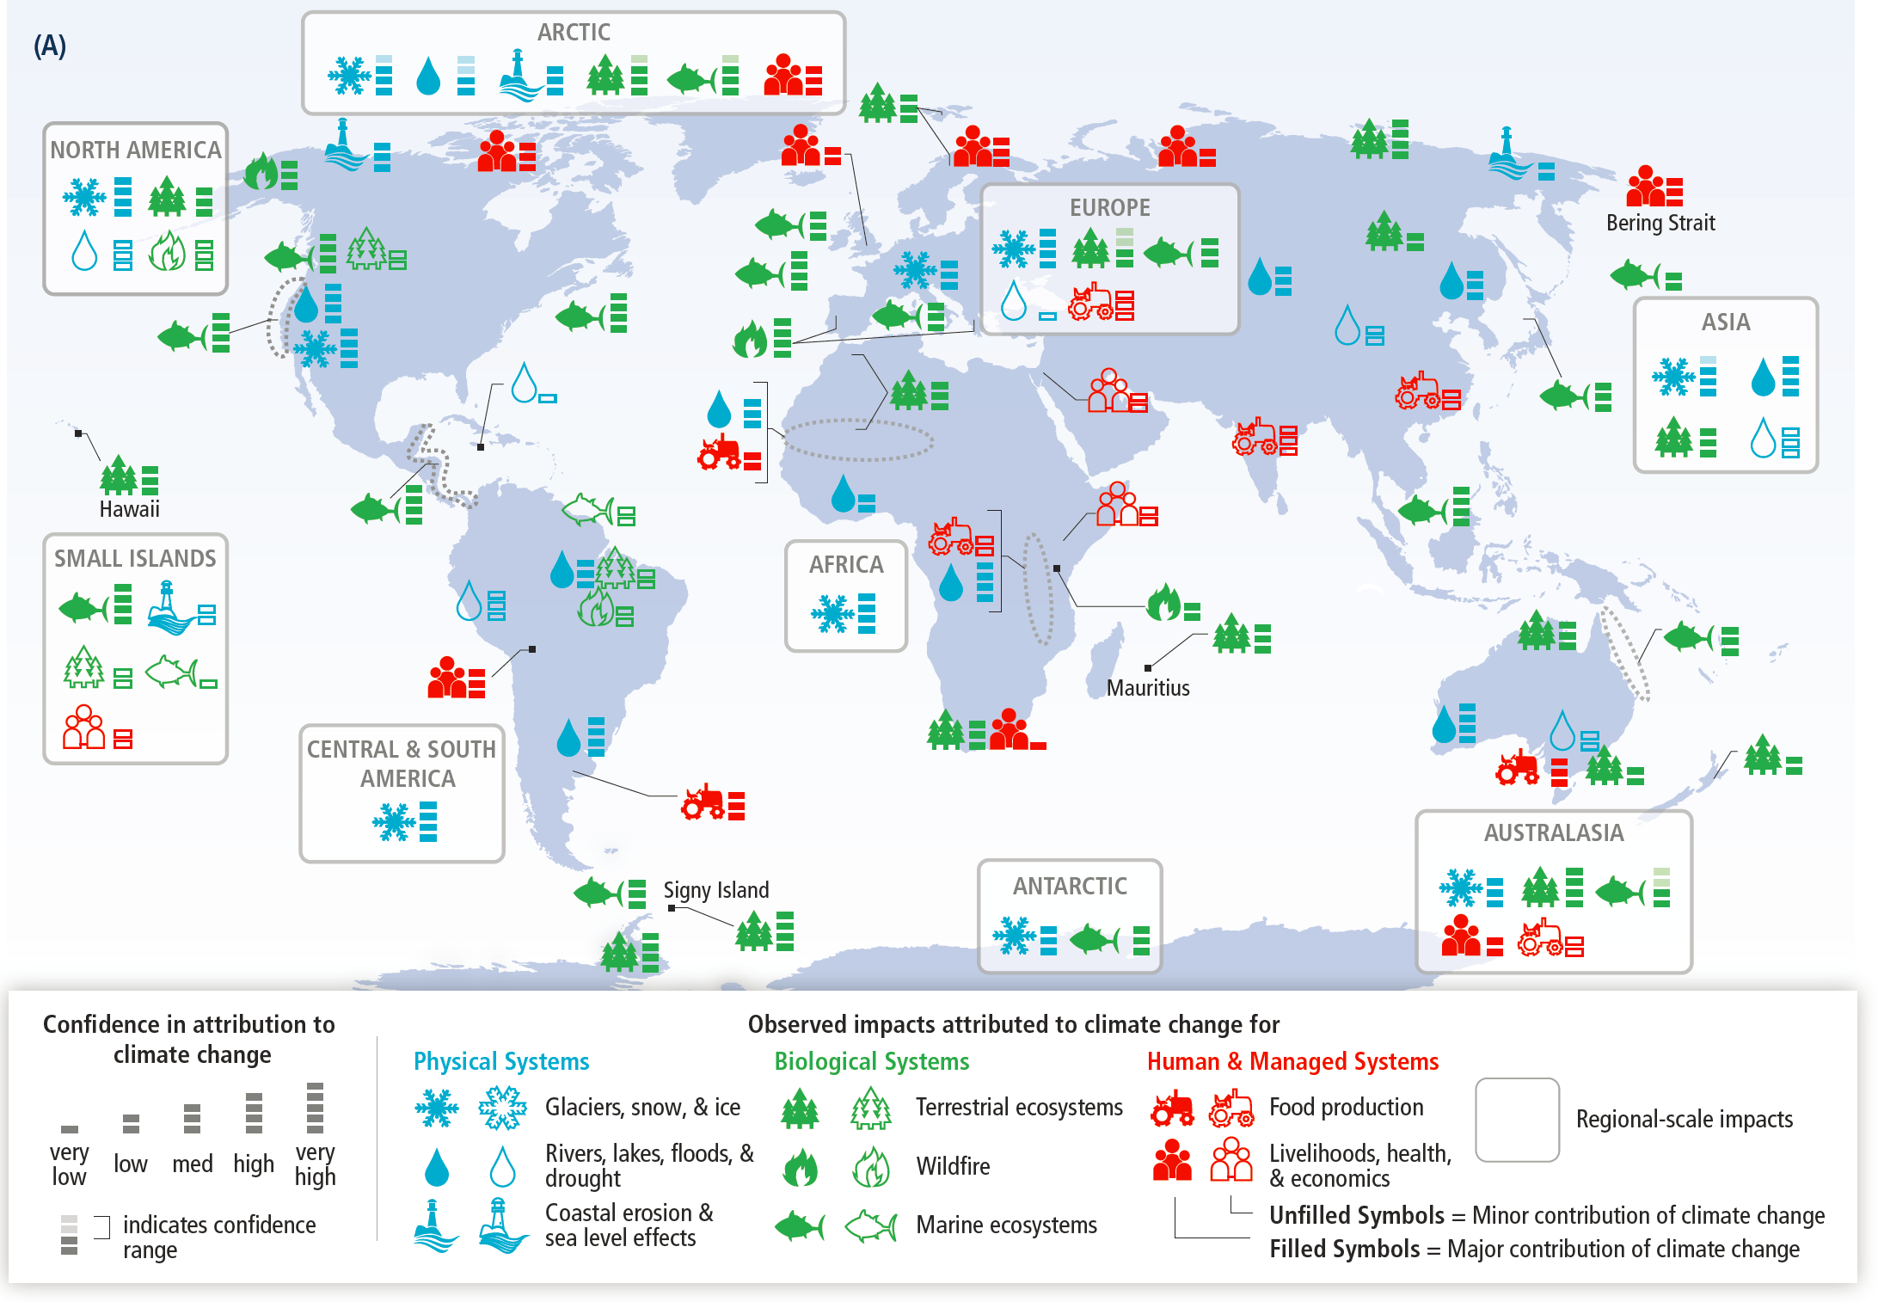
Global patterns of impacts in recent decades attributed to climate change, based on studies since the AR4. Impacts are shown at a range of geographic scales.

Slide 29
Summary of estimated impacts of observed climate changes on yields over 1960-2013 for four major crops in temperate and tropical regions.
2
0
-2
-4
90th Percentile
YIELD IMPACT
(% Change per Decade)
75th Percentile
-6
Median
25th Percentile
Wheat
Soy
Rice
Maize
10th Percentile
CROP TYPE

Slide 30
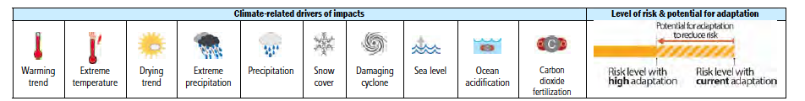
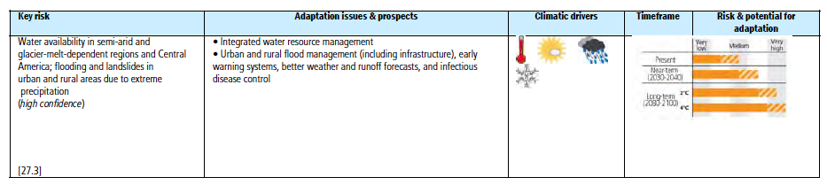
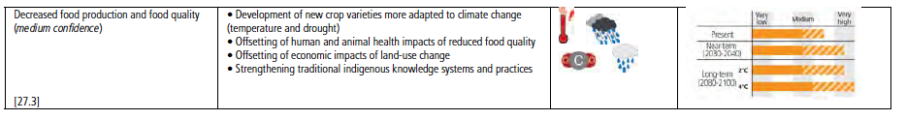
Central and South America could see increased risks to human health, problems with water availability in some regions, and flooding and landslides due to extreme precipitation in others, and decreased food production and quality.

Slide 31
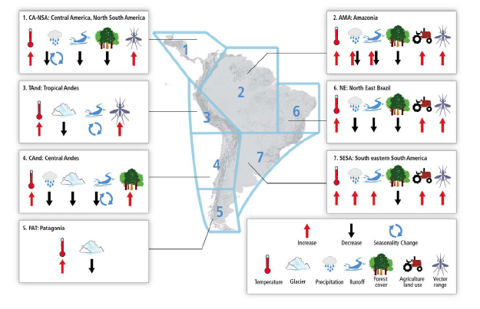
Summary of observed changes in climate and other environmental factors in representative regions of CA and SA. The boundaries of the regions in the map are conceptual (neither geographic nor political precision).

Slide 32
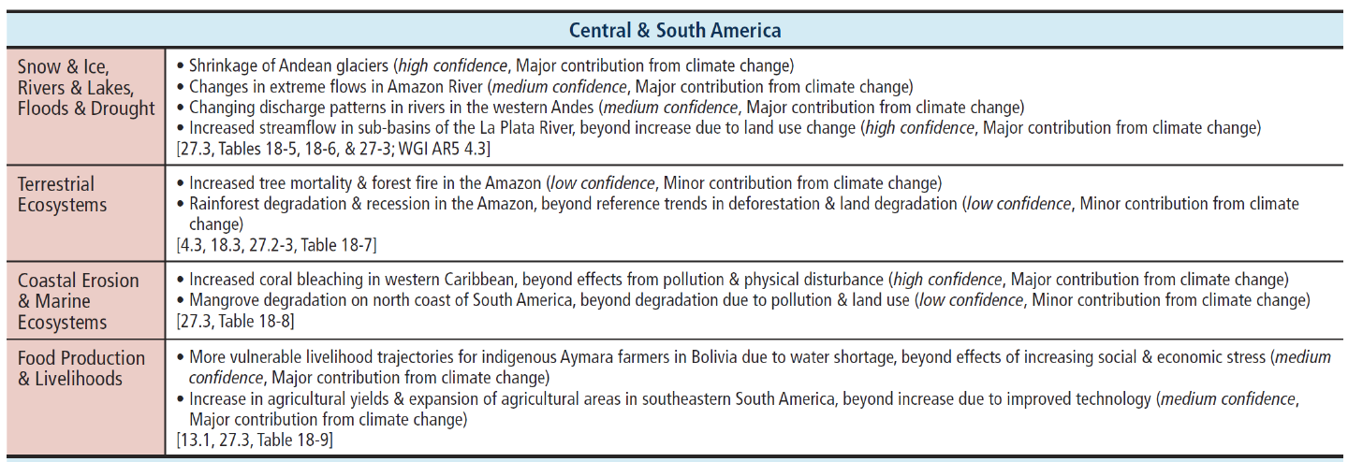
Observed impacts attributed to climate change reported in the scientific literature
since the AR4. These impacts have been attributed to climate change with very low, low, medium, or high confidence, with the relative contribution of climate change to the observed change indicated (major or minor), for natural and human systems across eight major world regions over the past several decades.

Slide 33
Significant trends in precipitation and temperature have been observed in CA and SA (high confidence ). Besides, changes in climate variability and in extreme events have severely
affected the region (medium confidence ).
Climate projections suggest increases in temperature, and increases or decreases in precipitation for CA and SA by 2100 (medium confidence ).
Changes in stream flow and water availability have been observed and projected to continue in the future in CA and SA, affecting already vulnerable regions (high confidence ).
Land use change contributes significantly to environmental degradation exacerbating the negative impacts of climate change (high confidence ).
Conversion of natural ecosystems is the main cause of biodiversity and ecosystem loss in the region, and is a driver of anthropogenic CC (high confidence ).
Sea-level rise (SLR) and human activities on coastal and marine ecosystems pose threats to fish stocks, corals, mangroves, recreation and tourism, and control of diseases (high confidence ).
Changes in agricultural productivity with consequences for food security associated to CC are expected to exhibit large spatial variability (medium confidence ).
In many CA and SA countries, a first step toward adaptation to future climate changes is to reduce the vulnerability to present climate.

Slide 34
Principles for Effective Adaptation
Adaptation is place and context specific, with no single approach for reducing risks
appropriate across all settings (high confidence).
Adaptation planning and implementation can be enhanced through complementary actions
across levels, from individuals to governments (high confidence).
A first step towards adaptation to future climate change is reducing vulnerability and
exposure to present climate variability (high confidence). Strategies include actions with cobenefits for other objectives.
Adaptation planning and implementation at all levels of governance are contingent on
societal values, objectives, and risk perceptions (high confidence). Recognition of diverse
interests, circumstances, social-cultural contexts and expectations can benefit decision making
processes.
Existing and emerging economic instruments can foster adaptation by providing incentives
for anticipating and reducing impacts (medium confidence). Constraints can interact to impede adaptation planning and implementation (high confidence).
Poor planning, overemphasizing short-term outcomes, or failing to sufficiently anticipate
consequences can result in maladaptation (medium evidence, high agreement).

Slide 35
