Slide 1

SDGs in Post-Conflict Settings
Carl Bruch
Colloquium on the Legal Dimension of Sustainable Development Goals: Global Perspectives
December 12, 2014
Federal Senate of Brazil

Slide 2
Why Focus on Post-Conflict Settings?
  55 countries have experienced major armed conflict (>1,000 battle deaths) since 1990
    By 2025, 80% of the poorest people will be in conflict-affected countries
  Of the 45 fragile states listed by OECD (2011)
    91% contain transboundary waters or globally significant biodiversity hot spots
    80% have high-value resources of global economic significance
  Most MDG goals not met in post-conflict and fragile settings
    8 countries met the goal to halve extreme poverty
    6 met goal for improved access to water, and 3 more on track
Notes:
2
The "80% by 2025" number is from an ODI report called Horizon 2025: http://www.odi.org/sites/odi.org.uk/files/odi-assets/publications-opinion-files/7723.pdf
http://www.worldbank.org/en/news/press-release/2013/05/01/twenty-fragile-states-make-progress-on-millennium-development-goals

Slide 3
How Are Post-Conflict Settings Different?
  Peacebuilding priorities drive donor, country, and community efforts
  In-country capacity is often devastated (human, information, natural resources, and infrastructure capacity)
  Rapid changes and uncertainty
  Unsustainable, short-term coping strategies undermine long-term efforts
  Trust and community cohesion take time to rebuild
  Unresolved grievances and lingering suspicions
  Lingering insecurity
  Uncertain rights and overlapping claims create the potential for new conflicts and relapses to conflict
Notes:
3

Slide 4
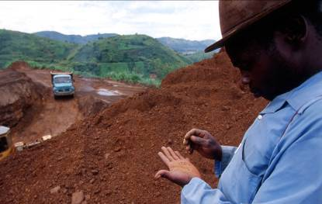
Implications of these differences
  Must always consider how an initiative contributes to peacebuilding
  Conflict sensitivity
  The post-conflict period is a critical window of opportunity to make reforms (for NRM and other sectors)
  Need to act with imperfect information
Notes:
4
The post-conflict period is a critical window of opportunity to make reforms (for NRM and other sectors)
Important to get the reforms right.
Decisions taken – or not taken – get locked in.
Need to act with imperfect information
Adaptive management

Slide 5
SDGs in Post-Conflict Settings: The Potential
  MDGs successful in focusing financial assistance and political attention; SDGs could play a similar role
  For the first time, development goals explicitly recognize the importance of peace, security, and good governance
  g7+ and the Busan New Deal
    Fragile states articulating what is needed
Notes:
5

Slide 6

Sustainable Development (1992-2012)
  Three key dimensions (a “three-legged stool”)
  War viewed as “development in reverse” but resistance to incorporating security into sustainable development
    A casualty of UN politics
Notes:
6

Slide 7

Sustainable Development (2012-…)
  Four key dimensions
    Peace and security now recognized as central to sustainable development
    “The Future We Want” (2012)
    Draft SDGs (2014)
  Sustainable Development
  Social
  Economic
  Environmental
  Peace
Notes:
7

Slide 8
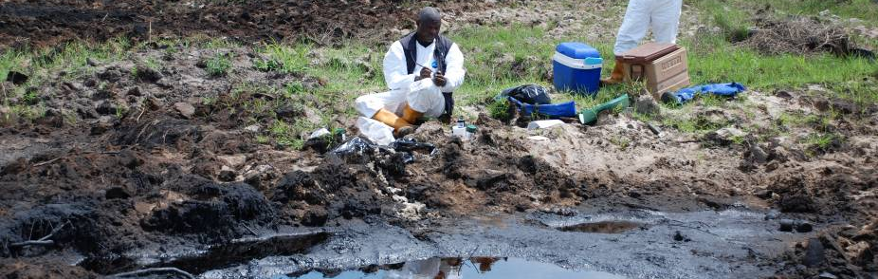
Relevant SDGs
  SDG 1: end poverty
  SDG 2: hunger and food security
  SDG 6: water and sanitation
  SDG 7: affordable, reliable, sustainable and modern energy
  SDG 8: economic growth and employment
  SDG 10: reduce inequality
  SDG 13: climate change and its impacts
  SDG 15: ecosystems, forests, desertification, biodiversity
  SDG 16: Promote peaceful and inclusive societies for sustainable development, provide access to justice for all and build effective, accountable and inclusive institutions at all levels
    16.1: significantly reduce all forms of violence and related death rates
    16.3: promote the rule of law at the national and international levels
    16.5: substantially reduce corruption and bribery in all its forms
  Goal 17: means of implementation
Notes:
8

Slide 9
Prospects for SDGs in Post-Conflict Settings
  It’s all about governance
    Countries cautious about being too explicit about how specifically the SDGs should address governance or security
  Will the expanded number of SDGs and targets have the same effect for mobilizing funding?
  Need to adapt programming approaches to post-conflict settings (conflict sensitivity, fragility lens, etc.)
  Mainstream sustainability into post-conflict recovery
    “Green Growth Sierra Leone” (focus on green economy)
Notes:
9

Slide 10
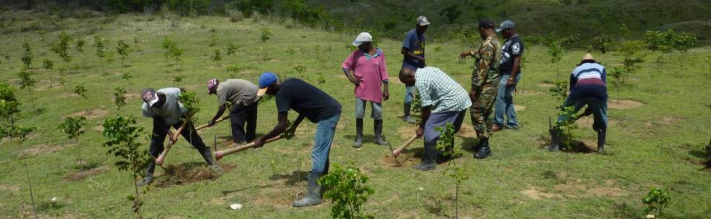
Obrigado!
Carl Bruch
bruch@eli.org
www.environmentalpeacebuilding.org
Notes:
10
CUT?

