Slide 1

A ‘paradigm shift’ in the climate affair
A monetary plan for upgrading climate finance and support a sustainable development
Jean-Charles Hourcade

Slide 2
The rationale for a ‘paradigm shift’
Jean-Charles Hourcade

Slide 3
Lessons from Kyoto’s unfinished business
A ‘mental map’ (a world cap and trade system with unique carbon price through all sectors and countries with compensating transfers) which
does not indicate that significant carbon prices:
    Hurt existing capital stock in developed countries and mobilize
    hurt emerging economies over the short run (higher share of energy expenditures in households budget and in production costs) and do not prevent their lock- in carbon intensive growth pattern
  ignores that technologies are not selected in function of their levelized costs in a ‘shareholder’ regime of firm management
indicates impossible ‘fair’ compensating transfers, focusses on how to share the very few remains
does not indicate the benefits of cooperation
Notes:
3

Slide 4
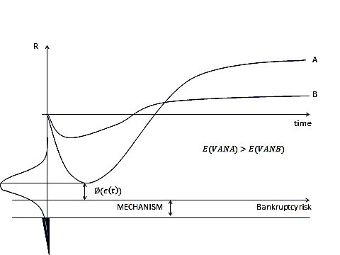
Why price-signals does not suffice. Why ‘finance’ matters in an uncertain world

Slide 5
Climate Finance at risks of the distrust?
A context of ’depression economics’, ‘public debts’ and rebalancing of the world economic equilibrium can only:
  exarcerbate the ‘donor fatigue’ in the Annex 1 countries
  Reinforce the social resistance to carbon pricing (explicit or implicit)
A problem of orders of magnitude: a funding gap of 90% for the Green Climate Fund?????
  leveraged invest costs< upfront invest costs < induced invest costs
  Redirected invest height times higher than incremental invest costs

Slide 6
Turning the question upside-down
The world economy between ‘instable growth’ and ‘depression economics’
  « Saving glut » and « Buridan’s Donkey » dilemma for investors
  Risks of depression vs risks of re-unleashing speculative bubbles
  Banking systems still fragile and in process of deleveraging
  Tensions due to a « currency cold war »
  Any new growth regime implies
    To redirect savings towards infrastructure and industry instead of speculation
    a more inward-oriented industrialisation
    A more resilient financial and monetary order
Low carbon finance is a good candidate to contribute to sustainable economic recovery with …. less « ups and downs »

Slide 7
The rationale for turning the question upside down in an adverse economic context
Can we afford climate policies? <-> No debt bailout and economic recovery w/o climate policy
A shift of less than 1% of the GDP is needed to fund incremental costs (in non energy exporting countries)
But the redirection of investments concerns about 8-9% of the GCF
Concerned sectors represent around 40% of the GCF and some are critical for inclusive growth
Climate policies can contribute to a stimulus for a sustainable and inclusive growth recovery finance
If this is the case climate finance should not remain a marginal department of global finance

Slide 8
A diplomatic non starter?
Is linking two sensitive issues diplomatically dangerous?
ignoring the short term economic and political constraints leads to a diplomatic dead-end
To go out of the ‘sharing the pie’ approach implies to link a diversity of domestic an international co-benefits
Getting the support of ‘non climate concerned’ policy-makers: the European Case

Slide 9
A ‘C4’ device

Slide 10
The agenda
Inject liquidity, provided that it is used to fund low-carbon investments (LCI)
Awake the Buridan’s Donkey: public guarantee to lower the risks of LCIs and enhance the solvency of low-carbon entrepreneurs’
Make the Banking System interested in funding LCIs:
  banks can better face their prudential constraints and improve their risk-weighted assets (RWA)
Make institutional investors interested in carbon-based financial products to attract savings (instead of real estates and others …)
Trigger a wave of LCI in infrastructure
  Revitalizing the industrial fabric in OECD countries
  More inward-oriented growth in emerging economies

Slide 11
Sketching a possible mechanism
Its anchor : an agreement, under UNFCCC on a Social Value of Avoided Carbon Emissions (SVC)
Voluntary commitments by governements, over every five years to back a quantity of carbon assets,
Central banks open drawing rights on these carbon assets and accept as repayment carbon certificates (CC) to fund LCIs
After certification of project completion: asset swap …. CCs are turned into carbon assets that appear on the balance sheet of central banks (like gold), banks or entreprises
An Independent Supervisory Body
  Negotiates with governments which NAMAs these LCI should contribute to
  Secures the « statistical additionality » of the investments

Slide 12
The SVC, a notional value not a carbon price
A signal of the political will ‘to do sth’ against climate change
It increases over time -> counterbalance the role of discount rate against investing in long lived capital stocks
Surrogate of a « gobal price signal »: it does not hurt existing capital stock and avoids the fragmentation of climate finance
Politically negotiable :
  The cost of cement in India will not be doubled and the peasant will not be obliged to pay more for irrigation
  The SVC differs theoretically across countries but is conditional upon the content of their development policies (Shukla)
  Countries may thus accept similar SVC for different reasons, including various views of the co-benefits of climate mitigation

Slide 14
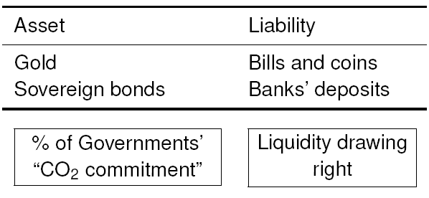
Gvt’s commitments and issuance of carbon-based liquidity by Central Banks
Central Bank balance sheet
Out of balance sheet
New credit lines for commercial banks, refundable with ↘ of CO₂

Slide 15
Table 1: Balance sheets at the opening date of the low-carbon loan

Slide 16
Balance sheets at the end of the payback period of the low-carbon loan before the asset swap

Slide 17
Balance sheets after the carbon asset swap

Slide 18
Adressing potential risks of the system
Environmental risk
Quality of LCIs?
-> statistical additionality
CC pre-determined share of a fixed EV of abatements per type of investment
No monetary laxity
No ‘carbon bubble’
Macroeconomic risks
New debt creation? Inflation
Social Cost of Carbon
Arbitrary
Issuance?
Regulatory risk
To be weighed against the benefits of redirecting part of (misused) savings toward a « green growth » recovery

Slide 19
Risk-adjusted costs, a matter of total costs and not of only ‘incremental’ costs: need of ‘statistical additionality’
Projects
BAU
Low carbon
100
100
Up-front costs (planning and building phases)
Excess up-front costs
10
Operating costs
14
9
CC allocated with no need for
counterfactuals
Non carbon-related risks premium
(technologyl, country, currency etc.)
10
20
Carbon-related risk premium
2.5
-13
Risk-adjusted costs
126.5
139
<126

Slide 20
Preliminary numerical assesments
‘based on last IEA World Energy Outlook’

Slide 21
The nature of the funding challenge
Energy Investments in the US in 2035
  - BAU: 470 B$
  - LCS: 510 B$
Energy Investments in the world
  BAU: 2000 B$
  - LCS: 1800 B$
21

Slide 22
Orders of magnitude of the ‘carbon based money issuance (in 2035)
OECD DC (Middle East Excl)
Total Energy INV 988 1143
Redirected INV 494 571
Need of Carbon Assets
Leverage 5 98 114
Leverage 10 49 57
% of the total GDP between 0.19 and 0. 30
22

Slide 23
A « pull-back force » to secure both ‘decarbonation’ and ‘equitable access to development’

Slide 24
Key Principles for a global architecture
targets and timetables per countries with a controlled degree of “when” and “where’” flexibility (COP3, 1997)
leave all latitude to Parties to select the NAMAS apt to align their climate and development policies ….. no misgiving about environmental colonialism
“common but differentiated responsibilities (CBDR)”
motivate countries to respect announced emissions pledges and to narrow the gap between these pledges and an emissions trajectory compatible with the 2°C target
deprive a defaulter country of the benefits of the system supported by a club of voluntary countries

Slide 25
A Pull-Back force hung on three pillars
allocating to each participating country part of the global emissions budget through a long term convergence trajectory (compromise easier than in the case of a cap and trade system)
emissions commitments to issue carbon assets by countries above their convergence trajectory, no geographical restriction on the use of ‘credit lines’
Emissions pledges announced by countries below their convergence trajectory

Slide 26
The pivotal role of pledges and Namas
The Namas serve in determining the eligible projects and policies
  Conventional determination of the amount of CC per $ invested in a category of project (with due discount for uncertainty)
The pledges serve to determine the drawing rights of the country to the total available credit lines
  Basic principle: invert correlation with the distance between a normative trajectory and pledges

Slide 27
CBDR and guarantee for multilateral policies
This system should trigger N/S transfers without any ex ante restriction on the behaviour of banks
It could very early involve Central Banks of a few emerging countries and the new ‘’Bank of the Basics)
What difference between Annex and non Annex 1 countries????
A share of the CA generated in Annex 1 countries should go into the GCF

Slide 28
To sum up
A deal on the « Social Cost of Carbon »
Money creation backed on real wealth (Avoided climate risks, Infrastructure investments)
No risk of ‘speculative bubble’ on carbon
Normative targets with when flexibility and back pulling force
A concrete way to secure « equitable access to development » by supporting NAMAs’ full incremental costs‘ by a real inflow
A respected CBDR that can be progressively extented to the most advanced emerging economies
Can support any carbon trading mechanism and bottom-up initiatives (sectorial arrangements in the industry, cities inititiatives ….) and stabilize the ‘business context’
28

