Slide 1
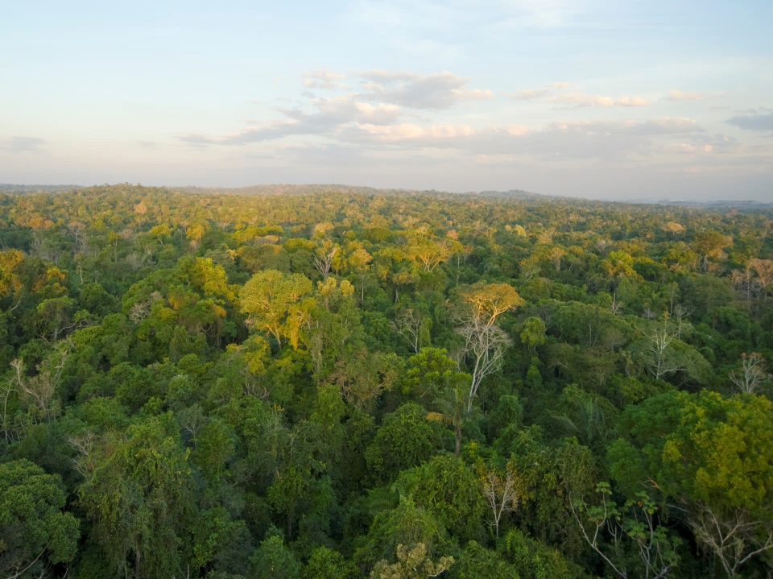
Notes:
#

Slide 2
CONGRESSO DO FUTURO
Desenvolvimento Sustentável na América Latina Sustentabilidade e a Agenda 2030
O FUTURO DA AMAZÔNIA É SUSTENTÁVEL?
Carlos A. Nobre
Instituto de C&T para Mudanças Climáticas
São José dos Campos, SP
Senado Federal, Brasília, DF
08 de Dezembro de 2016
Notes:
#

Slide 3
AGRADECIMENTOS
Meus agradecimentos as meus muitos estudantes e colaboradores
e agradecimentos especiais a
W. Soares, A. P. Cunha, G. Sampaio, M. Oyama, M. Cardoso, D. Lapola, P. Moutinho, M. Hirota, J. C. Castilla-Rubio e A. D. Nobre
Pelo fornecimento de informações para esta apresentação
Notes:
#

Slide 4
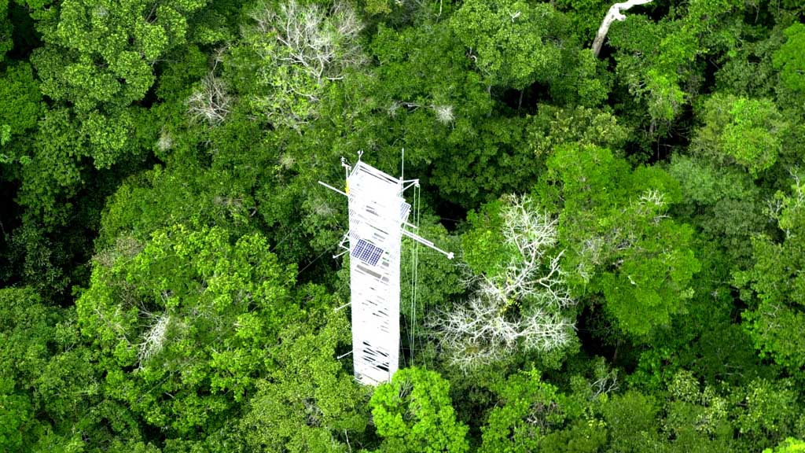
CONTEÚDO…
A importância da Amazônia no Antropoceno
Riscos à floresta Amazônica pelos desmatamentos e mudanças climáticas.
É possível interromper o desmatamento da Amazônia?
A “Terceira Via”: um novo paradigma para o desenvolvimento sustentável da Amazônia

Slide 5
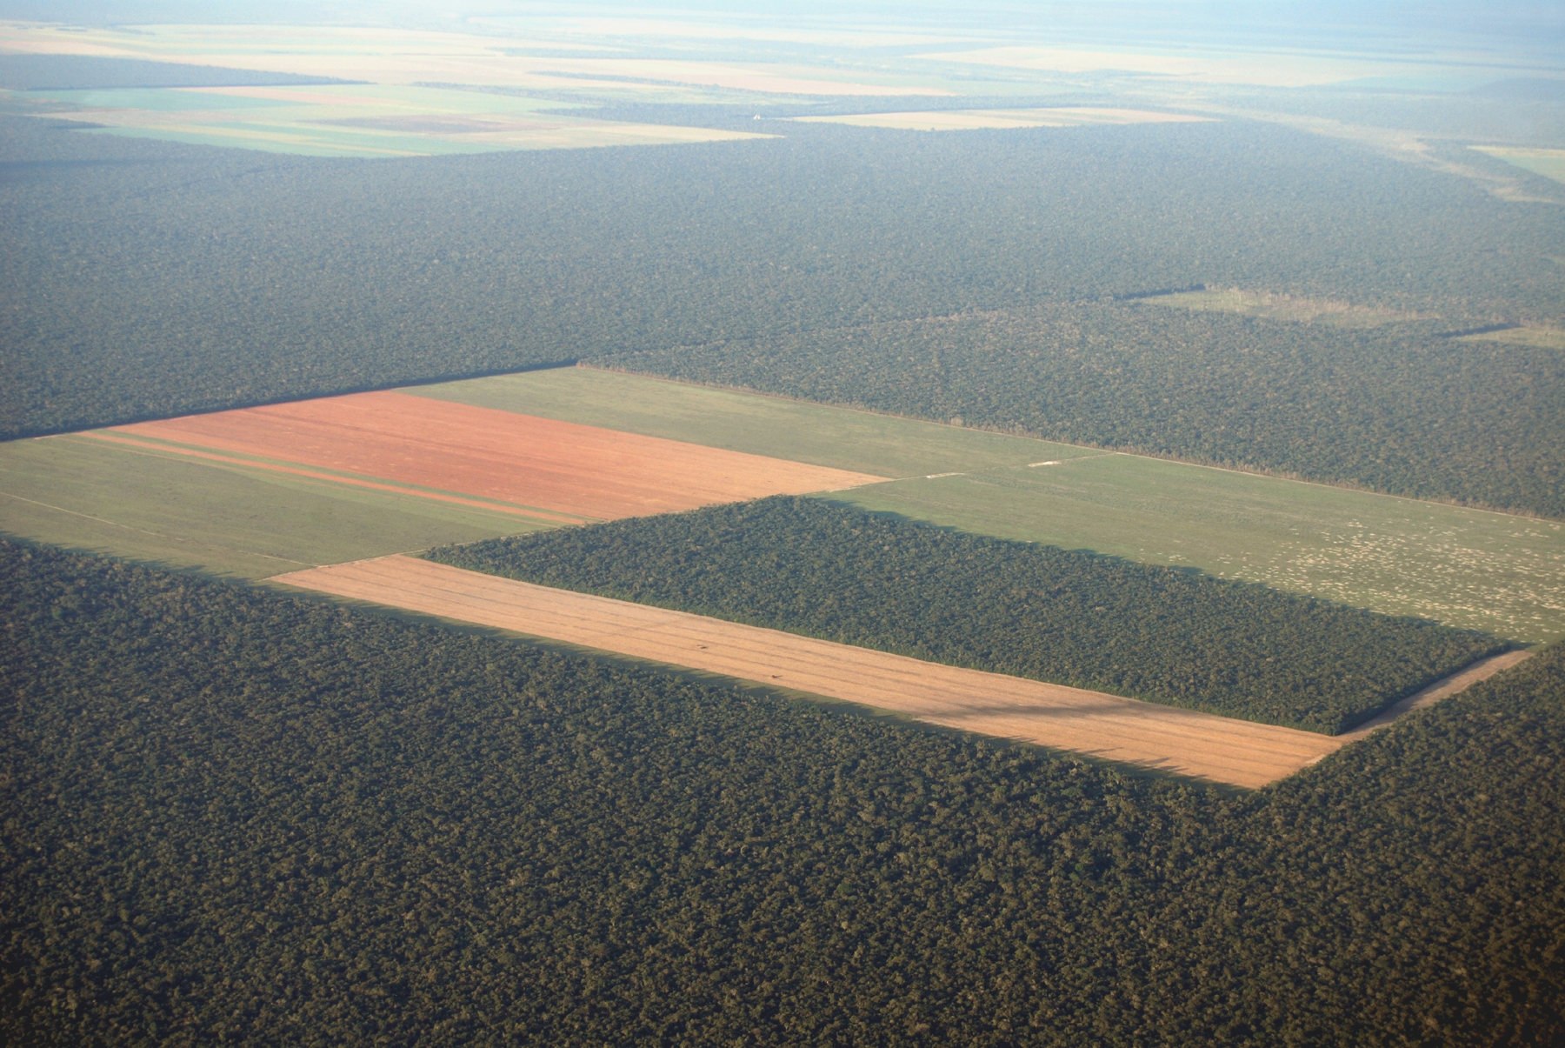
1. A IMPORTÂNCIA DA AMAZÔNIA NO ANTROPOCENO

Slide 6
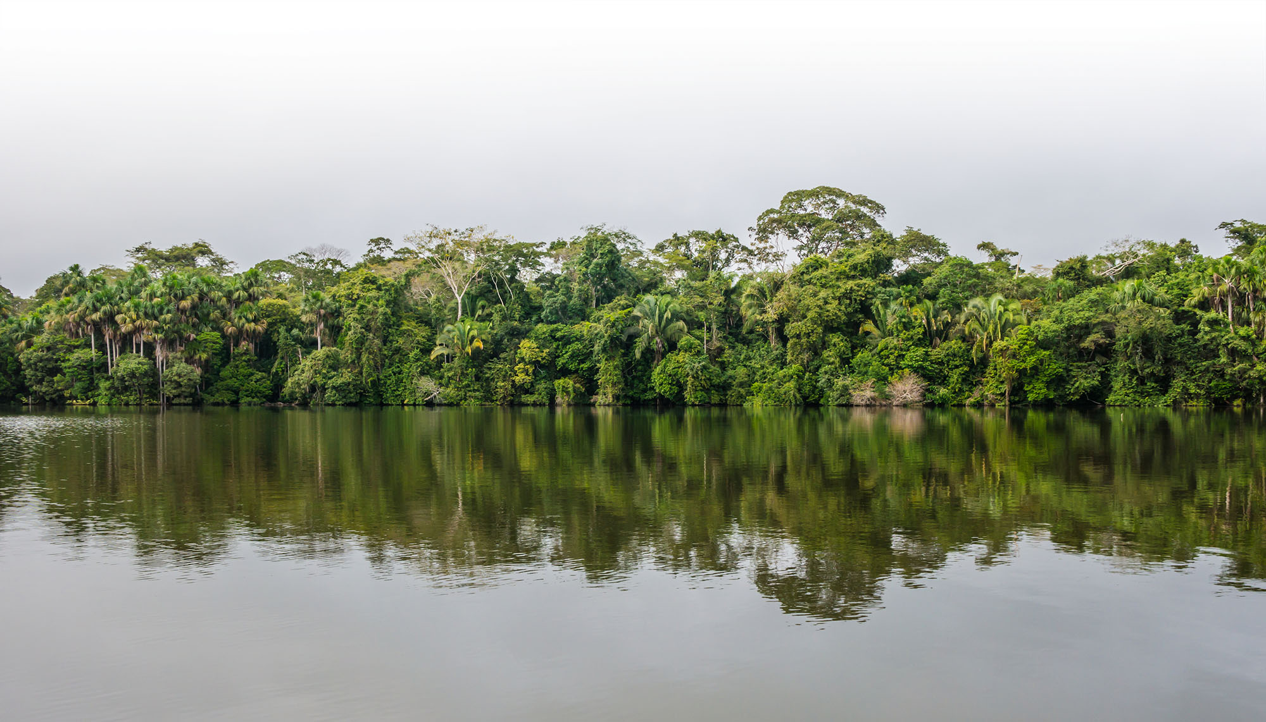
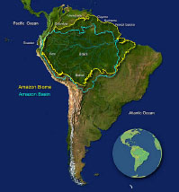
The Amazon: the largest river basin
and contiguous tropical forest
in the planet

Slide 7
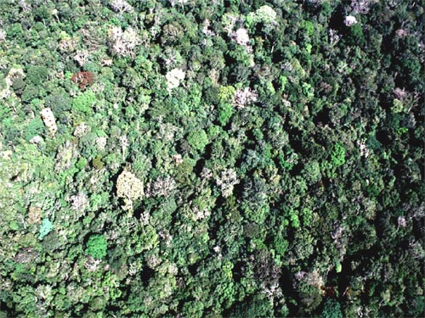
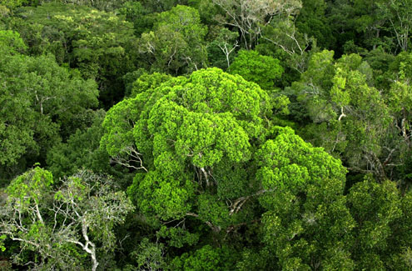
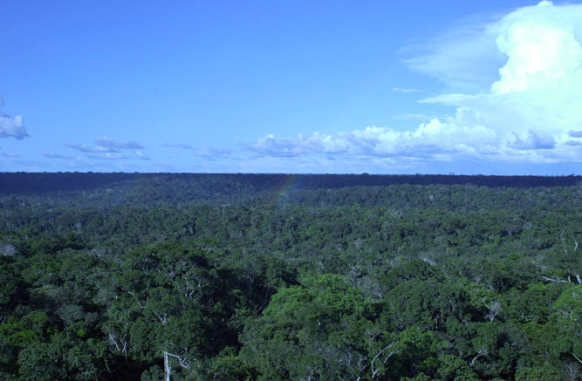

The forests…

Slide 8

The rains…

Slide 9


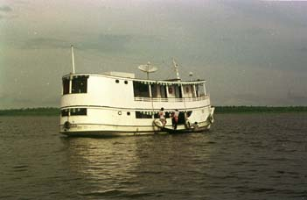
The rivers…

Slide 10
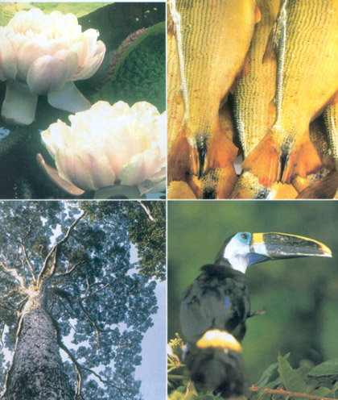




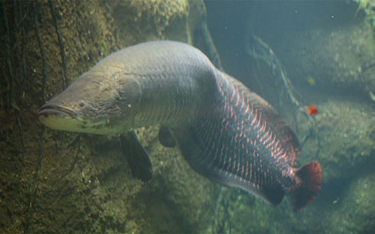
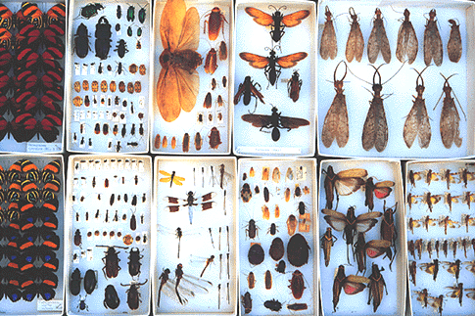

...
Biodiversity…

Slide 11
AMAZON ECOSYSTEMS AT A GLANCE
Maintenance of global carbon cycle
15% of global NPP and a key carbon sink for anthropogenic CO₂
Stores between 100 to 120 billion ton of carbon in the biomass
Climate stabilization
Key heat source for the atmosphere
Annual rainfall = 2400 mm
Powerful hydrology
18% of fresh water flow into the global oceans
Amazon river discharge of 220,000 m³/s
Helps to maintain cultural and ethnic diversity
Over 300 indigenous populations, language diversity
Biodiversity richness
> 10% of species
© Celestia
Notes:
#

Slide 12
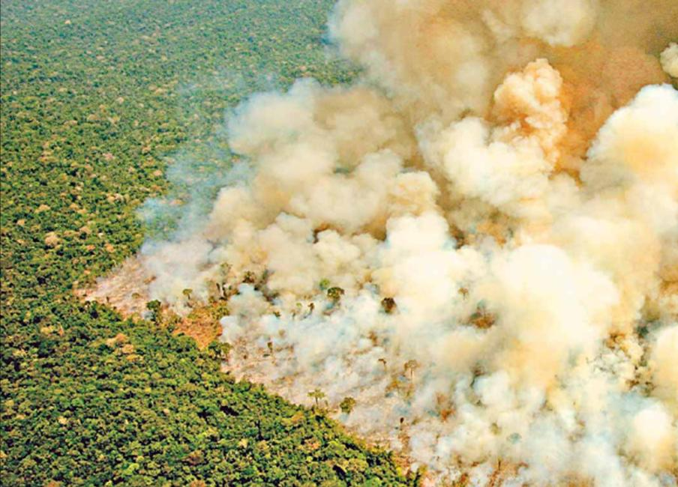
But, the reality of agricultural expansion in the Amazon is one of fire and forest destruction
Notes:
#

Slide 13
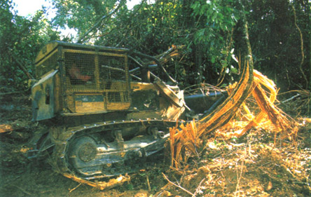
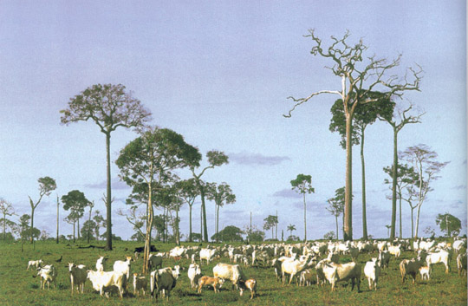
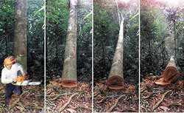
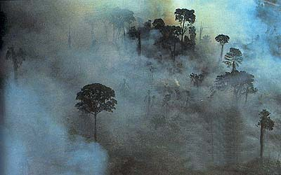
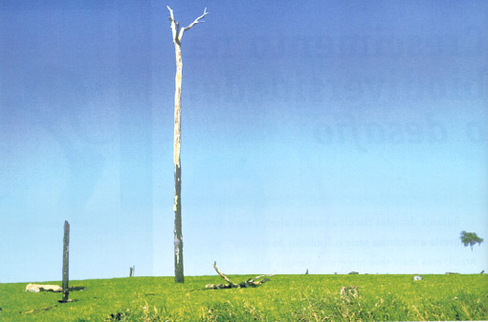
Deforestation…

Slide 14
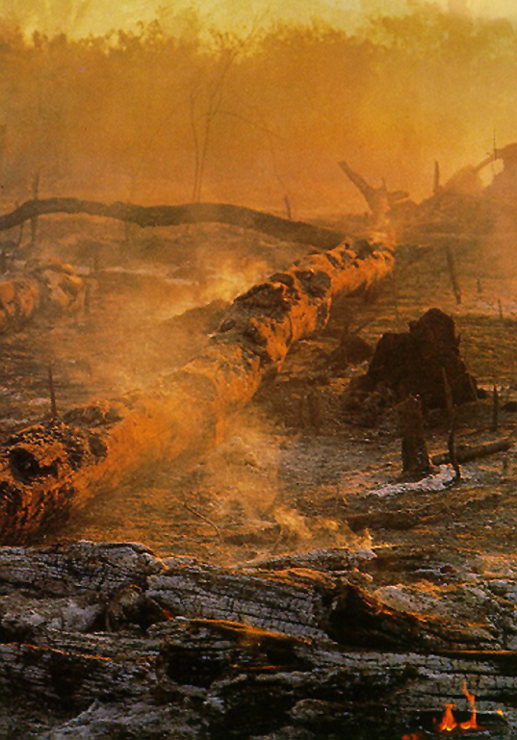
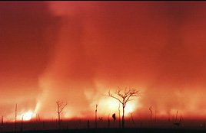
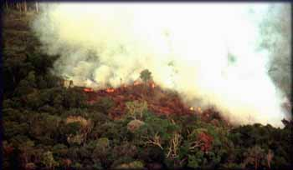
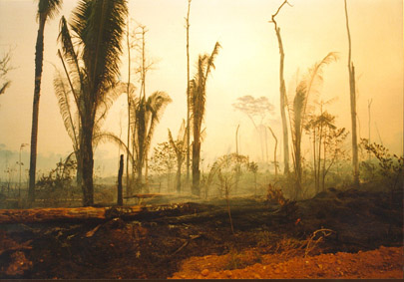
Fire…

Slide 15
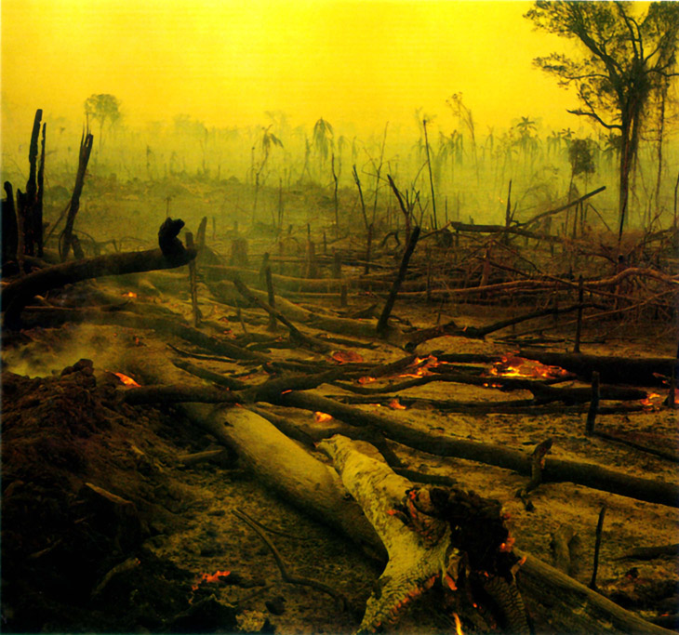
Fire…

Slide 16
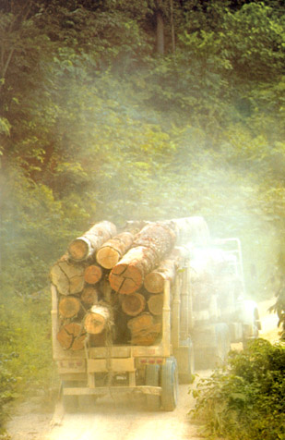
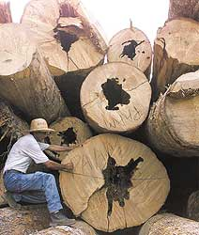
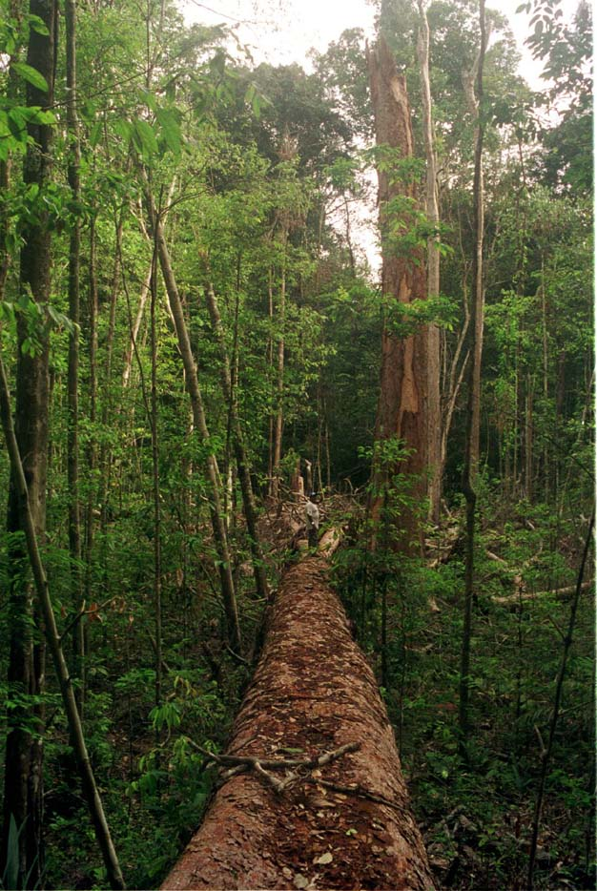
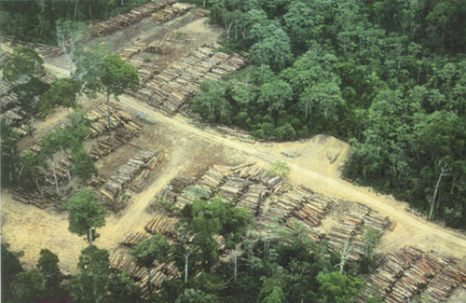
Selective logging…

Slide 17
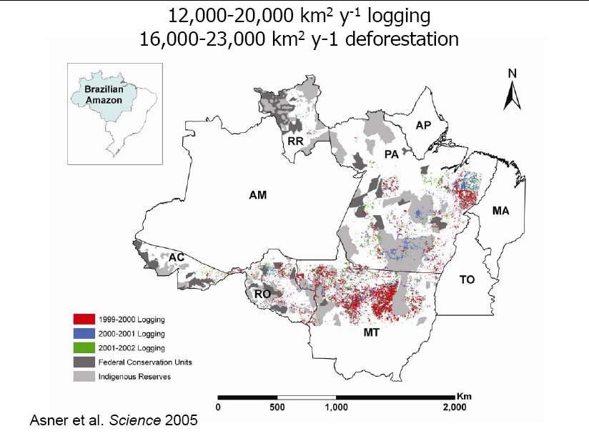
Land use change – observed logging and deforestation

Slide 18
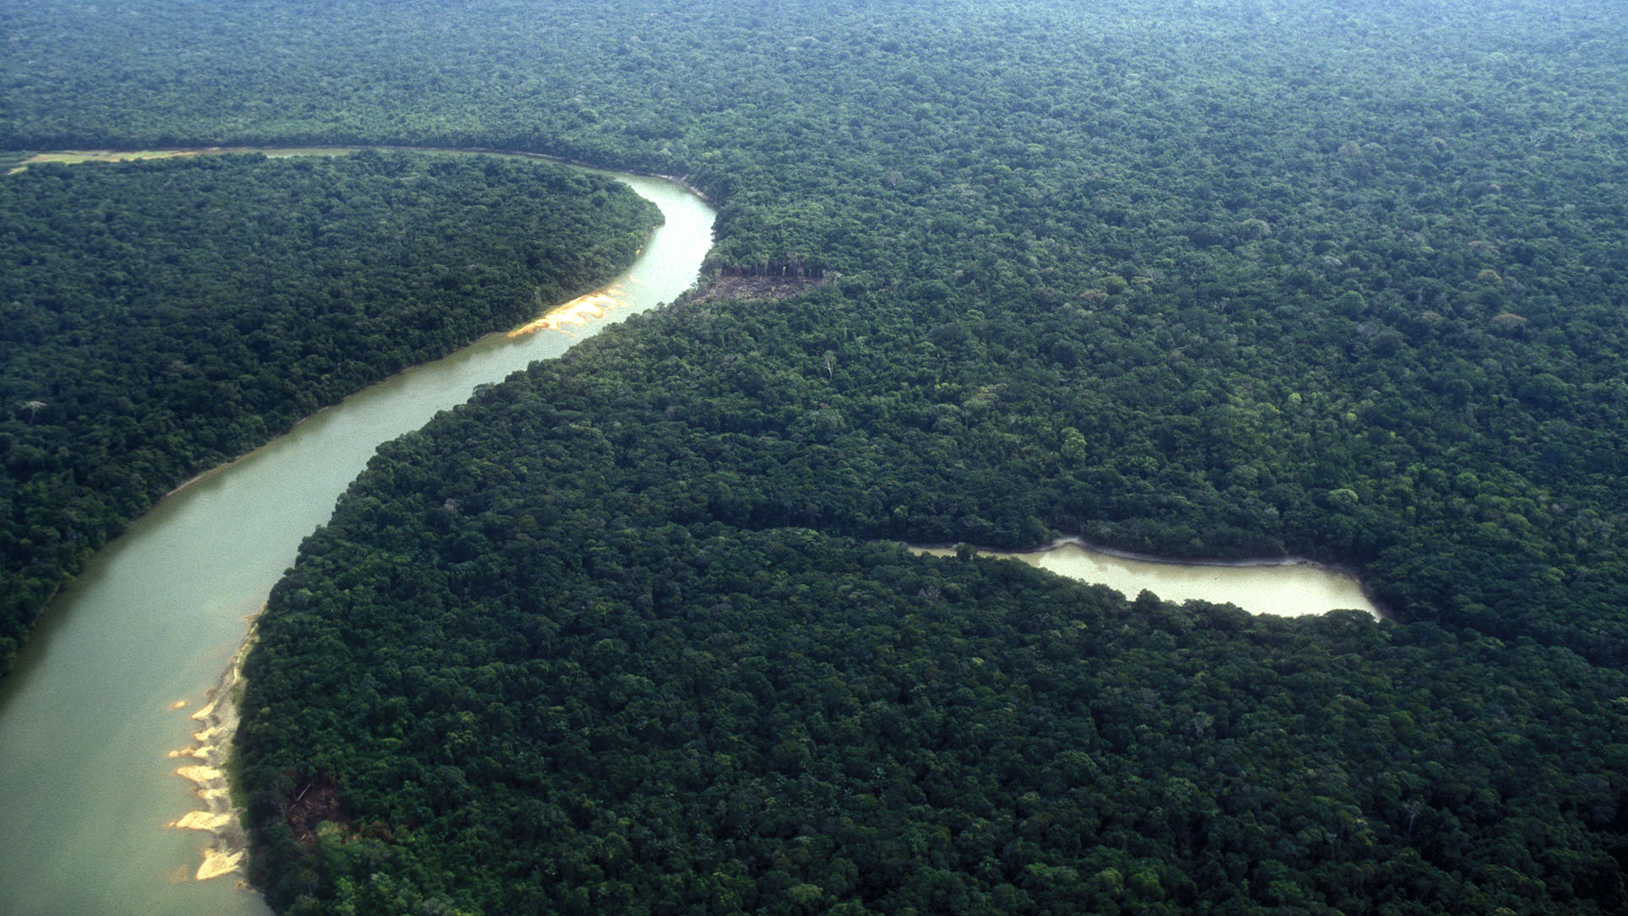
RISKS TO THE NATURAL SYSTEM IN THE AMAZON
The Amazon is a key regional component of the Earth system.
Does the “great acceleration” globally and regionally pose a risk to the functioning of Amazon ecosystems?
Notes:
#

Slide 19

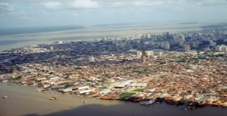
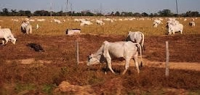
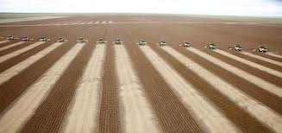
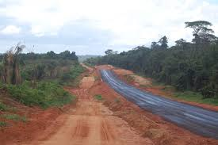
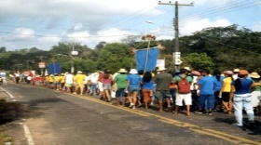
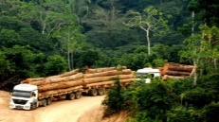

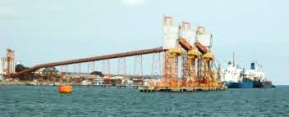

THE AMAZON IN THE ANTHROPOCENE
The “Great Amazon Acceleration” takes off in the 1970’s
Source: Brondizio, 2013
Notes:
-Total population, urban population, cities and towns=IBGE
-Roads, unofficial roads, cattle herd = Various sources literature + IBGE
-Indigenous/conservation areas = IBAMA + IBGE
-Deforestation = INPE *[ os dados para desmatamento podem ser diferentes dependendo da fonte; por exemplo tem outras estimativas de desmatamento que mostram um numero bem maior)

Slide 20
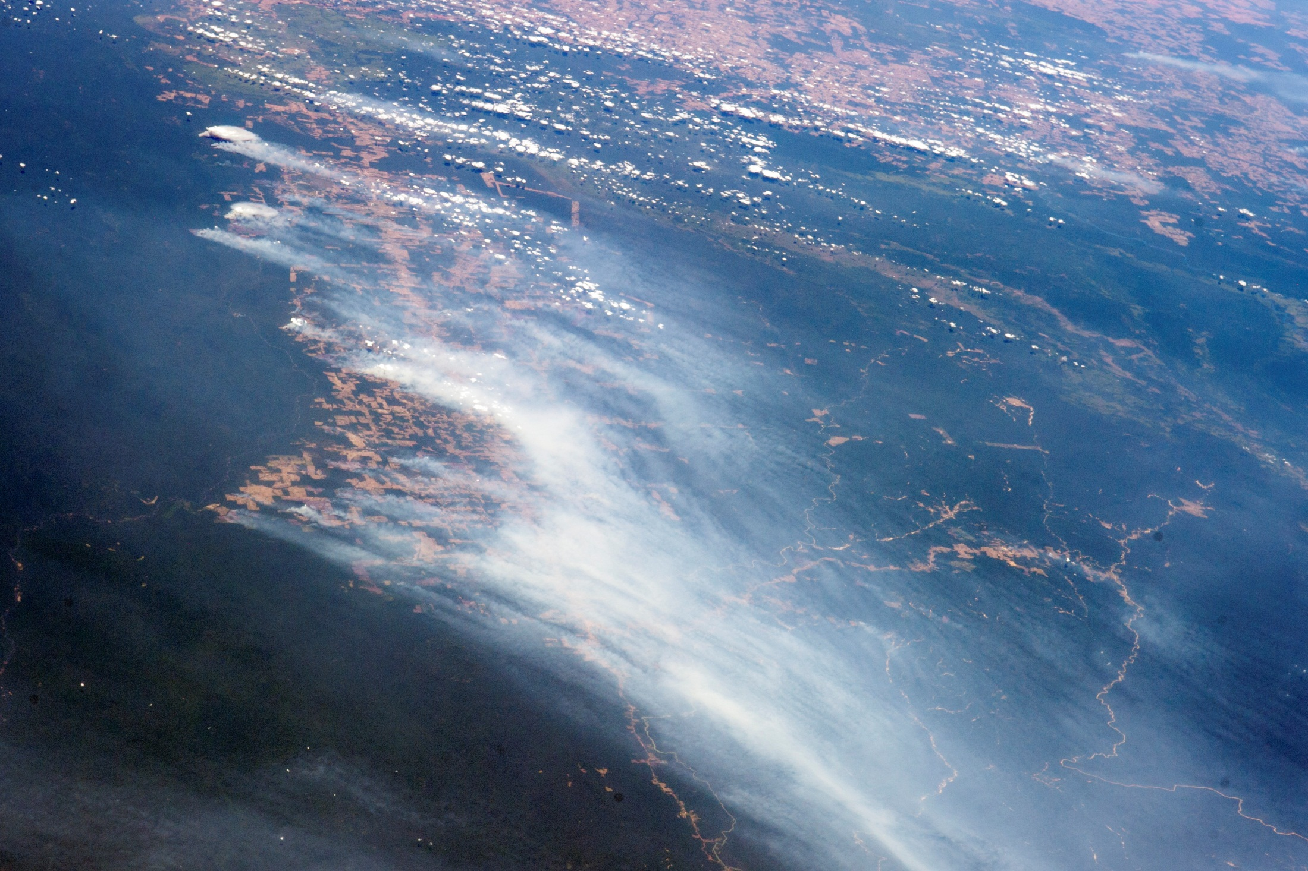
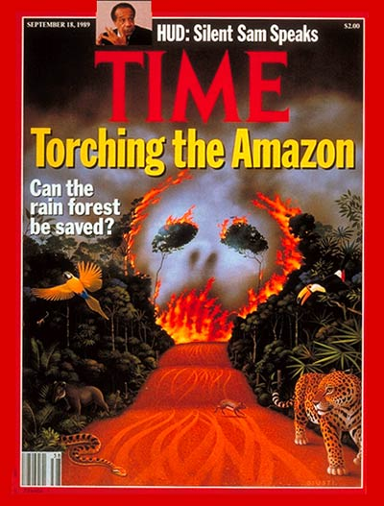
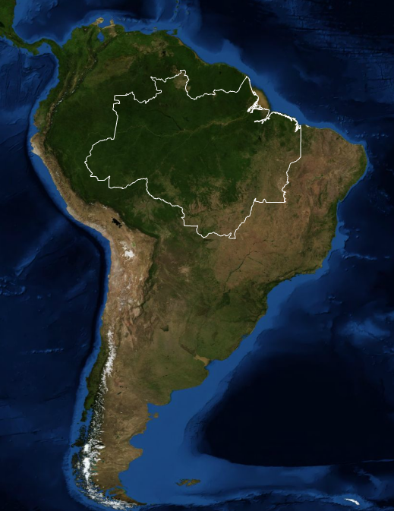
By the end of 1980’s, Amazon deforestation and forest fires became an issue of global concern…
Brazilian Amazon Deforestation in 1988 and 1989 (PRODES-INPE)
Deforestation rates
(km²/year)
1988
1989
Brazil’s Space Research Institute (INPE)
Starts producing in 1988 annual
deforestation rates
Images: http://content.time.com/time/covers/
NASA Earth Observatory, PRODES-INPE
Time Magazine (Sep. 18, 1989)
Notes:
#

Slide 21
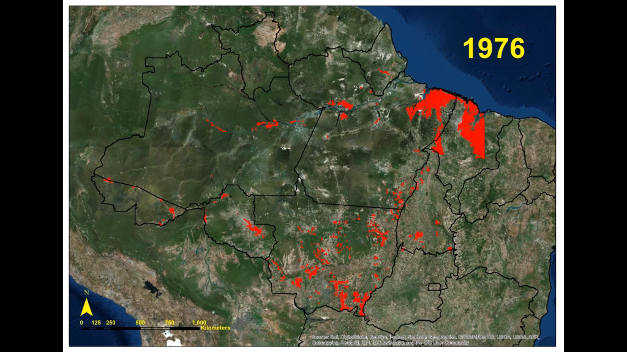
In the early 1970's the Brazilian military government starts the ‘geopolitical’ occupation of the Amazon: incentives to hundreds of thousands of migrants, subsidized large cattle ranches, and roads crisscrossing the region.

Slide 23
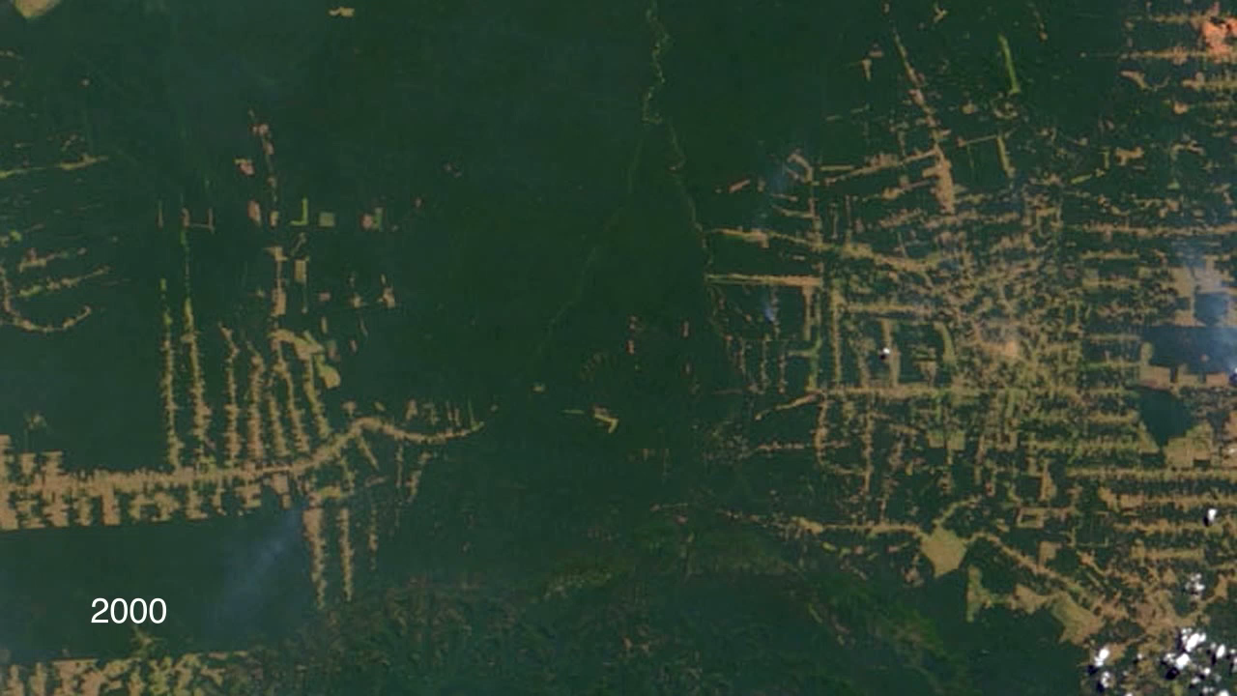
Rondonia, SW Amazon, deforestation pattern
Source: NASA/GSFC
Notes:
#

Slide 24
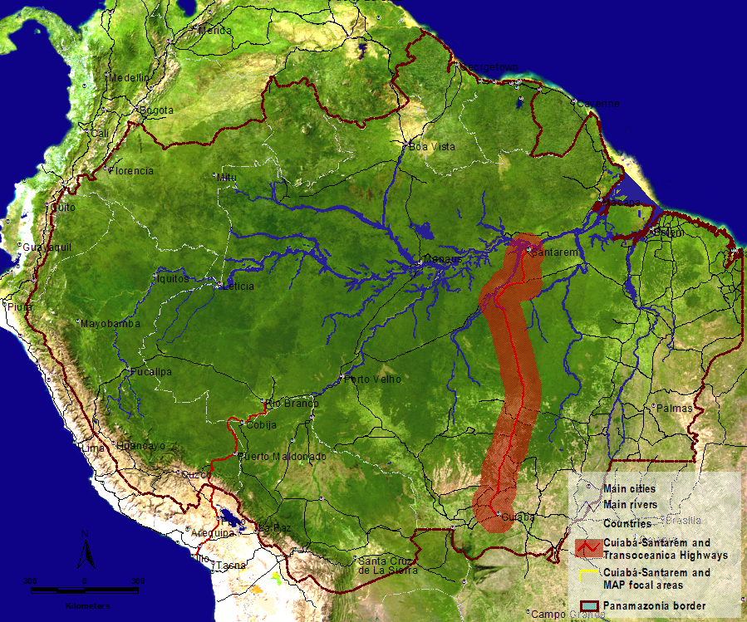
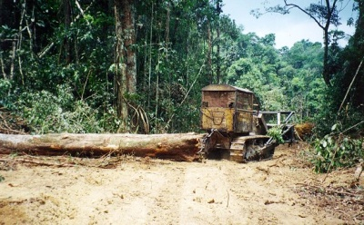
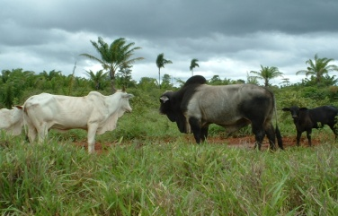
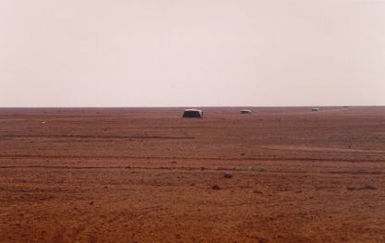
Traditional model is unsustainable!
5-27- thousand km²/year of deforestation
780 thousand km² already deforested
> 200 mil km² abandoned
close to 1 million km² under selective logging
> 50% of Brazil’s GHG emissions
unknown number of species extinct
production of raw materials without added-value
< 0,64% of Brazil’s GDP!
Traditional development model
Timber
Meat
Grain
Notes:
This is more to recall that socio-environmental processes are complex and therefore demand detailed and integrative knowledge of many factors and actors
SLIDE From Ane Alencar (IPAN)

Slide 25
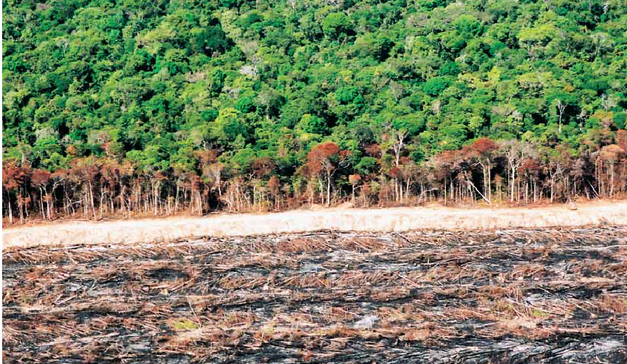
2. RISCOS À FLORESTA AMAZÔNICA PELOS DESMATAMENTOS E MUDANÇAS CLIMÁTICAS

Slide 26
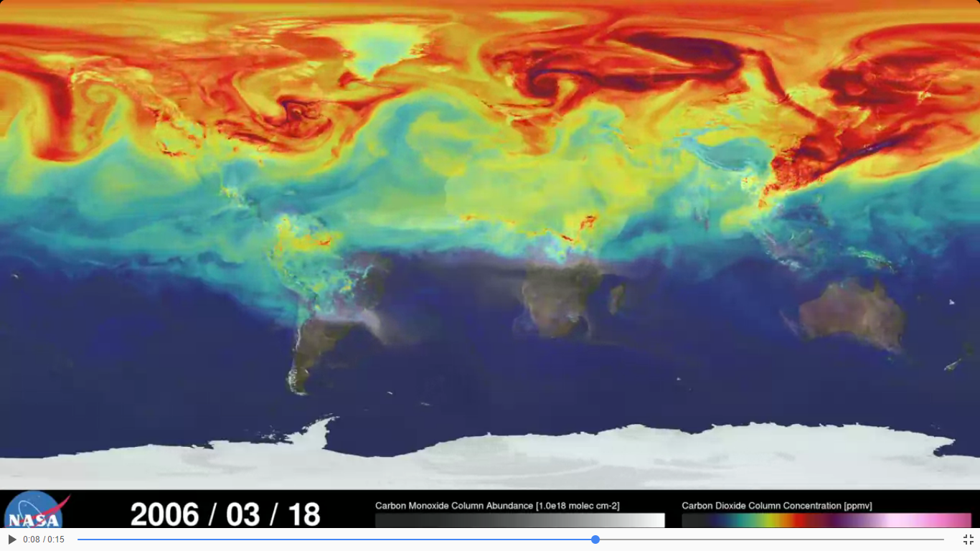
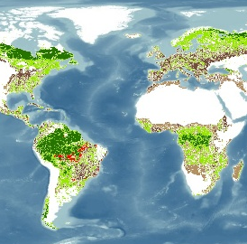
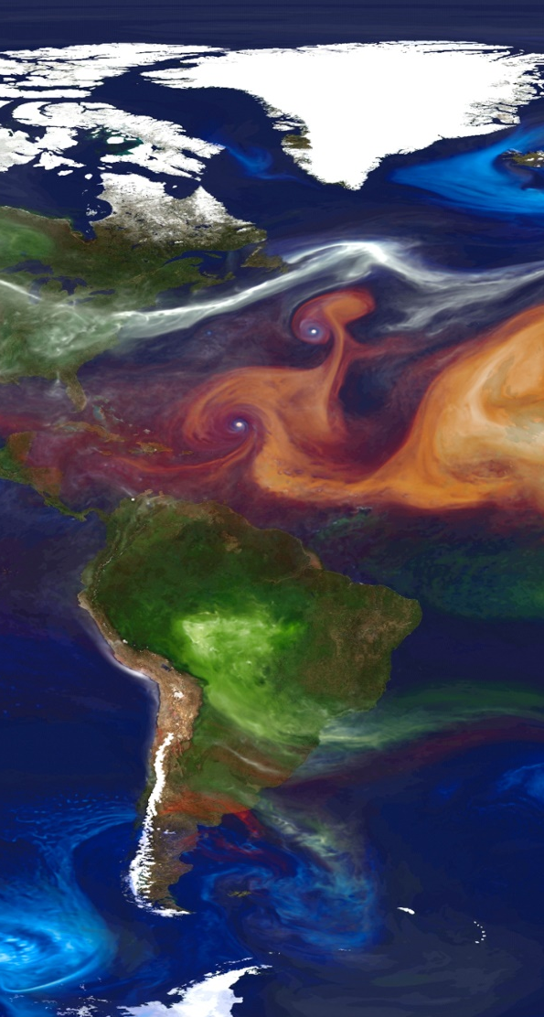
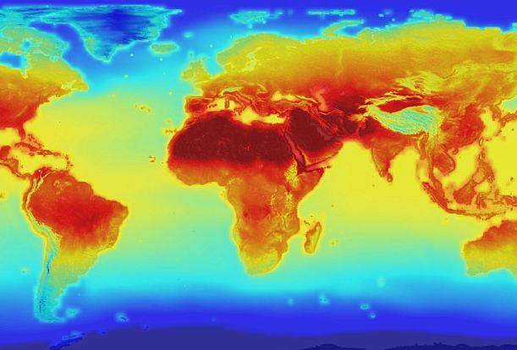
WHAT ARE THE SYNERGISTIC EFFECTS OF ANTHROPOGENIC DRIVERS OF
ENVIRONMENTAL CHANGE IN THE AMAZON?
ELEVATED CO₂
CO₂ concentrations reached 405 ppm in May 2016
GLOBAL WARMING
Warming of 1.1°C in Amazonia, 2014
3°C to 4°C by 2100
(IPCC AR5)
DEFORESTATION
Total deforested area (clear-cutting) is 770,000 km² in Brazilian Amazon (20%)
FOREST FIRES
Forest fire frequency ↑ (Nepstad et al., 2006)
+
+
+
?
Notes:
#

Slide 27


FRACTION OF THE REMAINING FOREST AREA FOR THE ENTIRE AMAZONIA
CLIMATE CHANGE PROJECTIONS – CMIP5 – 9 EARTH SYSTEM MODELS (ESM)
100%
DEFOR.
ONLY
CC ONLY
2050
Projected reductions of 50% or more of forest cover!
90%
20%
RCP 2.6
80%
RCP 4.5
CC+20% Defor.+Fire
2050
CC+
50%
Defor.
+Fire
2050
70%
RCP 8.5
RCP 2.6
60%
40%
RCP 4.5
50%
RCP 8.5
FRACTION OF REMAINING FOREST AREA (%)
50%
RCP 2.6
60%
RCP 4.5
RCP 8.5
40%
80%
30%
100%
20%
10%
0%
2025
2050
2025
2050
Nobre et al., 2016 PNAS

Slide 28



PROJECTED DISTRIBUTION OF NATURAL BIOMES IN SOUTH AMERICA
More than 2/3 of the models used (≥ 6 models) coincide for 2050 from 9 Earth System Models for the RCP 8.5 emission scenarios
COMBINED EFFECTS
Climate Change (RCP8.5) + Deforestation(20%) + Fire + CO₂ ‘Fertilization’ effect
Climate Change Scenario of IPCC AR5 (RCP8.5) in 2050
20% Def.+ Fire
Tropical Seasonal Forest
Savannah
Tropical Evergreen Forest
Forest
Savanna
Control Simulation
Nobre et al., 2016 PNAS .
Notes:
#

Slide 29



‘TIPPING POINTS’ OF FOREST-CLIMATE EQUILIBRIUM IN AMAZON
A) Tropical forest in equilibrium with current climate
B) Savanna state triggered by climate change and/or deforestation
C) Stability of second equilibrium state
One stable equilibrium state
Two stable equilibrium states
Savanna enhanced by increased frequency of droughts and forest fires
Amazon covered mostly by forests
Forest in the
West
Savanna in the
East-Southeast
Equilibrium states
Biome distribution
Biome distribution
Biome distribution
Thresholds for tipping
from state A to state B ≈ 4ºC warming or
≈ 40% of total deforested area
Observations: ΔT ≈ 1.1ºC
Deforestation: ≈ 20%
Fire (?)
Lengthening of dry season (?)
Increase in the frequency and intensity of extremes?
Adapted from Cardoso and Borma, 2010; Borma, Nobre and Cardoso, 2013, Nobre at al., 2015, 2016

Slide 30




EXAMPLE OF TROPICAL FOREST AREAS IN THE BRAZILIAN AMAZON PROGRESSIVELY DECLINING DUE TO DEFORESTATION AND FIRE
Selective logging
Under-canopy loss
Loss> 50% of canopy
Loss> 90% of canopy
Notes:
#
Figure 10.15: Natural capital degradation.
Large areas of tropical forest in Brazil’s Amazon basin are burned each year to make way for cattle ranches, plantation crops such as soybeans (see Figure 1-6, p. 10), and small-scale farms. Questions: What are three ways in which your lifestyle may be contributing to this process? How, in turn, might this process affect your life?

Slide 31




WHAT IS GOING ON RIGHT NOW IN TERMS OF CLIMATE VARIABILITY AND CHANGE IN THE AMAZON?
2005
2010
2012
2014
Record-breaking droughts (2005, 2010, 2016-16) and floods (2009, 2012, 2014)
Changes in extreme flow in Amazon River (medium confidence, major contribution from climate change) (IPCC/ WGIIAR5, 2014)
2014
Notes:
#

Slide 32

THE AMAZON CLIMATE SYSTEM HAS BEEN OSCILLATING BETWEEN TWO EXTREMES IN THE LAST 10 YEARS
CLIMATE SYSTEM
OSCILLATION
DROUGHTS
FLOODS
3 events (1/200)
In the last 10 years
3 events (1/200)
In the last 10 years
2005
2010
2015/16 (El Niño-related)
2009
2012
2014 (over SW Amazon)

Slide 33

3. É POSSÍVEL INTERROMPER O DESMATAMENTO DA AMAZÔNIA?

Slide 34

COMMODITY PRICES DRIVING DEFORESTATION?
Global demand of meet and soy ever increasing…
Annual deforestation rates in Brazilian Amazon
Commodity prices
PRODES/INPE
Source: PRODES-INPE and Assunção et al. (2012)

Slide 35






THE POLITICAL DRIVE TO STOP DEFORESTATION
THE RUPTURE WITH PAST POLICES BY 2003 - 2004
Notes:
#

Slide 36

POLICIES TO REDUCE AMAZON DEFORESTATION
2004
Prevention and Control of Deforestation in the Legal Amazon (PPCDAM).
Coordinated activities among government agencies;
Introduction of real-time remote-sensing forest monitoring technology
Extensive expansion of protected territories.
2008
Targeting of priority municipalities - prevention, monitoring, and combating of illegal deforestation
Revision of legislation - environmental infractions and respective sanctions.
Conditioning of rural credit.
2004
2008
Deforestation rates
(km²/year)
Annual deforestation rates in Brazilian Amazon
Sources: PRODES/INPE and Assunção et al. (2012)
Notes:
NECESSITA ATUALIZAÇÃO PARA DESMATAMENTO EM 2015 E 2016

Slide 37


PROTECTED AREAS – BRAZILIAN AMAZON
1990
# Indigenous Lands: 54
Area: 11 million ha
# Protected Areas: 65
Area: 33 million ha
Indigenous Lands
Protected Areas
Settlements of Agrarian Reform
Notes:
#

Slide 38
PROTECTED AREAS – BRAZILIAN AMAZON
1990
# Indigenous Lands: 54
Area: 11 million ha
# Protected Areas: 65
Area: 33 million ha
Indigenous Lands
Protected Areas
Settlements of Agrarian Reform
Notes:
#

Slide 39

PROTECTED AREAS – BRAZILIAN AMAZON
2000
# Indigenous Lands – 212
Área – 69 million ha
# Protected Areas – 149
Área – 54 million ha
Indigenous Lands
Protected Areas
Settlements of Agrarian Reform
Protected Areas of the ARPA Project
Notes:
#

Slide 40

PROTECTED AREAS – BRAZILIAN AMAZON
2005
# Indigenous Lands – 285
Area – 94 million ha
# Protected Areas – 238
Área – 84 million ha
Indigenous Lands
Protected Areas
Settlements of Agrarian Reform
Protected Areas of the ARPA Project
Notes:
#

Slide 41

PROTECTED AREAS – BRAZILIAN AMAZON
2008
# Indigenous Reserves – 330
Area - 102 million ha
# Protected Areas – 274
Area – 119 million ha
Indigenous Lands
Protected Areas
Settlements of Agrarian Reform
Protected Areas of the ARPA Project
Notes:
#

Slide 42


PROTECTED AREAS – BRAZILIAN AMAZON
2013
# Indigenous Lands – 381
Area – 112 million ha
# Protected Areas – 311
Area – 125 million ha
Indigenous Lands
Protected Areas
Settlements of Agrarian Reform
Protected Areas of the ARPA Project
Notes:
#

Slide 43

POLICIES TO REDUCE AMAZON DEFORESTATION
Avoided
emissions of 3.2 billion ton of CO₂
Law enforcement campaigns
Deforestation declines seem to have been halted
Credit restrictions to deforesters
Establishment of new protected areas
14
15
Adapted from: Nepstad D., D. McGrath, C. Stickler, A. Alencar, A. Azevedo et al. 2014. Science 344, 1118.

Slide 44

CATTLE PRODUCTION AND DEFORESTATION TRENDS IN THE BRAZILIAN AMAZON, 1990-2014
Gibbs, H.K., Munger, J., L’Roe, J., Barreto, P., Pereira, R., Christie, M., Amaral, T. and Walker, N.F. (2015). Did Ranchers
and Slaughterhouses Respond to Zero Deforestation Agreements in the Brazilian Amazon? Conservation Letters.

Slide 45

For many years, ranchers and land speculators had illegally cleared the Amazon rain forest and other important ecosystems to satisfy demand for beef.
Amid calls for change, the Sustainable Agriculture Network, created a certification system designed to encourage the adoption of sustainable ranching practices and foster a market for forest-friendly beef and leather products.
Few consumers and corporations cared about where the beef they bought came from, and
ranchers were reluctant to change their ways in the absence of significant financial incentives.
By late 2016, only a handful of ranchers, whose combined holdings
represented a tiny fraction of 1% of Brazil’s pastureland, had received certification.
However, the program succeeded in developing niche markets for certified beef, and proponents expressed hopes for more gains as consumers became more interested in the sustainability of food production.
Source: ISS-2016, Cameron, B., Princeton University.

Slide 46
DEFORESTATION RATES AND COMMODITY PRICES
(BASE 2015)
Mean Meat Price
(km²/year)
Mean Soy Price
Commodity price is not coupled to deforestation rates past 2005
http://www.agrolink.com.br/cotacoes/Historico.aspx
Notes:
# 7989

Slide 47

GROWTH OF AGRICULTURAL OUTPUT IN THE BRAZILIAN AMAZON IS DECOUPLED FROM DEFORESTATION RATES
Deforestation rates
Annual deforestation rate (km2)
Brazilian Amazon agricultural output (million R$)
Amazon agricultural
product
YEAR
Nobre, Silva e Silva, 2016 (unpublished)
Notes:
#

Slide 48




FUTURE LAND USE CHANGE IN THE AMAZON: SUSTAINABILITY OR FRAGMENTATION?
Fragmentation?
Weakening of policy of recent years
Observed
Deforested Area (%) in 2010
Scenarios of future deforestation to 2030
Sustainability?
Declining deforestation rates
Annual deforestation rates
in Brazilian Amazon
?
Source: PRODES/INPE and Aguiar et al., 2013
Notes:
NECESSITA ATUALIZAÇÃO PARA DESMATAMENTO EM 2016
Notas:
As duas flechas (vermelha e verde) não são apenas para apontar para os cenários possíveis. Elas deveria refletir possíveis trajetórias.
Primeiro, não é necessário novamente colocar as explicações de políticas públicas de 2004 e 2008. O gráfico em si pode começar em 2004 e extrapolar até, digamos, 2030. as flechas vermelha e verde, na verdade, não são linhas retas. Devem ser assintotas. A vermelha começa subir a partir do presente e depois sobe um pouco mais rápido perto de 2030. A verde continua a descer a partir do presente e depois assintoticamente se aproxima de zero. O padrão atual do paper da Ana Paula Aguiar deve ficar em cima das barrinhas do presente. Estas figuras de cenário podem ficar menores para caber tudo na figura.

Slide 49

4. A “TERCEIRA VIA”: UM NOVO PARADIGMA PARA O DESENVOLVIMENTO SUSTENTÁVEL DA AMAZÔNIA
Notes:
#

Slide 50






IS THERE A ‘THIRD WAY’ SUSTAINABLE DEVELOPMENT PARADIGM FOR THE AMAZON ?
The Two Current Paradigms of Development
?
(A)
Resource-intensive
development
(B)
Conservation
Is There a Third Way?

Slide 51
FIRST WAY: EXPAND PROTECTED AREAS IN THE AMAZON
2013
# Indigenous Lands – 381
Area – 112 million ha
# Protected Areas – 311
Área – 125 million ha
Over 50% of Brazilian Amazon
is under some kind of protection
from deforestation, in principle
Indigenous Lands
Protected Areas
Settlements of Agrarian Reform
Protected Areas of the ARPA Project
Notes:
#
GZ: dúvida, esse slide deve ser assim mesmo?

Slide 52

HOW VULNERABLE ARE PROTECTED AREAS?
XINGU INDIAN RESERVATION
Notes:
#

Slide 53

FLAMMABLE FOREST:
RESERVATIONS MAY NO LONGER PROTECT
Fire Scars – Xingu IndIgenous Reservation
Image credit: Antonio Donato Nobre 11/nov/2012
Notes:
#

Slide 54

FIRE SCARS 2010-2012
30% OF THE INDIAN LAND BURNED
Data
Project DETER
Dalton Valeriano,
Luiz E. Maurano OBT/INPE
Notes:
#

Slide 55


SECOND WAY: RESOURCE-INTENSIVE DEVELOPEMENT
THE GLOBAL FARM
AND THE GLOBAL CATTLE RANCH
With its plentiful sun, water and land, Brazil is quickly surpassing other countries in food production and exports. But can it continue to make agricultural
gains without destroying
the Amazon?
Image: http://oglobo.globo.com/
Nature 466, 554-556 (2010)
Notes:
#

Slide 56



NET PROFITABILITY OF CURRENT ECONOMIC ACTIVITIES IN THE AMAZON AND THE POTENTIAL FOR REDD+
CATTLE - US$ 20 - 70 ha/year
SELECTIVE LOGGING - US$ 100 – 400 ha/25-30 years
REDD+ - US$ 500 – 750 ha (US$ 20 ton C)
SOY - US$ 100 – 200 ha/year
Notes:
56
#
Observações: 1) O preço para REDD é baseado num preço médio de US$ 20 por tonelada de carbono, ainda que o preço tenha variado bastante
Tanto no mercado de carbono do Protocolo de Kyoto como no do mercado voluntario. Porem, todas as projeções são de que o preço do
Carbono subirá significativamente se a COP15 chegar a um acordo sobre limitações de emissões até 2020, podendo o valor no
carbono subir acima de US$ 50 dólares por tonelada de carbono; 2) os preços de rentabilidade da pecuária variam de números negativos (prejuízo) até um máximo de US$ 70 dólares por ha por ano, num caso de alta rentabilidade; 3) A rentabilidade da madeira foi calculada assumindo uma retirada
média entre de até 10 m3 a 40 m3 a um preço de US$ 10 por m3. A extração seletiva é feita uma única vez, e o retorno pode se dar em 25-30 anos.
Referências.
Diaz, M. D. C. and Schwartzman, S., 2005. Carbon offsets and land use in the Brazilian Amazon. In: Moutinho, P. and Schwartzman, S (Eds.), Tropical Deforestation and Climate Change. Amazon Institute for Environmental Research (IPAM), 98 pp.
Mertens, B., Poccard-Chapuis, R., Piketty , M –A, Lacques, A.-E., Venturieri, A. , 2002. Crossing spatial analyses and livestock economics to understand
deforestation processes in the Brazilian Amazon: the case of São Félix do Xingú in South Pará. Agricultural Economics 27: 269–294.
Rodrigues, A.S. L., R. M. Ewers, L. Parry, C. Souza Jr., A. Veríssimo, A. Balmford, 2009. Boom-and-Bust Development
Patterns across the Amazon Deforestation Frontier. Science, 324: 1435-1437.
Merry F., B. Soares-Filho, D. Nepstad, G Amacher, H. Rodrigues, 2009. Balancing Conservation and Economic Sustainability:
The Future of the Amazon Timber Industry. Environmental Management (2009) 44:395–407, DOI 10.1007/s00267-009-9337-1.

Slide 57

Razão da Produtividade Real de Culturas Agrícolas em relação ao Potencial Máximo de Produtividade
Agricultura brasileira está longe do potencial máximo de produtividade
Fonte: FAO-IIASA GAEZ , 2012
Notes:
Application of GAEZ whose mass of data was recently made available in partnership with FAO
Data portal aims to help unlock food production bottlenecks
FAO and IIASA launch online Global Agro-ecological Zones Interactive Data Portal
Rome, Italy 25 May 2012 – A new online data portal developed by the Food and Agriculture Organization of the United Nations (FAO) and the International Institute for Applied Systems Analysis (IIASA) aims to help unlock the planet’s potential to feed a rapidly growing population.
The Global Agro-ecological Zones (GAEZ) portal developed by FAO and IIASA is a planning tool designed to help to identify areas for increased global food production while maintaining the natural resources base and facing the challenge of climate change. According to FAO estimates, world food production needs to increase 60 percent by 2050 to feed a world population expected to surpass 9 billion people.
Much of the necessary growth will need to be achieved by increasing the amount of food produced on existing agricultural land, as most of the world’s best farmland is already being used.
Water scarcity is another limiting factor for area expansion. And intensification of food production will occur within a changing climate, requiring adaptation and mitigation and will have to be sustainable to safeguard future use of the resources.
A critical first step in sustainably intensifying food production is to close the “yield gaps” that continue to plague the farming sector in many parts of the world.
“GAEZ can help identify where there are ‘bridgeable yield gaps’ and what causes them, allowing for the formulation of appropriate investment policies and the provision of appropriate support to farmers to help them produce more food” says Parviz Koohafkan, Director of FAO’s Land and Water Division.
The term “yield gap” refers to the difference between how much food a farm actually produces and how much food it would be capable of producing if appropriate practices, inputs, technologies and knowledge were applied.
Such gaps can be quite wide: for example, a recent FAO study found that in some rural areas of Eastern Europe, the Caucasus and Central Asia, crop production by small farmers, especially for cereals, can run as low as low as just 30-40 percent of potential.
The world region with the highest yield gaps is sub-Saharan Africa. Cereal yields in Africa as a whole have long hovered around 1.2 tons per hectare, compared to an average yield of some 3 tons per hectare in the developing world as a whole.
A wellspring of data, online
A new online data portal developed by FAO and the International Institute for Applied Systems Analysis (IIASA) seeks to enhance planners’ and decision makers’ capacity to estimate agricultural production potentials and variability under different environmental and management scenarios, including climatic conditions, management regimes, water availability and levels of inputs.
The portal -- the Global Agro-Ecological Zones Interactive Data Access Facilities offers access to what IIASA Director/CEO Pavel Kabat calls “the most ambitious global agro-resources assessment ever conducted”. “The objective was to assemble a vast wealth of data information and make this available in a way that is most accessible to land use planners and specialists to help close yield gaps and promote the sustainable intensification of agricultural production,” Kabat says.
At the heart of the GAEZ system is an extensive inventory of the world’s agricultural resources and related data, organized around five thematic areas:
Land and water resources, including multiple spatial layers of climate, soil, terrain, land cover, irrigation potentials, protected areas, population density, livestock density and accessibility, etc...
Agro-climatic resources, providing major climatic indicators important for assessing crop growth, development and yield formation. GAEZ’s spatial agro-climatic inventories of the prevailing thermal and moisture regimes and growing periods are used for estimating crop suitability and potential yields.
Agricultural suitability and potential yields, including information on yield constraints, crop calendars, and production potential estimates for 11 major crop groups, 49 major crops and 92 crop types. Productivity estimates are made for rain-fed farming, rain-fed farming with water conservation and gravity, sprinkler and drip irrigation systems.
Actual yields and production, consisting of spatially explicit crop production estimates including crop harvested area, yield and production figures for 23 major commodities.
Yield and production gaps, which provide important information on locations with differences between actual achieved and potential attainable yield and production under different management scenarios.
Being geo-referenced, GAEZ allows a user to identify agricultural zones across the globe that share similar ecological conditions and are producing the same crops using the same kinds of production system, but which do not have the same production levels. This means the reasons underlying lower production – inadequate or inappropriate agricultural practices, policies, institutions, support services and access to markets. – can be pinpointed and dealt with. The potential exists to expand food production efficiently while limiting impacts on other ecosystem values.
In particular, given the scarcity of suitable resources in some regions, future demand and expected negative impacts of climate change, GAEZ would allow users to evaluate options for more widespread adoption of sustainable land and water management practices in agricultural systems at risk, recently highlighted in FAO's report The State of the World's Land and Water Resources for Food and Agriculture.
These systems at risk face the threat of progressive breakdown of their productive capacity. They warrant priority attention for remedial action simply because there are no substitutes.
Alexander Mueller, Assistant Director General of the FAO Natural Resources Management and Environment Department, which developed GAEZ in collaboration with IIASA, concludes: “the new GAEZ data portal will provide a global tool to manage natural resources for food and agriculture in a more sustainable way. Natural resources are the basis for food production. In a world already facing today water scarcity and land degradation in many areas and coping with increasing risks from climate change, this is the only way to achieve food security.”
The FAO-IIASA GAEZ portal can be found online at: http://www.iiasa.ac.at/Research/LUC/GAEZv3.0/ and http://www.fao.org/nr/gaez/en/

Slide 58
EFFICIENCY OF AGRICULTURE IN THE AMAZON
GROSS AGRICULTRE PRODUCT AND AREA UTILIZED IN AGRICULTURE AND ANIMAL HUSBANDRY
AMAZON AGRICULTURE PRODUCT ≈ 14.5% OF BRAZIL’S AGRICULTURE SECTOR GDP ON 750,000 KM²
≈ 1% OF AGRICULTURE GDP FOR EACH 50 THOUSAND KM²
COMPARED TO
SÃO PAULO STATE AGRICULTURE PRODUCT ≈ 11.3% OF BRAZIL’S AGRICULTURE SECTOR GDP ON 193,000 KM²
1% OF AGRICULTURE GDP FOR EACH 17 THOUSAND KM²
SÃO PAULO STATE AGRICULTURE IS ≈ 3 TIMES MORE EFFICIENT!
NOBRE ET AL., 2016 PNAS

Slide 59

Agriculture output per unit area in the Amazon is only one-quarter of the more productive areas in elsewhere in Brazil.
Endless expansion of the agriculture frontier has to be halted and sustainable agriculture has to be the new norm, including intensification.
Notes:
#

Slide 60

DO NO HARM, ANYMORE!

Slide 61



Desafio de Bonn
Atlas de Oportunidades
de Restauração de Paisagens e Florestas
Meta global para restaurar 150 milhões de hectares de terras degradadas e desmatadas
até 2020
Oportunidades de restauração de paisagens florestais
Restauração em larga escala
Restauração em mosaico
Restauração remota

Slide 62
Desafio de Bonn
Sequestro de Carbono em Áreas de Florestas
Floresta Amazônica madura ≈ 0,4 tonC/ha/ano
Mata Atlântica madura ≈ 0,3 tonC/ha/ano
Atlas de Oportunidades
de Restauração de Paisagens e Florestas
Meta brasileira para restaurar 12 milhões de hectares de terras degradadas e desmatadas
até 2025
Sequestro de C em floresta em recrescimento depende da história prévia de usos da terra:
Previamente floresta ≈ 5 tonC/ha/ano
Previamente pastagem ≈ 2,9 tonC/ha/ano
Previsamente agricultura ≈ 4,7 tonC/ha/ano
Oportunidades de restauração de paisagens florestais
MCTI, 2016 Terceira Comunicação Nacional
Restauração em larga escala
Restauração em mosaico
Restauração remota

Slide 63


Potencial de regeneração natural
(WRI-Brasil, 2016)
Milhões de ha Passivo APP
Baixo Potencial 4,70 0,99
Médio Potencial 4,15 1,17
Alto Potencial 4,19 0,85
Muito Alto Potencial 8,31 1,48
TOTAL 21,35 4,50

Slide 64

CARBON SEQUESTRATION POTENTIAL IN RANGELANDS
High potential for
pastureland in Brazil
Source: Herrero, M., Henderson, B., Havlik, P. Thornton, Philip K., Conant, R.T., Smith, P., Wirsenius, S., Hristov, A.N., Gerber, P., Gill, M., Butterbach-Bahl, K., Valin, H. Garnett, T. and Stehfest, E. (2016) Greenhouse gas mitigation potentials in the livestock sector. Nature Climate Change.

Slide 65

Intensificação da pecuária e efeito poupa-terra
Ocupação atual ≈ 1.25 cab/ha
Pecuária “neutra em carbono”
≈ 2,6 cab/ha em solos bem manejados (sequestro de até 1 tonC/ha/ano)
“Emissões ≈ Sequestro de Carbono”
Fonte: E. Assad, EMBRAPA

Slide 66
A M A Z O N
THIRD WAY
Notes:
#

Slide 67
80% DEFORESTATION REDUCTION IN THE BRAZILIAN AMAZON PROVIDES A UNIQUE WINDOW OF OPPORTUNITY TO RETHINK FUTURE DEVELOPMENT PARADIGMS
km²/year
Annual deforestation rates in Brazilian Amazon
DEFORESTATION RATES WERE REDUCED AS WELL IN
OTHER AMAZONIAN COUNTRIES IN THE LAST DECADE
Year
Annual deforestation rates in Brazilian Amazon
Source: PRODES/INPE, 2015

Slide 68
THE AMAZON HAS A SIGNIFICANT SHARE OF THE WORLD’S BIODIVERSITY
ESTIMATE OF WORLD’S BIODIVERSITY

Slide 69






ARE THERE WAYS TO UTILIZE AMAZON BIODIVERSITY SUSTAINABLY?
The Assaí Berry Case
Economic Product from Assaí Berryin the Amazon
≈ US$ 1,8 billion/year
New uses: natural marker for plaque
Net Profitability from Assaí Production in the Amazon
Pará State: US$ 200 ha/year (unmanaged) to US$ 2,300 ha/year (managed)
Jardim and Anderson (1987)
Hiraoka (1994a, 1994b)
Brondizio, E. (2007)
Notes:
#

Slide 70
THE AMAZON THIRD WAY COMBINES THE WORLD OF BIOLOGICAL/BIOMIMETIC ASSETS WITH ADVANCED TECHNOLOGIES IN A VIRTUOUS CIRCLE

Slide 71
THE DNA OF AMAZON THIRD WAY INNOVATIONS & APPLICATIONS

Slide 72
THE RECENT APPARENT REVERSAL OF DEFORESTATION DECLINE TREND HIGHLIGHTS THAT WE MUST SEEK FOR DISRUPTIVE CHANGE IN THE AMAZON DEVELOPMENT PARADIGMS
km²/year
Annual deforestation rates in Brazilian Amazon
Year
DEFORESTATION RATES WERE REDUCED AS WELL IN
OTHER AMAZONIAN COUNTRIES IN THE LAST DECADE
Annual deforestation rates in Brazilian Amazon
Source: PRODES/INPE, 2015
Notes:
NECESSITA ATUALIZAÇÃO PARA DESMATAEMNTO EM 2016

Slide 73

NECESSITAMOS UM NOVO PARADIGMA ECONÔMICO SUSTENTÁVEL PARA A AS FLORESTAS TROPICAIS
“Agregar valor ao
coração da floresta”
Bertha Becker
Ciência e Tecnologia deve oferecer soluções para a emergência de uma inovadora bioindústria na Amazônia.
Simultaneamente ao empoderamento e educação de qualidade para as populações Amazônicas.
Notes:
#

Slide 74




CONHECIMENTO COM BASE DA SUSTENTABILIDADE PARA A AMAZÔNIA
Notes:
#

Slide 75

THANK YOU!
OBRIGADO!
¡GRACIAS!
Notes:
#

