Slide 1

Food Security and the 2015-30 Sustainable Development Goals: From Human to Planetary Health
Rafael Pérez-Escamilla, PhD
Professor of Epidemiology & Public Health
Yale University, School of Public Health, USA

Slide 2

Global Food Security is key to achieve the SDGs

Slide 3
What is Food Insecurity?

Slide 4
Food Security exists when…
“…people, at all times, have physical, social and economic access to sufficient, safe and nutritious food which meets their dietary needs and food preferences for an active and healthy life”
1996 Rome World Food Summit

Slide 5
What Causes Food Insecurity?

Slide 6
UNICEF, Frankenberg et al
Global Food Availability
Global
Food Imports
Local Food Production
National
Education & other
National Food Availability
Household Income
Household Food Access
Households & Individuals
Access to Health Care & Other Basic Needs
Food Security
Nutrition Security
Individual

Slide 7
How do we Measure Food Insecurity?

Slide 8
Food Insecurity Dimensions
Boyle (2003)
Quantity: Enough calories?
Quality: Adequate nutritional value?
Suitability: Culturally acceptable?
Psychological: Anxiety, feelings of deprivation?
Social: Socially acceptable methods for acquiring foods?

Slide 9
Escala Brasileira de Insegurança Alimentar (EBIA)
Experience-based HFI measurement scale
Adapted and validated in 2003-04
  From U.S. HFSSM
Repeated national applications since 2003 through PNAD, PNDS
Explosion of HFI research in Brazil since 2003
Segall-Corrêa, Pérez-Escamilla and cols. (2004, 2008, 2014)

Slide 10
EBIA questionnaire items. English back-translation from Portuguese [Perez-Escamilla et al. (2004)]
item | During the last 3 months….
1 | were you worried that you would run out of food before being able to buy or receive more food?
2 | did you run out of food before having money to buy more?
3 | did you run out of money to have a healthy and varied diet?
4 | did you have to consume just a few foods because you ran out of money?
5 | were you unable to offer your children/adolescents a healthy and varied diet because you didn’t have enough money?
6 | did any of the children/adolescents didn’t eat enough because there wasn’t enough money to buy food?
7 | did you or any adult in your household ever reduced the size of meals or skipped meals because there wasn’t enough money to buy food?

Slide 11
8 | did you ever eat less than what you thought you should because there wasn’t enough money to buy food?
9 | did you ever feel hungry but didn’t eat because there wasn’t enough money to buy food?
10 | did you lose weight because you didn’t have enough money to buy food?
11 | did you or any other adult in your household ever went without eating for a whole day or just had one meal in a whole day because there wasn’t enough money to buy food?
12 | did you ever reduced the size of meals of your children/ adolescents because there wasn’t enough money to buy food?
13 | did your children/adolescents ever had to skip a meal because there wasn’t enough money to buy food?
14 | were your children/adolescents ever hungry but you just couldn’t buy more food?
15 | did your children remained without food for a whole day because there wasn’t enough money to buy food?

Slide 12
Outcomes from national EBIA applications
(and process that led to them)
“Hunger” maps
  Magnitude and distribution of the problem
Valuable baselines
  e.g., First national application in 2004
Strong media coverage
  Public opinion interest
  Policy makers engagement
  National dialogue about what food insecurity “is”, extent of problem and how to go about solving it

Slide 13
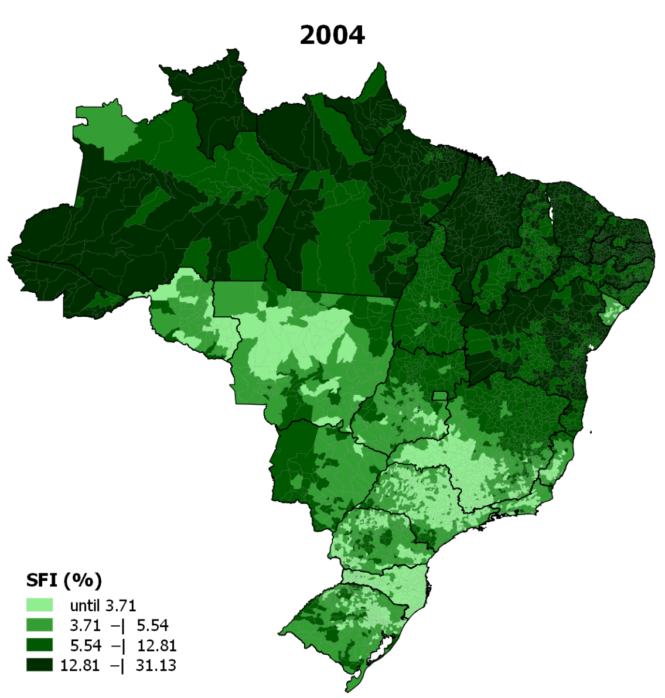
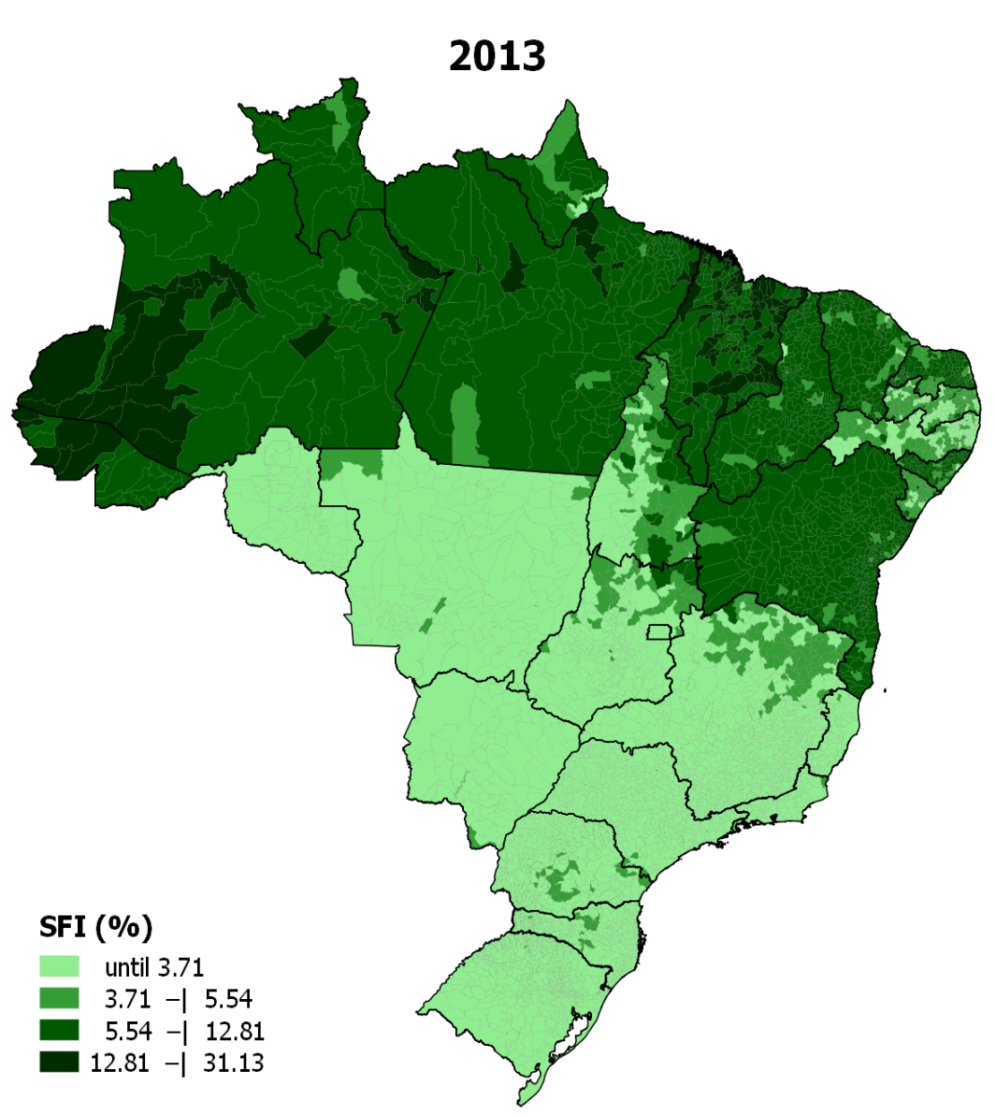
Changes in Prevalence of Severe HFI in Brazilian Municipalities*
Muriel Gubert et al. 2016
*Severe HFI predicted with PNAD and census data

Slide 14
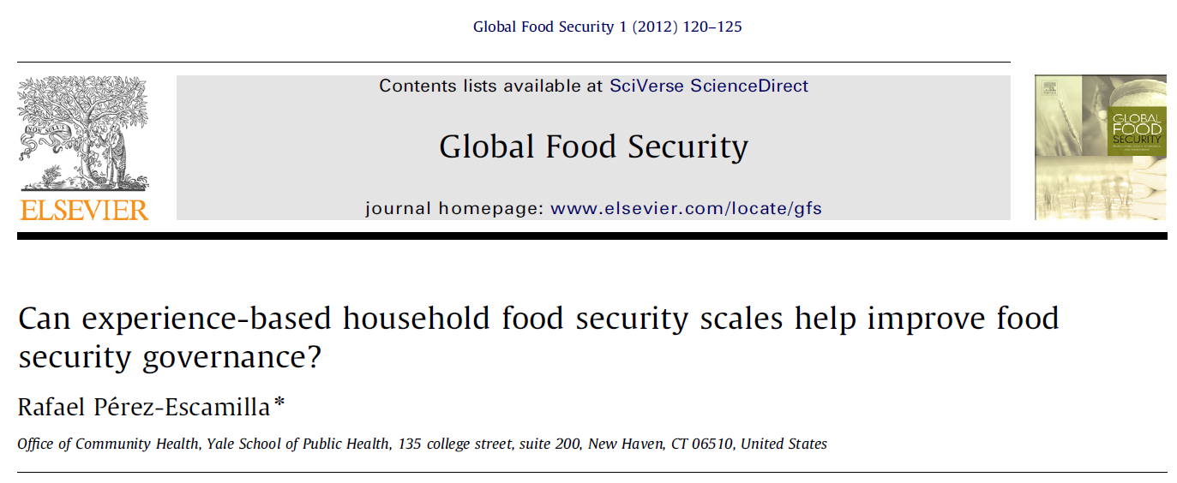
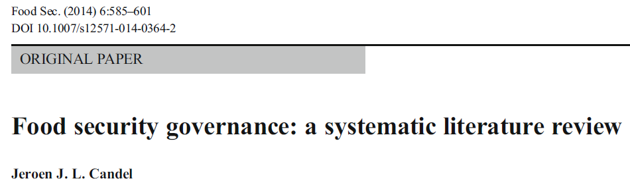

Slide 15

EBIA yields a SMART indicator with strong but yet to be proven potential to help improve food security governance
SENSITIVE
MEASURABLE
ATTAINABLE
RELEVANT
TIME BOUND
When it comes to food security governance process of introduction of EBIA into Brazil mattered as much as instrument itself
Perez-Escamilla Glob Food Sec (2012)

Slide 16
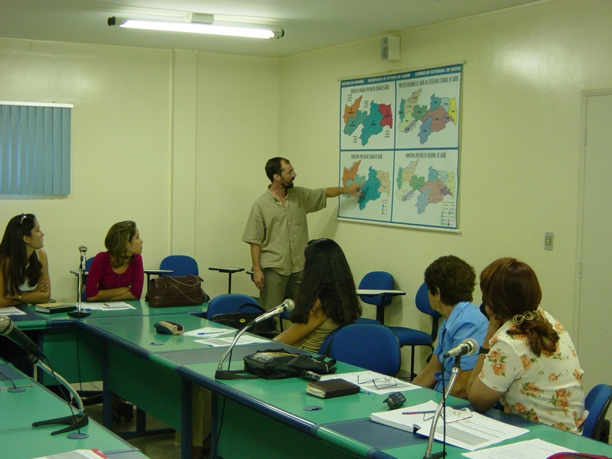

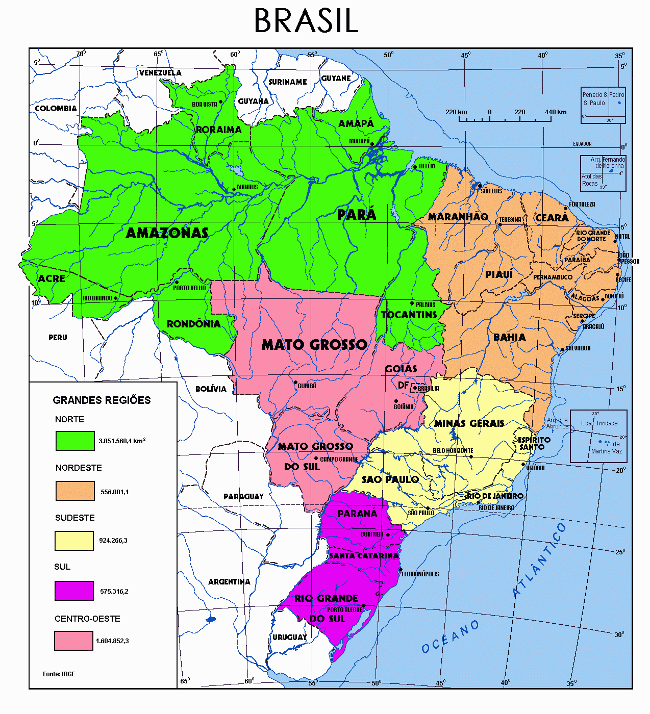
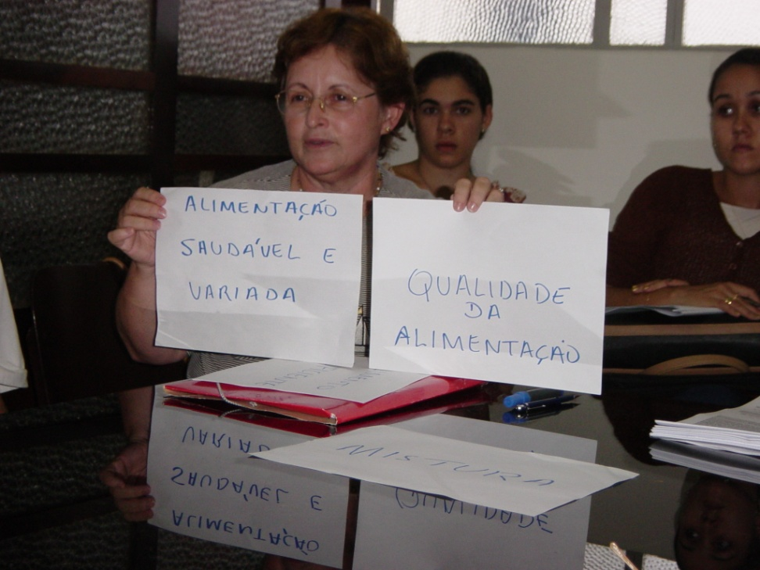
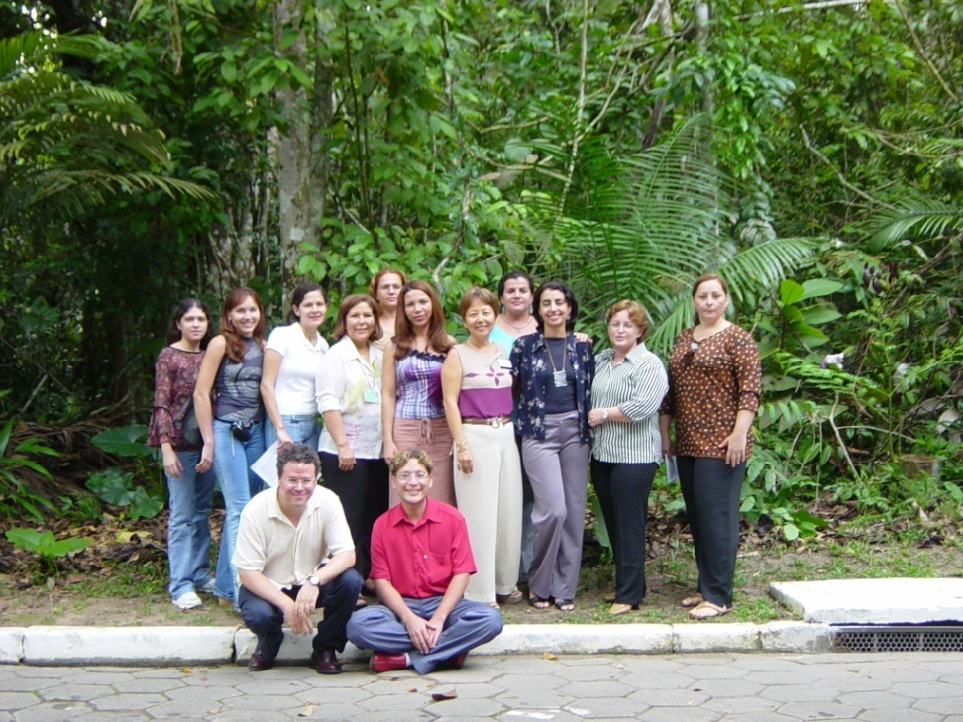
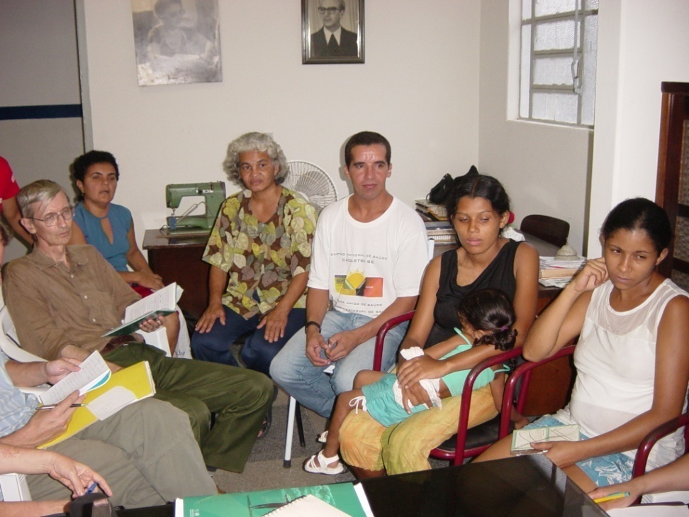
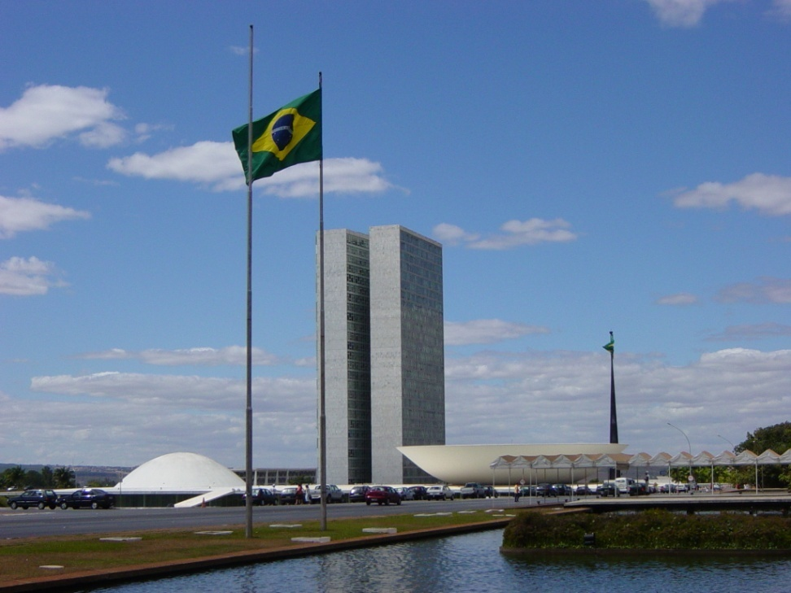
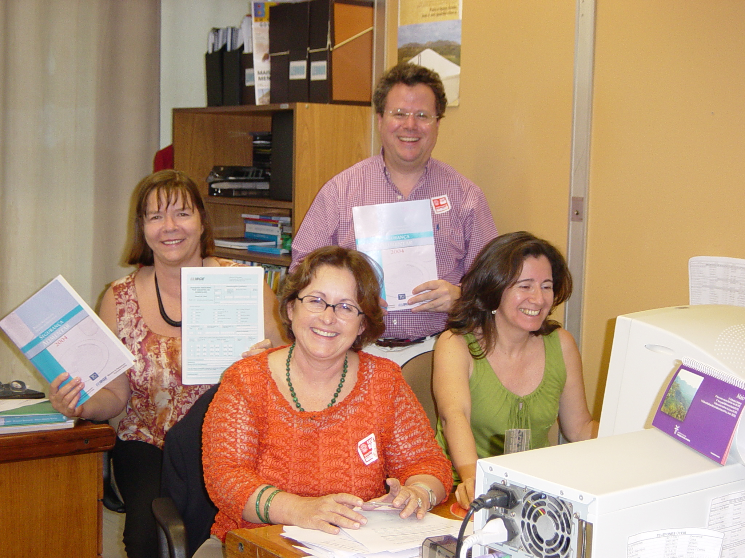
EBIA

Slide 17
What are the Consequences of Food Insecurity?

Slide 18
Consequences of Food Insecurity
Perez-Escamilla. Global Food Security (2012)
Poor psycho-social and mental development
Poor physical development
Increased morbidity
Increased mortality
In short, food insecurity is associated with
  Low human capital
  Low social capital
  Poor national development

Slide 19
Poor Nutrition
Home Stress
Stress Anxiety Depression
Problem Internalization & Externalization
Social & Cognitive Development
Poor Mom’s Health
Child Psycho-emotional Problems
Poor Child Developm-ent
HFI
Poverty
Poor Health
Livelihood Strategies
Pérez-Escamilla & Pinheiro de Toledo Vianna, J Appl Res Child. 2012
Notes:
The theoretical framework for my presentation posits that HFI mediates the relationship between poverty, livelihood strategies, and poor health of household members and suboptimal maternal mental health and child psycho social and cognitive outcomes.
The association between HFI and poor maternal mental health and child development outcomes is in turn mediated by nutrition and non-nutrition pathways such as overall stress at the household level.

Slide 20
HFI and Stunting
Mexican Children < 5 Years- 2012
Shamah-Levy et al. 2013

Slide 21
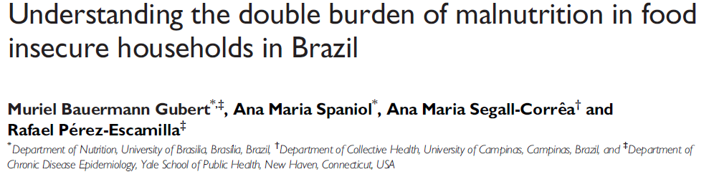
Double Burden of Malnutrition: Simultaneous presence of stunted children under five and overweight mother in same household
Data set: 2006 Brazilian PNDS
DBM AOR associated with severe HFI:
2.65 (CI: 1.17–8.53)

Slide 22
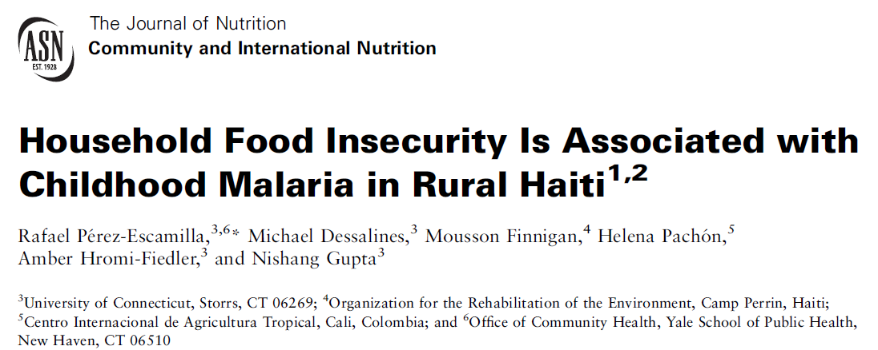
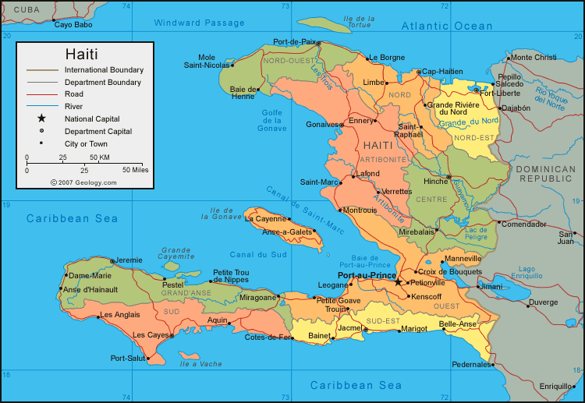
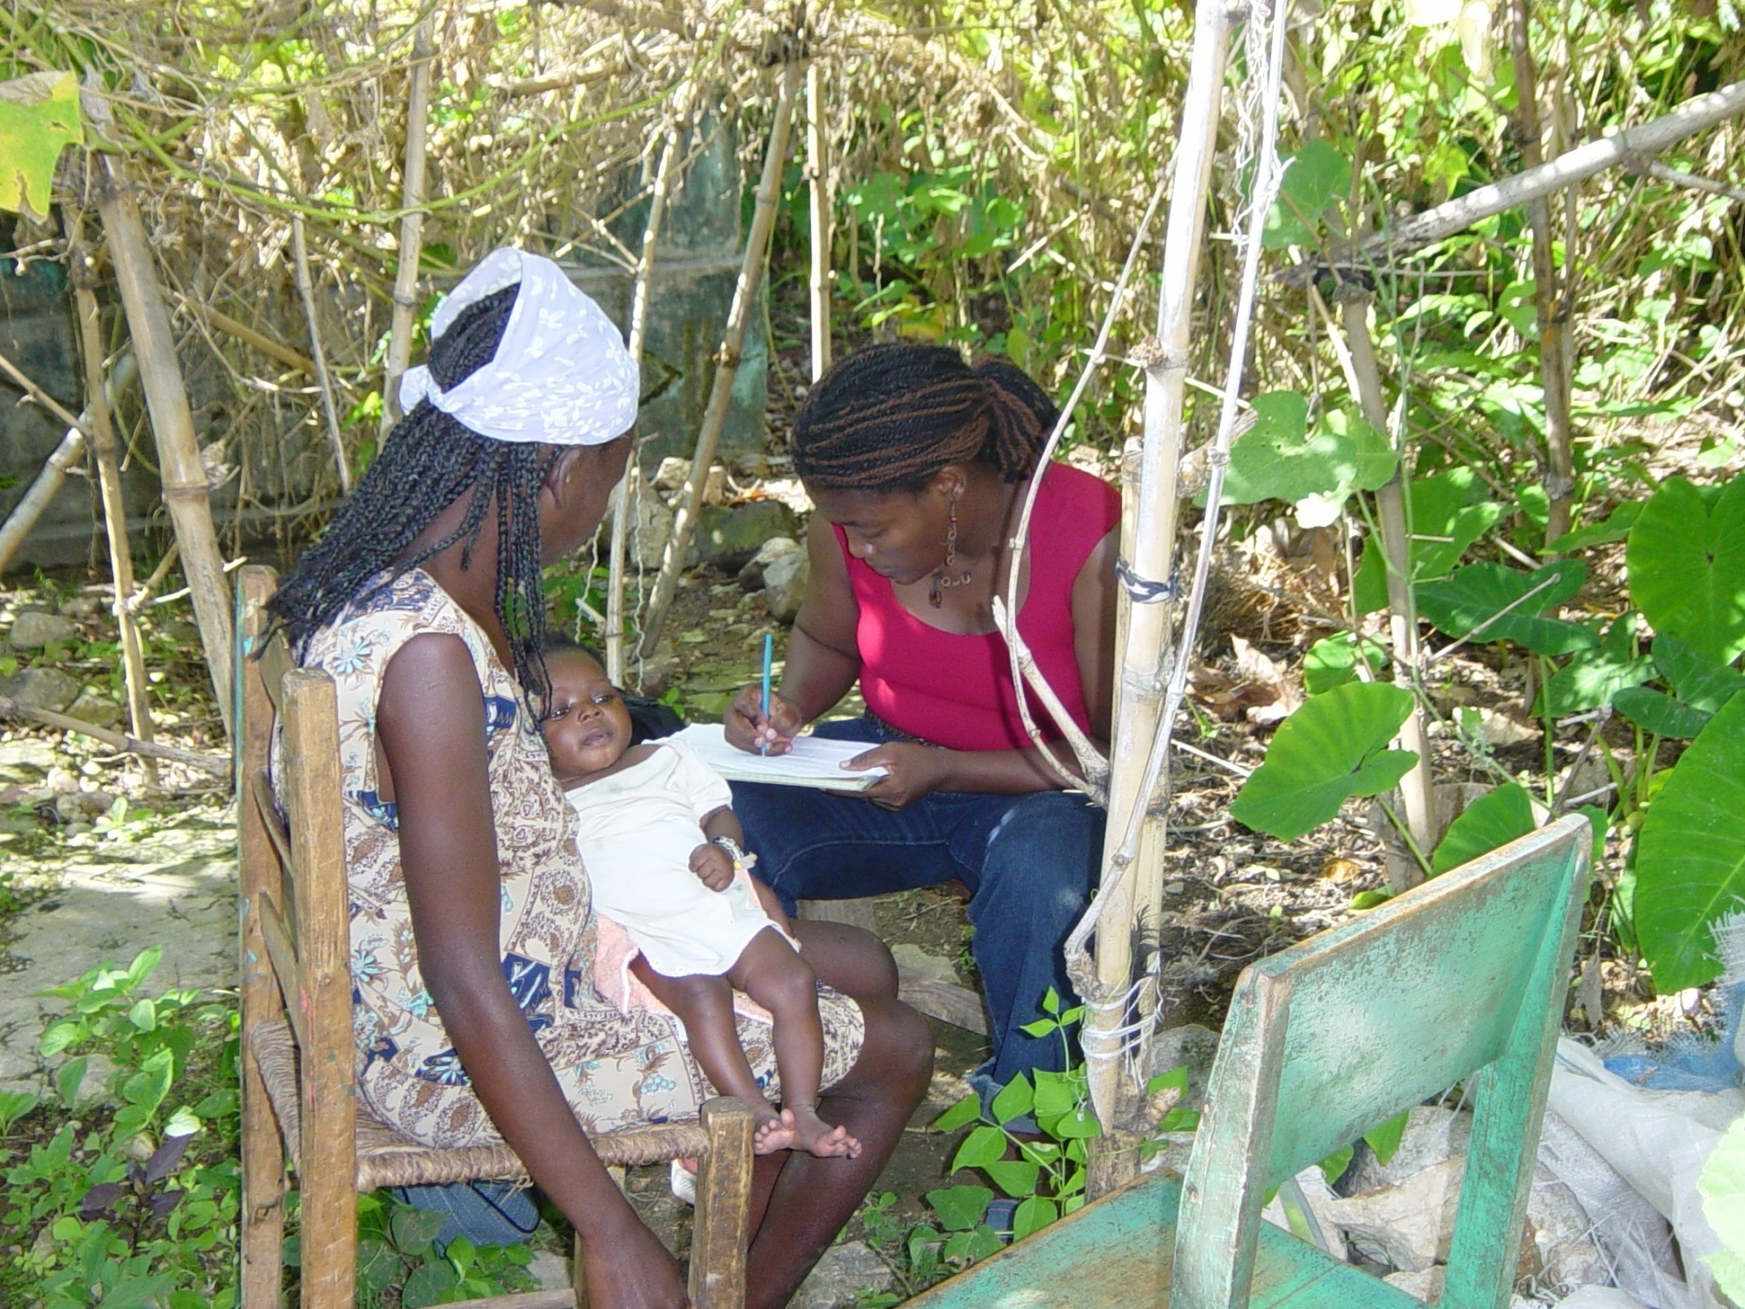

Slide 23
Household Food Insecurity and Malaria Risk among Young Children: Haiti*
Pérez-Escamilla et al. J Nutr. (2009)
P<0.05
*Logistic regression adjusting for poverty indicators, anthropometry, child age and sex, family structure head of household occupation, land ownership electricity at home, child health, child BMI, maternal age and education, colostrum feeding and vitamin A supplementation

Slide 24
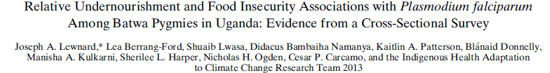
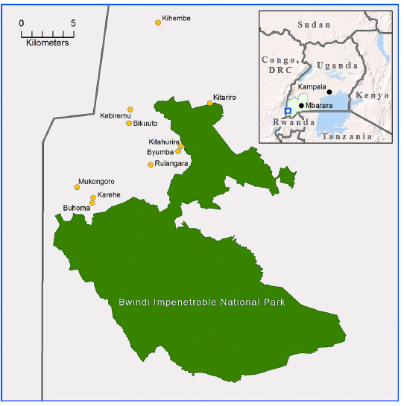
Am. J. Trop. Med. Hyg., 91(1), 2014, pp. 39–49
Severe Household Food Insecurity
  Malaria aRR*: 13.09
  95% CI: 2.23-76.79
*Adjusting for sex, age, wealth and arm circumference
Malaria was diagnosed through blood tests

Slide 25
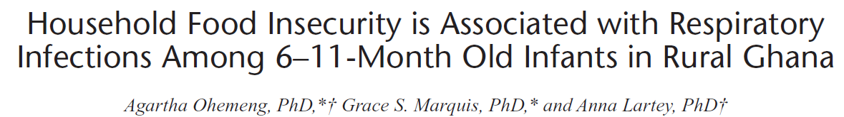
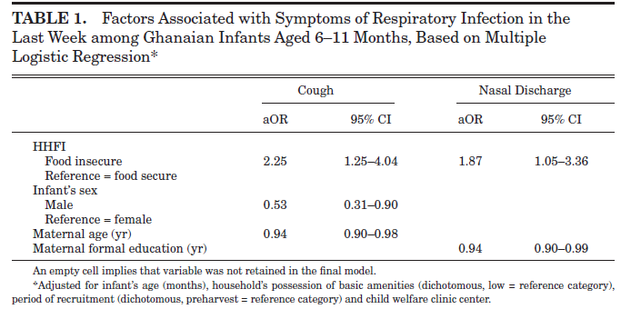
Notes:
-N=367 6-11 month olds attending growth monitoring sessions
-32 communities in Manya Krobo Eastern region
-HFI: 15-item modified US HFSSM; 20.5% with FI (affirmed at least 1 item)

Slide 26
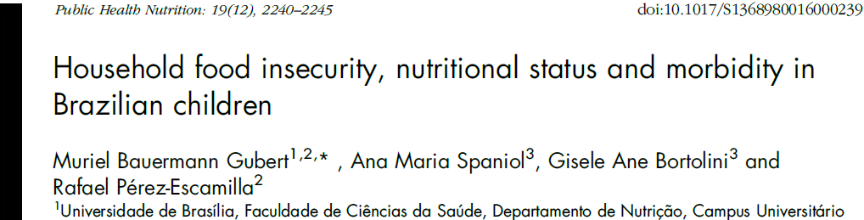
Morbidity | AOR* Severe HFI | 95% CI
Cough(last two weeks) | 1.67 | 1.14,2.46
Hospitalización due to Diarrhea (last year) | 2.93 | 1.61,5.31
N=4064 children under five; *Adjusted for potable water availability, household sanitation infrastructure, maternal education, maternal age, urbano or rural household, geographic region, child nutritional status

Slide 27


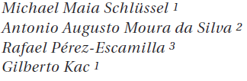
“…severe HFI was associated with obesity risk among adult women (PR: 1.49; 95%CI: 1.17-1.90), moderate HFI was associated with excess weight among female adolescents (PR: 1.96; 95%CI: 1.18-3.27).”

Slide 28
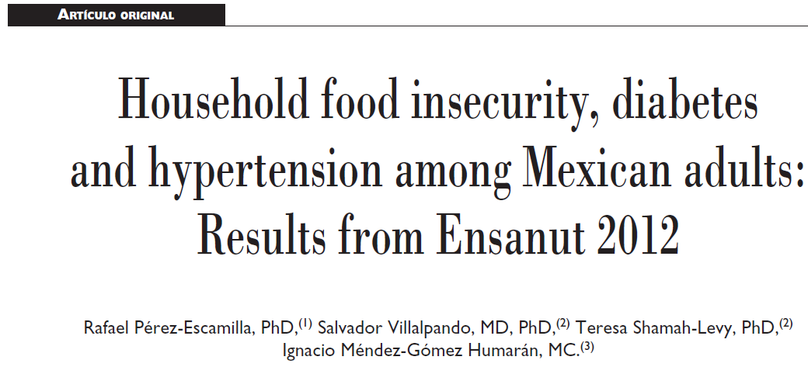
N=32,320 adults
Multiple logistic regression (adjusted for complex sampling design)
  Adjusted for education, age, urban/rural, socio-economic class, health insurance, BMI
HFI is a risk factor for self-reported T2D (women)
  Food secure; AOR: 1.00 (ref. category)
  Mild HFI; AOR (95%CI): 1.31 (1.06-1.62)
  Moderate HFI; AOR (95%CI): 1.67 (1.31-2.13)
  Severe HFI; AOR (95%CI): 1.48 (1.14-1.93)

Slide 29
HFI & Fasting Blood Glucose (mg/dl) among U.S. Hispanics
 | Mean | Std. Dev.
Food Secure (n=24) | 145.5ª | 17.4
Mild-FI (n=18) | 170.7^{b} | 21.3
Moderate-FI (n=21) | 184.0^{c} | 19.6
Severe-FI (n=17) | 204.4^{d} | 21.7
Multivariate linear regression, N=97, p=0.007; Adjusted for 6 SES and demographic confounders; model R²=0.23
Perez-Escamilla et al. (2014)

Slide 30

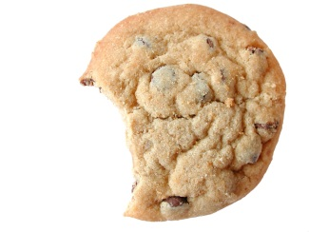
Stress, Reward & Habitual Eating Pathways
STRESSORS
Limbic System
(Emotions)
PFC
(Regulation,
Mindfulness)
Reward Area (NuAc)
Dopamine, Opioids
(Motivation, Pleasure)
Basal Ganglia
(Habit)
Comfort Food
Adapted from:
Epel, Tomiyama, Dallman, 2010, in Brownell & Gold (Eds) Food & Addiction
Slide -courtesy of Barbara Laraia
Notes:
Stress, reward and memory or habitual eating behavior are intertwined. This illustration by Epel, Tomiyama and Dallman, although simple, shows that under normal conditions we rely on the prefrontal cortex to help with decision making and regulation. Under stress conditions, however, the limbic system that responds to emotions can take over. The stress response that produces cortisol and nueropeptide Y, shifts metabolism to energy storage. The stress response activates the reward system as well as invokes the basal ganglia where memory and habit reside, such that when we reach for the high fat/high sugar comfort food the stress response is dampened, and we learn a behavior. The next time we experience stress, even a lower level of stress, we reach for that cookie. Mindfulness can help restore balance among these systems and permit the prefrontal cortex to regulate eating.
Limbic: arousal, energy storage; Reward: strong motivational drives; Basal ganglia: motor behavior, habit, low level
During normal conditions, the PFC reigns, and cognition is dominated by reflective cognition. During stress, the PFC activity is dampened and the limbic system dominates. Shifts in this neural network, the “PFC/limbic balance,” effects cognition and behavior during acute stress, it shapes eating behavior and lead to energy imbalance, and in particular, abdominal obesity.

Slide 31
Could Food Shortages Bring Down Civilization?
‘The biggest threat to global stability is the potential for food crises in poor countries to cause government collapse’
Lester R. Brown
Scientific American - April 22, 2009

Slide 32
FAO Food Prices Index increase (%)
Shrimpton et al., 2009

Slide 33
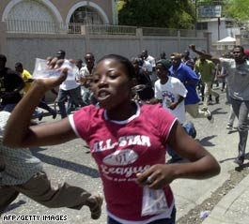
Grain prices up 120%; hungry people riot
Riots from Haiti to Bangladesh to Egypt over the soaring costs of basic foods have brought the issue to a boiling point and catapulted it to the forefront of the world's attention. "There are riots all over the world in the poor countries ... and, of course, our own poor are feeling it in the United States," said the director of Columbia University's Earth Institute.
Source: CNN online, April 14, 2008

Slide 34
Planetary Health and Food Insecurity?

Slide 35




Slide 36
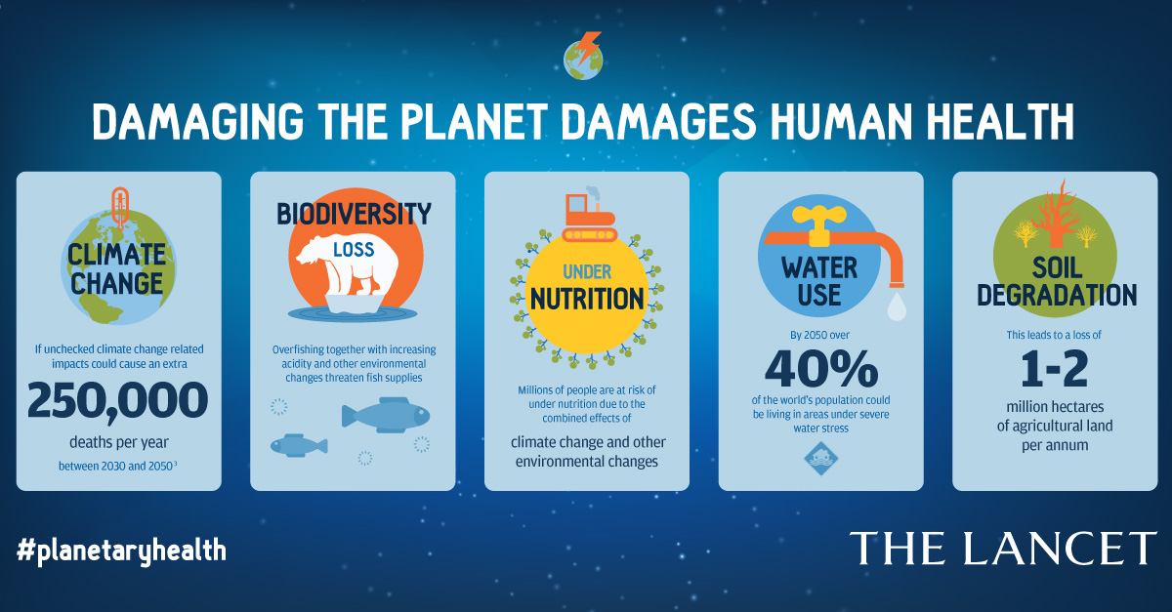

Slide 37
How Many are Food Insecure?

Slide 38
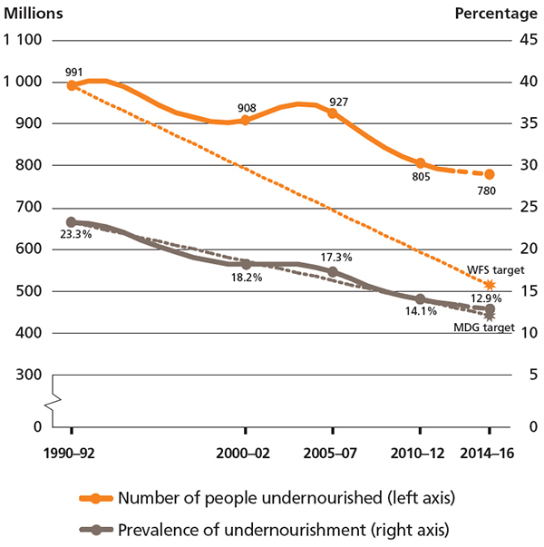
The trajectory of undernourishment in developing regions: actual and projected progress towards the MDG and WFS targets
Key reasons for improvements
Economic growth
Social protection systems
Strongest reductions in Latin America
Social protection
Role of CCTs
Note: Undernourishment means that a person is not able to acquire enough food to meet the daily minimum dietary energy requirements, over a period of one year. FAO defines hunger as being synonymous with chronic undernourishment.
Source: FAO 2015

Slide 39
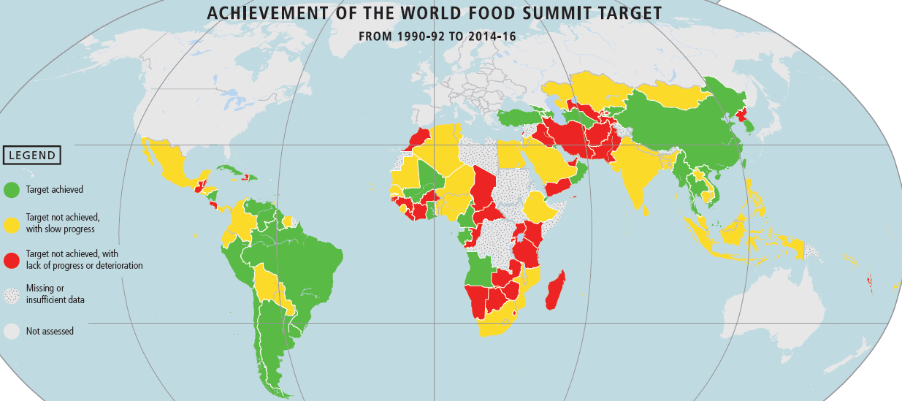
Source: FAO 2015

Slide 40
Global Magnitude of the Problem of Food Insecurity
In addition to the 800+ million people without access to enough food, over 2 billion people don’t have access to diets of adequate quality
  Low access to fresh fruits, vegetables, dairy, fish, whole grains, pulses, etc…
    Micronutrient deficiencies
  Many of them are overweight or obese
    Cheap ultra processed foods and beverages very high in calories and low in essential nutrients
International Food Policy Research Institute. 2016. Global Nutrition Report 2016: From Promise to Impact: Ending Malnutrition by 2030. Washington, DC.

Slide 41
Are there Effective Policies to Address Food Insecurity?

Slide 42
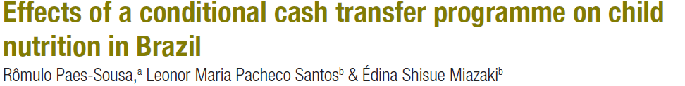
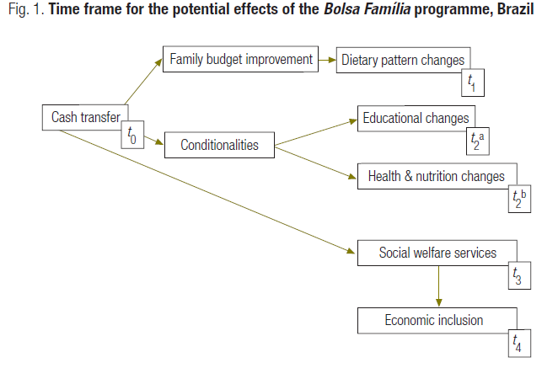

Slide 43
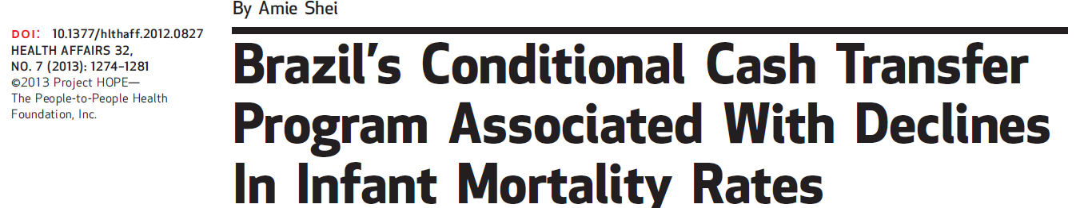
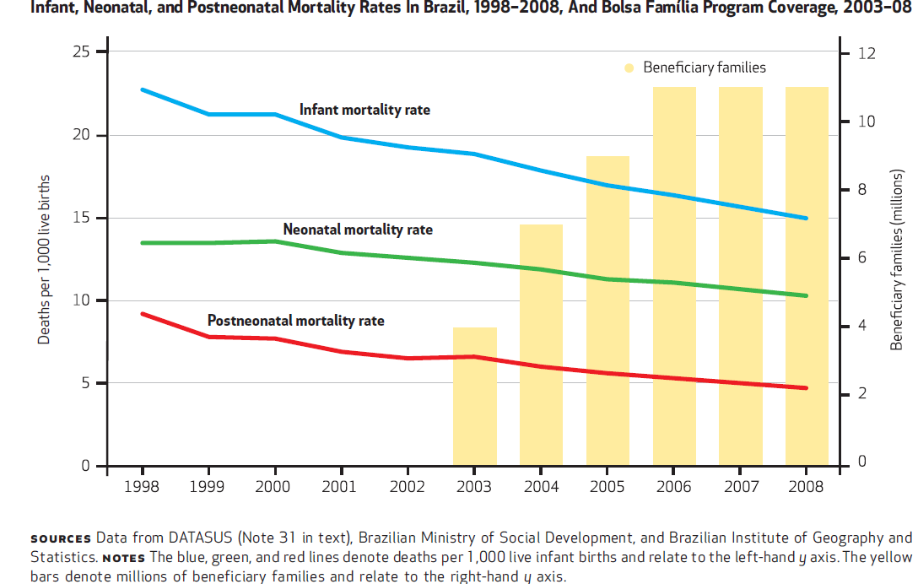

Slide 44
The association between Bolsa Família program coverage and declines in infant mortality and postneonatal mortality rates was greatest in municipalities with high levels of Family Health Program coverage.
Greater association between increased Bolsa Família program coverage and lower infant and postneonatal mortality rates in municipalities with higher infant mortality rates at baseline.
(Shei, Health Affairs 2013)

Slide 45
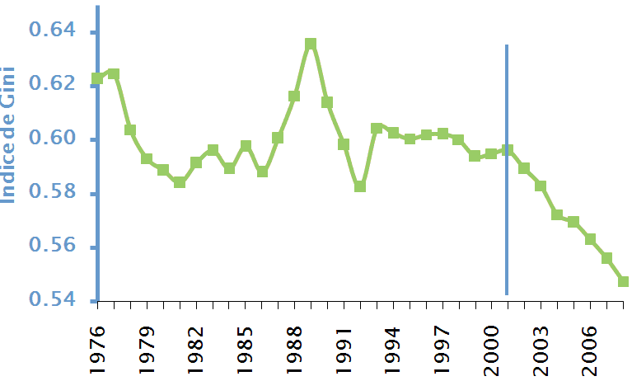
Effect of PBF on income distribution in Brazil
Gini Index, Brazil 1976-2008
The Gini index has dropped consistently since 2001; almost 25% of the drop is attributable to Bolsa Familia (IPEA)
(50% attributable to Minimum Wage adjustments)
Slide courtesy of Dr. Leonor Pacheco< University of Brasilia

Slide 46




“Breastfeeding is the most effective preventive measure to improve child health and survival”
World Health Organization, 2010

Slide 47
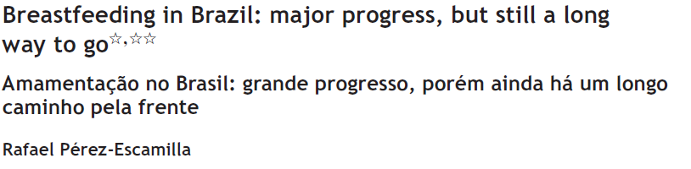
Brazil must pay close attention to the breastfeeding inequities that have developed over time
Health care professionals (HCPs) have a central role to play
COI training for HCPs is essential
Apply mobile communications technology, e.g. two-way text messaging and social media

Slide 48
Conclusions
Food insecurity is prevalent and highly damaging to the health of humans and well being of societies
Environmental degradation and climate change pose a major threat to food security and the survival of the human species
Poverty, social exclusion and food insecurity accelerate the pace of environmental degradation
Brazil has led the way with effective social equity and food security policies reflected in an adequate FS governance
Brazil has SMART tools to monitor food insecurity through advanced monitoring systems
  Lots of progress but much…much work remains to be done. Strong support from Congress will be needed to keep the success going….

Slide 49
“About half (47·8%) of the Quilombolas lived in severely food-insecure households, with the North and Northeast regions facing the most critical situation.”

Slide 50
Global Food Security is key to achieve the SDGs

Slide 51

Muito Obrigado!

