Slide 1


Fixed Book Prices – an international perspective
Richard Charkin
IPA President
Brasilia 30 June 2015

Slide 2

IPA: Who are we?
International federation of PAs
60 members in 50 countries: CBL and SNEL in Brazil
The global voice for publishers: IPA provides leadership and focus
IPA fights for publishers nationally, regionally and internationally
International Publishers Association

Slide 3
IPA: What do we stand for?
Strong copyright
Strong action against piracy
Exceptions only in exceptional cases
Freedom to publish
Freedom of expression for authors
Choice: an abundance of models
Open and fair markets
Access and interoperability
Innovation
Professionalism and high quality
International Publishers Association

Slide 4
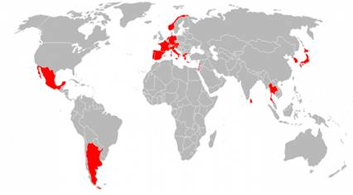
Fixed Book Price (FBP)
Countries currently with FBP
Argentina, Austria, France, Germany, Greece, Israel, Italy, Japan, Lebanon, Mexico, Netherlands, Norway, Portugal, Slovenia, South Korea, Spain, Sri Lanka, Thailand
Countries that used to but don’t any more
Australia, Finland, Hungary, Sweden, UK; Switzerland
International Publishers Association

Slide 5
The case for FBP
Each FBP country has created a different, local regime
Statute-based (France) or voluntary agreements between publishers and booksellers (Norway)
Four main objectives:
  Maintaining the number and range of bookshops
  Competing against online monopolies
  Supporting diversity of titles
  People should be able to buy books at a single price, no matter where they live in a country
International Publishers Association

Slide 6
Case Study: Norway
They maintain FBP does not eliminate competition, but rather shifts it from booksellers to publishers
Therefore, to attract readers/buyers, booksellers will need to compete using strategies other than price
Some researchers conclude that in a non-FBP market there are increased sales of bestsellers and lower prices on certain books, while in a FBP-system there is a wider selection of titles on offer
But the researchers were unable to find a noticeable difference in the average selling price across the two systems
International Publishers Association

Slide 7
Case Study: Israel
Fixed Book Price in Israel is called ‘The law to support authors and literature’
FBP operating since September 2014
Israeli publishers very supportive
Price is fixed for 18 months
Now able to negotiate annual terms on discounts with booksellers, not monthly as before
Average price of books has dropped from around 89 New Israeli Shekels to 67-76 NIS
International Publishers Association

Slide 8
The case against FBP
Not just an Anglo position (the Danes and Swiss recently looked at FBP and said ‘No!’)
But FBP does go against a certain ‘mercantilist’ attitude to books that is strong in the Anglophone world — a book is a commodity like any other
Price fixing, in principle, is a bad thing
FBP is yet another example of publishers taking responsibility for the whole supply chain, when they might do better to focus on their own survival and let the booksellers evolve?
International Publishers Association

Slide 9
Case Study: Australia
FBP law repealed in 1972
RRP system similar to UK, USA without UK’s extremes. USA discounting tempered by Robinson Patman Act: booksellers set terms, but publish these terms and cannot deviate
‘Independent booksellers are doing well in Australia, with over 25% of total sales for a trade publisher. They are successful because they are good and because they connect very well with their communities’ R Gorman, CEO, Allen & Unwin
Australian bookshop numbers have stabilised and 2014 book sales up by 2.3% (Source: Australian Booksellers Association)
Australia (and USA) interesting for Brazil because of similar geography
International Publishers Association

Slide 10
Case Study: UK 1
1995: collapse of the voluntary ‘Net Book Agreement’, when some publishers opted out, gaining a temporary competitive advantage
Independent booksellers faced increased competition over time from:
  Supermarkets
  Amazon initially selling p-books, and finally,
  e-books across all platforms
International Publishers Association

Slide 11
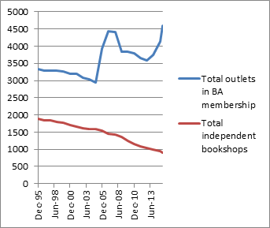
Case Study: UK 2
Declining number of indie booksellers
Source: Booksellers Association of UK and Ireland
International Publishers Association

Slide 12
Case Study: UK 3
Fewer indie bookshops:
  Traditional to non-traditional (i.e. supermarkets)
  Physical bookshops to online
  Print books to e-books
  And sales of ‘midlist’ titles have collapsed
BUT UK is still a leading publishing territory and remains a global literary and educational giant
International Publishers Association

Slide 13
Beyond the FBP: How IPA can help
Copyright exceptions and IP battles in Geneva
Government interference in educational publishing in Poland, Hungary, Norway, etc
Competition laws
Like in Brazil and UK, VAT rates on all books, globally, should be 0%
IPA promotes publishing as a force for economic, social and cultural good
International Publishers Association

Slide 14
International Publishers Association
Obrigado!
For more information about the IPA and our policies, contact José Borghino, Policy Director:
borghino@international publishers.org
+41 22 704 1820
International Publishers Association

