Slide 1

Data Protection Frameworks and AI regulation
“Challenges in Artificial Intelligence Regulation: international contribution to the Brazilian
lawmaking process” – Federal Senate of Brazil
dr. Gabriela Zanfir-Fortuna
VP Global Privacy, FPF
10 June 2022

Slide 2
In Brief
Data Protection Law was developed in the 1960s and 1970s in Western Europe and the US to tackle harmful consequences of automated personal data systems
How is current data protection law relevant for Automated Decision-Making and Algorithmic Decision-Making: A case study on GDPR & LGPD
Examples: GDPR Case-Law on Automated Decision-Making
A Look Ahead: Proposals in US Federal Data Privacy & Protection Bill (ADPPA) & the EU AI Act

Slide 3
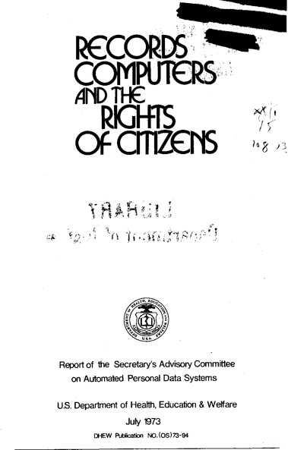
[1] ‘Records, Computers and the Rights of Citizens’ Report, 1973
‘. . . a growing concern that automated personal data systems present a serious potential for harmful consequences, including infringement of basic liberties’
‘. . . can help to assure that decisions about individual citizens are made on the basis of accurate, up-to-date information’ and ‘demands a hard look at the adequacy of our mechanisms for guaranteeing citizens all the protections of due process in relation to the records we maintain about them.’ Forward letter, Caspar Weinberger, the HEW Secretary
=> Fair Information Practice Principles

Slide 4

French Data Protection Act of 1978: prohibition of ADM & “right to know” & “to challenge”
The French Data Protection Act of 1978 specifically prohibited solely ADM in the context of judicial, administrative, or private decisions involving assessment of human behavior that would profile or define the personality of the individual (Article 2), while granting individuals a right to know and a right to challenge the information and the reasoning (akin to “logic involved”) used by automated processing affecting them (Article 3).
Photo Source: metv.com

Slide 5






“The processing of personal data should be designed to serve mankind.”
Freedom of speech, The right to private life/privacy,
The right to life,
The right to security, The right to non-discrimination, Freedom of assembly, etc.
GDPR: Recital 4, first sentence
the goal of data protection is to ensure that information relating to individuals is collected and used, including by automated means & algorithms, in such a way that all their other fundamental rights are protected

Slide 6
[2] How is data protection relevant in the age of Automated Decision Making? A GDPR case study
Relevant GDPR provisions:
Broad definition of personal data (any information related to an identified or identifiable individual)
Broad definition of processing (any operation or set of operations performed on personal data, like collection, structuring, combination, making available etc.)
This brings training of models for ML, algorithmic decision-making, any form of automated decision-making that rely on personal data, even in mixed data sets, under the scope of the GDPR, triggering the application of all its rules.
Fairness & Accountability & Transparency are Principles under the GDPR (Art 6)
Data Protection Impact Assessment – “assessment of the risks to the rights & freedoms”
+ Article 22 GDPR: the right not to be subject to solely automated decision-making that produces legal or significant effects on individuals (interpreted as prohibition)

Slide 7
What else does Article 22 require?
1) If “solely” and with “legal” or similarly significant effects => only specific consent, contract, or law can allow ADM
2) Implement suitable measures to safeguard the data subject’s rights and freedoms and legitimate interests”:
  the right “to obtain human intervention on the part of the controller
  to express his or her point of view and
  to contest the decision”

Slide 8
What about the LGPD?
Broad definitions of “personal data” & “processing” => covers complex processing such as ADM
Principles of Transparency and Responsibility & Accountability (Art. 6 VI & X – similar to GDPR)
Principle of Non-Discrimination: impossibility of processing personal data for discriminatory, unlawful or abusive purposes (Art. 6 IX) & good faith mentioned as overarching rule for all the principles (Art. 6)
Data Protection Impact Assessment (Art. 37) but much more limited (at request of the ANPD & with no reference to the fundamental rights & freedoms)
ADM provision (Art 20), but no prohibition;
  Individuals have the right to request a review of solely automated decisions that impact their interests
  Individuals have the right to request info on the criteria & procedures used for ADM, but “with due regard to business & industrial interests”
  If info is refused, the ANPD may conduct an audit to verify discriminatory aspects in the automated processing

Slide 9
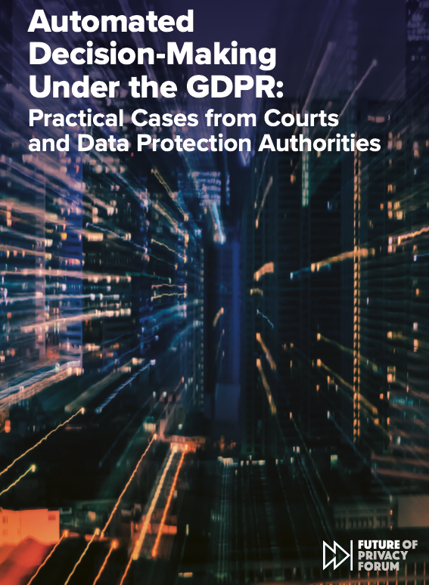
[3] Meaningful protection for persons in the age of algorithms fed by personal data?
School access and attendance control through Facial Recognition technologies
Online proctoring in universities and automated grading of students
Automated screening of job applications
Algorithmic management of platform workers
Distribution of social benefits and tax fraud detection
Automated credit scoring
Content moderation decisions in social networks
All covered by the GDPR, as applied by Courts and Data Protection Authorities in Europe
FPF Report based on +70 GDPR cases from Courts & DPAs
May 2022
Available at: https://fpf.org/wp-content/uploads/2022/05/FPF-ADM-Report-R2-singles.pdf
Notes:
Deploying Automated Facial Recognition in Schools for:
Recording students’ attendance (Sweden, 2021; unlawful, DPA – imbalance of power, consent, Art. 9),
Together with a temperature measurement system installed at the entryway, for managing the pandemic response (Bulgaria, 2020; DPA; unlawful, breaches Art. 22, consent invalid)
Granting and refusing access to people that enter the school and are not enrolled students (France, 2020; Court; unlawful, breaches Art 9 GDPR and necessity requirements)
ADM in employment
a job application assessment tool that selects what candidates will be invited to interviews (Saxon State Chancellery in Germany, 2019; DPA; unlawful – no meaningful human intervention)
Food delivery app: the company failed to systematically verify the accuracy and correctness of its automated rider-management decisions, as well as the relevance of the data to the decision making process (Italian DPA; 2021; unlawful; breach of Article 22)

Slide 10

“Emotion Recognition” AI System deployed by a bank
A bank deployed an AI system from a service provider (processor) and used it to analyze voice recordings of customers calling the bank.
The AI system promised emotion detection and measurement in order to prioritize for callbacks those tagged as most upset and impatient customers.
The Hungarian DPA found multiple breaches of the GDPR (the principles of lawfulness, transparency and purpose limitation; notice obligations; the right to object; controller accountability obligations; and data protection by design and by default)
Fine of 650.000 EUR issued in February 2022 (but just for the bank as controller; the provider, as processor, was not sanctioned)

Slide 11
[4] A look ahead: EU AI Act & US American Data Privacy & Protection Act
EU: AI Act
AI Act proposal “is without prejudice and complements the GDPR”
ex-ante “Conformity Assessments” for high-risk AI that complement & do not replace DPIAs
Prohibited AI systems
”Bias monitoring” allowed on the basis of processing sensitive data (in accordance with GDPR – data related to health, race, religion etc.), and mandated for high-risk AI systems
US: ADPPA (bi-partisan bill)
”Large data holders” would have an obligation to conduct “algorithmic impact assessment” to mitigate “potential harms to an individual”
All covered entities must conduct an “algorithm design evaluation”, including any training data, to reduce the risk of potential harms
Harms related to: children; advertising for housing, education, employment, healthcare, insurance, credit opportunities; disparate impact on the basis of race, color, religion, national origin, gender, sexual orientation, disability status

Slide 12




Thank you!
gzanfir-fortuna@fpf.org
@gabrielazanfir
(Twitter)
https://fpf.org

