Slide 1
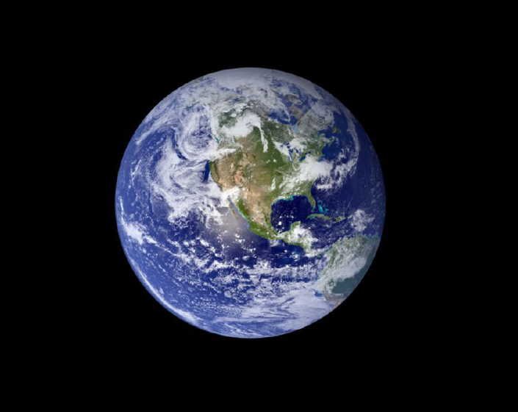
Sustainable Development Goals and Protected Areas

Slide 2
Federal Senate of Brazil
Legal Dimension of Sustainable Development Goals:
Global Perspectives
Sustainable Development Goals and Protected Areas
Ben Boer
Deputy Chair, IUCN World Commission on Environmental Law
Distinguished Professor, Research Institute of Environmental Law, Wuhan University, China

Slide 3
Outline
What is a protected area?
Why conserve protected ares
New data on protected areas
Sustainable Development Goal 15
The Biodiversity Convention and the Aichi Targets
The threat of PADDD: Protected Areas Downsizing, downgrading, and degazettement
Conclusions

Slide 4
What is a protected area?
IUCN Definition:
‘A clearly defined geographical space, recognized, dedicated and managed, through legal or other effective means, to achieve long-term conservation of nature with associated ecosystem services and cultural values”
Applies to land and marine areas
Does it include the air (flyways for migratory birds)?

Slide 5
Why conserve protected areas?
Protected areas are
essential to the conservation of species, ecosystems and the livelihoods they support, Play a key role in adapting to and mitigating the impacts of climate change
  by reducing risks from natural hazards
  providing a carbon sink through forests, 7.8 million km² of which are in protected areas.

Slide 6
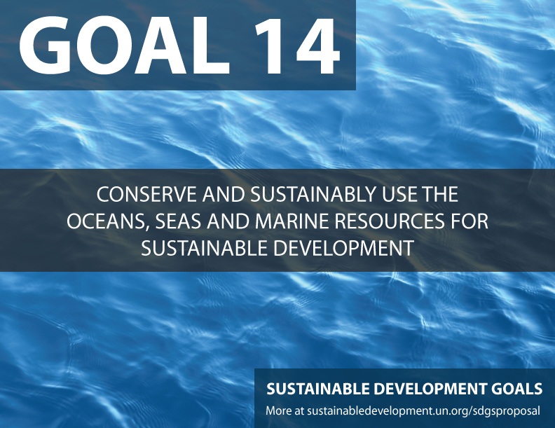
Sustainable Development Goal 15
15.1 by 2020 ensure conservation, restoration and sustainable use of terrestrial and inland freshwater ecosystems and their services, in particular forests, wetlands, mountains and drylands, in line with obligations under international agreements15.2 by 2020, promote the implementation of sustainable management of all types of forests, halt deforestation, restore degraded forests, and increase afforestation and reforestation

Slide 7
Sustainable Development Goal 14
Conserve and sustainably use the oceans, seas and marine resources for sustainable development

Slide 8
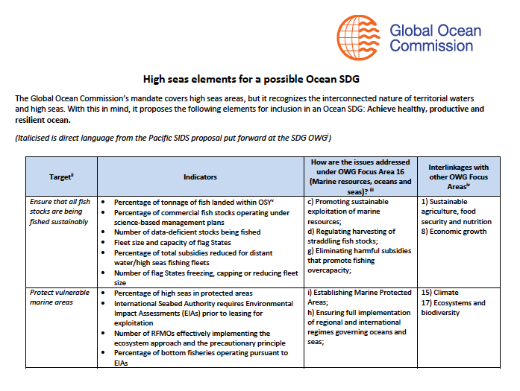
Also an Oceans SDG and Protected Areas

Slide 9
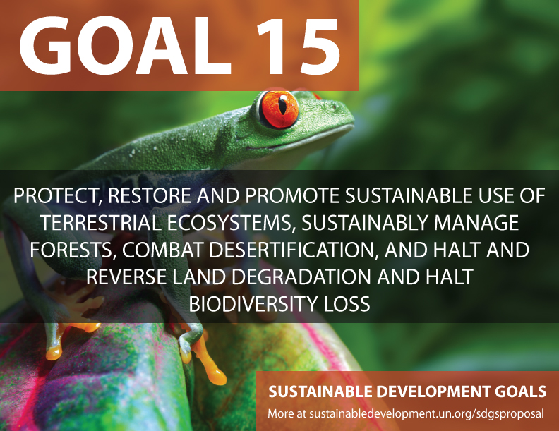

Slide 10
Sustainable Development Goal 15
“Protect, restore and promote sustainable use of terrestrial ecosystems, sustainably manage forests, combat desertification, and halt and reverse land degradation and halt biodiversity loss”

Slide 11
Aichi Targets to expand Protected Areas Worldwide
2010 Conference of the Parties of Convention on Biodiversity set Goals for Protected Areas:
Strategic Goal A: Address the underlying causes of biodiversity loss by mainstreaming biodiversity across government and society
Strategic Goal B: Reduce the direct pressures on biodiversity and promote sustainable use
Strategic Goal C: To improve the status of biodiversity by safeguarding ecosystems, species and genetic diversity
Strategic Goal D: Enhance the benefits to all from biodiversity and ecosystem services
Strategic Goal E: Enhance implementation through participatory planning, knowledge management and capacity building

Slide 12
Aichi Target 11
By 2020,
at least 17 per cent of terrestrial and inland water,
at least 10 per cent of coastal and marine areas,
are conserved through:
effectively and equitably managed,
ecologically representative and well connected systems of protected areas and other effective area-based conservation measures,
and integrated into the wider landscapes and seascapes.

Slide 13
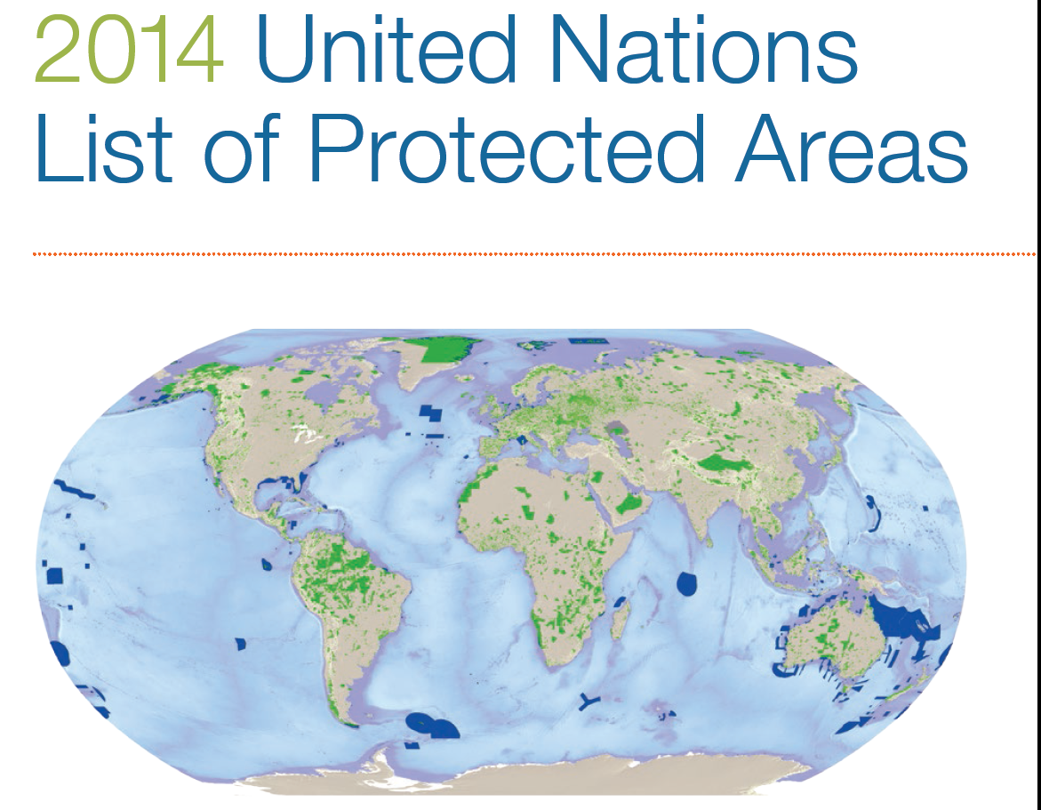
How are we progressing in achieving
Aichi Target 11?

Slide 14
New data on protected areas
15.4% of terrestrial areas, 3.4% of oceans are now protected
Further progress needed to cover and effectively manage areas of importance for biodiversity and ecosystem services
The world is on track to meet a 2020 target on the expansion of protected areas, United Nations Environment Programme (UNEP) report at IUCN World Parks Congress.
Recognition that protected areas play a crucial role in the2015 Sustainable Development Goals.

Slide 15
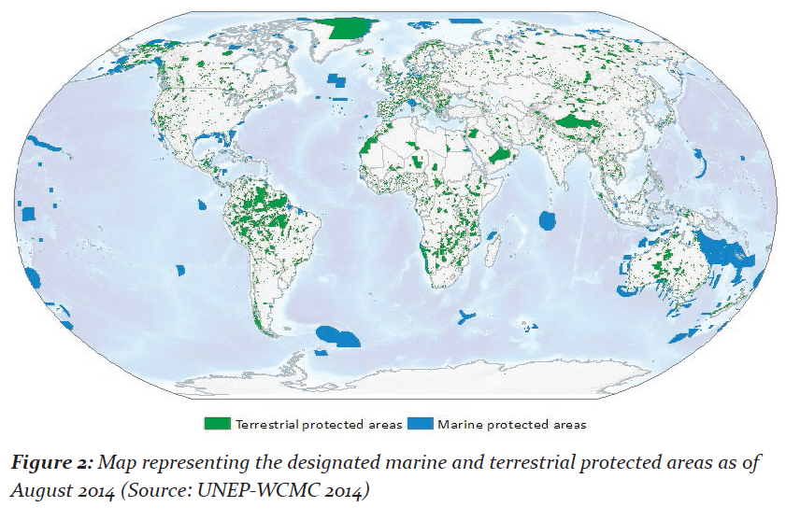

Slide 16
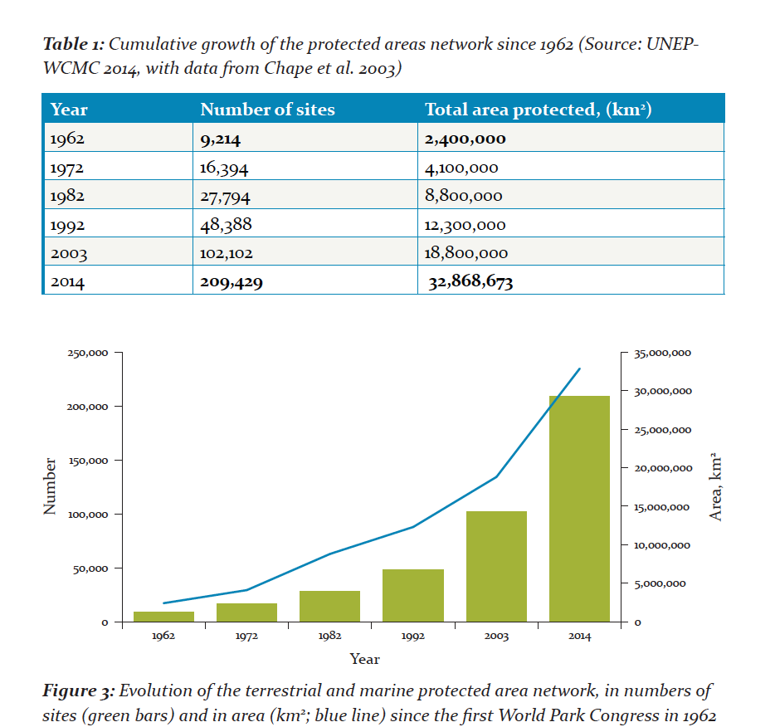

Slide 17
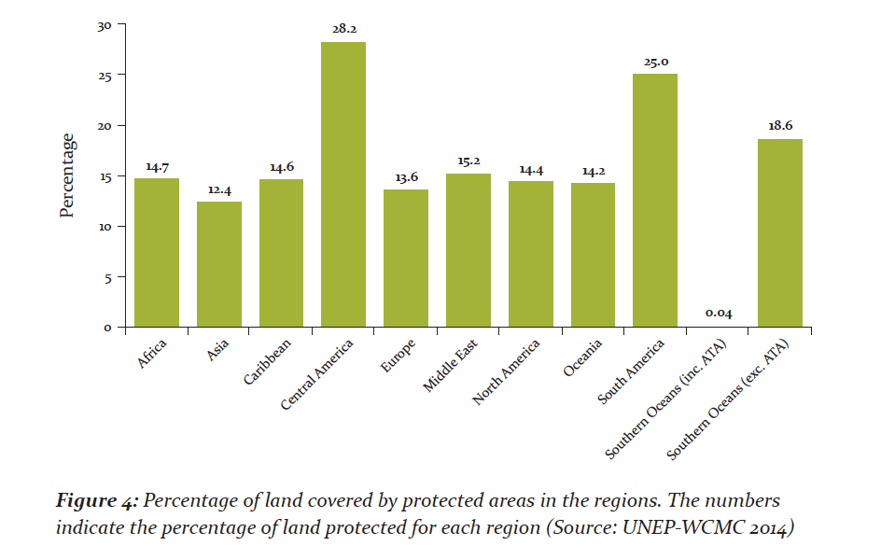
Percentage of Protected Areas in global regions

Slide 18
Example of Brazil data: 1864 Protected Areas
IUCN Protected area
category
Ia (169)
Ib (1)
II (324)
III (25)
IV (47)
V (253)
VI (256)
ECOREGION
Marine (135)
Terrestrial (1732

Slide 19
Global Increase in Protected Areas since 2010
Terrestrial protected area coverage
Has increased by about one million km² since 2010
In total, 20.6 million km² of terrestrial and inland water areas are now covered.
To cover 17 per cent of terrestrial and inland waters, 2.2 million additional km² of protected areas are needed.
Just over six million km² of marine protected areas have been added since 2010, with 1.5 million km² of this total coming since 2012.
In total, 12 million km² of the global ocean is now covered.

Slide 20
Benefits of protected areas to people and nature
Protected areas deliver numerous benefits for people and nature and need to be recognized as a proven and cost-effective natural way to deal with global challenges such as water provision, food security, disaster-risk reduction, and climate change mitigation and adaptation.

Slide 21
Protected areas and the SDGs
UNEP report recognizes that
‘Protected areas, as vital elements of the landscape and models of sustainable development, could play an important role in the establishment and monitoring of the Sustainable Development Goals.

Slide 22
Role of IUCN in Protected Areas
World Commission on Protected Areas
  World Parks Congress November 2014
  Role of Environmental Law in Protected areas and Sustainable Development Goals

Slide 23
The threat of PADDD: Protected Areas downsizing, downgrading, and degazettement
Despite the expansion in protected areas worldwide, there are threats in many countries because of inadequate legal protection

Slide 24
The threat of PADDD: Protected Areas downsizing, downgrading, and degazettement
Despite the expansion in protected areas worldwide, there are threats in many countries because of inadequate legal protection
This is also happening in Brazil; see Worldwide Fund for Nature “Coalition for Protected Areas (Coalizão Pró-UCs) to advocate for and strengthen the National System of Protected Areas”

Slide 25
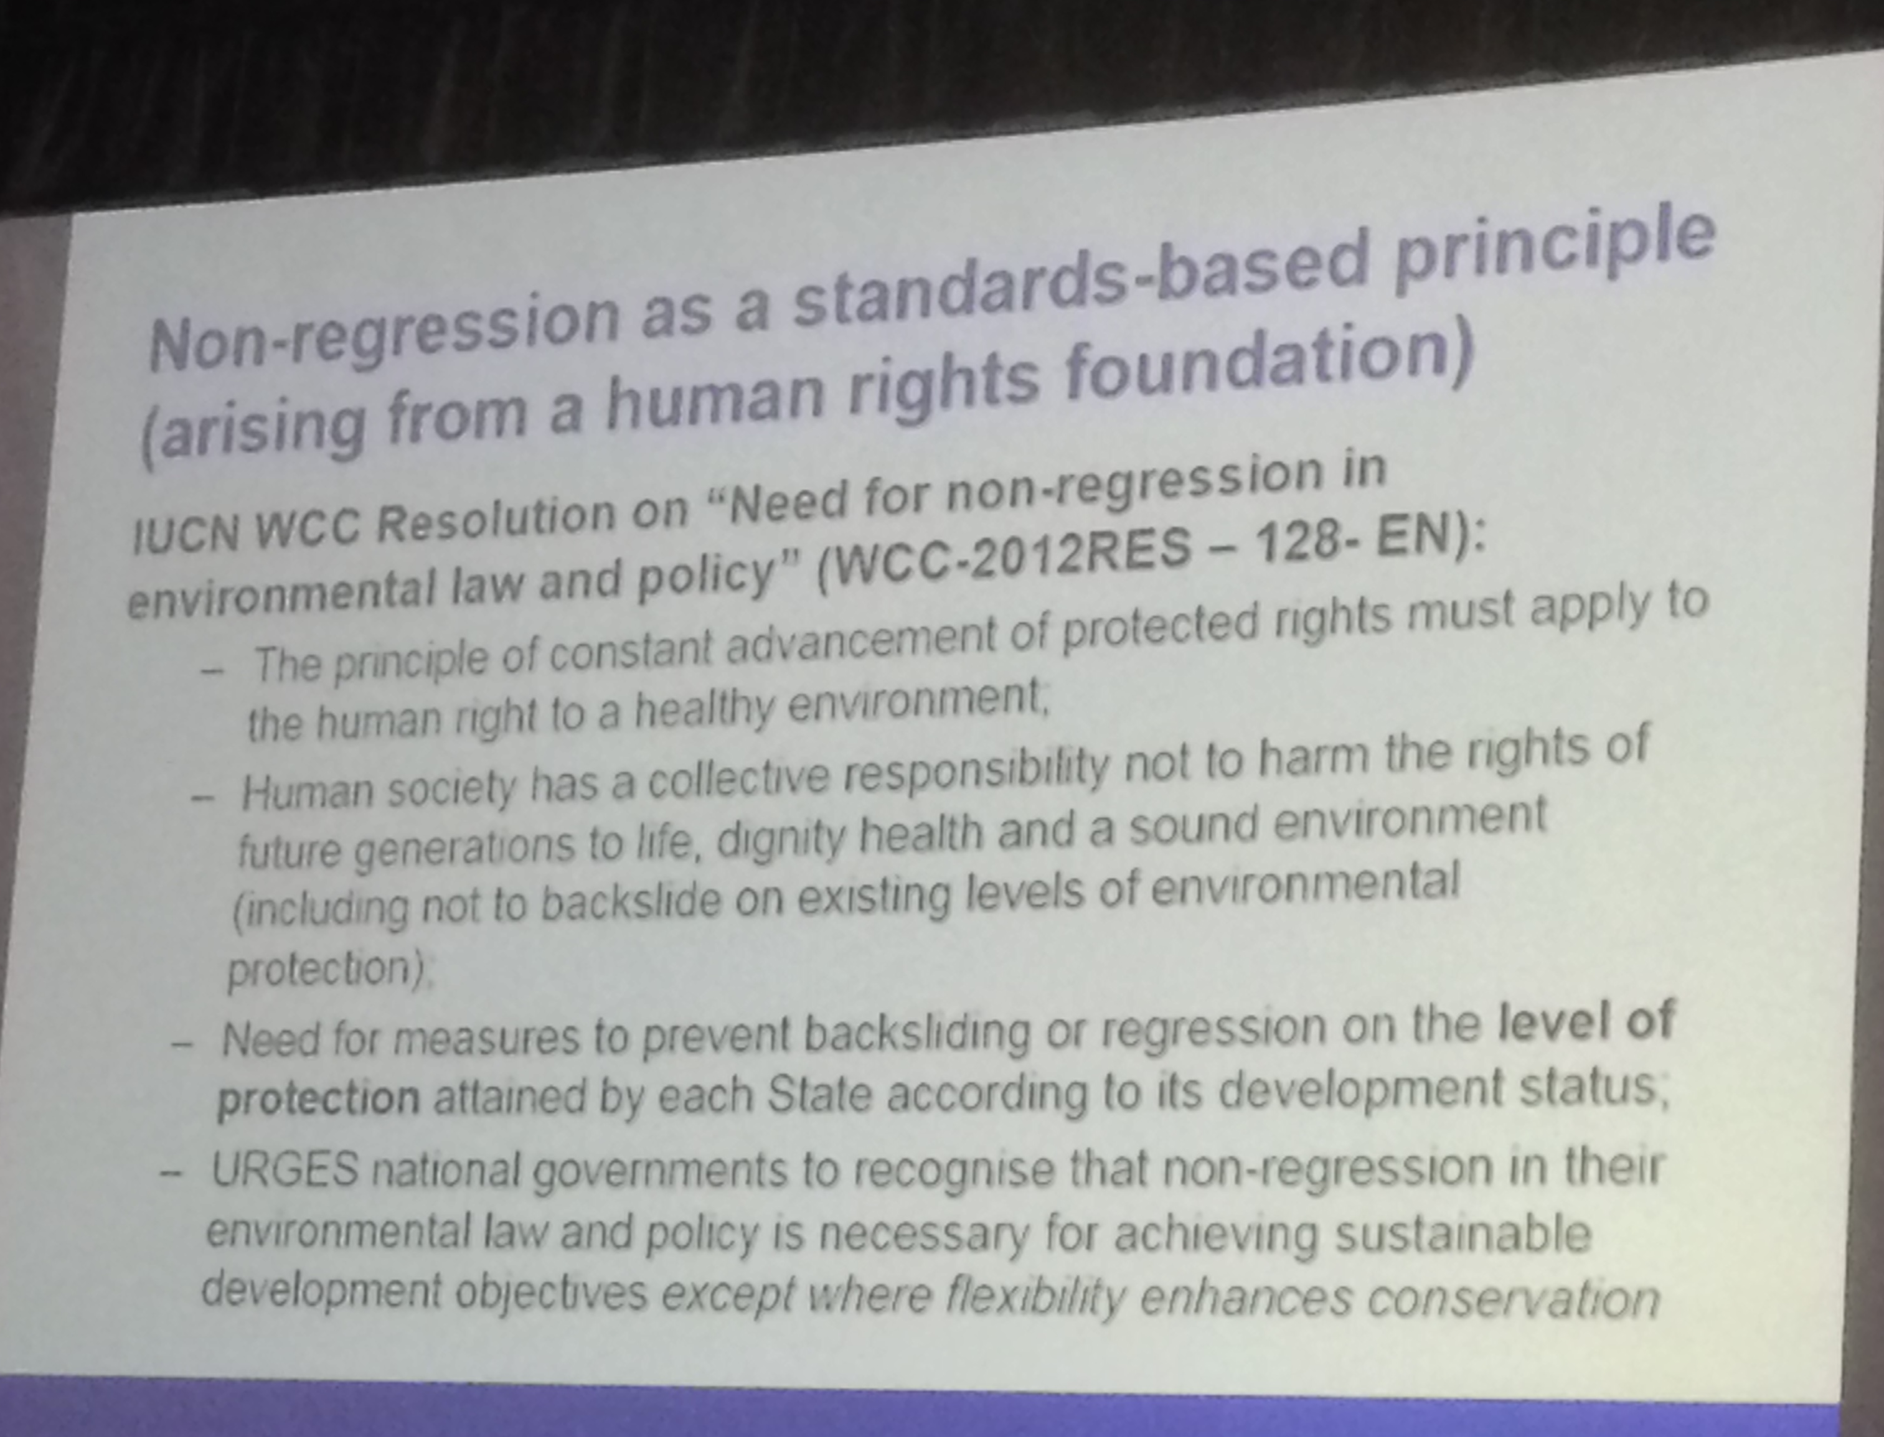

Slide 26
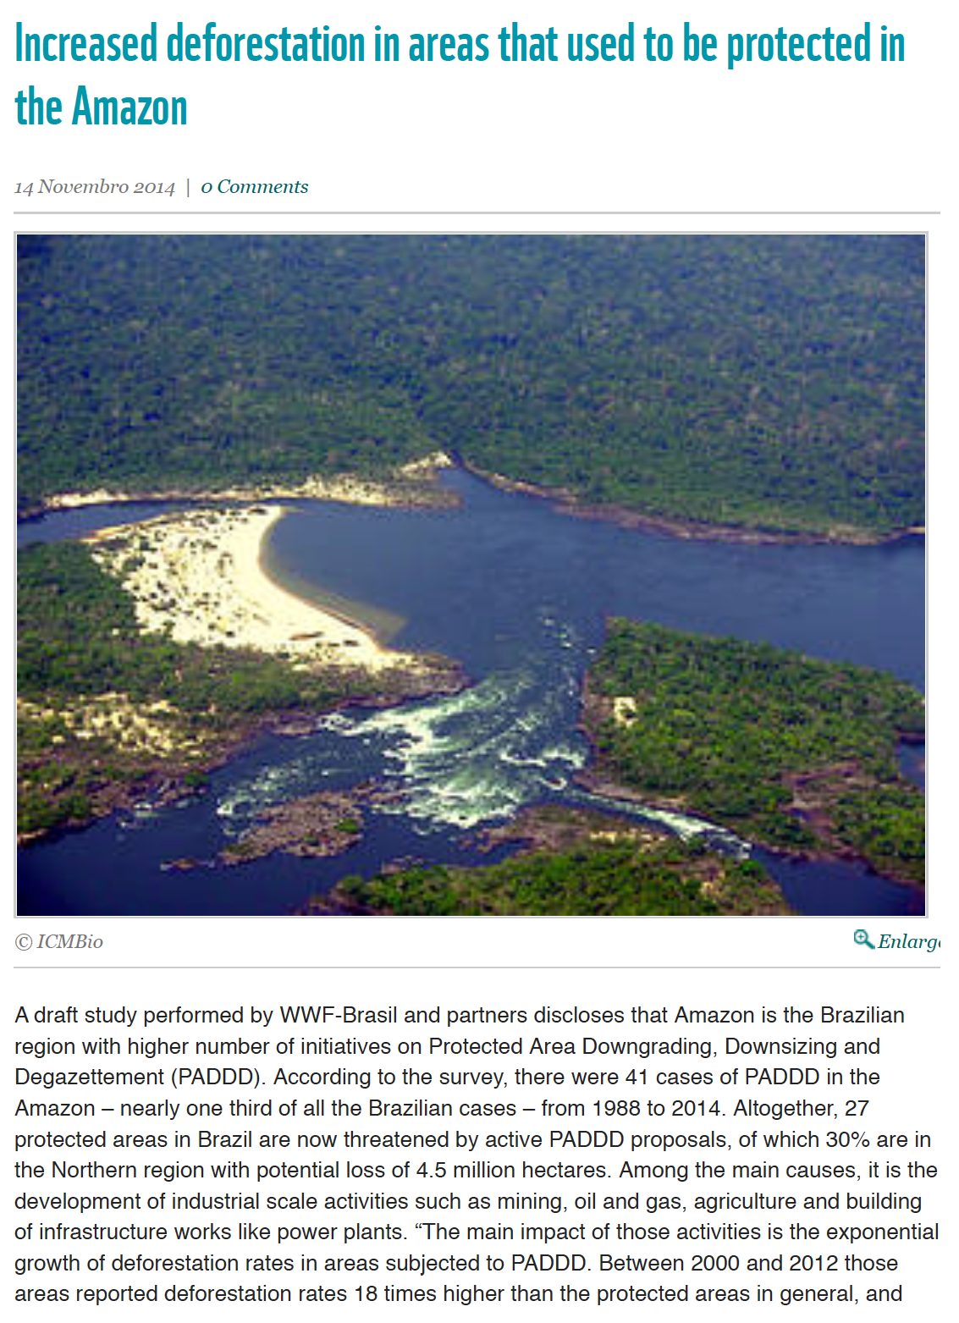
PADDD in Brazil
41 cases of PADDD in the Amazon – nearly one third of all the Brazilian cases – from 1988 to 2014. Altogether, 27 protected areas in Brazil are now threatened by active PADDD proposals, of which 30% are in the Northern region with potential loss of 4.5 million hectares

Slide 27
PADDD in Brazil
“Altogether, 27 protected areas in Brazil are now threatened by active PADDD proposals, of which 30% are in the Northern region with potential loss of 4.5 million hectares. Among the main causes are the development of industrial scale activities such as mining, oil and gas, agriculture and building of infrastructure works like power plants.”
“The main impact of those activities is the exponential growth of deforestation rates in areas subjected to PADDD. Between 2000 and 2012 those areas reported deforestation rates 18 times higher than the protected areas in general, and 2.65 times higher than those regions that have never been protected”
From WWF website

Slide 28
Need for the non-regression principle in protected areas
Non-regression principle means “no back-sliding” in law and policy
Once a natural area is legally protected you do not go backwards, only forwards
This principle is emerging in a number of countries
It is an important tool for ensuring that the Sustainable Development Goals are not eroded by retrograde legislation

Slide 29
Conclusions
Protected areas are recognized as an important part of achieving sustainable Development Goal 15 on ecosystem conservation
Protected areas world-wide are expanding and meeting the CBD Aichi Targets
There is a substantial role for environmental law to play in the declaration, protection and management of protected areas
In many countries, there are still significant threats to protected areas, because the protected areas law is either too weak, or not well enough enforced
All SDGs also need to be protected by legal frameworks
We need to think of all the SDGs as being subject to the principle of non-regression

Slide 30
Thanks to the Earth!

