Slide 1
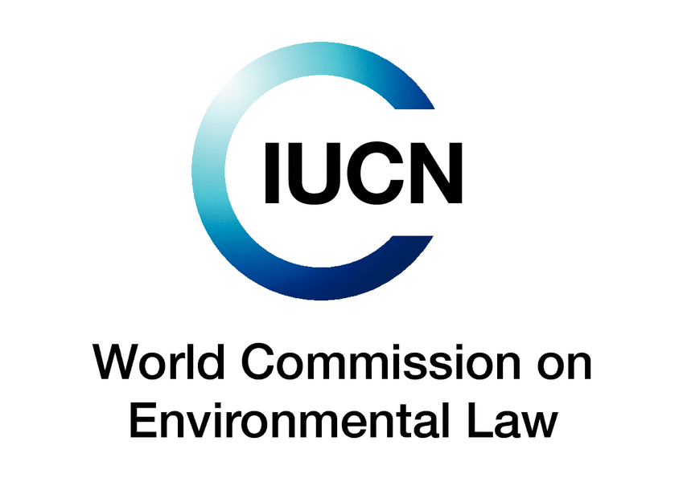

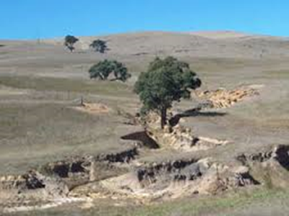
International Colloquium
“Legal Dimensions of Sustainable Development Goals: Global Perspectives”
December 2014 Brasilia
Brazil
“Land Degradation, Desertification, and Sustainable
Development Goals – Developing a Global Soil Regime”
Associate Professor Dr. Ian Hannam
University of New England, Armidale, Australia
IUCN World Commission on Environmental Law
Co-Chair, Specialist Group on Sustainable Soil and Agricultural Systems

Slide 2
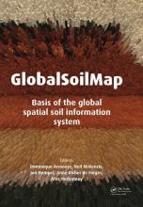
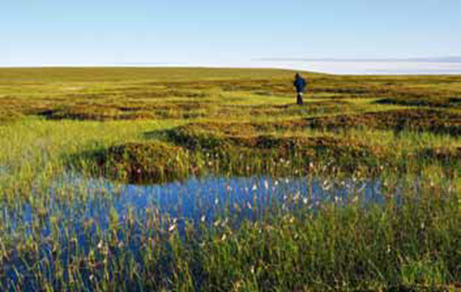
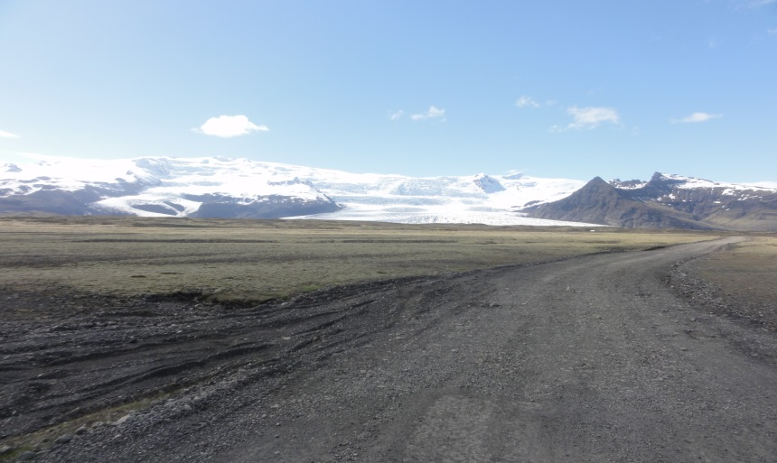
OVERVIEW
□ Background
□ Sustainable Development Goal
□ Environmental Law for Soil
□ UNCCD and concept of Zero Net Land Degradation
□ Conclusions

Slide 3
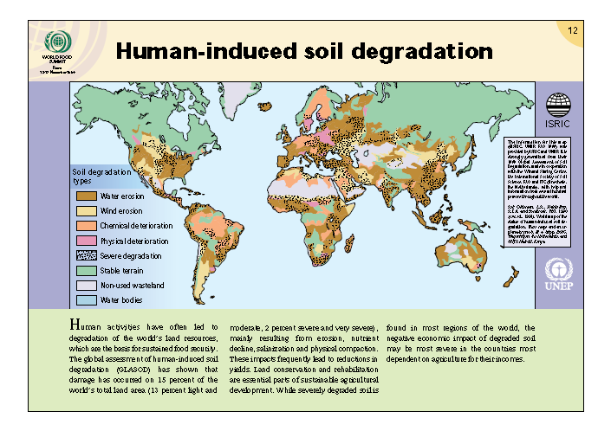
Soil issues are global issues
Notes:
1996 Modified from 1990 GLASOD map

Slide 4
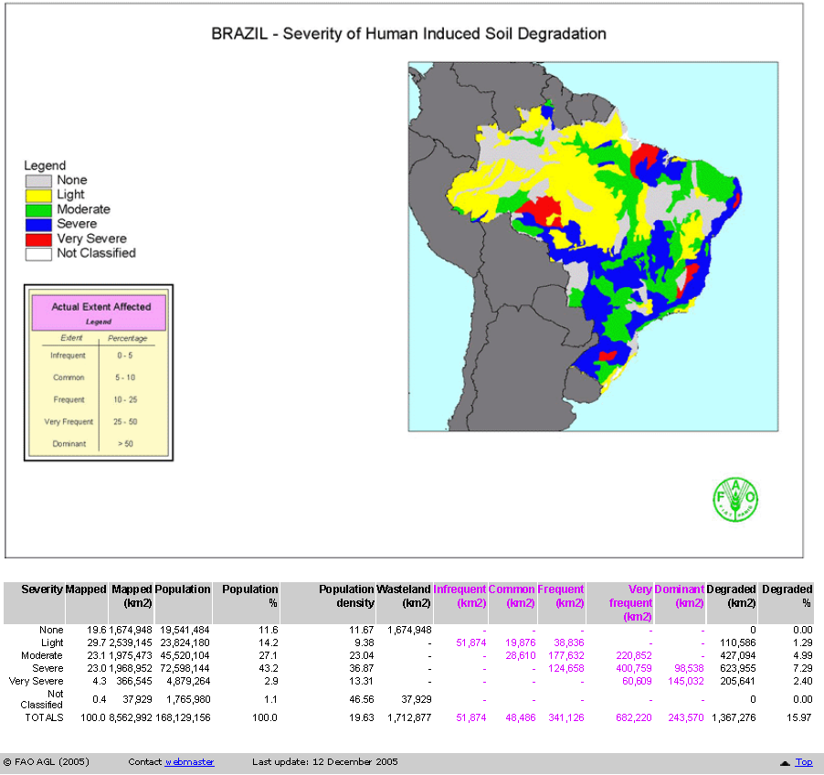
Brazil -Soil degradation

Slide 5
Background
Over the last three decades, climate change, biodiversity, desertification, drought, and land degradation have become prominent.
Each of these phenomena is often linked.
Biodiversity loss and climate change have had close attention in international environmental law - soil, as the primary basis for all terrestrial biodiversity, has until recently been largely ignored in international fora.
Soil requires same level of attention as biodiversity and climate change.

Slide 6
Right to Food
  □ Soil has ecological limits.
  □ There is an increasing imbalance in the production of food due to the differential rate of land degradation and desertification.
  □ Food security has gained extra focus with the appointment in 2014 of the UN Special Rapporteur on the Right to Food.

Slide 7
Status of Soil
  □ In the “Preambles” of the UNFCCC and CBD - climate change and biodiversity are regarded as matters of "common concern of humankind" - but in the UNCCD - no such concept is included !!
  At international and national level Soil needs to be understood from the perspective of - human rights, demography, poverty, health, globalization, conflict and governance towards soils.

Slide 8
Status of Soil Law
  □ One of the principal roles of environmental law is to encourage and influence behavioural change in the interest of improving the condition of the environment.
  □ Investigations into the environmental law for soils since 2000 by the IUCN WCEL indicates that soil is poorly catered for in international treaties and national soil legislation is generally inadequate worldwide.
  □ In 2004 the IUCN WCEL produced a generic guide for “Drafting Legislation for Sustainable Soils”

Slide 9
Sustainable Development Goal
  □ Many of the matters I have mentioned have become part of the debate to the formulation of the United Nations Sustainable Development Goals (SDGs), which, as a result of the Rio+20 Conference in 2012, will replace the Millennium Development Goals.
  □ For environmental lawyers - the challenge is to ensure that the SDGs acquire legal “teeth”.
  □ In the context of land degradation and sustainable use of soils, it is argued that some bold forward steps are now urgently required.

Slide 10
Sustainable Development Goal
  □ The SDG's are intended to converge with the post-2015 development agenda. They are being prepared on the basis of an "inclusive and transparent intergovernmental process open to all stakeholders, with a view to developing global sustainable development goals to be agreed by the General Assembly".
  □ The Rio +20 Outcome Document included three paragraphs (205-207) focusing on desertification, degradation and drought.
  □ These three paragraphs are reflected to some degree in the proposed SDG 15 prepared by the United Nations in 2014.

Slide 11
Challenges for Legal Frameworks on Soil
  □ Key challenges for the improvement of legal frameworks for soil include:
  □ The effects on soils from unequal patterns of consumption.
  □ The involuntary migration of people and communities from productive lands into marginal ecological and economic areas.
  □ The effects of climate change.
  □ These issues lower human well-being and increase their vulnerability.

Slide 12
Binding and Non-binding instruments
□ The existing binding instruments - are insufficient as a framework for soil as they fall well short of including the range of legal elements for soil.
□ Current international non-binding instruments for soil - include general conceptual material that is still relevant in the 21st century.
□ Some regional binding instruments - have specific articles for soil as well as other articles that can support the objective of sustainable soil.

Slide 13
Option for Binding instruments
International binding instrument options:
A specific treaty - with all of the essential legal elements for soil.
A framework treaty - which identifies the soil elements in existing treaties and links them through a separate binding instrument.
Protocol to an existing treaty - specifically for soil.

Slide 14
Using the Existing MEA Framework
United Nations Framework Convention Climate Change
Recognizes the role of terrestrial ecosystems as a sink for GHG.
Two principal GHG sources are changes in land use cover and agricultural activities.
Art. 4.2 - implicit for States to adopt legislation to reduce GHGs;

Slide 15
United Nations Framework Convention on Climate Change
►Parties to UNFCCC have an obligation:
Prepare national climate mitigation and adaptation measures to address GHG emissions and to protect carbon sinks;
Kyoto Protocol – Art. 2 promoted SD and called for Parties to “implement the policies and measures to protect sinks and reservoirs of GHG”;
  COP 20 Lima and Paris 2015 … forge a new climate agreement 2020;

Slide 16
Convention Biological Diversity
CBD relevant to soil – land degradation reduces biological diversity.
Art. 6 outlines obligations for nations to prepare strategies to conserve biological diversity.
Strategies can make links between conserving biodiversity and how these will conserve soil and mitigate the effects of climate change.

Slide 17
Convention Biological Diversity
International Initiative for Conservation and Sustainable Use of Soil Biodiversity (2006)
Main international framework for action on soil biodiversity;
Its “Strategic Principles” include integrated local solutions, technology development and dissemination of information;
The Strategic Plan for Biodiversity (2011-2020)
Adopted at COP-10 as framework for action by CBD stakeholders;
It is accompanied by 20 Aichi Biodiversity targets where soil biodiversity is cross-cutting amongst various targets, including - sustainable agriculture (T7), restoring ecosystems (T14), enhancing ecosystem resilience and health - by 2020;

Slide 18
United Nations Convention to Combat Desertification
□ The main decision-making mechanisms of UNCCD are relevant to soils.
□ National Action Programmes – a vehicle for strategies for soil management.
□ The 10-Year Strategic Plan and Framework to Enhance the Implementation of the Convention (2008-2018) - provides a good framework to implement soil programs.
□ An appropriate way to implement sustainable soil strategies would be through a protocol to UNCCD – BUT NO PROTOCOL PROVISION IN UNCCD (Art 30- amendment).

Slide 19
Concept of Zero Net Land Degradation
Concept of ZNLD introduced by UNCCD Secretariat at Rio+20 in 2012.
“Land degradation neutrality is achieved when globally or in a given landscape or terrestrial ecosystem, the area of productive land (and therefore sustainable land use) remains stable or increases”
The Secretariat proposed that a “Protocol on ZNLD” to UNCCD could be adopted to facilitate S. 5.2.2 of UNCCD Secretariat Policy Brief ZNLD May 2012
Ramsar and UNCCD unite to achieve land degradation neutrality - "to create a sustainable and resilient future for our children by stopping and reversing land degradation” - World Parks Congress

Slide 20
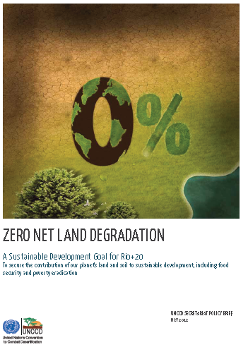
Soils and ZNLD
A legal addition to the UNCCD on ZNLD can be seen as a vital step to achieving a land-degradation neutral world
However, it is argued that there is a need for a generally applicable Sustainable Soils Convention for all lands

Slide 21
A Zero Net Land Degradation Protocol
The incorporation of emerging economic instruments.
The negotiation and setting of targets for ZNLD.
The development of policies, measures, guidelines and mechanisms for the implementation of ZNLD at national and regional levels.
The provision of legal frameworks, guidelines and models for national and sub-national policies to promote ZNLD.

Slide 22
United Nations Convention to Combat Desertification
□ The UNCCD provides for the development of Annexes to improve the implementation of the Convention (Art. 31).
□ Annexes can be either regionally focused, or general.
□ An alternative approach to a Protocol would be preparation of a General Annex with guidelines for drafting legislation for soils.
□ A general Annex to UNCCD could also include provisions to implement the SDG Goal of a Land Degradation Neutral World, (SDG 15), encouraging countries to promote this goal through legislation and policies.

Slide 23
Conclusions
  Consider the content and structure of a soil instrument and its relationship to the relevant SDGs (15).
  Is the concept of a Protocol the most realistic to promote?
  Consider the best vehicle - UNCCD, CBD or UNFCCC?
  Consider a general Annex to UNCCD?
  Are there other options or approaches?
  Maintain dialogue between legal and soil science disciplines.

Slide 24
WCEL Specialist Group on Sustainable Soil and Agricultural Systems

